Slide 1



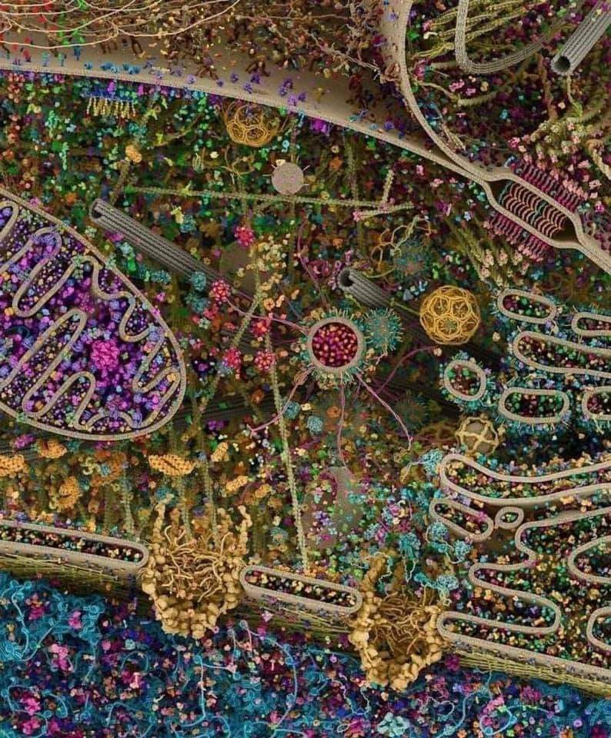
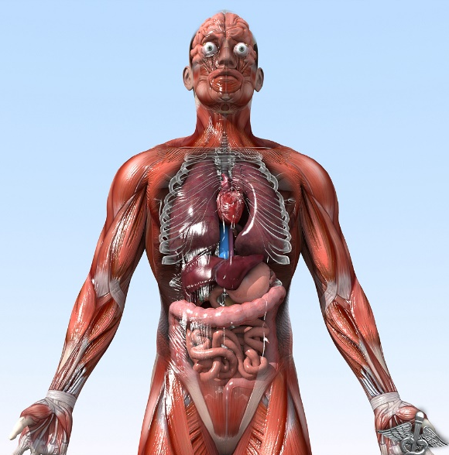
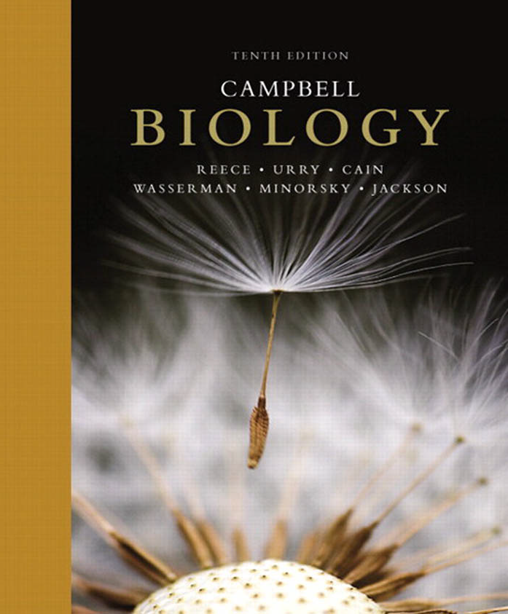
General Animal Biology
Zoo-109
علم الأحياء
109- حــيـن
College of Science,
Zoology Department
For Pre-Medical Students
Common First Year
السنة الأولى المشتركة - المسار الصحي
1447-H - 2025
Reference: Campbell, N. A. and Reece, J. B. (2014). Biology (10th edition). Pearson Education. Inc. USA.

Slide 2



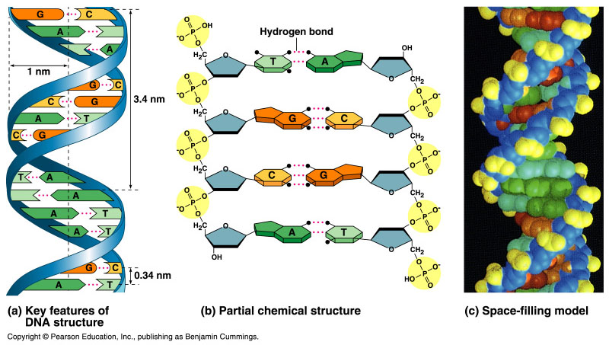
The molecular basis of inheritance
Copyright © 2002 Pearson Education, Inc., publishing as Benjamin Cummings

Slide 3
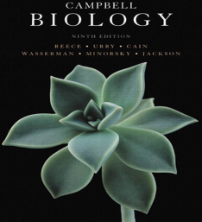

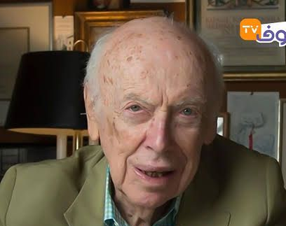
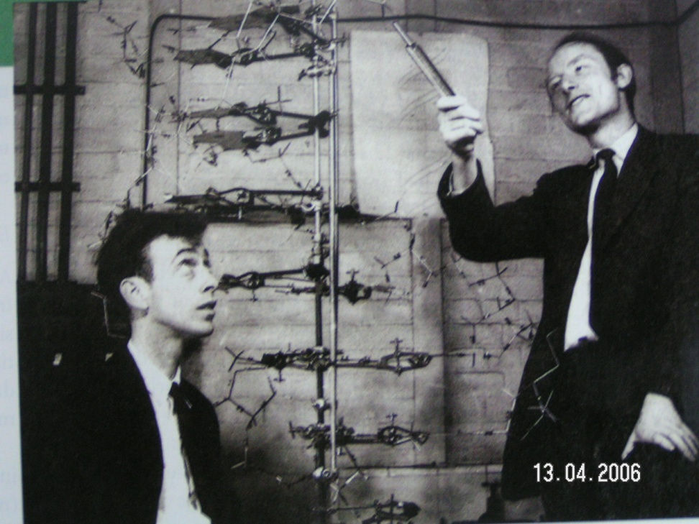
Watson and Crick discovered the double helix by building models to conform to X-ray data
In April 1953, James Watson and Francis Crick shook the scientific world with an elegant double-helical model النموذج الحلزوني المزدوج for the structure of deoxyribonucleic acid or DNA (الحمض النووي الريبوزي منزوع الأكسجين).
Watson and Crick began to work on a model of DNA with two strands, the double helix الحلزوني المزدوج.

Slide 4
DNA: the Genetic Material
The amino acid sequence of a polypeptide is programmed by a gene.
A gene is a small region in the DNA.
Nucleic acids store and transmit hereditary information المعلومات الوراثية.
There are two types of nucleic acids: ribonucleic acid (RNA) and deoxyribonucleic acid (DNA).
DNA also directs mRNA synthesis, thus, controls protein synthesis.
Organisms inherit تتوارث DNA from their parents.
  Each DNA molecule is very long and usually consists of hundreds to thousands of genes.
  When a cell divides تنقسم, its DNA is copied and passed to the next generation of cells (during Meiosis)
The mRNA interacts with ribosomes to direct the synthesis of amino acids in a polypeptide (protein).

Slide 5
Structure of DNA
3
5
Bases
o
o
P
o
o
DNA nucleotide
نيوكليوتيدة واحدة
Base
Adenine (A)
5
o
Phosphate group
CH₂
Purine
4
H
H
1
H
H
Guanine (G)
3
2
H
o
Deoxyribose
o
P
o
o
Base
Cytosine (C)
o
CH₂
Pyrimidine
H
H
H
H
Thymine (T)
5
3
3
H
Sugar-phosphate backbone

Slide 6
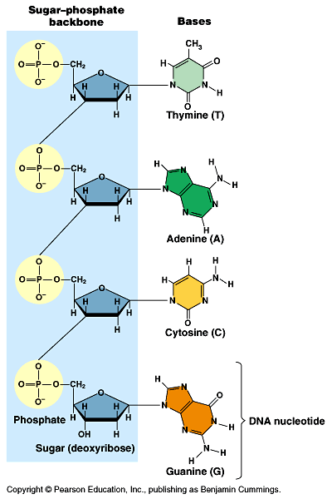
  The PO₄³⁻ group of one nucleotide is attached to the sugar of the next nucleotide in line في صف مستقيم.
  The result is a “backbone” of alternating تبادل phosphates and sugars, from which the bases starts.

Slide 7
Nitrogenous bases القواعد النيتروجينية
3
5
Hydrogen bonds
Cytosine (C)
Guanine (G)
Nitrogenous bases
Thymine (T)
Adenine (A)
Uracil (U)
Pyrimidines
Purine
5
3
Sugar-phosphate backbones

Slide 8
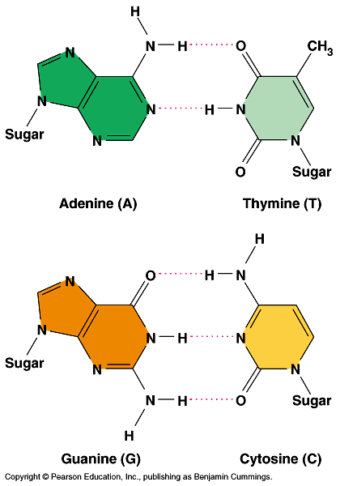
Structure of DNA
  Adenine (A) would
  form 2 hydrogen bonds only with thymine (T)
  Guanine (G) would form 3 hydrogen bonds only with
  cytosine (C).

Slide 9
DNA & RNA
A comparison (DNA & RNA)
الحمض النووي الريبوزي منزوع الأكسجين
الحمض النووي الريبوزي
o
CH₂
o
CH₂
H
H
H
H
H
H
H
H
H
OH
Deoxyribose sugar (O on C-2 is missed)
Ribose sugar (no missed O)
Deoxiribo-Nucleic-Acid
Ribo-Nucleic-Acid
Double stranded nucleic acid
Single stranded nucleic acid
Bases: A, G, C, T
Bases: A, G, C, U

Slide 10
The nucleic acid strand is a polymer of nucleotides
Nucleic acids are polymers of monomers called nucleotides.
Each nucleotide consists of three parts: a nitrogenous base, a pentose sugar, and a phosphate group.
The nitrogenous bases (rings of carbon and nitrogen) come in two types: Purines and Pyrimidines.
The pentose sugar joined to the nitrogen base is ribose in nucleotides of RNA and deoxyribose in DNA.
The only difference between the sugars is the lack نقص of an oxygen atom on carbon-2 in the deoxyribose.

Slide 11
The nucleic acid strand is a polymer of nucleotides
Polynucleotides are synthesized by connecting the sugars of one nucleotide to the phosphate of the next with a phosphodiester link.
This creates a repeating backbone of sugar-phosphate units with the nitrogenous bases as appendages.
The sequence of nitrogen bases along a DNA or mRNA polymer is unique for each gene.
Genes are normally hundreds to thousands of nucleotides long.
The linear order الترتيب التتابعي of bases in a gene specifies يُحدد the order of amino acids ترتيب الأحماض الأمينية (the monomers of a protein). We will study this process in Lecture 21.

Slide 12
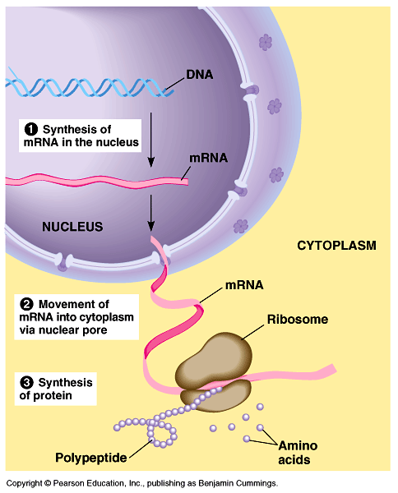
The flow of genetic information
The flow of genetic information is from DNA mRNA
protein (at the ribosome).
  Protein synthesis occurs
  by ribosomes.
  In eukaryotes, DNA is
  located in the nucleus,
  but most ribosomes are
  in the cytoplasm with
  mRNA as an intermediary وسيط.

Slide 13
DNA double helix & RNA
An RNA molecule is a single polynucleotide chain (single strand).
DNA molecules have two polynucleotide strands (double strand) that spiral around تدور حلزونيا to form a double helix حلزون مزدوج.

Slide 14
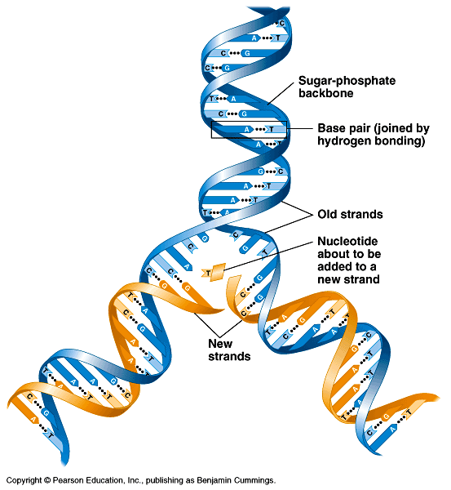
DNA double helix
The sugar-phosphate backbones of the two polynucleotides are on the outside of the helix.
Pairs of nitrogenous
bases (one from each
strand) connect the
polynucleotide chains
with hydrogen bonds.
Most DNA molecules
have thousands to
millions of base pairs زوج من القواعد (bP).

Slide 15
Summary: DNA double helix
Because of their shapes, only some bases are compatible متوافقة with each other.
  Adenine (A) always pairs with thymine (T), and guanine (G) always pairs with cytosine (C).
With these base-pairing rules, if we know the sequence of bases on one strand, we know the sequence on the opposite strand الشريط المقابل
The two strands are complementary مكملين لبعضهما.
During preparations for cell division each of the strands serves as a template قالب نسخ to order nucleotides into a new complementary strand (see the next lecture).
This results in two identical copies نسختين طبق الأصل of the original double-stranded DNA molecule.
  The copies are then distributed توزع to the daughter cells (by meiosis).
This mechanism ensures that the genetic information is transmitted to the new cells. This will be studied in the next lecture.

Slide 16
Final hints
Repeated Sugar - Phosphate
DNA backbone
Sugar–Phosphate-Base
One nucleotide
Polynucleotides
DNA Molecule
DNA Double stranded
RNA single stranded
DNA
A
G
C
T
A
T
C
mRNA
T
U
C
G
A
T
U
A
G

Slide 17

College of Science,
Zoology Department
General Animal Biology
(Zoo-109)
Zoology Department

