Slide 1



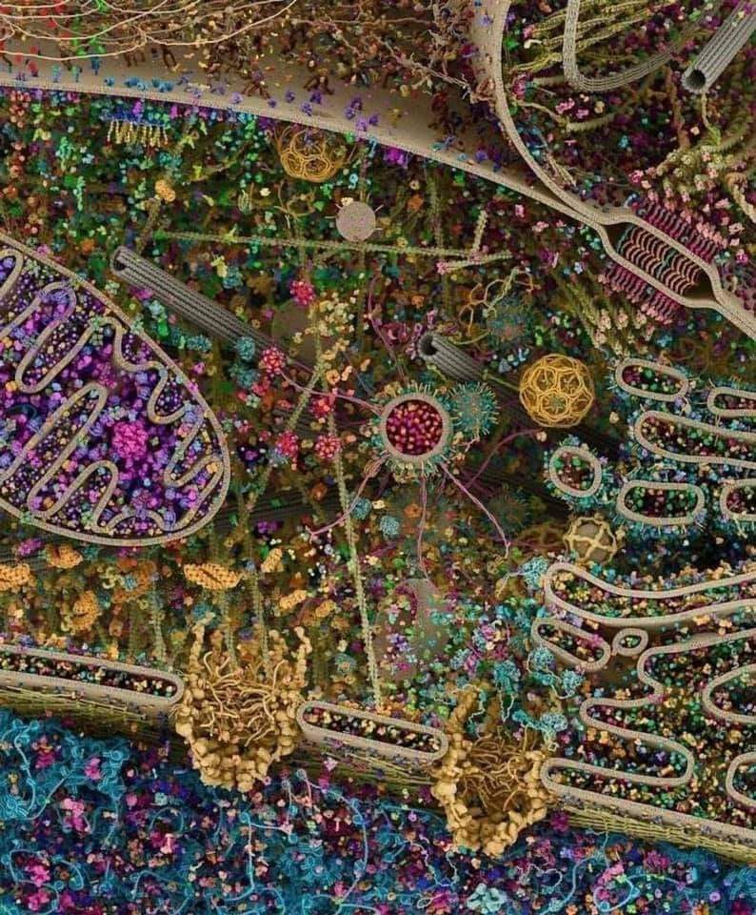
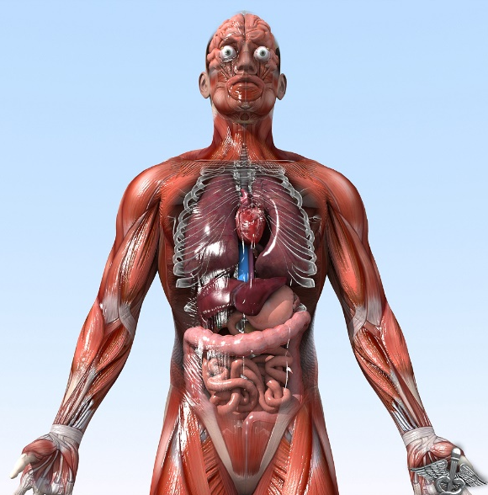

General Animal Biology
Zoo-109
علم الأحياء
109- حــيـن
College of Science,
Zoology Department
For Pre-Medical Students
Common First Year
السنة الأولى المشتركة - المسار الصحي
1444-H - 2023
Reference: Campbell, N. A. and Reece, J. B. (2014). Biology (10th edition). Pearson Education. Inc. USA.

Slide 2



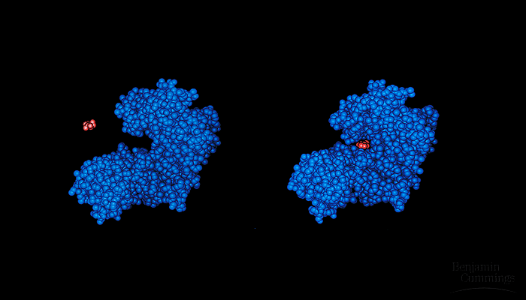
AN INTRODUCTION TO METABOLISM
Copyright © 2002 Pearson Education, Inc., publishing as Benjamin Cummings

Slide 3
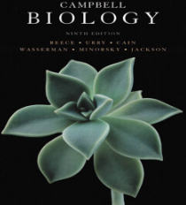


Objectives
  The Control of Metabolism via regulation of enzymes
  Allosteric Regulation of Enzymes
    Allosteric Activation
    Allosteric Inhibition
    Feedback Inhibition
      B. Cooperativity regulation.

Slide 4

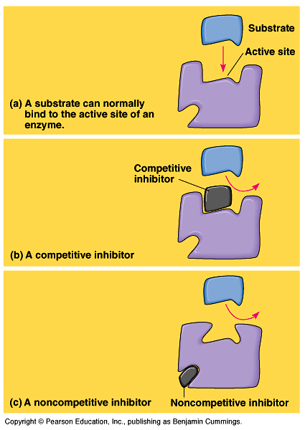
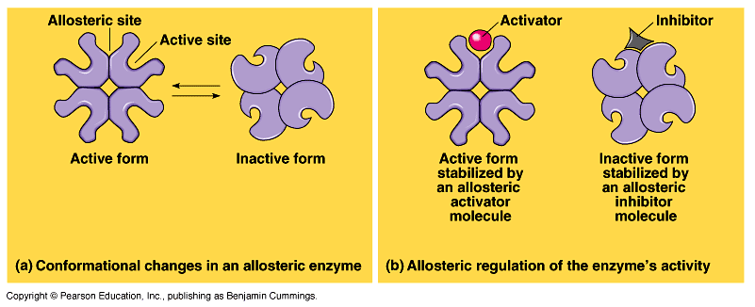
The Control of Metabolism
In many cases, the molecules that naturally regulate enzyme activity behave like reversible noncompetitive inhibitors.
These molecules often bind weakly to an allosteric site which is a specific receptor on the enzyme that is not the active site.
These molecules can either inhibit or stimulate enzyme activity.
Allosteric site
A)- Allosteric Regulation: التنظيم الألوستيري
Most allosterically regulated enzymes are constructed of two or more polypeptide chains.
Each subunit has its own active site. The allosteric sites are often located where subunits are joined.
The whole protein exists in two conformational shapes, The active form, and the inactive form.

Slide 5
The Control of Metabolism
a)- Allosteric activatorsمنشطات :
It stabilizes the conformation that has a functional active site.
b)- Allosteric inhibitorsمثبطات :
It stabilizes the conformation that lacks an active site.
In many cases, both inhibitors and activators are similar enough in shape that they compete for the same allosteric sites.
These molecules may be products and substrates of a metabolic pathway.

Slide 6
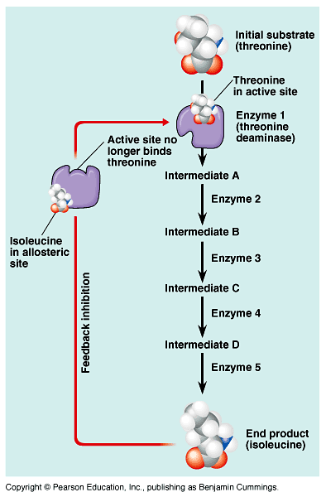
c)- Feedback inhibition التثبيط بالأثر الراجعي:
It is one of the common methods of metabolic control in which a metabolic pathway is turned off يتوقف by its end product الناتج النهائي.
Example:
The production of Isoleucine from Thereonine by Thereonine deaminase:-
The end product acts as an inhibitor of an enzyme in the pathway.
When the product is abundant متوفر, the pathway is turned off, when rare قليل the pathway is active.

Slide 7
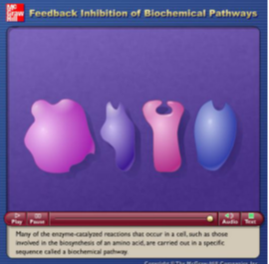
Video: plays in LMS
Source: http://highered.mcgraw-hill.com/sites/dl/free/0072437316/120060/ravenanimation.html

Slide 8
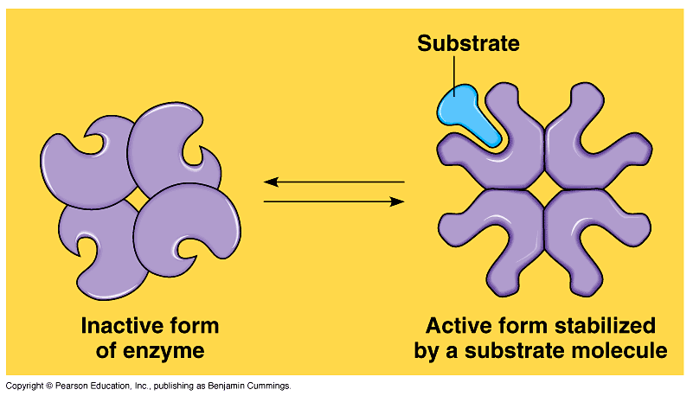
B)- Cooperativity regulation التنظيم التضامني
It occurs in enzymes with multiple catalytic subunits. binding a substrate to one active site stabilizes favorable conformational changes at all other subunits, a process called cooperativity التضامنية.
This mechanism amplifies يـُزيد the response استجابة of enzymes to substrates, making the enzymes accept additional إضافي substrates.

Slide 9
Summary of metabolic control
The cell is controlling its metabolism by regulating enzyme activity:
1)- Allosteric Regulation:
Regulatory molecules that bind weakly to an Alosteric site of the enzyme (Allosteric Enzymes) in order to inhibit or stimulate the enzyme activity
A)- Allosteric activation.
B)- Allosteric inhibition
C)- Feedback inhibition.
2- Cooperativity.
Stabilizes favorable conformational changes at all other subunits to make the enzyme more efficient.

Slide 10

College of Science,
Zoology Department
General Animal Biology
(Zoo-109)
Zoology Department

