Slide 1



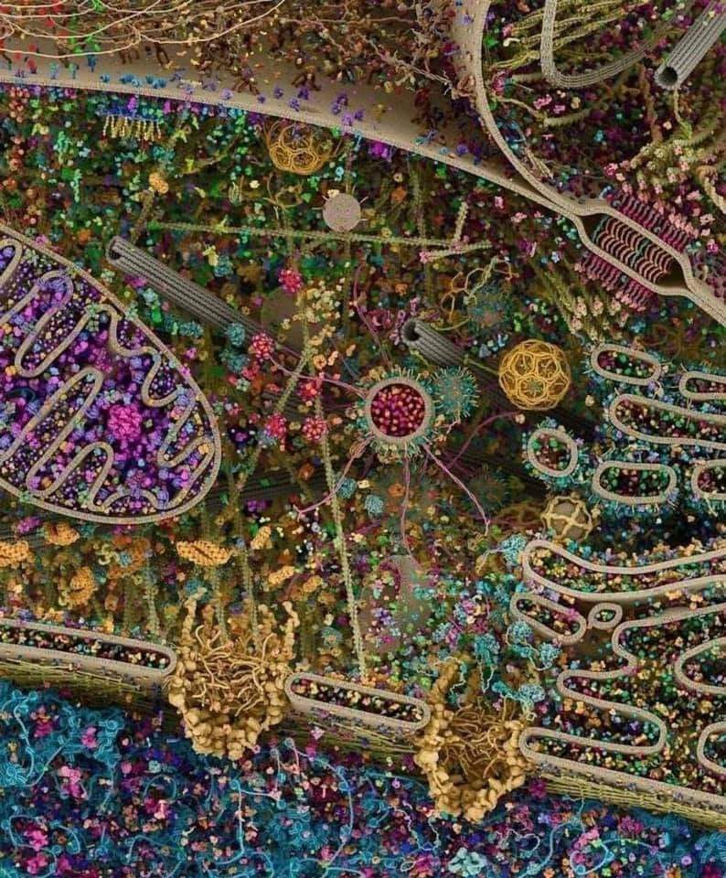
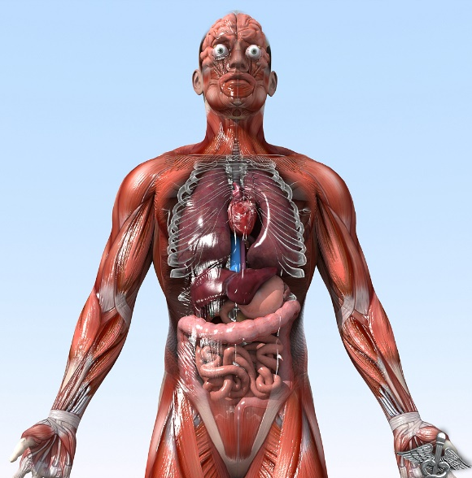

General Animal Biology
Zoo-109
علم الأحياء
109- حــيـن
College of Science,
Zoology Department
For Pre-Medical Students
Common First Year
السنة الأولى المشتركة - المسار الصحي
1444-H - 2023
Reference: Campbell, N. A. and Reece, J. B. (2014). Biology (10th edition). Pearson Education. Inc. USA.

Slide 2
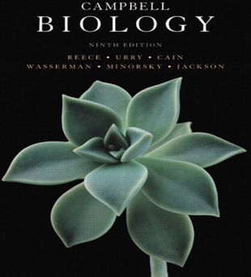

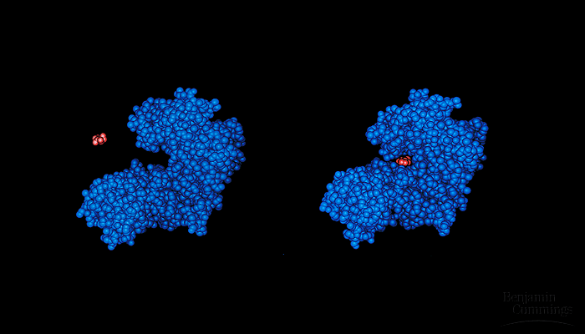
AN INTRODUCTION TO METABOLISM
AN INTRODUCTION TO METABOLISM
Enzymes
Protein molecules with catalytic properties due to their power of specific activation
Pages 96 - 103

Slide 3


Objectives
Enzymes speed up metabolic reactions by lowering energy barriers.
  Enzymes and Activation Energy (EA).
  Enzymes are substrate specific.
  The active site: is the enzyme’s catalytic center.
  Catalytic Cycle of Enzyme.
Cellular factors affecting enzyme activity:
  Temperature.
  pH.
  Cofactors.
Types of enzyme inhibition
  Competitive inhibition.
  Non-competitive inhibition.
  Some benefits of enzyme inhibition

Slide 4
Hydrolysis of sucrose (table sugar)
1)- Enzymes speed up metabolic reactions by lowering energy barriers حواجز الطاقة
Dehydration
Glucose + Fructose
Sucrose
Hydration (H₂O)
Glucose + Fructose
Sucrase
Hydrolysis of sucrose in the presence of Sucrase results in its two monosaccharide components.
This process include:
1- Breaking the bond between Glucose and Fructose;
2- Then, forming new bonds with H⁺ and OH⁻ to from water.
This process consumes تستهلك energy (Activation Energy; E_{A})

Slide 5
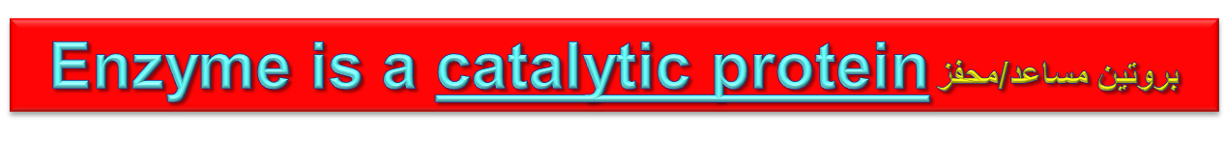
Enzymes and Activation Energy
Activation Energy:
It is the amount of energy needed for the reaction (between enzyme & substrate) to complete (to break the bonds).
Raising the temperature for these reactions to complete will either denature the compounds or kill the cell.
Thus, organisms must therefore use a catalyst عامل محفز.
A catalyst: is a chemical agent that accelerates the reaction without being consumed by the reaction.

Slide 6
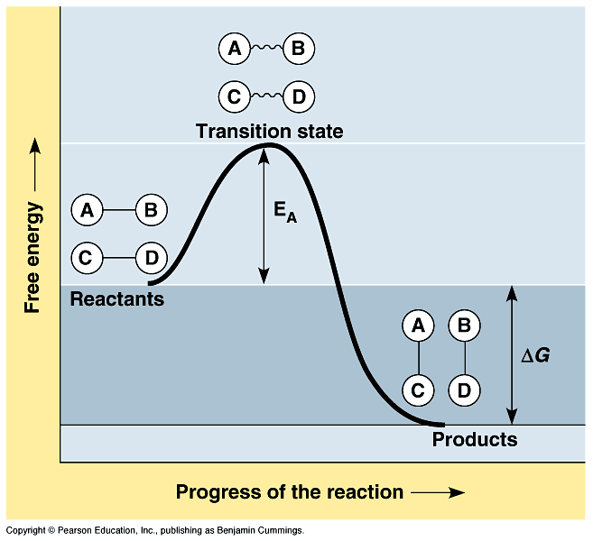
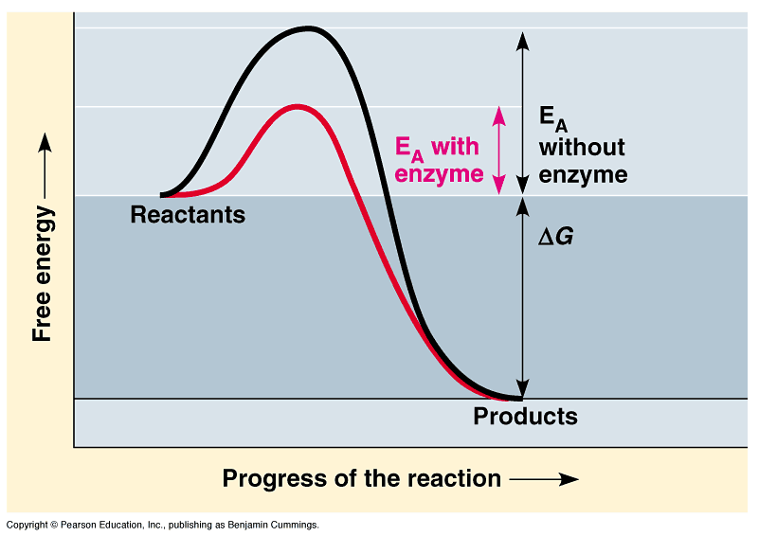
Enzymes speed up metabolic reactions by lowering the activation energy
Activation energy
Activation energy: is the amount of energy necessary to push the reactants over an energy barrier.
  At the transition state, the molecules are at an unstable point.
  The difference between free energy of the products and the free energy of the reactants is the delta G.
  Enzyme can increase the rate of reactions by lowering E_{A}.
  The transition state can then be reached even at moderate temperatures.

Slide 7
Activation energy

Slide 8
Enzymes are substrate specific
The substrate المادة المطلوب تكسيرها: is a reactant which binds to an enzyme.
When a substrate binds to an enzyme, the enzyme catalyzes يسهل the conversion تحويل of the substrate to the product مكوناتها البنائية.
  Sucrase (catalyst) is an enzyme that binds to sucrose (substrate) and breaks the disaccharide into fructose and glucose (products).
Enzyme (a catalyst)
Substrate
Product (s)
Sucrase
Sucrose + H₂O
Glucose + Fructose
Enzyme specificity: an enzyme is specific متخصص catalyst for specific reactants in the cell (e.g. Sucrase for only Sucrose).
This specificity of an enzyme تخصصية الإنزيم refers to the shape of its Active Site المركز النشط into which fits يـُناسب the surface of the substrate.

Slide 9
The active site is an enzyme’s catalytic center
The active site المكان النشطof an enzymes:
is the grooveالجيب on the surface of the enzyme into which the substrate fits.
Thus, specificity of an enzyme is due to the fit between التناسب بين the active site and the substrate.
As the substrate binds, the enzyme changes shape to fit the substrate, bringing chemical groups in position to catalyze the reaction.

Slide 10
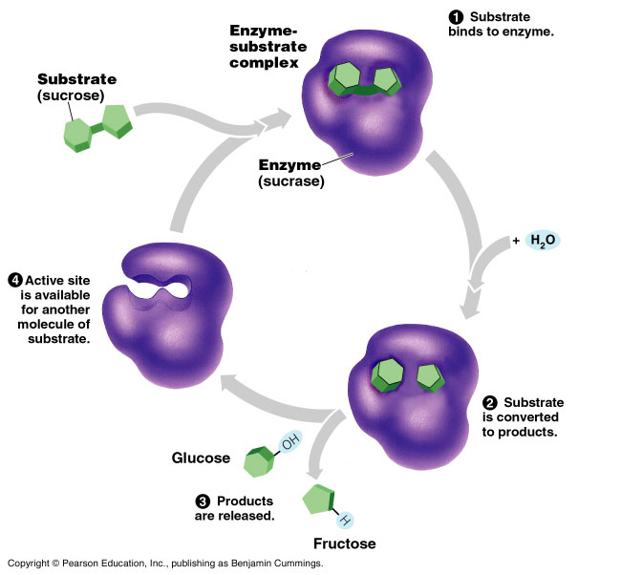
The Catalytic Cycle of Enzyme

Slide 11
Summary:
Active site of enzyme and Catalytic Cycle
Sucrase
Sucrose
Glucose
H₂O
Fructose

Slide 12
Summary:
Active site of enzyme and Catalytic Cycle

Slide 13
Summary:
Active site of enzyme and Catalytic Cycle
1- The substrate binds to the active site of enzyme.
2- This forms an Enzyme-Substrate complex (via weak
hydrogen bonds).
3- The active site catalyzes the conversion of the
substrate to final products (to its original components) by
breaking bonds.
4- The resulting products release from the enzyme.
5- The enzyme starts another reaction over and over again.
6- Thus, the enzyme can have a huge metabolic effect in
the catalytic cycle.
7- An enzymes has catalytic properties due to its power of hydrolytic activities

Slide 14
Summary:
Some characters of enzyme
A single enzyme molecule can catalyze thousands or more reactions a second.
Enzymes are un-affected by the reaction and are reusable يـُعاد استخدامها.
Most metabolic enzymes الإنزيمات الأيضية can catalyze a reaction in both the forward and reverse directions.
  The actual direction depends on the relative concentrations of products and reactants.
  Enzymes catalyze reactions in the direction of equilibrium التعادل.
The enzyme lowers the activation energy and speed up the reaction.
The rate that a specific number of enzymes converts substrates to products depends, in part, on substrate concentrations.
At some substrate concentrations, the active sites of all enzymes are engaged مشغولة, called enzyme saturation التشبع الإنزيمي.

Slide 15
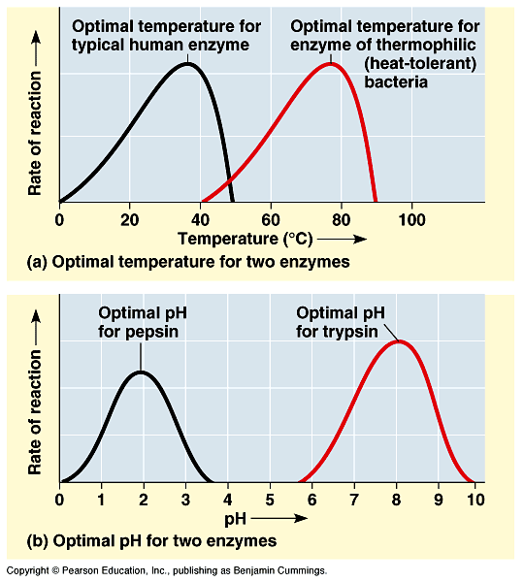
2)- Cellular factors affecting enzyme activity
Some conditions lead to the most active conformation and lead to optimal rate of reaction. These factors are:
Temperature: has a major impact on the reaction rate.
  As temperature increases, reaction between substrate and active sites occur faster.
  However, at some point thermal increase begins to denature the enzyme.
  Each enzyme has an optimal temperature درجة حرارة مُثلى .

Slide 16
2)- Cellular factors affecting enzyme activity
2. pH: also influences the reaction rate, each enzyme has an optimal pH falls between pH 6 - 8 for most enzymes.
However, digestive enzymes in the stomach are designed to work best at pH 2 while those in the intestine are optimal at pH 8, both matching their working environments.
3. Cofactors: العوامل المساعدة
A non-protein helpers for catalytic activity of enzymes. They bind permanently دائما to the enzyme and include two types:-
  a)- Inorganic cofactors, include zinc, iron, and copper.
b)- Organic cofactors, include vitamins or molecules derived
from vitamins called (coenzymes)

Slide 17
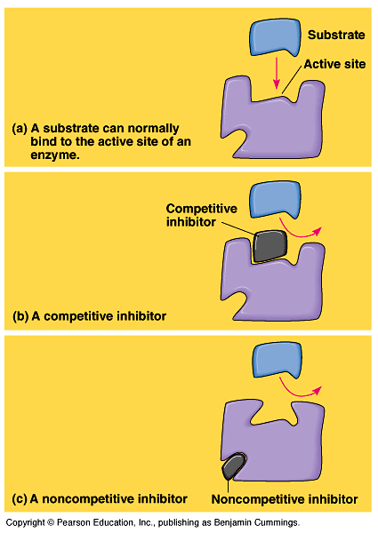
3)- Enzyme inhibitors: مُـثـبِّطات الإنزيمات
Inhibitors: are chemicals that reduce the rate of enzymatic reactions.
They are usually specific and work at low concentrations.
They block the enzyme but do not usually destroy it.
Many drugs and poisons are inhibitors of enzymes in the nervous system.
A)- Competitive inhibition تثبيط تنافسي : the inhibitor binds to the same site as the substrate, thus prevents the enzymatic reactions.
B)- Non-competitive inhibition: تثبيط لا تنافسي the inhibitor binds somewhere other than the active site, resulting in changing enzyme shape. Finally, deactivates يـُخمد the active site

Slide 18
Some benefits of enzyme inhibitors
The insecticide DDT is an inhibitor for key enzymes of nervous system in insects results in death.
Many antibiotics (e.g. Penicillin) inhibits enzymes that help bacteria to make their cell walls.
In the next lecture we will explain that:
Activation and inhibition of enzymes are essential for metabolic control

Slide 19
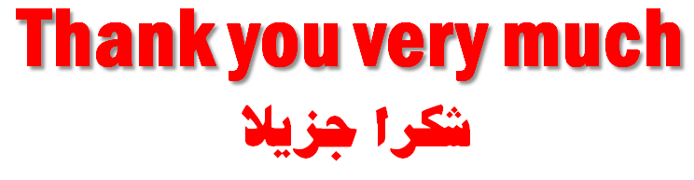
College of Science,
Zoology Department
General Animal Biology
(Zoo-109)
Zoology Department

