Slide 1



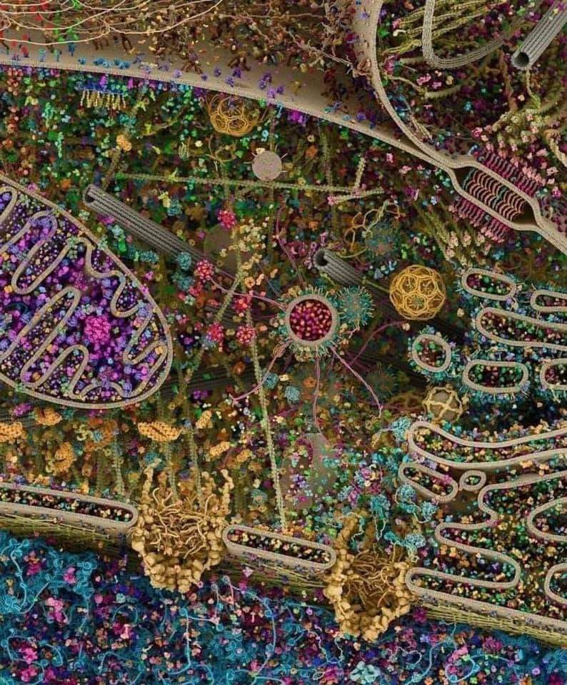
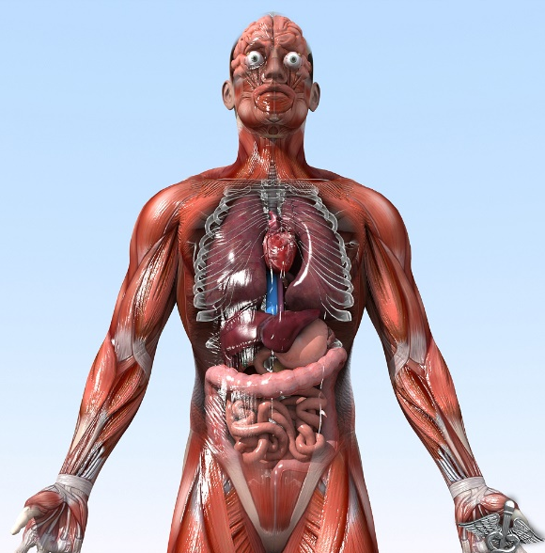

General Animal Biology
Zoo-109
علم الأحياء
109- حــيـن
College of Science,
Zoology Department
For Pre-Medical Students
Common First Year
السنة الأولى المشتركة - المسار الصحي
1444-H - 2023
Reference: Campbell, N. A. and Reece, J. B. (2014). Biology (10th edition). Pearson Education. Inc. USA.

Slide 2



How things get into and out of the cell?
Active Transport
Copyright © 2002 Pearson Education, Inc., publishing as Benjamin Cummings

Slide 3
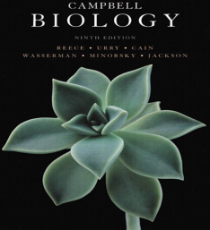

Objectives
B)- Active transport
Transport of small molecules
Transport of large molecules (macromolecules).
  Exocytosis
  Endocytosis
  Phagocytosis
  Pinocytosis
  Receptor-mediated endocytosis

Slide 4
Active transport: pumping ضَخ of solutes against their concentration gradient ضد الإنحدار التركيزي
Some facilitated transport proteins can move solutes against their concentration gradient, from the side where they are less concentrated to the side where they are more concentrated.
This active transport requires metabolic energy via ATP.
Active transport is critical بالغ الأهمية for a cell to maintain its internal
concentrations of small molecules.
Active transport is performed by specific proteins embedded in
the membranes called transport protein (T. protein).
Copyright © 2002 Pearson Education, Inc., publishing as Benjamin Cummings

Slide 5
1)- Transport of small molecules (Ions )
Sodium-potassium pump
It is actively maintains the gradient of sodium (Na⁺) and potassium ions (K⁺) across the membrane.
  The animal cell has higher concentrations of K⁺ and lower concentrations of Na⁺ inside the cell.
  The sodium-potassium pump (T. protein) uses the energy of one ATP to pump 3 Na⁺ ions out and 2 K⁺ ions in.
Outside the cell
Na
Na
Na
Na
Protein molecule
Na
Na
1ATP
T. protein
ATP
Low conc. of K⁺
High conc. of K⁺
Cellular membrane
Na
2
High conc. of Na⁺
Low conc. of Na⁺
3
Inside the cell

Slide 6
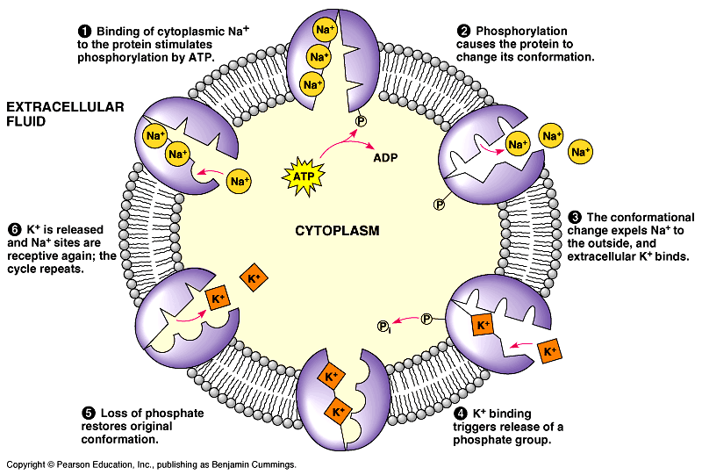
Sodium-potassium pump

Slide 7
http://highered.mcgraw-hill.com/sites/dl/free/0072437316/120060/ravenanimation.html

Slide 8
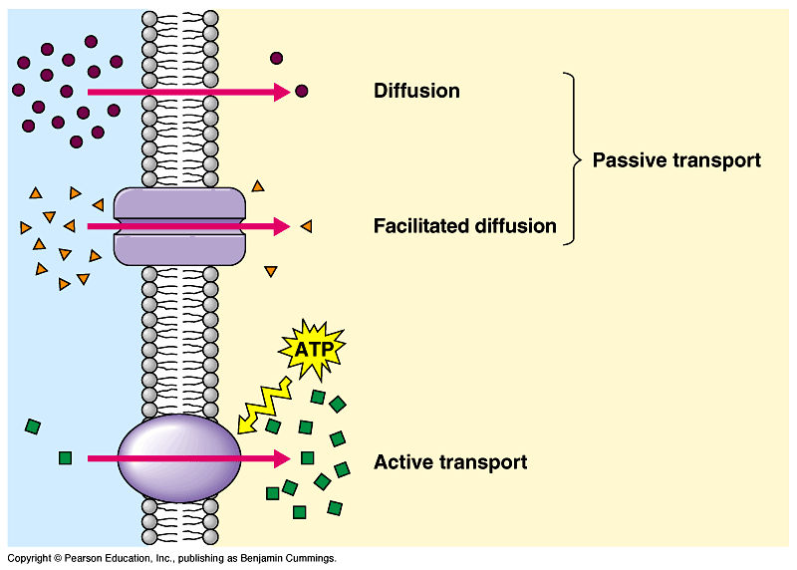
Two roles of membrane protein
Both diffusion and facilitated diffusion are forms of passive transport of molecules down their concentration gradient. While active transport requires an investment of energy to move molecules against their concentration gradient.

Slide 9
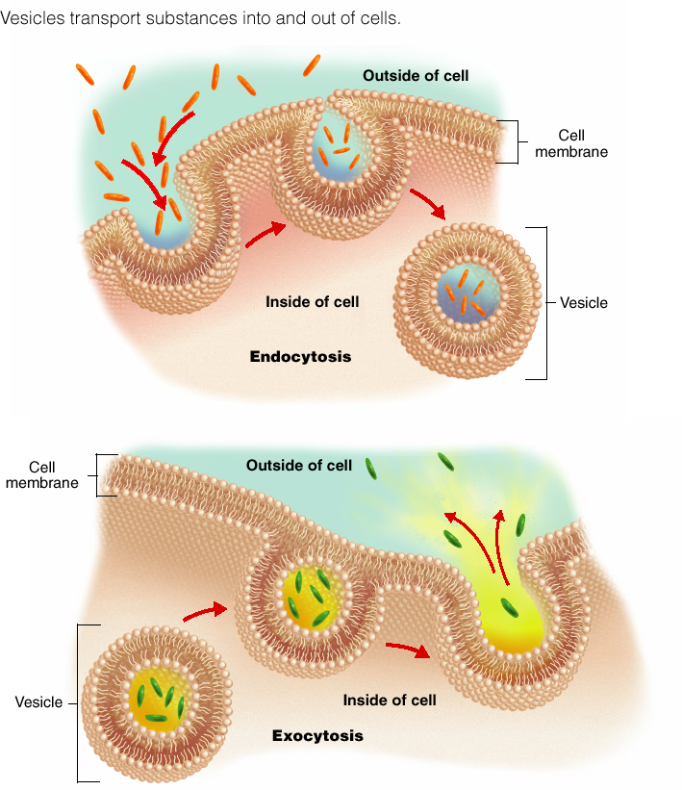
Large molecules are transported by Exocytosis and endocytosis
2)- Transport of large molecules (macromolecules)
Small molecules and water enter or leave the cell through the lipid bilayer or by transport proteins as described previously.
However, large molecules, such as polysaccharides, proteins and lipoprotein particles cross the membrane by vesicles أوعية .
Exocytosis الإخراج الخلوي:
A transport vesicle budded from ينشأ من the Golgi apparatus is moved by the cytoskeleton to the plasma membrane.
When the two membranes come in contact تلامس, the bilayers fuse يندمج and spill يُفرع the contents to the outside.

Slide 10
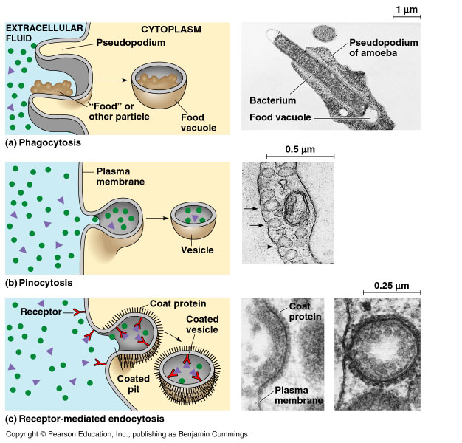
Transport of large molecules (macromolecules)
2- Endocytosis الإدخال الخلوي:
A cell brings in macromolecules and particulate matter by forming new vesicles from the plasma membrane and include the following:
A)- Phagocytosis الإبتلاع الخلوي :
Called “cellular eating”. The cell engulfs تـَبْلَع a particle by extending pseudopodia أقدام كاذبة around it and packaging it تـُغلفها in a large vacuole.
The contents of the vacuole are digested when the vacuole fuses with a lysosome.

Slide 11
Phagocytosis

Slide 12
Transport of large molecules (macromolecules)
B)- Pinocytosis, الشرب الخلوي “cellular drinking”.
A cell creates a vesicle around droplets نقاط of extracellular fluid السائل الموجود خارج الخلية.
  This is a non-specific process عملية غير متخصصة.

Slide 13
Transport of large molecules (macromolecules)
C)- Receptor-mediated endocytosis: الإدخال الخلوي عن طريق المستقبلات المتخصصة
It Is called (Selective eating) which is very specific in what substances are being transported.
It is triggered تـُستـَحث when extracellular substances bind to special receptors مُستقبـِلات خاصة, on the membrane surface. This triggers the formation of a vesicle
It enables a cell to take large quantities of specific materials that may be in low concentrations in the environment.

Slide 14
Source: http://highered.mcgraw-hill.com/olc/dl/120068/bio02.swf

Slide 15
Summary
Cell Transport
Passive
Active
Diffusion
Osmosis
Facilitated
diffusion
Small
Molecules/ions
Large
molecules
(Solute molecules)
(Solvent molecules)
(T. protein)
(T. protein)
(Membrane)
(Na⁺-K⁺ pump)
Endocytosis
Exocytosis
Phagocytosis
Pinocytosis
Receptor-mediated
endocytosis
Cellular eating
Cellular drinking
Selective eating

Slide 16

College of Science,
Zoology Department
General Animal Biology
(Zoo-109)
Zoology Department

