Slide 1



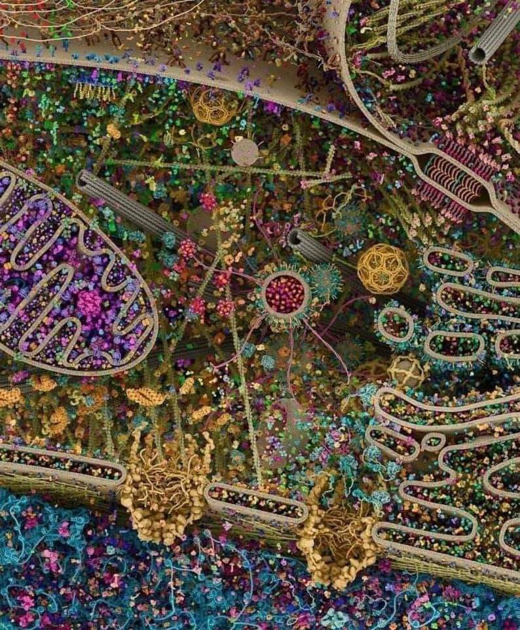
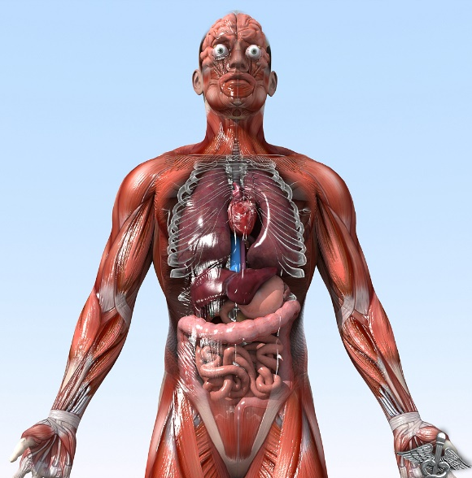
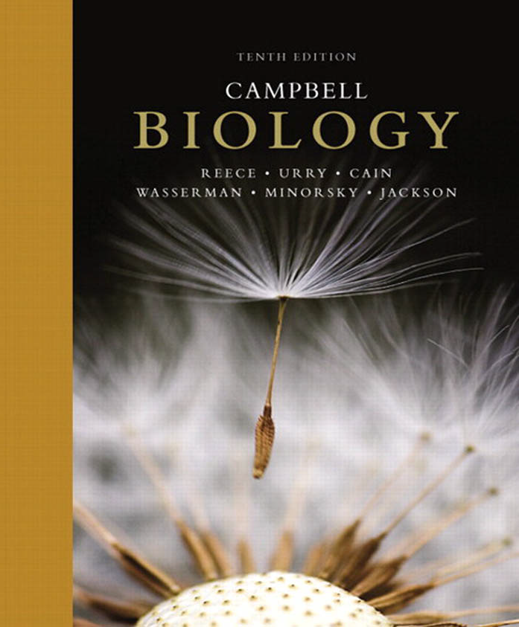
General Animal Biology
Zoo-109
علم الأحياء
109- حــيـن
College of Science,
Zoology Department
For Pre-Medical Students
Common First Year
السنة الأولى المشتركة - المسار الصحي
1444-H - 2025
Reference: Campbell, N. A. and Reece, J. B. (2014). Biology (10th edition). Pearson Education. Inc. USA.

Slide 2
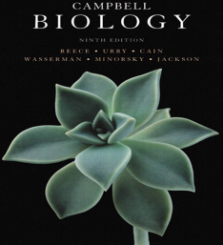

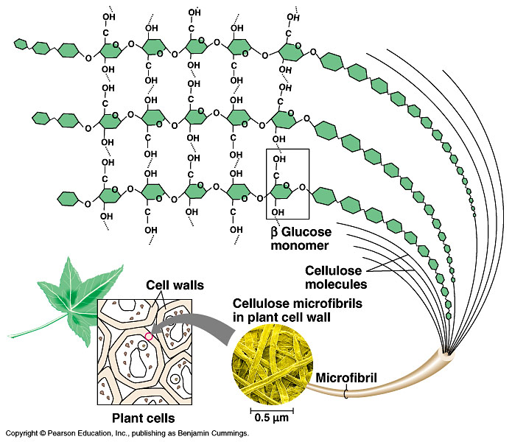
THE STRUCTURE AND FUNCTION OF MACROMOLECULES
Polymer principles
And
Macromolecules
Copyright © 2002 Pearson Education, Inc., publishing as Benjamin Cummings

Slide 3
Objectives
Polymers principles: The synthesis and breakdown of polymers.
A)- Carbohydrates
  Monosaccharides:
    Classifications of Monosaccharides: Types and examples.
  Disaccharides: Types and examples
  Polysaccharides:
    A)- Storage Polysaccharides: Types and examples
    B)- Structural Polysaccharides: Types and examples

Slide 4
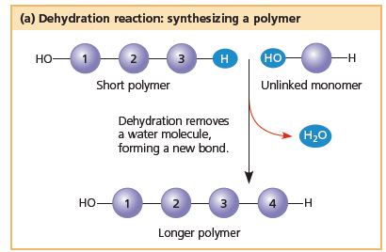
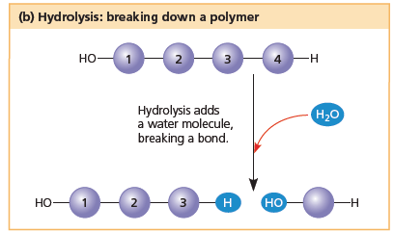
Polymers principles
Monomers are connected by covalent bonds through a dehydration reaction تفاعل نزع الماء.
  One monomer provides a hydroxyl group (OH) and the other provides a hydrogen (H) atom to form water (H₂O).
  This process requires energy and is aided by enzymes.
The covalent bonds connecting monomers in a polymer can be disassembled
تـُكسَــر by hydration (hydrolysis) reaction تفاعل إضافة الماء.
  In hydrolysis as the covalent bond is broken, a hydrogen atom and a hydroxyl group from a split water molecule attaches where the covalent bond used to be.
  Hydrolysis reactions dominate the digestive
  process, guided by specific enzymes.
4

Slide 5
Polymers principles
(Carbohydrates, Lipids, Proteins and nucleic acids)
Mono-mer
Di-mer
Poly-mer
أحادي
ثنائي
عديد
A Polymer: is a long molecule consists of a chain of similar building molecules (monomers) covalently bonded together.

Slide 6
Polymers principles
Cells join تربط smaller organic molecules (Monomers) together to form larger molecules (macromolecules) (Polymers), which may be composed of thousands of molecules.
Macromolecules are organic molecules that weigh more than 100,000 Daltons (ATOMIC MASS UNIT).
The four major classes of macromolecules are:
- Carbohydrates,
- Lipids,
- Proteins,
- Nucleic acids (will be studied later: lectures 18, 19 & 20)

Slide 7
A. Carbohydrates
Sugars, Carbo = carbon, hydrate = water; Used as an immediate energy source.
  The molecular formula is C_{n}H_{2n}O_{n} means that, carbon, hydrogen and oxygen are found in the ratio = 1:2:1
  Monosaccharides:
  are the simplest form of carbohydrates (simple sugars). contain a single sugar molecule.
  Disaccharides:
  contain two monosaccharides joined via dehydration reactions
  Polysaccharides:
  are polymers of many monosaccharides.
Notes:
7

Slide 8

1- Monosaccharides السكر الأحادي
Aldehyde sugars
Aldose
Aldose
H
O
H
O
C
C
Glucose
Galactose
C₆H₁₂O₆
H
C
OH
H
C
OH
C₆H₁₂O₆
OH
C
H
OH
C
H
H
C
OH
OH
C
H
Asymmetric C
Asymmetric C
H
C
OH
H
C
OH
H
C
OH
H
C
OH
H
H
An OH group is attached to each carbon except one, which is double bonded to an oxygen (carbonyl).

Slide 9
Fructose
Triose Sugar
Pentose Sugar
Hexose Sugar
C₆H₁₂O₆
H
H
OH
C
H
O
Ketone sugar
H
O
C
Ketose
C
C
O
H
C
OH
C
C
OH
H
H
OH
H
C
OH
H
C
OH
H
C
OH
H
C
OH
H
H
C
OH
Glyceraldehyde
H
C
OH
H
C
OH
H
Ribose
H

Slide 10
Classification of monosaccharides
A- Based on the location of the carbonyl group (C=O)
Aldoses: are the monosaccharides with the carbonyl group (C=O) at the end of Carbon chain (e.g. Glucose).
Ketoses: are the monosaccharides with the C=O carbonyl group within داخل the Carbon chain (e.g. Fructose).
B- Based on the number of C in the skeleton
Triose (3C): e.g.Glyceraldehyde.
Pentose (5C): e.g. Ribose.
Hexose (6C): e.g. Glucose, Fructose and Galactose.

Slide 11
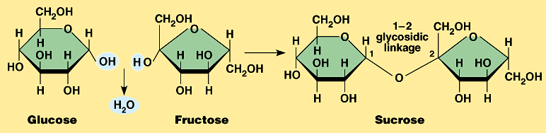
2- Disaccharides السكر الثنائي
Consist of 2 monosaccharide molecules joined during a dehydration reaction تفاعل نزع الماء.
Sucrose (table sugar): consists of Glucose + Fructose.
The covalent bond formed between Glucose & Fructose is called “glycosidic linkage”.

Slide 12
3- Polysaccharides السكر العديد
They consist of few hundreds to few thousands of monosaccharides joined by a dehydration reaction.
These are of two types:
1- Storage تخزينية. Provide sugar for cell by hydrolysis إضافة ماء.
2- Structural تركيبية. Serve as building materials for the organism.

Slide 13
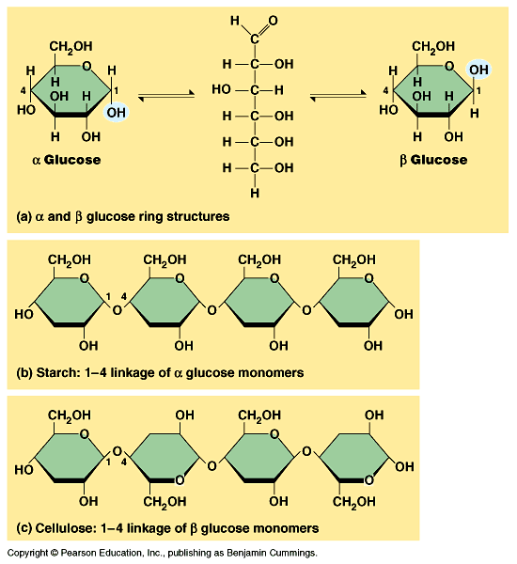
I- Starch (in plants) النشا
A)- Storage تخزينية Polysaccharides
A storage polysaccharide of plants (within plastids).
It consists of thousands of α glucose molecules.
Thus, it gives glucose when hydrolysed بإضافة الماء by special enzymes in humans.
Potatoes and grains are the major sources of starch.

Slide 14
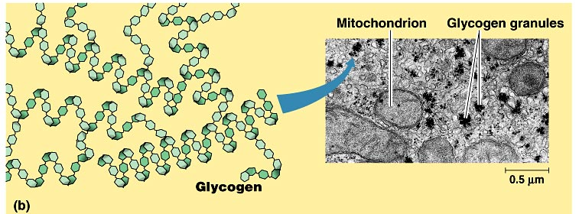
II- Glycogen (in animals) الجليكوﭽـين
Storage Polysaccharides
Stored in animal cells (e.g. liver and muscle cells in Human).
It is consisted of thousands of glucose molecules.
Thus, it gives glucose when hydrolysed.

Slide 15
I- Cellulose
B)- Structural تركيبية Polysaccharides
It is the building material of plant cell wall.
Forms the micro-fibrils and cell wall in plants.
It is consisted of thousands of β glucose molecules.
Humans cannot digest it, but some bacteria and protozoa can (e.g. in Termites and Cows stomach).

Slide 16
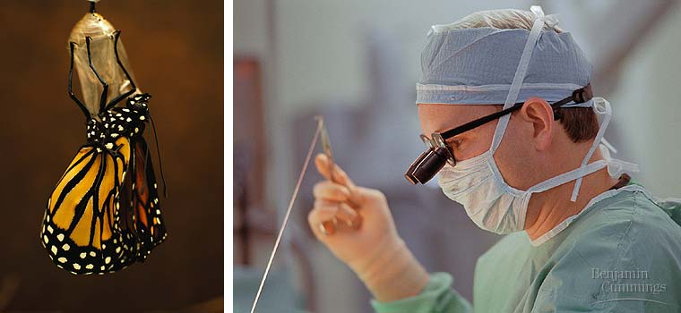
Structural Polysaccharides
II- Chitin الكيتين
It is the building material of the cuticle الجُـلَيد in insects.
It is consisted of thousands of glucose molecules with a N atom at one end.
It is used to manufacture the surgical threads.

Slide 17
Carbohydrates
No. of sugar molecules
Monosaccharides
Disaccharides
Polysaccharides
(Glucose)
(Sucrose)
Storage
Structural
Starch (in plants) & Glycogen (in animals)
Cellulose (in plants)
& Chitin (in insects)
No. of C atoms
Location of Carbonyl Group
Triose (3C)
Glyceraldehyde
Pentose (5C)
Ribose
Hexose (6C)
Glucose
Aldose
Ketose
C=O on top
C=O within chain

Slide 18

College of Science,
Zoology Department
General Animal Biology
(Zoo-109)
Zoology Department

