Slide 1
Genetics Engineering (Zoo-455)
Lecture-1

Slide 2
Aims of the genetics engineering course
To study the structure of DNA , and the process of gene expression.
To understand the process of DNA cloning.
To design the primer of the gene cloning using NCBI database.
To understand the types and function of restriction enzymes.
To understand the types of vectors using in DNA cloning.
To create a recombinant DNA containing the gene of interest.
To study the steps of PCR technique and gel electrophoresis.
To study the human genome and the types of gene therapy.
To study the genetically modified organisms.
To study the regulation of genetic modification.

Slide 3
Time table for weekly planning for genetic engineering
Lectures | Syllabus view
1 | Structure of DNA and gene expression
2 | DNA cloning
3 | Primer design
4 | Restriction enzymes (types and functions)
5 | Types of vectors using in DNA cloning
6 | Creating of a recombinant DNA
7 | PCR technique and gel electrophoresis
8 | human genome and the types of gene therapy
9 | Written Exam
10 | The genetically modified organisms
11 | the regulation of genetic modification

Slide 4
Assessment
Lecture
Monthly exam (20%)
Attendance, participation, and homework (10%)
Final exam (40%)
70% of total grade
Laboratory
30% of total grade

Slide 5
Introduction to Genetics Engineering

Slide 6
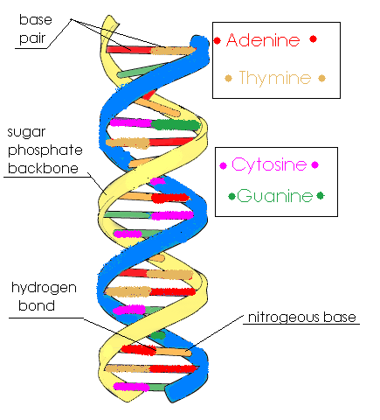
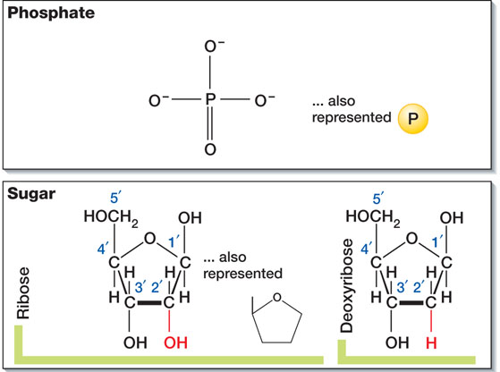
DNA= Deoxyribonucleic Acid
DNA is a very large molecule, made up of smaller units called nucleotides
Each nucleotide has three parts: a sugar (deoxyribose), a phosphate molecule, and a nitrogenous base.
DNA polymerization only occurs in the 5’ to 3’ direction.
The nitrogenous base is the part of the nucleotide that carries genetic information
The bases found in DNA are four: adenine, cytosine, guanine, and thymine.
Base-pairing is accomplished by hydrogen bonding between DNA BASE PAIR. Watson-Crick base-pairing dictates the base pairs in DNA are: A-T, C-G.

Slide 7
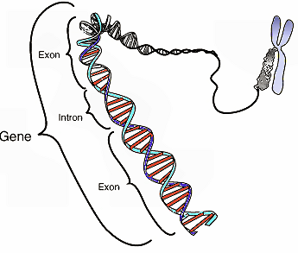
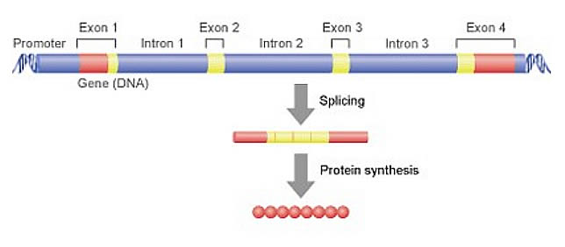
A gene is a stretch of DNA that codes for a type of protein that has a function in the organism.
It is a unit of heredity in a living organism. All living things depend on genes
Genes hold the information to build and maintain an organism's cells and pass genetic traits to offspring.
Genes contain:
EXONS: a set of coding regions.
INTRONS: Non-coding regions removed sequence and are therefore labeled split genes (splicing).
Genome: The genetic complement of an organism, including all of its GENES, as represented in its DNA

Slide 8
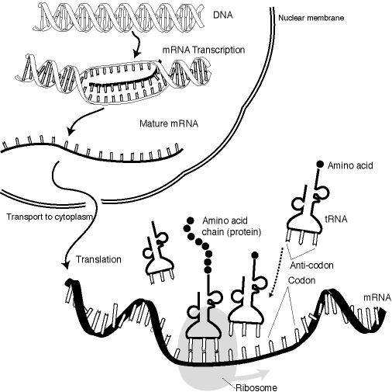
Gene Expression:
Is the process by which information from a gene is used in the synthesis of a functional gene product (proteins)
The process of gene expression is used by all known life - eukaryotes , prokaryotes , and viruses - to generate the macromolecular machinery for life.

Slide 9
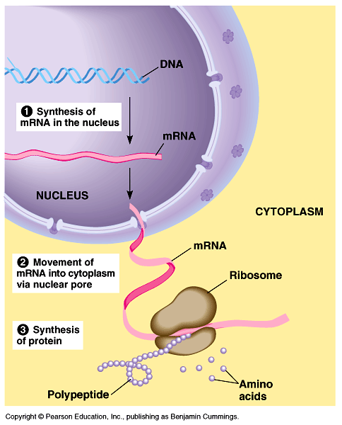
Steps of gene expression
(1) Transcription (mRNA synthesis),
(2) Post-transcriptional process (RNA splicing),
(3) Translation (protein synthesis)
(4) Post-translational modification of a protein.

Slide 10
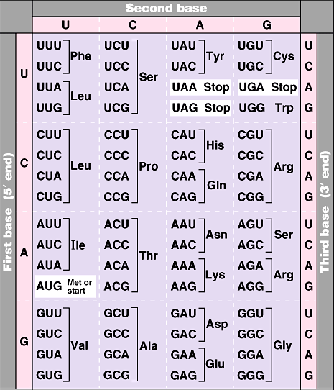
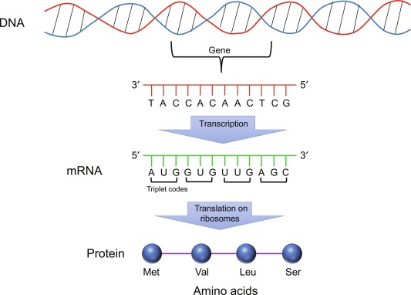
The genetic code is universal…
All living organisms…
Use the same DNA
Use the same code
Read their genes in the same way

Slide 11
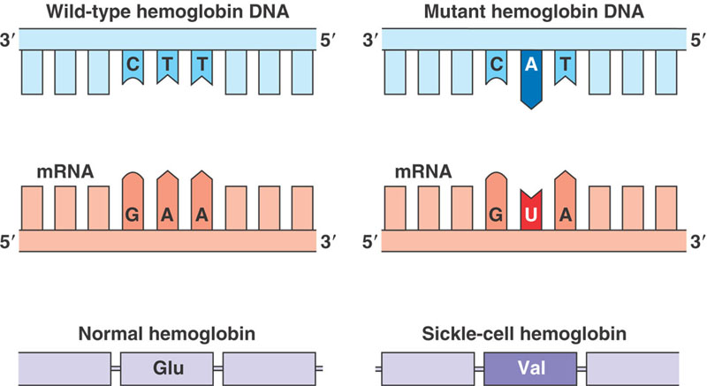
What is the difference between a mutation and a recombinant DNA?
A mutation: is a change in the nucleotide sequence of a short region of a genome.
Many mutations are point mutations that replace one nucleotide with another; others involve insertion or deletion of one or a few nucleotides.
Mutations result either from errors in DNA replication or viruses or from the damaging effects of mutagens, such as chemicals and radiation, which react with DNA and change the structures of individual nucleotides.

Slide 12
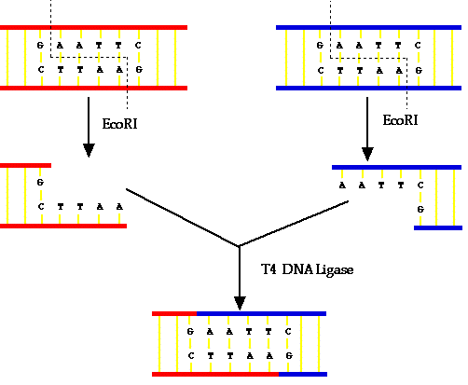
Recombination: The exchange of corresponding DNA segments between adjacent chromosomes during the special type of cell division that results in the production of new genetic make up..
In genetic engineering:
Recombination is the process of breaking and recombining segments of DNA from different organisms to create a recombinant DNA.
This recombination mechanism generates genetic variation at the gene level.
It represents species-specific variances in DNA sequences.
Genetic engineering is also known as genetic modification, is the process of changing the DNA in an organism’s genome.

Slide 13
https://www.youtube.com/watch?v=DIM38NlkWEo

Slide 14

Questions?

