Slide 1
Principles of Information Systems, Thirteenth Edition
Chapter 1
An Introduction to Information Systems
Notes:
Principles of Information Systems, Thirteenth Edition
Chapter 1
An Introduction to Information Systems

Slide 2
Objectives
After completing this chapter, you will be able to:
Distinguish data from information and knowledge, and describe the characteristics of quality data
Identify the fundamental components of an information system and describe their function
Identify the basic types of business information systems
Notes:
Objectives
After completing this chapter, you will be able to:
Distinguish data from information and knowledge, and describe the characteristics of quality data
Identify the fundamental components of an information system and describe their function
Identify the three fundamental information system types and explain what organizational complements must be in place to ensure successful implementation and use of the system

Slide 3
Data, Information, and Knowledge
Information : One of an organization’s most valuable resources that is often confused with the term data
Data: raw facts
Information: collection of data organized in such a way that they have value beyond the facts themselves
Process: set of logically related tasks performed to achieve a defined outcome
  Turning data into information is a process
Knowledge: awareness and understanding of a set of information and the ways it can be made useful to support a task
  The process of defining relationships among data to create useful information requires knowledge
Notes:
Data, Information, and Knowledge
Data: raw facts
Information: collection of data organized in such a way that they have value beyond the facts themselves
Process: set of logically related tasks performed to achieve a defined outcome
Turning data into information is a process
Knowledge: awareness and understanding of a set of information and the ways it can be made useful to support a task
The process of defining relationships among data to create useful information requires knowledge

Slide 4
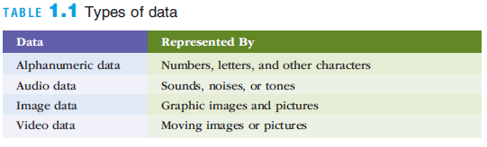
Data, Information, and Knowledge
Notes:
Data, Information, and Knowledge

Slide 5
Example: Weather Data
Data could be a series of raw temperature measurements collected from a weather station, such as the following readings for March 20:
  6am: 20°C
  7am: 21°C
  8am: 22°C
  Etc
Information is derived by processing and organizing this data into a more meaningful and useful format. For example, we could calculate the high and low temperatures for this day

Slide 6
Example: Weather Data
Knowledge goes beyond information by incorporating multiple pieces of information.
  In this example, let's say we have historical weather data for the same date in previous years, as well as the current year's data:
1) The average of high temperature (March 20) for the past 10 years: 28°C
2) Current year high temperature (March 20): 31°C
By comparing these two pieces of information, the machine can derive knowledge that the high temperature for the given date in the current year is higher than the historical average
This insight could be useful for understanding weather patterns or making decisions related to climate change adaptation

Slide 7
The Value and Quality of Information
Valuable information helps people perform tasks more efficiently and effectively
  Inaccurate data can result in loss of potential new customers and reduced customer satisfaction
If an organization’s information is not accurate or complete:
  People can make poor decisions, costing thousands, or even millions, of dollars
Depending on the type of data you need:
  Some characteristics become more important than others
  For example, accuracy and completeness are critical for data used in accounting for the management of company assets
Notes:
The Value of Information
Valuable information helps people perform tasks more efficiently and effectively
Inaccurate data can result in loss of potential new customers and reduced customer satisfaction

Slide 8
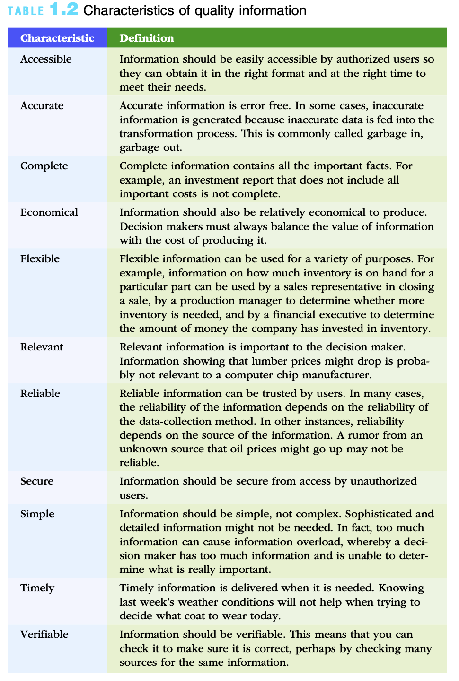
Notes:
The Value of Information
Valuable information helps people perform tasks more efficiently and effectively
Inaccurate data can result in loss of potential new customers and reduced customer satisfaction

Slide 9
What is an Information System?
An information system (IS) is a set of interrelated elements that:
  Collect (input)
  Process
  Store
  Disseminate data and information
  Provides a feedback mechanism to monitor and control its operation to make sure it continues to meet its goals and objectives
A computer-based information system (CBIS) is a single set of hardware, software, databases, networks, people, and procedures
  That are configured to collect, manipulate, store, and process data into information
Notes:
What is an Information System?
An information system (IS) is a set of interrelated elements that:
Collect (input)
Process
Store
Disseminate data and information
Provides a feedback mechanism to monitor and control its operation to make sure it continues to meet its goals and objectives
A computer-based information system (CBIS) is a single set of hardware, software, databases, networks, people, and procedures
That are configured to collect, manipulate, store, and process data into information
An organization’s technology infrastructure includes all the hardware, software, databases, networks, people, and procedures
That are configured to collect, manipulate, store, and process data into information

Slide 10
Feedback: Examples
User Feedback: The system can collect feedback from users regarding their experience, satisfaction, and suggestions for improvement.
  This can be done through surveys, user feedback forms, or online reviews.
  User feedback helps identify usability issues, functionality gaps, or areas where the system can be enhanced to better meet user needs.
Error Reporting: When errors or exceptions occur within the system, a feedback mechanism can be in place to capture and report them.
  This feedback helps identify the root causes of errors, troubleshoot issues, and implement corrective actions to prevent future occurrences.

Slide 11
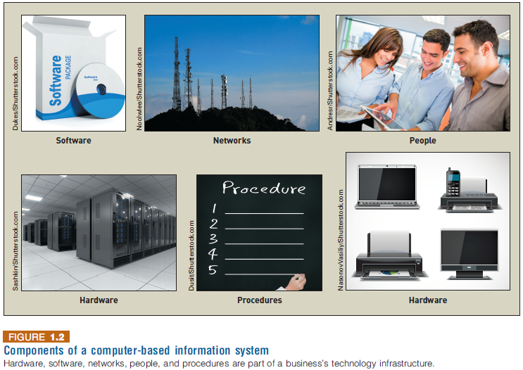
What is an Information System?
Notes:
What is an Information System?

Slide 12
People
People make the difference between success and failure in all organizations.
Good systems can boost job satisfaction and worker productivity.
Information systems personnel include all the people who manage, run, program, and maintain the system.

Slide 13
Procedures
Procedure defines the steps to follow to achieve a specific end result
  Such as enter a customer order, pay a supplier invoice, or request a current inventory report
Using a CBIS involves setting and following many procedures, including those for the operation, maintenance, and security of the system.
Notes:
What is an Information System?
Procedure defines the steps to follow to achieve a specific end result
Such as enter a customer order, pay a supplier invoice, or request a current inventory report
Using a CBIS involves setting and following many procedures, including those for the
Operation, maintenance, and security of the system

Slide 14
Procedures: Examples
User Authentication Procedure: Outlines the steps for users to log in securely to the system. It may include instructions on providing usernames, passwords, and any additional authentication factors.
System Access Control Procedure: Outlines the process of granting and revoking user access privileges to the CBIS. It may include steps for creating user accounts, assigning appropriate permissions, and managing user roles.
Data Backup Procedure: Defines the process of regularly creating backup copies of data stored in the CBIS. It may include details on selecting backup media, scheduling backups, and verifying the integrity of backed-up data.
Data Retention Procedure: Specifies the guidelines for retaining and disposing of data within the CBIS. It may include requirements for data archiving, deletion, and the duration of data retention based on legal, regulatory, or business needs.
Incident Response Procedure and System Maintenance Procedure.

Slide 15
Information Systems in Organizations
For each type of IS, certain key organizational complements must be in place to ensure successful implementation and use of the system:
  Well-trained workers
  System support
  Better teamwork
  Redesigned processes
  New decision rights
Notes:
Information Systems in Organizations
For each type of IS, certain key organizational complements must be in place:
Well-trained workers
System support
Better teamwork
Redesigned processes
New decision rights

Slide 16
Redesigned processes
د.خالد الغنيم يروي حكاية أول تعاون لشركة "علم" مع "الجوازات"
  https://twitter.com/i/status/1642286268598853633

Slide 17
Business Information Systems
Information systems are used in all functional areas of business organizations, such as:
  Accounting and finance
  Customer service
  Human resources
  Manufacturing
  Research and development
  Sales and marketing
Notes:
Business Information Systems
Information systems are used in all functional areas of business organizations, such as:
Accounting and finance
Customer service
Human resources
Manufacturing
Research and development
Sales and marketing

Slide 18
Business Information Systems
Information systems are also used in nearly every industry, such as:
  Agriculture
  Finance
  Health care
  Mining
  Professional services
  Retail
Notes:
Business Information Systems
Information systems are also used in nearly every industry, such as:
Agriculture
Finance
Health care
Mining
Professional services
Retail

Slide 19
Types of Information Systems
Electronic and Mobile Commerce
Enterprise Systems
Decision Support Systems (DSS)
Knowledge Management Systems (KMS)
Geographic Information Systems (GIS)
Learning Management Systems (LMS)
  Can be considered a type of KMS
etc

Slide 20
1) Electronic and Mobile Commerce
Mobile commerce (m-commerce): the use of mobile, wireless devices to place orders and conduct business
Forms of e-commerce:
  Business-to-business (B2B)
    Alibaba, Amazon Web Services (AWS)
  Business-to-consumer (B2C)
    Amazon, niceone and فلاورد
  Consumer-to-consumer (C2C)
    eBay, etsy, and سوم
  Government-to-citizen (G2C)
    ابشر
E-business: use of information systems and the Internet to perform business-related tasks and functions
Notes:
Electronic and Mobile Commerce
Mobile commerce (m-commerce): the use of mobile, wireless devices to place orders and conduct business
Used to support all forms of e-commerce:
Business-to-business (B2B)
Business-to-consumer (B2C)
Consumer-to-consumer (C2C)
Government-to-citizen (G2C)
E-business: use of information systems and the Internet to perform business-related tasks and functions

Slide 21
2) Enterprise Systems
Transaction
  Any business-related exchange, such as payments to employees and suppliers and sales to customers
Transaction processing system (TPS)
  An organized collection of people, procedures, software, databases, and devices
  Used to perform and record completed business transactions
  Example: Point-of-Sale (POS) System in a retail store that records sales transactions, updates inventory levels, and processes customer payments
Notes:
Enterprise Systems
Transaction
Any business-related exchange, such as payments to employees and suppliers and sales to customers
Transaction processing system (TPS)
An organized collection of people, procedures, software, databases, and devices
Used to perform and record completed business transactions
Management information system (MIS)
Organized collection of people, procedures, software, databases, and devices
Provides routine information to managers and decision makers
Focuses on operational efficiency
Provides standard reports generated with data and information from the TPS or ERP

Slide 22
2) Enterprise Systems
Management information system (MIS)
  Organized collection of people, procedures, software, databases, and devices
  Provides routine information to managers and decision makers
  Focuses on operational efficiency
  Provides standard reports generated with data and information from the TPS
  Example: Sales Report Dashboard that provides managers with visualized data on sales performance, customer demographics, and product trends for informed decision-making
Notes:
Enterprise Systems
Transaction
Any business-related exchange, such as payments to employees and suppliers and sales to customers
Transaction processing system (TPS)
An organized collection of people, procedures, software, databases, and devices
Used to perform and record completed business transactions
Management information system (MIS)
Organized collection of people, procedures, software, databases, and devices
Provides routine information to managers and decision makers
Focuses on operational efficiency
Provides standard reports generated with data and information from the TPS or ERP

Slide 23
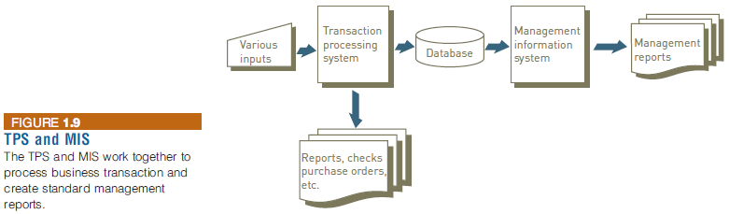
2) Enterprise Systems
Notes:
Enterprise Systems

Slide 24
2) Enterprise Systems
Enterprise resource planning (ERP)
  A set of integrated programs
  Manages the vital business operations for an entire multisite, global organization
Most ERP systems provide integrated software to support manufacturing and finance
  Also provide support for business analytics and e-business
Notes:
Enterprise Systems
Enterprise resource planning (ERP)
A set of integrated programs
Manages the vital business operations for an entire multisite, global organization
Most ERP systems provide integrated software to support manufacturing and finance
Also provide support for business analytics and e-business

Slide 25
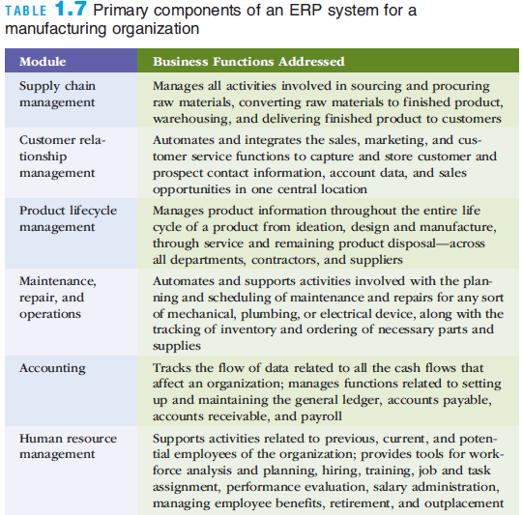
2) Enterprise Systems
Notes:
Enterprise Systems

Slide 26
3) Knowledge Management Systems
Knowledge management systems (KMSs)
  An organized collection of people, procedures, software, databases, and devices that:
    Stores and retrieves knowledge
    Improves collaboration
    Locates knowledge sources
    Captures and uses knowledge
    Enhances the knowledge management process
  Examples:
    Microsoft SharePoint
    Confluence by Atlassian
Notes:
The most effective knowledge management systems provide a variety of information databases:
Lesson Learned Databases - These are databases of information that are retrieved from people who have already tackled a problem and found a solution. The term "lessons learned" is synonymous with the popular term "best practices."
Expertise Location - This is a database which provides a way to locate an expert or expert information.
Communities of Practice - These are groups of individuals who discuss problems, opportunities, lessons learned and other information gained from users. As companies grow globally, these communities become more geographically spread out. A good knowledge management system provides these groups with a way to share information in what could be described as a "virtual water cooler" approach.
Some examples of different knowledge management systems include:
Feedback database - A company may have a database of feedback from customers and employees and shares this feedback with their design and research and development departments. All members of the organization would be able to enter feedback into the database and an integrated approach would be taken to understanding the shared information.
Shared project files - An employee team can work collaboratively on a project. They have a system of shared files and information that allows everyone on the team to upload and comment on work performed by others.
Research files - A company developing a new product conducts research on their competitors and conducts focus groups to find out what is needed in their product or market niche. This information is entered into a database that contains objective data on market sales potential and indicates what assets and processes the company has in place which can be used to meet this sales potential, meet customer needs and fill gaps within the marketplace.
There are many types of knowledge management systems, but they all share some common characteristics. These include:
FAQ content
Forum or community feature
How-to articles and tutorials
Education, academies, and training programs
Certificates
Case studies
Webinars

Slide 27
4) Geographic Information Systems (GIS)
Urban Planning and Development:
  A city government uses GIS to analyze traffic patterns and plan new road infrastructure
  Planners use GIS to determine suitable locations for new parks, schools, and commercial zones
Environmental Management:
  Conservationists use GIS to track animal migration patterns and plan protected areas.
  GIS can help monitor deforestation, erosion, and other environmental changes over time
Healthcare:
  Epidemiologists use GIS to track disease outbreaks and analyze their spread patterns.
  Hospitals can use GIS to identify regions with higher health risks and plan resource allocation accordingly

Slide 28
Ethical, Legal, and Social Issues of Information Systems
Ethics
  A set of beliefs about right and wrong behavior
Ethical behavior
  Conforms to generally accepted social norms
The use of information about people
  Requires balancing the needs of those who want to use the information against the rights and desires of the people whose information may be used
Notes:
Ethical, Legal, and Social Issues of Information Systems
Ethics
A set of beliefs about right and wrong behavior
Ethical behavior
Conforms to generally accepted social norms
The use of information about people
Requires balancing the needs of those who want to use the information against the rights and desires of the people whose information may be used

Slide 29
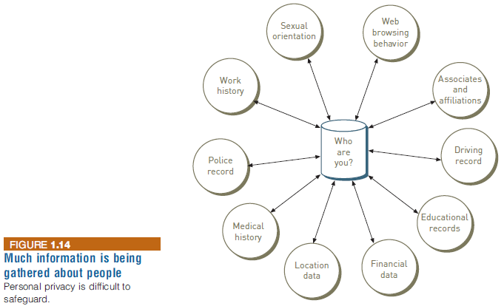
Ethical, Legal, and Social Issues of Information Systems
Notes:
Ethical, Legal, and Social Issues of Information Systems

Slide 30
Ethical, Legal, and Social Issues of Information Systems
Internet censorship
  The control or suppression of the publishing or accessing of information on the Internet
Digital divide
  A term used to describe the gulf between those who do and those who don’t have access to modern information and communications technology
Net neutrality
  The principle that Internet service providers (ISPs) should be required to treat all Internet traffic running over their networks the same
Notes:
Ethical, Legal, and Social Issues of Information Systems
Internet censorship
The control or suppression of the publishing or accessing of information on the Internet
Digital divide
A term used to describe the gulf between those who do and those who don’t have access to modern information and communications technology
Net neutrality
The principle that Internet service providers (ISPs) should be required to treat all Internet traffic running over their networks the same

Slide 31
Summary
The value of information is directly linked to how it helps decision makers achieve the organization’s goals
Information systems are composed of fundamental components that must be carefully assembled and integrated to work well together
Organizations employ a variety of information systems to improve the way they conduct business and make fact-based decisions
Strategic planning and project management are keys to ensuring that the organization is working effectively on the right projects
Information systems must be applied thoughtfully and carefully so that society, organizations, and individuals around the globe can reap their enormous benefits
Notes:
Summary
The value of information is directly linked to how it helps decision makers achieve the organization’s goals
Information systems are composed of fundamental components that must be carefully assembled and integrated to work well together
Managers have an essential role to play in the successful implementation and use of information systems-that role changes depending on which type of IS system is being implemented

