Slide 1
EE 202 Electric Circuits
Lecture 21 August
First Semester 2023-2024
Dr. Anmar Arif

Slide 2
Course Introduction
Anmar Arif
Assistant Professor
Power Systems
Office: 2C 26
Email: anarif@ksu.edu.sa
Whatsapp: +447598120082
Office Hours:
Sunday: 12:00 pm – 02:00 pm
Tuesday: 10:00 am – 12:00 pm
If my office is open, come in
Textbook
“Introduction to Electric Circuits”, Richard C. Dorf and James A. Svoboda, Wiley, 9th Ed, 2014, including Wiley plus Learning Management System.
Website
https://fac.ksu.edu.sa/anarif

Slide 3
My Schedule

Slide 4
Grades
Quizzes and Homework (15%)
Attendance and participation (5%)
Exams (80%)
Exam 1 (20%)
Exam 2 (20%)
Final (40%) (25 December 2023 – 1:00 pm)

Slide 5
What are we learning?

Slide 6
Lecture 1
Introduction to dependent sources (Section 2.7)
KVL and KCL (Section 3.8)

Slide 7
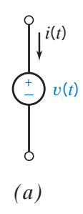
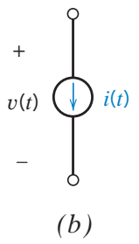
Independent sources

Slide 8
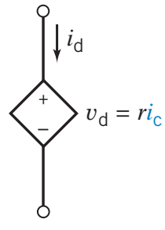
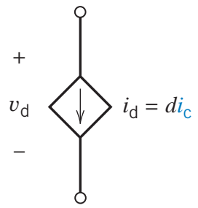
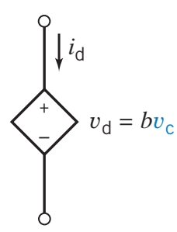
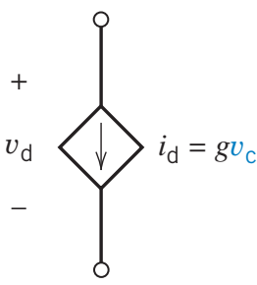
Dependent sources
Current-Controlled Voltage Source (CCVS)
Current-Controlled Current Source (CCCS)
Voltage-Controlled Voltage Source (VCVS)
Voltage-Controlled Current Source (VCCS)

Slide 9
Dependent sources

Slide 10
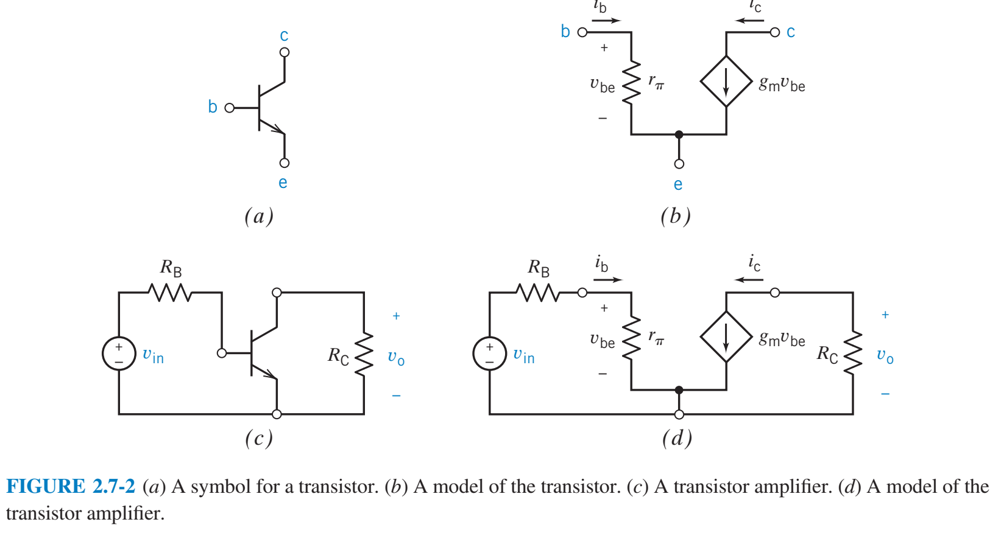
Dependent sources
These dependent sources do not exist physically as ideal sources. They are simplified representations of other devices, such as transistors and operational amplifiers.

Slide 11
Sources power calculation

Slide 12
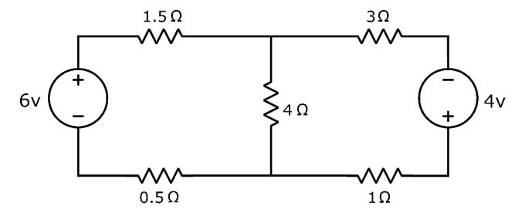
Mesh circuit (KVL)

Slide 13
Mesh circuit (KVL)

Slide 14
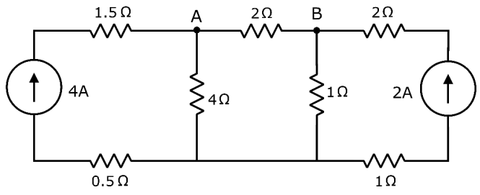
Mesh circuit (KCL)

Slide 15
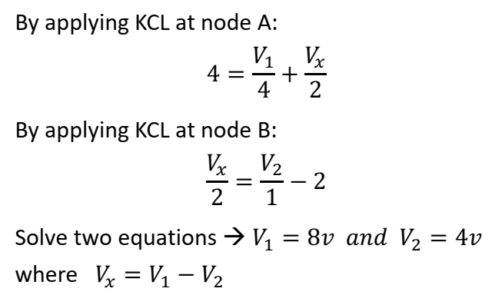
Mesh circuit (KCL)

Slide 16
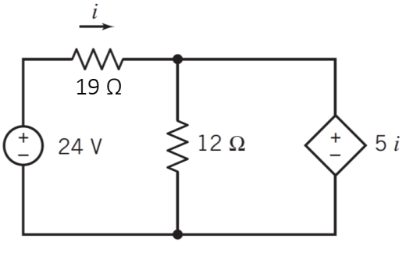
Dependent source analysis (1)
Find the power supplied/consumed by the voltage sources.

Slide 17
Dependent source analysis (1)
Find the power supplied/consumed by the voltage sources.

Slide 18
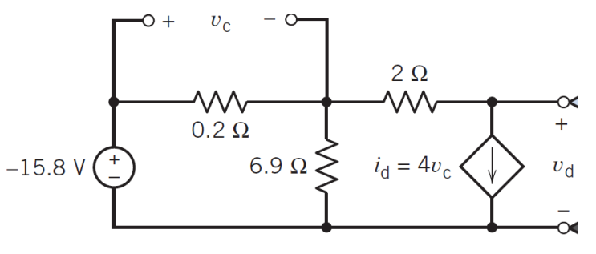
Dependent source analysis (2)
Find the power supplied/consumed by the VCCS.

Slide 19
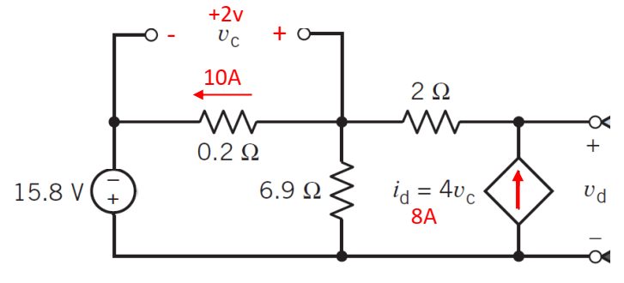
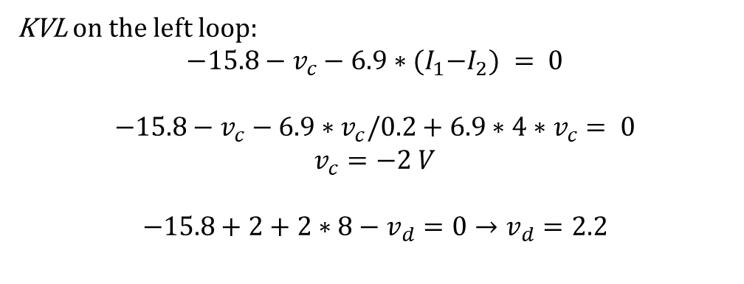
Dependent source analysis (2)
Find the power supplied/consumed by the VCCS.
KVL on the left loop:
$$−15.8−v_{c}−6.9∗{(I}_{1}−I_{2}) = 0$$
$$−15.8−v_{c}−6.9∗v_{c}/0.2+6.9∗4∗v_{c}= 0$$
$$v_{c}=−2 V$$
$$−15.8+2+2∗8−v_{d}=0→v_{d}=2.2$$

