Slide 1
سبر 1213 Network Defense 5 Part 2#Lecture Securing Hosts and Data
King Saud University – Applied Studies and Community Service –سبر 1213 - اسم المقررLecture 1

Slide 2
Encrypting Drives
Full disk encryption (FDE)
Encrypts entire drive
Self-encrypting drives (SEDs)
Automatically encrypts entire drive
Users typically need to log on to access drive

Slide 3
Boot Integrity
Unified Extensible Firmware Interface (UEFI)
Trusted Platform Module (TPM)
Hardware Security Module (HSM)

Slide 4
DLP
Data loss prevention (DLP) techniques & technologies
Rights management
Removable media
Data exfiltration
Encrypting data
Database encryption

Slide 5
Summarizing Cloud Computing
Software as a Service (SaaS)
Applications provided over the Internet (such as web-mail accessed with a web browser)
Platform as a Service (PaaS)
Provides customers with a fully managed platform
Vendor keeps platform up-to-date

Slide 6
Understanding Cloud Computing
Infrastructure as a Service (IaaS)
Provides customers with access to hardware in a self-managed platform
Customers are responsible for keeping an IaaS system up to date
Anything as a Service (XaaS)
Cloud services beyond SaaS, PaaS, and IaaS
Services that can be delivered via the cloud, such as communications, databases, desktops, storage, and security

Slide 7
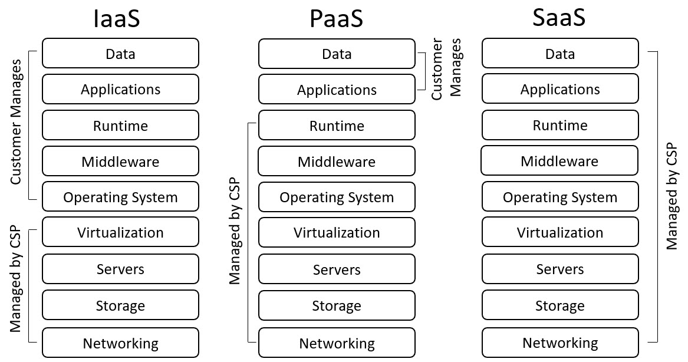
Cloud Service Provider Responsibilities

Slide 8
Cloud Deployment Models
Public – Available to anyone
Private – Only available within a company
Community – Cloud shared by two or more organizations
Hybrid – Combination of any two models

Slide 9
MSSP Services
Patch management
Vulnerability scanning
Spam and virus filtering
Data loss prevention (DLP)
Virtual private network connections
Proxy services for web content filtering
Intrusion detection and prevention systems
Unified threat management (UTM) appliances
Advanced firewalls such as next-generation firewalls

Slide 10
Cloud Security Controls
Google Cloud and Amazon Web Services (AWS) documentation
High availability and high availability across zones
Resource policies
Secrets management
Integration and auditing
Cloud-based storage characteristics
Permissions
Encryption
Replication

Slide 11
Cloud-based Networks
Virtual networks
Public and private subnets
Segmentation
Security groups
Dynamic resource allocation
Instance awareness
VPC endpoint
Transit gateway
Container security

Slide 12
Cloud-based Networks
Segmentation
Instance awareness
VPC endpoint
Transit gateway
Container security
Virtual networks
Public and private subnets
Security groups
Dynamic resource allocation

Slide 13
On-Premises Versus Off-Premises
On-premises
Cloud resources owned, operated, and maintained by an organization for its employees
Off-premises
In the cloud
CSP maintains

Slide 14
Cloud Computing Security
Cloud access security broker (CASB)
Software tool or service
Placed between organization’s network and the cloud provider
Cloud-based DLP
Secure web gateway (SWG)
Cloud-based firewalls

Slide 15
Cloud Computing
Infrastructure as Code
Software defined network (SDN)
Software-defined visibility (SDV)
Edge computing
Fog computing
Cloud Security Alliance (CSA)

Slide 16
End of Second Lecture
King Saud University – Applied Studies and Community Service –سبر 1213 - اسم المقررLecture 1

