Slide 1
سبر 1213 Network Defense 5 Part 1#Lecture Securing Hosts and Data
King Saud University – Applied Studies and Community Service –سبر 1213 - اسم المقررLecture 1

Slide 2
Introduction
Implement Access Controls: Regular Software Updates and Patch Management
Use Encryption:
Network Segmentation:
Implement Intrusion Detection and Prevention Systems (IDPS):
Endpoint Protection:
Data Backup and Disaster Recovery:

Slide 3
Employee Training and Awareness:
Implement Security Policies and Procedures:
Monitor and Audit:
Physical Security:
Vendor and Third-Party Risk Management:

Slide 4
Implement Access Controls: Utilize strong authentication mechanisms such as passwords, biometrics, or two-factor authentication to control access to hosts and data. Implement least privilege principles to ensure users have only the permissions necessary to perform their job functions.
Regular Software Updates and Patch Management: Keep operating systems, applications, and firmware up to date with the latest security patches to mitigate vulnerabilities that could be exploited by attackers.
Use Encryption: Encrypt data at rest and in transit using robust encryption algorithms to prevent unauthorized access even if the data is compromised. This includes encrypting hard drives, databases, communication channels, and backups.
Network Segmentation: Segment networks to limit the scope of potential breaches. Use firewalls, VLANs, and other network security measures to separate sensitive data and critical systems from less secure areas of the network.
Implement Intrusion Detection and Prevention Systems (IDPS): Deploy IDPS solutions to monitor network and system activities for malicious behavior or policy violations, and automatically respond to security incidents.
Implement Access Controls:

Slide 5
Endpoint Protection: Install and regularly update antivirus and anti-malware software on all hosts to detect and prevent malware infections. Endpoint protection solutions can also include features such as host-based firewalls and intrusion prevention.
Data Backup and Disaster Recovery: Regularly back up critical data and systems, storing backups securely offsite. Develop and regularly test a disaster recovery plan to ensure business continuity in the event of a security incident or data loss.
Employee Training and Awareness: Educate employees about security best practices, such as identifying phishing emails, creating strong passwords, and recognizing social engineering attempts. Regular security awareness training can help reduce the risk of human error leading to security breaches.
Implement Security Policies and Procedures: Develop and enforce security policies and procedures that govern the secure handling of data and access to hosts. This includes policies for password management, acceptable use of resources, data classification, and incident response.
Monitor and Audit: Implement logging and monitoring solutions to track user activities, system events, and network traffic for signs of unauthorized access or suspicious behavior. Regularly review logs and conduct security audits to identify and address potential security issues.
Physical Security: Secure physical access to hosts and data centers by implementing measures such as access controls, surveillance cameras, and environmental controls (e.g., temperature and humidity monitoring).
Vendor and Third-Party Risk Management: Assess the security posture of third-party vendors and service providers who have access to your hosts or handle your data. Ensure they meet your organization's security standards and requirements.

Slide 6
Virtualization
Virtualization plays a significant role in securing hosts and data by providing several mechanisms that enhance security, isolation, and control within virtualized environments. Here are some ways virtualization contributes to securing hosts and data:
Isolation of Workloads
Hypervisor Security
Virtual Networking Security
Encrypted Virtual Machines
Virtual Machine Encryption
Virtual Machine Integrity Checking
Snapshot Security
Virtual Desktop Security
Security Compliance and Auditing

Slide 7
Isolation of Workloads: Virtualization enables the isolation of workloads within individual virtual machines (VMs). Each VM operates independently of others, with its own isolated runtime environment, file system, and network stack. This isolation helps contain security breaches within a single VM, reducing the impact on other VMs and the underlying host.
Hypervisor Security: The hypervisor, which manages virtual machines, is a critical component of virtualization infrastructure. Hypervisors are designed with security in mind, incorporating features such as secure boot, memory protection, and access controls to prevent unauthorized access and tampering. Regular security updates and patches are also essential to maintain the security of the hypervisor.
Virtual Networking Security: Virtualization platforms offer robust networking features that enable the creation of virtual networks and segmentation of traffic between VMs. Network security policies can be applied at the virtual switch level to control traffic flow, enforce access controls, and monitor network activity within the virtualized environment.
Encrypted Virtual Machines: Some virtualization platforms support encryption of VM disks and memory to protect data at rest and in transit within the virtualized environment. Encrypted VMs help prevent unauthorized access to sensitive data, even if the underlying storage or network is compromised.
Virtual Machine Encryption: Virtualization platforms may also offer features for encrypting VM files and configuration data to prevent unauthorized access and tampering. Encrypting VMs adds an additional layer of security, especially when VMs are migrated or stored on shared storage.

Slide 8
6. Virtual Machine Integrity Checking: Virtualization platforms can perform integrity checks on VMs to ensure that their configuration and state have not been tampered with. Techniques such as secure boot and runtime integrity monitoring help detect and prevent unauthorized modifications to VMs, protecting them from malware and other security threats.
7. Snapshot Security: Virtualization platforms often include snapshot functionality, allowing administrators to capture the state of VMs at specific points in time. Secure management of snapshots is essential to prevent unauthorized access to sensitive data contained within snapshots and to ensure their integrity and confidentiality.
8. Virtual Desktop Security: In desktop virtualization environments, security measures such as remote access controls, data encryption, and endpoint security solutions help protect virtual desktops and data accessed from remote locations.
9. Security Compliance and Auditing: Virtualization platforms provide tools for monitoring and auditing security-related events within the virtualized environment. Logging, reporting, and compliance management features help organizations assess their security posture, identify potential vulnerabilities, and meet regulatory requirements.

Slide 9
Implementing Secure Systems
Secure Configuration Management:
Strong Authentication Mechanisms:
Access Control and Privilege Management:
Encryption:
Endpoint Protection:
Intrusion Detection and Prevention:
Regular Security Audits and Assessments:
Secure Data Backup and Recovery:
Security Monitoring and Logging:
Employee Training and Awareness:
Incident Response Plan:
Regular Security Updates and Patch Management:

Slide 10
Secure Configuration Management: Ensure that hosts are configured securely according to best practices and industry standards. This includes hardening operating systems, disabling unnecessary services, and applying security patches and updates regularly to address known vulnerabilities.
Strong Authentication Mechanisms: Implement strong authentication mechanisms such as multi-factor authentication (MFA) to control access to hosts and data. This helps prevent unauthorized access, especially in cases where credentials may be compromised.
Access Control and Privilege Management: Enforce the principle of least privilege by granting users and processes only the permissions necessary to perform their tasks. Use access control lists (ACLs), role-based access control (RBAC), and other access control mechanisms to restrict access to sensitive data and critical system resources.
Encryption: Implement encryption at various levels to protect data both at rest and in transit. Use strong encryption algorithms to encrypt sensitive data stored on hosts and during data transmission over networks. Additionally, consider implementing encryption for data backups and temporary files.
Endpoint Protection: Deploy endpoint protection solutions such as antivirus, anti-malware, and host-based firewalls to detect and prevent malicious activities on hosts. Ensure that endpoint protection software is regularly updated and configured to provide real-time protection against emerging threats.
Intrusion Detection and Prevention: Implement intrusion detection and prevention systems (IDPS) to monitor hosts and networks for suspicious activities and potential security breaches. IDPS solutions can help detect and block unauthorized access attempts, malware infections, and other security incidents in real-time.

Slide 11
7. Regular Security Audits and Assessments: Conduct regular security audits and vulnerability assessments of hosts and systems to identify potential security weaknesses and gaps. Perform penetration testing to simulate attacks and assess the effectiveness of security controls in place.
8. Secure Data Backup and Recovery: Implement secure data backup and recovery procedures to ensure that critical data can be restored in the event of a security incident or data loss. Regularly test backup and recovery processes to verify their effectiveness and reliability.
9. Security Monitoring and Logging: Enable comprehensive logging and monitoring on hosts to track and analyze security-related events and activities. Centralize logs from hosts and analyze them for indicators of compromise (IOCs) and suspicious behavior. Implement real-time alerting mechanisms to notify security teams of potential security incidents.
10. Employee Training and Awareness: Provide security awareness training to employees to educate them about security best practices, common threats, and their role in maintaining a secure computing environment. Encourage employees to report security incidents and suspicious activities promptly.
11. Incident Response Plan: Develop and maintain an incident response plan that outlines procedures for responding to security incidents, including containment, investigation, and recovery steps. Ensure that all stakeholders are familiar with the incident response plan and their roles and responsibilities during security incidents.
12. Regular Security Updates and Patch Management: Establish processes for regularly applying security updates and patches to hosts and systems to address known vulnerabilities and mitigate security risks. Implement automated patch management solutions to streamline the patching process and ensure timely updates.

Slide 12
Hardening Systems
Disabling unnecessary services
Improves security posture
Reduces attack surface
Reduces risks from open ports
Disabling unneeded applications
Disabling unnecessary accounts
Protecting management interfaces and applications

Slide 13
Using Baselines
Improve overall security posture
Three steps
Initial baseline configuration Start in secure state
Continuous security monitoring Scan for and detect changes
Remediation Isolate or quarantine modified systems

Slide 14
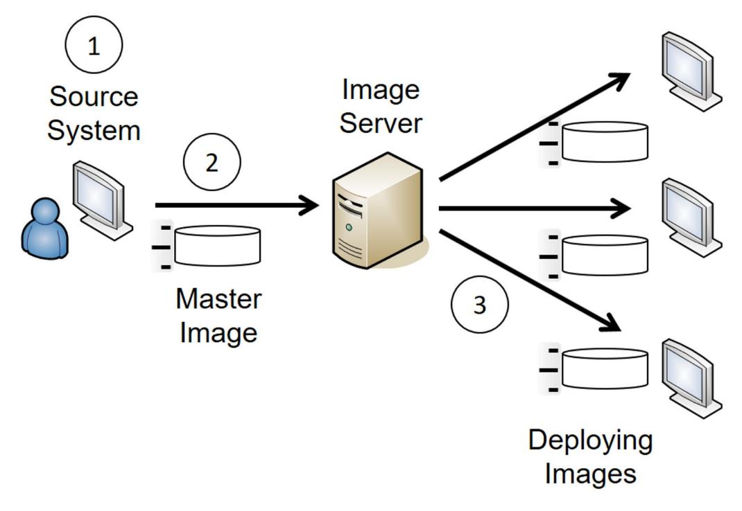
Master Images

Slide 15
Implementing Patch Management
Ensure that systems are up-to-date
Protects system against known vulnerabilities
Test patches in a test environment that mirrors the production environment

Slide 16
Patch Management
Automated deployment
Controlled deployment
Scheduling patch management
Testing, deploying and verifying updates
Test updates
Deploy updates
Verify updates

Slide 17
Change Management
Helps ensure changes to IT systems do not result in unintended outages
Provides an accounting structure or method to document all changes
Changes are proposed and reviewed before implementation

Slide 18
Allowing & Blocking Applications
Application allow list
Blocks all applications NOT on the list
Application block list
Blocks all applications on the list


Slide 19
Implementing Secure Systems
Application Programming Interface
Authentication
Authorization
Transport level security
Microservices

Slide 20
End of First Lecture
King Saud University – Applied Studies and Community Service –سبر 1213 - اسم المقررLecture 1

