Slide 1
سبر 1213 Network Defense 4 Part 3#Lecture Securing Your Network
King Saud University – Applied Studies and Community Service –سبر 1213 - اسم المقررLecture 1

Slide 2
Remote Access
VPNs and VPN concentrators
King Saud University – Applied Studies and Community Service –سبر 1213 - اسم المقررLecture 1

Slide 3
Tunneling Protocols
IPsec as a tunneling protocol
Authentication
AH provides authentication &integrity (protocol ID 51)
Encryption
ESP adds confidentiality (protocol ID 50)
Uses tunnel mode for VPNs with IKE over port 500
TLS as a tunneling Protocol
Useful when VPN go through NAT
SSTP uses TLS over port 443
text
-
King Saud University – Applied Studies and Community Service –سبر 1213 - اسم المقررLecture 1

Slide 4
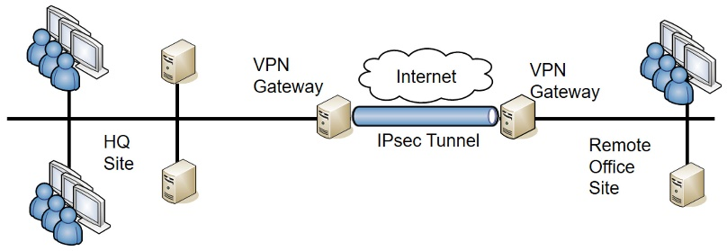
Site-to-Site VPNs
Gateways as VPN servers
King Saud University – Applied Studies and Community Service –سبر 1213 - اسم المقررLecture 1

Slide 5
Always-On VPNs
Site-to-site VPNs
Regular VPNs for users
Mobile devices
King Saud University – Applied Studies and Community Service –سبر 1213 - اسم المقررLecture 1

Slide 6
Tunneling Protocols
L2TP
not used by itself for VPN traffic
HTML5 VPN Portal
allows users to connect to the VPN using their web browser
King Saud University – Applied Studies and Community Service –سبر 1213 - اسم المقررLecture 1

Slide 7
Network Access Control
Health agents
Inspects clients for predefined conditions
Restricts access of unhealthy clients to a remediation network
Used for VPN clients and internal clients
King Saud University – Applied Studies and Community Service –سبر 1213 - اسم المقررLecture 1

Slide 8
NAC Agents
Permanent (Agent)
Installed on client and remains on
client
Persistent NAC agent
Dissolvable (Agentless)
Does not stay on client
Downloaded to client when session
starts
Removed during or after session
Commonly used for mobile devices
-
King Saud University – Applied Studies and Community Service –سبر 1213 - اسم المقررLecture 1

Slide 9
Identity and Access Services
PAP – Sends passwords in cleartext
CHAP – uses shared secret
TACACS+
Cisco alternative to RADIUS
Uses TCP port 49
Encrypts entire authentication process
Uses multiple challenges and responses
King Saud University – Applied Studies and Community Service –سبر 1213 - اسم المقررLecture 1

Slide 10
Identity and Access Services
RADIUS
King Saud University – Applied Studies and Community Service –سبر 1213 - اسم المقررLecture 1

Slide 11
AAA Protocols
Provide authentication, authorization, and accounting
Authentication verifies a user’s identification
Authorization provides access
Accounting tracks user access with logs
King Saud University – Applied Studies and Community Service –سبر 1213 - اسم المقررLecture 1

Slide 12
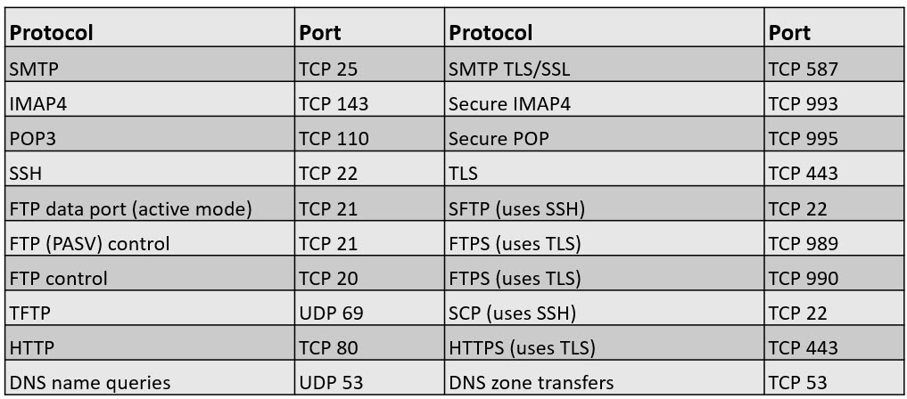
From Appendix C – Table 1
King Saud University – Applied Studies and Community Service –سبر 1213 - اسم المقررLecture 1

Slide 13
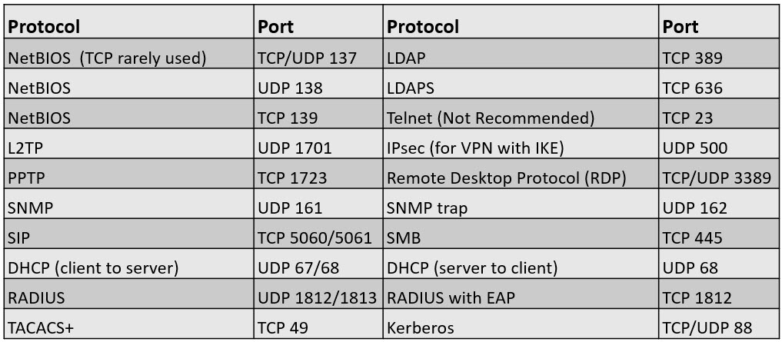
From Appendix C – Table 2
King Saud University – Applied Studies and Community Service –سبر 1213 - اسم المقررLecture 1

Slide 14
Chapter 4 Summary
Exploring Advanced Security Devices
Securing Wireless Networks
Understanding Wireless Attacks
Using VPNs for Remote Access
Check out the free online labs
King Saud University – Applied Studies and Community Service –سبر 1213 - اسم المقررLecture 1

Slide 15
End of Part Three
King Saud University – Applied Studies and Community Service –سبر 1213 - اسم المقررLecture 1

