Slide 1
CYS 1212 Cybersecurity Design Principles Lecture 1 – Part 1 CIA Triad and Fundamental Security Design Principles
King Saud University – Applied Studies and Community Service –CYS 1212

Slide 2
Topics
Three key objectives of computer security.
Levels of security.
Examples of security requirements: Confidentiality, Integrity, and Availability.
Challenges of computer security.
Fundamental Security Design Principles.
King Saud University – Applied Studies and Community Service –CYS 1212

Slide 3
Objectives
Levels of security breach impact
Recognizing Three key objectives of Computer Security (the CIA triad).
Knowing Levels of security.
.
Give Examples of security requirements.
Explaining Levels of security.
Recognizing of Challenges of computer security.
Listing Fundamental Security Design Principles.
King Saud University – Applied Studies and Community Service –CYS 1212

Slide 4
Three key objectives (the CIA triad)
Confidentiality
Data confidentiality: Assures that confidential information is not disclosed to unauthorized individuals.
Privacy: Assures that individual control or influence what information may be collected and stored.
Integrity
Data integrity: assures that information and programs are changed only in a specified and authorized manner.
King Saud University – Applied Studies and Community Service –CYS 1212

Slide 5
Three key objectives (the CIA triad
System integrity: Assures that a system performs its operations in unimpaired manner.
Availability: assure that systems works promptly and service is not denied to authorized users.
King Saud University – Applied Studies and Community Service –CYS 1212

Slide 6
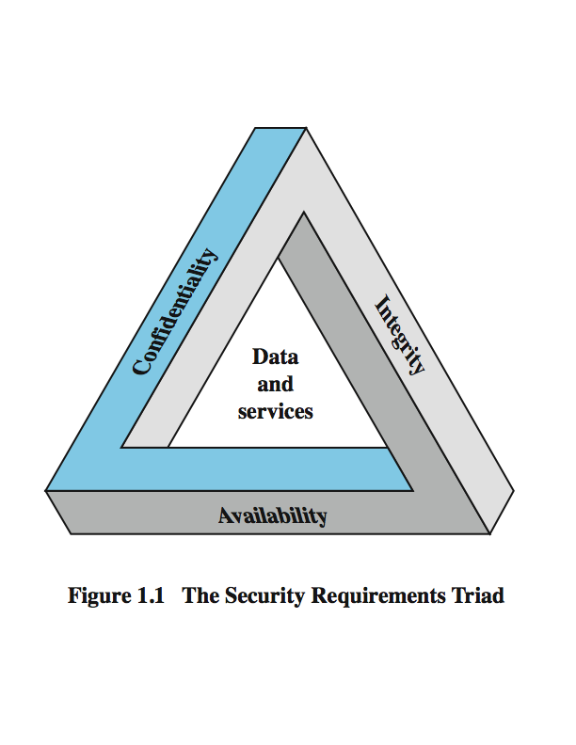
Key Security Concepts
King Saud University – Applied Studies and Community Service –CYS 1212

Slide 7
Levels of security
Authenticity: the property of being genuine and being able to be verified and trusted; confident in the validity of a transmission, or a message, or its originator
Accountability: generates the requirement for actions of an entity to be traced uniquely to that individual to support nonrepudiation, deference, fault isolation,
Low: the loss will have a limited impact, e.g., a degradation in mission or minor damage or minor financial loss or minor harm
Moderate: the loss has a serious effect, e.g., significance degradation on mission or significant harm to individuals but no loss of life or threatening injuries
High: the loss has severe or catastrophic adverse effect on operations, organizational assets or on individuals (e.g., loss of life)
King Saud University – Applied Studies and Community Service –CYS 1212

Slide 8
Examples of security requirements: Confidentiality
Student grade information is an asset whose confidentiality is considered to be very high
- The US FERPA Act: grades should only be available to students, their parents, and their employers (when required for the job)
Student enrollment information: may have moderate confidentiality rating; less damage if enclosed
Directory information: low confidentiality rating; often available publicly
King Saud University – Applied Studies and Community Service –CYS 1212

Slide 9
Examples of security requirements: Integrity
A hospital patient’s allergy information (high integrity data): a doctor should be able to trust that the info is correct and current
- If a nurse deliberately falsifies the data, the database should be restored to a trusted basis and the falsified information traced back to the person who did it.
An online newsgroup registration data: moderate level of integrity
An example of low integrity requirement: anonymous online poll (inaccuracy is well understood)
King Saud University – Applied Studies and Community Service –CYS 1212

Slide 10
Examples of security requirements: Availability
A system that provides authentication: high availability requirement
A system that provides authentication: high availability requirement
If customers cannot access resources, the loss of services could result in financial loss
A public website for a university: a moderate availably requirement; not critical but causes embarrassment
An online telephone directory lookup: a low availability requirement because unavailability is mostly annoyance (there are alternative sources)
King Saud University – Applied Studies and Community Service –CYS 1212

Slide 11
Some / Challenges of computer security
A system that provides authentication: high availability requirement
Computer security is not simple
One must consider potential (unexpected) attacks
Procedures used are often counter-intuitive
Must decide where to deploy mechanisms
A battle of wits between attacker / admin
Requires constant monitoring
Regarded as impediment to using system
King Saud University – Applied Studies and Community Service –CYS 1212

Slide 12
Fundamental Security Design Principles
These principles offer a balance between aspirational (and therefore unobtainable) “perfect security,” and the pragmatic need to get things done.
Although each of the principles can powerfully affect security, the principles have their full effect only when used in concert and throughout an organization.
King Saud University – Applied Studies and Community Service –CYS 1212

Slide 13
Fundamental Security Design Principles
These principles are a powerful mental tool for approaching security: one that doesn’t age out of usefulness or apply only to a few specific technologies and contexts.
The principles are ultimately only one piece in the security practitioner’s toolkit, but they are a flexible piece that will serve different roles for different people.
King Saud University – Applied Studies and Community Service –CYS 1212

Slide 14
Fundamental Security Design Principles
Separation of privilege and duties.
Least Privilege .
Isolation .
Modularity.
Economy of mechanism.
Encapsulation.
Minimization of Implementation (Least Common Mechanism).
Open Design
Complete Mediation.
Layering and Defense-in-Depth.
Fail Safe Defaults/Fail Secure.
Least Astonishment (Psychological Acceptability).
Minimize Trust Surface (Reluctance to Trust).
Trust Relationships
Usability
King Saud University – Applied Studies and Community Service –CYS 1212

Slide 15
Questions?
King Saud University – Applied Studies and Community Service –CYS 1212

Slide 16
End of Part 1 of Lecture 1
King Saud University – Applied Studies and Community Service –CYS 1212

