Slide 1

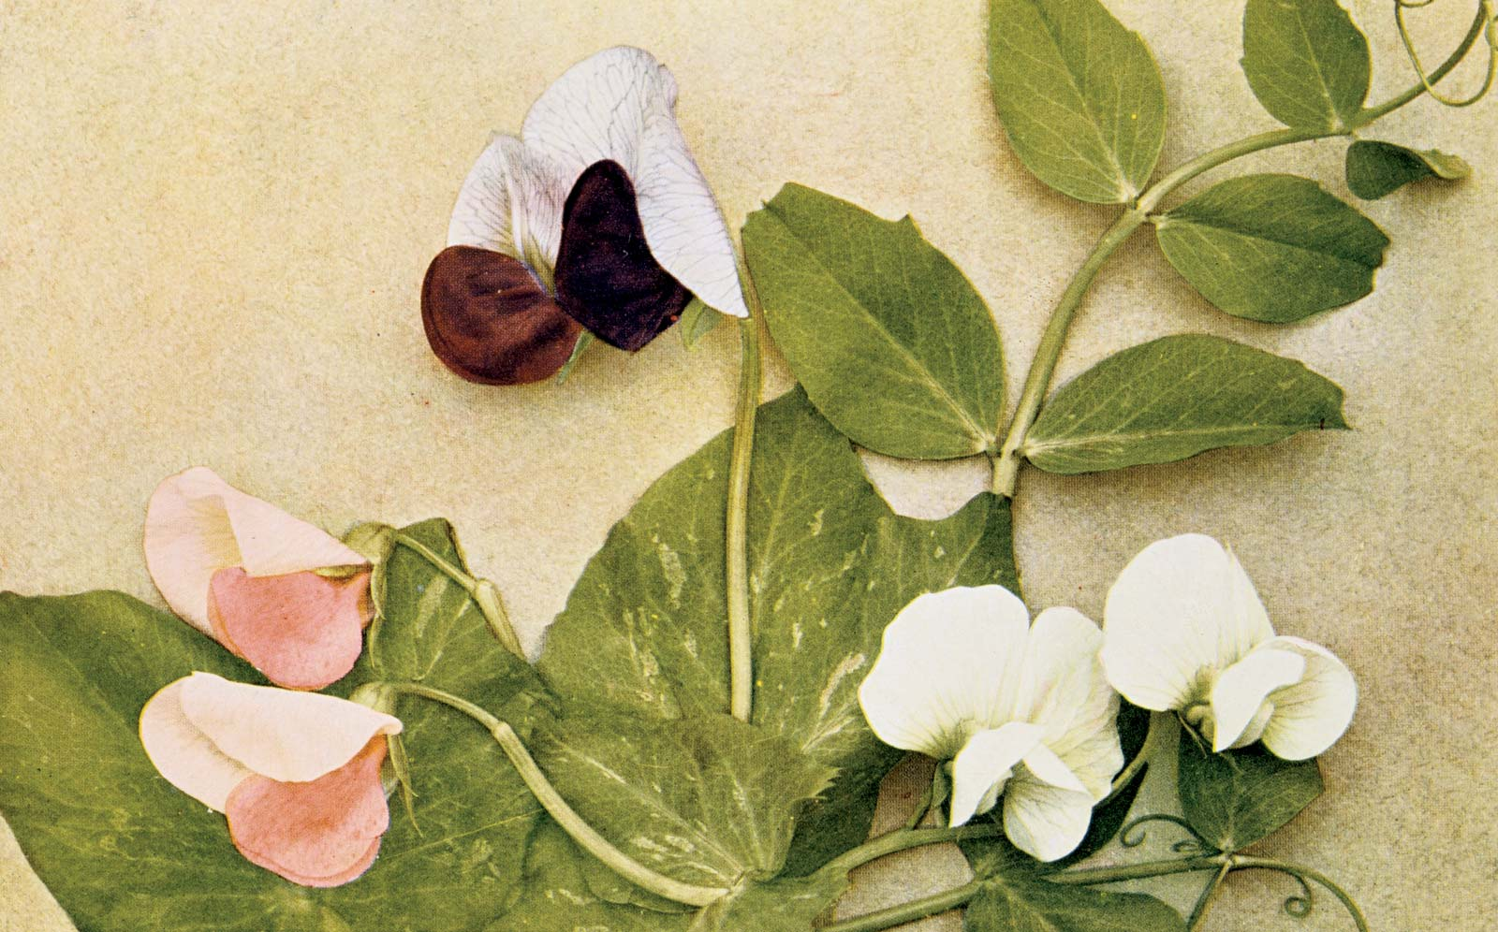
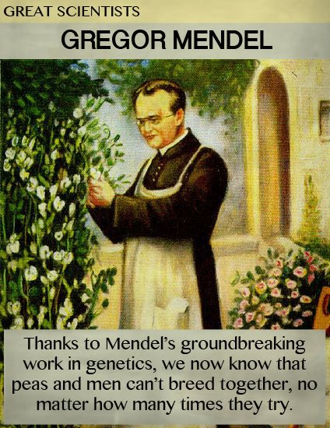
LECTURE (8)
Mendel and the gene idea

Slide 2
Lecture contents
Mandel’s experiment
Mendel’s laws
Mendel’s hypothesis
Test cross
Some terminology
1
2
3
4
5

Slide 3
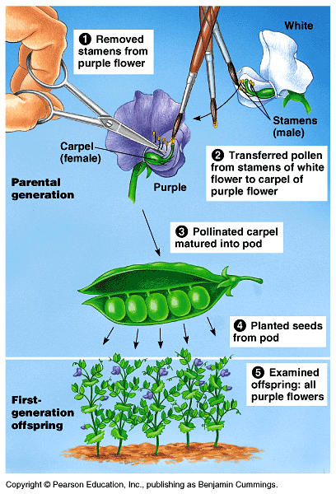
Mendel brought an experimental and quantitative approach to genetics
Around 1857, Mendel began breeding garden peas to study inheritance. Because they are available in many varieties with distinct heritable characters with different genes.
Each pea plant has male (stamens) and female (carpel) sexual organs.
In nature, pea plants typically
self-fertilize, fertilizing ova with their own pollens.
However, Mendel could also move pollens from one plant to another to cross-pollinate plants.

Slide 4
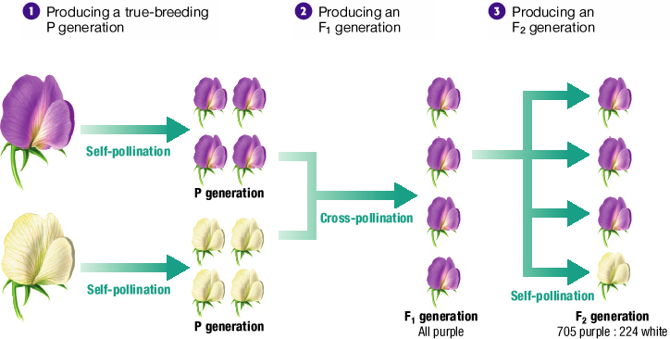
Three Steps of Mendel’s Experiments

Slide 5
Mendel’s laws
In a breeding experiment, Mendel would cross-pollinate (hybridize) two contrasting, true-breeding pea varieties.
  The true-breeding parents are the P (Parental generation) and their hybrid offspring are the F₁ (1st Filial generation) .
Mendel would then allow the F₁ (1st Filial generation) hybrids to self-pollinate to produce an F₂ generation.
It was mainly Mendel’s quantitative analysis of F₂ plants that revealed the two fundamental laws of heredity:
A)- The law of segregation.
B)- The law of independent assortment.

Slide 6
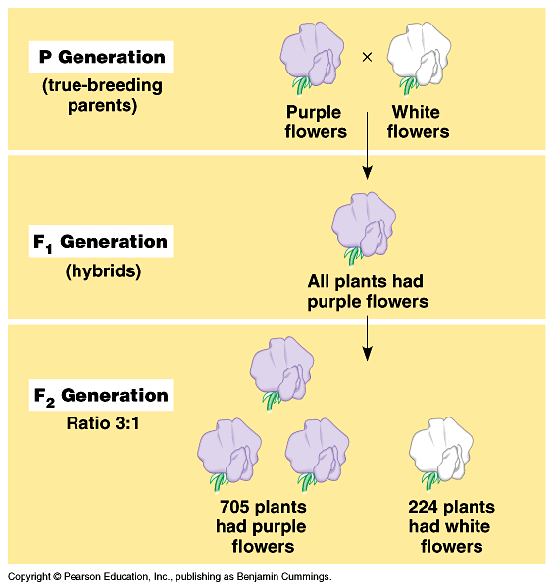
A)- Law of segregation
The two alleles for a character are isolated into separate gametes
Mendel expected that the F₁ hybrids from a cross between purple-flowered and white-flowered pea plants would have pale purple flowers.
Instead, the F₁ hybrids all have purple flowers, just a purple like their parents.
This cross produced a 3 purple to 1 white ratio of traits in the F₂ offspring.
Mendel reasoned that the heritable factor for white flowers was present in the F₁ plants, but it did not affect flower color.
Thus, purple flower is a dominant color and white flower is a recessive color.

Slide 7
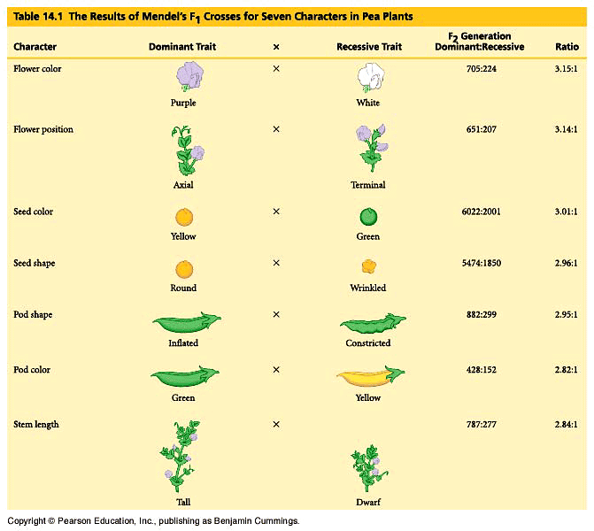
Mendel found similar 3 : 1 ratios of two traits among F₂ offspring when he conducted crosses for six other characters, each represented by two different varieties.
For example, when Mendel crossed two true-breeding varieties, one of which produced round seeds, the other of which produced wrinkled seeds, all the F₁ offspring had round seeds, but among the F₂ plants, 75% of the seeds were round and 25% were wrinkled (see second law in the next lecture).

Slide 8
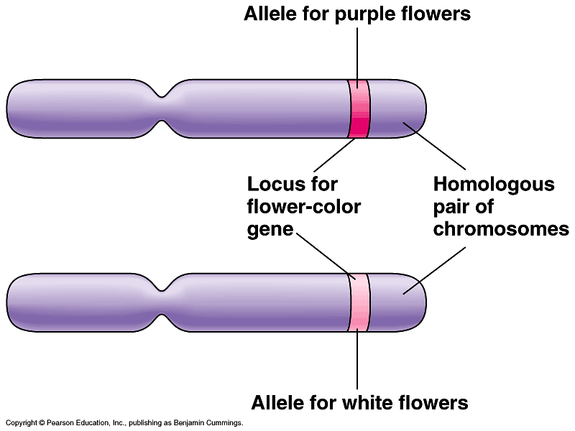
Mendel h’s Hypothesis
Mendel developed a hypothesis to explain these results that consisted of four related ideas.
1. Alternative version of genes (different alleles) account for variations in inherited characters.
  Different alleles vary somewhat in the sequence of nucleotides at the specific locus of a gene.
2. For each character, an organism
inherits two alleles, one from
each parent.
  These homologous loci may differ
  In the flower-color example, the F₁ plants inherited a purple-flower allele from one parent and a white-flower allele from the other.

Slide 9
Mendelian inheritance reflects rules of probability for the behaviour of genes (alleles).
  Alleles segregate because of the distribution of homologous chromosomes to different gametes in meiosis.
For each character, an organism inherit two alleles (one from each parent).
If the two alleles differ, one of them will be Dominant, and the other is Recessive.
The two alleles (genes) for a character are separated (segregated) into separate gametes (summarized as Mendel’s law of segregation) and aggregated again by fertilization.
Red colour gene (allele)
Homologous chromosomes
White colour gene (allele)

Slide 10
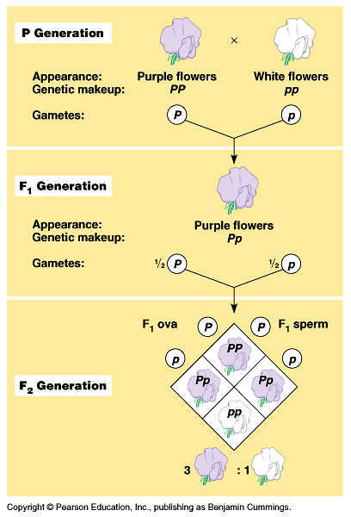
The F₁ hybrids will produce two classes of gametes, half with the purple-flower allele and half with the white-flower allele.
During self-pollination, the gametes of these two classes unite randomly.
This can produce four equally likely combinations of sperm and ovum.
A Punnett square predicts the results of a genetic cross between individuals of known genotype.
A Punnett square analysis of the flower-color example demonstrates Mendel’s model.
Mendel’s model accounts for the 3:1 ratio in the F₂ generation.

Slide 11
Pea plant
Pp
Pp
PP
pp
X
X
Heterozygous
Homozygous
P
p
P
p
P
p
Pp
PP
Pp
Pp
pp
Dominant allele
Recessive allele
100% Purple
3 Purple : 1 White
F₁ generation
F₂ generation

Slide 12
Phenotype: Is the organism’s appearance.
Phenotype
(Colour)
Genotype: Is the organism’s genetic makeup.
PP
PP
Homozygous
pp
An organism having a pair of identical alleles
Genotype
Pp
Heterozygous
(Genetic make up)
An organism having a pair of two different alleles

Slide 13
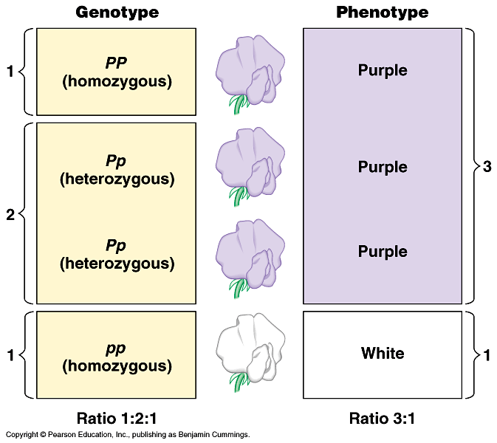
Homozygous and Heterozygous
Genotype and Phenotype
For flower color in peas, both PP and Pp plants have the same phenotype (purple) but different genotypes (homozygous and heterozygous).
The only way to produce a white phenotype is to be homozygous recessive (pp) for the flower-color gene.

Slide 14
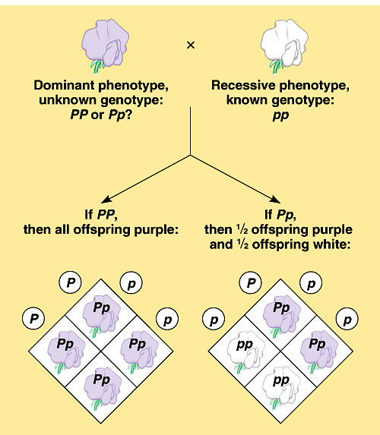
Test cross
It is not possible to predict the genotype of an organism with a dominant phenotype.
  The organism must have one dominant allele, but it could be homozygous dominant or heterozygous.
Test cross:
is breeding a homozygous recessive with dominant phenotype,
but unknown genotype, can determine the identity of the unknown allele.
Q: What is the result of Cross hybridization of purple X white colored flowers ?

Slide 15
Some Terminology
The Law of Segregation: The law of segregation states that a pair of factors is segregated, or separated, during the formation of gametes.
Dominant character (allele): Is fully expressed in the organism’s appearance.
Recessive character (allele): Has no noticeable effect on the organism’s appearance.
Homozygous: An organism with two identical alleles for a character.
Heterozygous: An organism with two different alleles for a character.
Phenotype: A description of an organism’s traits (feature).
Genotype: A description of an organism’s genetic makeup.

Slide 16
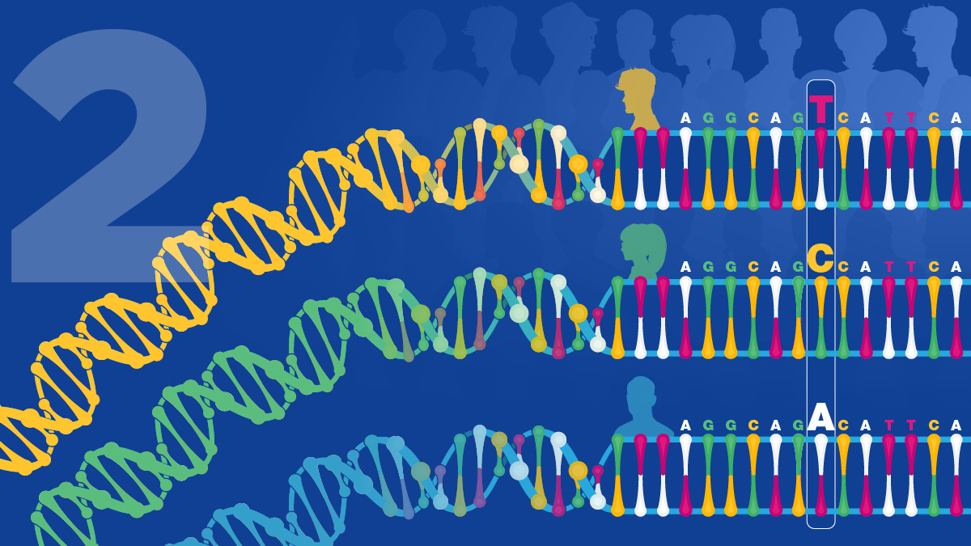
THANK YOU ……

