Slide 1

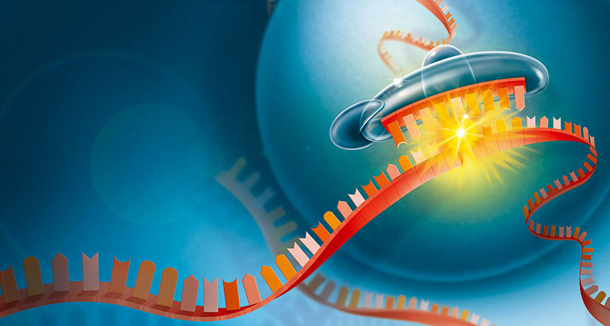
LECTURE (6)
RNA as a genetic material

Slide 2
Lecture contents
RNA and its types
RNA transcription and translation
From gene to protein
Genetic code “nucleotide triplets”
Some terminology
1
2
3
4
5

Slide 3
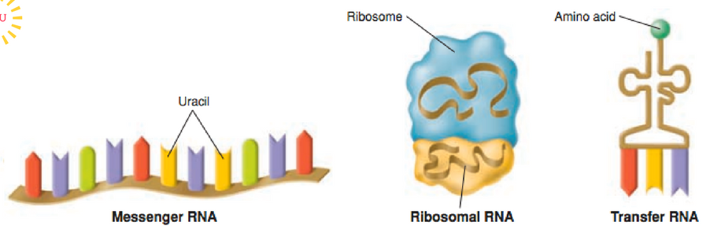
Types of RNAs
mRNA: is the carrier of the genetic “message” from the DNA to the cytosol.
rRNA: is the major component of ribosomes.
tRNA: is the carrier of specific amino acid from the cytosol to ribosomes thus help to form polypeptides.

Slide 4
RNA transcription and translation are the two main processing that link gene to protein
The information content of DNA is in the form of specific sequences of nucleotides along the DNA strands.
The DNA inherited by an organism leads to specific traits by dictating the synthesis of proteins.
Proteins are the links between genotype and phenotype.
  For example, Mendel’s dwarf pea plants lack a functioning copy of the gene that specifies the synthesis of gibberellins (which stimulate the normal elongation of stems).
Genes provide the instructions for making specific proteins.
The bridge between DNA and protein synthesis is RNA.
The specific sequence of hundreds or thousands of nucleotides in each gene carries the information for the primary structure of a protein, the linear order of the 20 possible amino acids.

Slide 5
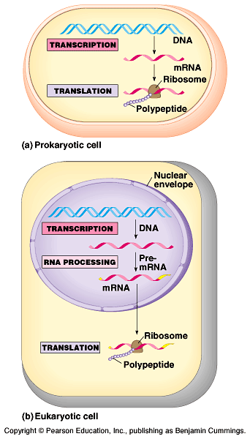
From gene to protein
During RNA transcription, a DNA strand provides a template for the synthesis of a complementary RNA strand.
Transcription of a gene produces a messenger RNA (mRNA) molecule.
During RNA translation (at ribosomes), the information contained in the order of nucleotides in mRNA is used to determine the amino acid sequence of a polypeptide.
The basic mechanics of transcription and translation are similar in eukaryotes and prokaryotes.
Because bacteria lack nuclei, transcription and translation are coupled.
Ribosomes attach to the leading end of a mRNA molecule while transcription is still in progress.

Slide 6
In a eukaryotic cell, all transcription occurs in the nucleus and translation occurs mainly at ribosomes in the cytoplasm.
In addition, before the primary transcript can leave the nucleus it is modified in various ways during RNA processing before the finished mRNA go to the cytoplasm.
To summarize, genes program protein synthesis via genetic messenger RNA.
Transcription
Translation
DNA
mRNA
Protein

Slide 7
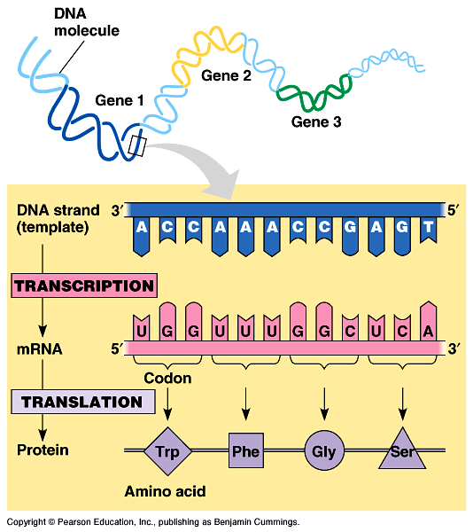
In the genetic code, “nucleotide triplets” specify amino acids
Triplets of nucleotide bases are the smallest units that can code for all the amino acid.
In the triplet code three consecutive bases specify an amino acid.
The genetic instructions for a polypeptide chain are written in DNA as a series of three-nucleotidewords (triplets).
During transcription, one DNA strand (the template strand) provides an RNA template.
The complementary RNA molecule is synthesized according to base-pairing rules, except that uracil is the complementary base to adenine.
During translation, blocks of three nucleotide bases (codons), are decoded into a sequence of amino acids.

Slide 8
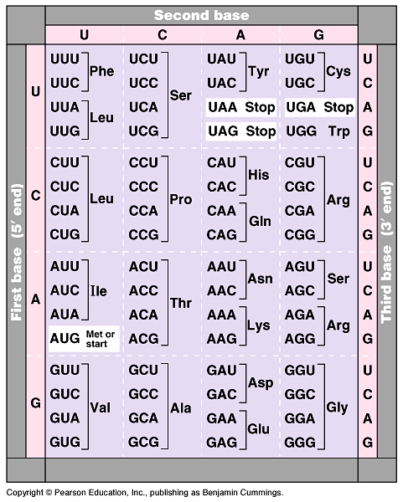
During translation, the codons are read in the 5’->3’ direction along the mRNA.
The codon UUU coded for the amino acid phenylalanine.
The codon AUG not only codes for the amino acid methionine but also indicates the start of translation.
A specific codon indicates a specific corresponding amino acid, but the amino acid may be the translation of several possible codons.
The reading frame and subsequent codons are read in groups of three nucleotide bases (codon).
In summary, genetic information is encoded as a sequence of base triplets (codons) which is translated into a specific amino acid during protein synthesis.

Slide 9
The Transcription and Processing of mRNA
mRNA is transcribed from the template strand of a gene.
RNA polymerase separates the DNA strands at the suitable point and bonds the RNA nucleotides as they base-pair along the DNA template.
Like DNA polymerases, RNA polymerases can add nucleotides only to the 3’ end of the growing polymer.
Specific sequences of nucleotides along the DNA mark where gene transcription begins and ends.
  RNA polymerase attaches and initiates transcription at the promotor, at the beginning of the transcription unit (gene) on the DNA.
  The terminator ends the transcription.
Bacteria have a single type of RNA polymerase that synthesizes all RNA molecules.
In contrast, eukaryotes have three RNA polymerases (I, II, and III) in their nuclei.
  RNA polymerase II is used for mRNA synthesis.

Slide 10
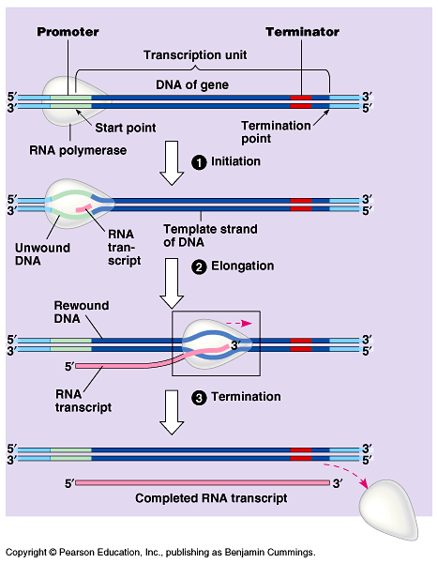
Transcription can be separated into three stages:
1- initiation
2- elongation
3- termination
Promotor contains the starting point for the transcription of a gene.
Promotor also includes a binding site for RNA polymerase.
Thus, RNA- polymerase can recognize and bind directly to the promotor region.

Slide 11
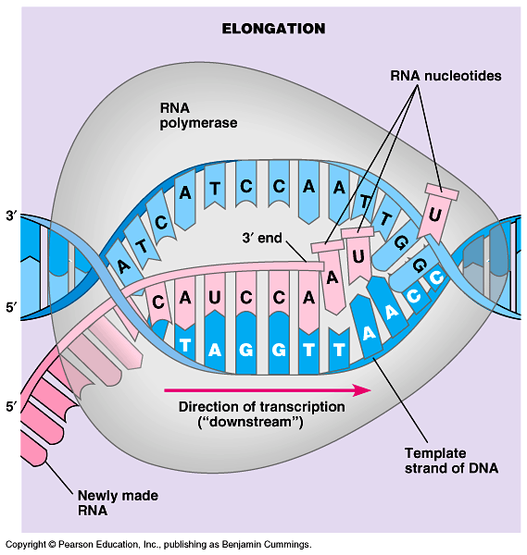
As RNA polymerase moves along the DNA, it untwists the double helix, 10 to 20 bases at time.
The enzyme adds nucleotides to the 3’ end of the growing strand.
Behind the point of RNA synthesis, the double helix re-forms and the RNA molecule moves away.
Transcription proceeds until after the RNA polymerase transcribes a terminator sequence in the DNA.

Slide 12
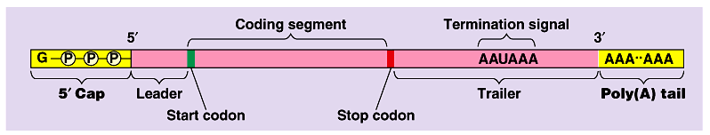
Eukaryotic cells modify RNA after transcription
Enzymes in the eukaryotic nucleus modify pre-mRNA before the genetic messages are dispatched to the cytoplasm.
At the 5’ end of the pre-mRNA molecule, a modified form of guanine is added, the 5’ cap which function as:
  protect mRNA from hydrolytic enzymes.
  a translation start point for ribosomes.
At the 3’ end, an enzyme adds 50 to 250 adenine nucleotides, the poly(A) tail.
The poly(A) tail facilitate the export of mRNA from the nucleus.

Slide 13
RNA transcription & translation
Bubble
5
3
T
A
C
T
G
A
C
RNA
polumerase
T
A
G
A
G
T
C
T
A
T
G
A
C
A
T
C
C
U
C
U
C
G
A
G
A
A
T
G
A
C
T
G
T
G
A
A
T
G
A
C
T
G
Promoter
Ribosome
Protein

Slide 14
Some Terminology
Codons or triplet code: it is a block of three consecutive nucleotide bases that specify a particular amino acid.
Start codon: a codon that specifies the start of RNA translation.
Stop codon: a codon that specifies the end of RNA translation.
RNA polymerases: RNA transcription enzyme that first separates the DNA strands at the suitable point then start to add nucleotides to the 3’ end of the growing RNA polymer until completed.
Transcription unit (the gene): a specific sequences of nucleotides along the DNA that marks where RNA transcription begins and ends.
Promotor : a specific short sequence on DNA at which RNA polymerase attaches and initiates transcription at the beginning of the transcription unit.
Terminator : a specific short sequence on DNA at which RNA transcription ends (the end of the gene).

Slide 15
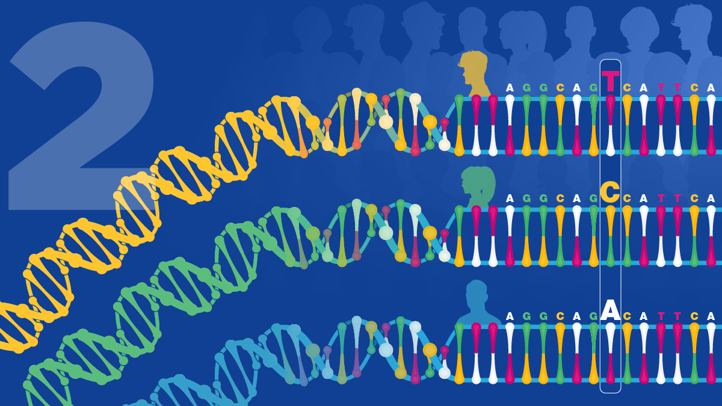
THANK YOU ……

