Slide 1

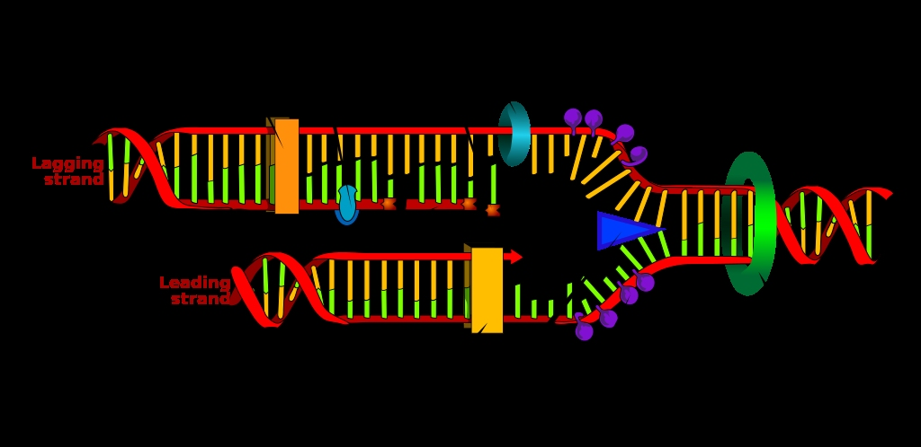
LECTURE (5)
DNA replication

Slide 2
Lecture contents
DNA replication
Types of DNA replication
The replication mechanism
Summary of replication mechanism
Some terminology
1
2
3
4
5

Slide 3
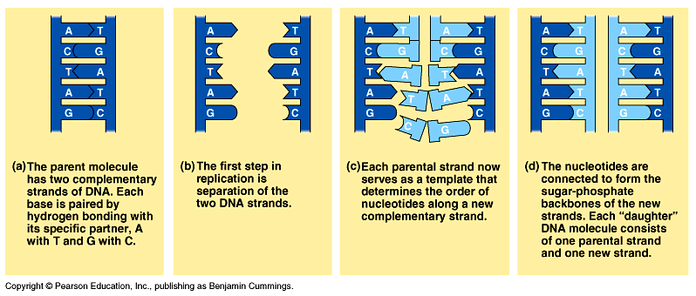
DNA replication
When a cell copies a DNA molecule, each strand serves as a template for ordering nucleotides into a new complimentary strand.
  Nucleotides line up along the template strand according to the base-pairing rules.
  The nucleotides are linked to form new strands (complementary).

Slide 4
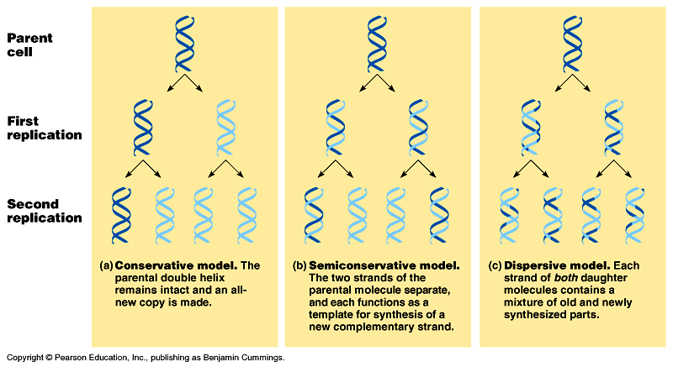
Types of DNA replication
Semiconservative replication (the most common and accepted by Watson and Crick). The double helix replicates each of the daughter molecules and will have one old strand and one newly made strand.
The other two models are the conservative and the dispersive models

Slide 5
For Semiconservative DNA Replication
During DNA replication, base pairing enables existing DNA strands to serve as templates for new complimentary strands
Several enzymes and other proteins carry out DNA replication:
Helicase,
Primase,
Polymerase,
Ligase.
The ends of DNA molecules are replicated by a special mechanism.

Slide 6
A large team of enzymes and other proteins carries out DNA replication: The Replication Mechanism
It takes E. coli less than an hour to copy each of the 5 million base pairs in its single chromosome and divide to form two identical daughter cells.
A human cell can copy its 6 billion base pairs and divide into daughter cells in only a few hours.
This process is remarkably accurate, with only one error per billion nucleotides.
A helicase; untwists and separates the template DNA strands at the replication fork.
Single-strand binding proteins; keep the unpaired template strands apart during replication.

Slide 7
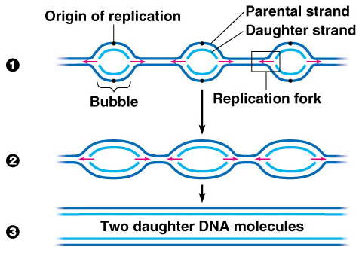
The Replication Mechanism
The replication of a DNA molecule begins at special site called origin of replication which is a single specific sequence of nucleotides that is recognized by the replication enzymes.
Replication enzymes separate the strands, forming a replication “bubble”.
  Replication proceeds in both directions until the entire molecule is copied.
In eukaryotes, there may be hundreds or thousands of bubbles (each has origin sites for replication) per chromosome.
  At the origin sites, the DNA strands separate forming a replication “bubble” with replication forks at each end.
  The replication bubbles elongate as the DNA is replicated and eventually fuse.

Slide 8
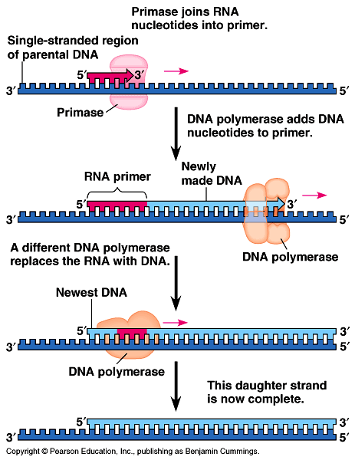
Primer: (a short segment of RNA, 10 nucleotides long) is required to start a new chain.
Primase: (an RNA polymerase) links ribonucleotides that are complementary to the DNA template into the primer.
DNA polymerases: catalyze the elongation of new DNA at a replication fork. After formation of the primer, DNA polymerases can add deoxyribonucleotides to the 3’ end of the ribonucleotide chain.
Another DNA polymerase later replaces the primer ribonucleotides with deoxyribonucleotides complimentary to the template.

Slide 9
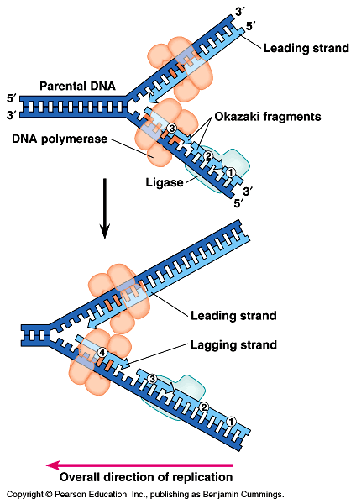
The Replication Mechanism
DNA polymerases can only add nucleotides to the free 3’ end of a growing DNA strand.
A new DNA strand can only elongate in the 5’->3’ direction.
At the replication fork, one parental strand (3’-> 5’ into the fork), the leading strand, can be used by polymerases as a template for a continuous complimentary strand.
The other parental strand (5’->3’ into the fork), the lagging strand, is copied away from the fork in short segments
(Okazaki fragments).
Okazaki fragments (each about 100-200 nucleotides) are joined by DNA ligase to form the sugar-phosphate backbone of a single DNA strand.

Slide 10
Summary of DNA replication mechanism
The two DNA-strands separate forming replication bubbles.
Each strand functions as a template for synthesizing new complementary & lagging strands via primers, polymerase and ligase.
5
3
T
A
C
T
G
A
C
A
G
A
G
G
G
A
T
A
C
T
Primer
T
C
T
3
5
Complementary (leading) strand
Templates
Polymerase
Ligase
T
A
C
T
G
A
C
3
5
Lagging strand (complementary)
Okazaki fragments

Slide 11
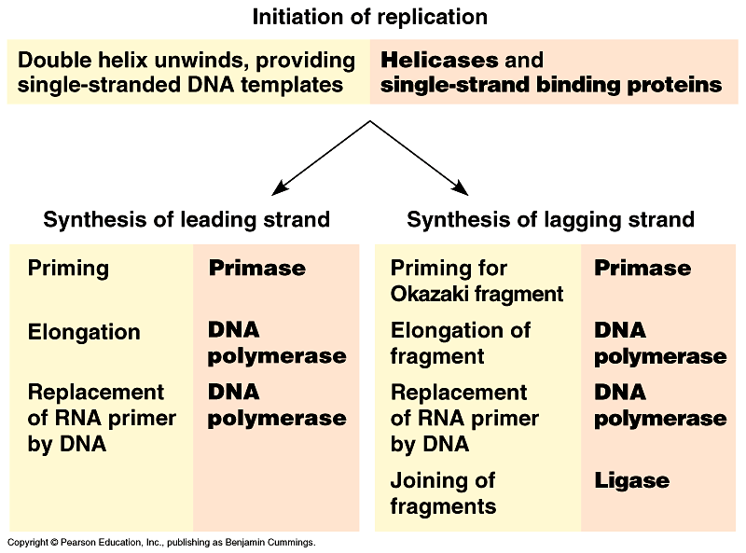
1
2
3
4
Fig. 16.15, Page 298

Slide 12
Some Terminology
Helicase: untwists the double helix to separate the DNA strands by forming replication bubbles.
Replication enzymes: separates DNA strands, forming a replication “bubble”.
Replication bubble: formed at the origin sites of replication as DNA strands separate, and hence, replication forks formed at each end.
Replication site: it is also called origin of replication which is a single specific sequence of nucleotides that is recognized by the replication enzymes and at which replication starts.
Primer: is a short piece of RNA (10 nucleotide long) which is synthesised by primase and used to initiate the leading strands of the new DNA.

Slide 13
Some Terminology
DNA-polymerase: builds up the new DNA strand by adding nucleotides to the primer (from 5’ to 3’ end).
Leading strand: the elongation strand (5’ - 3’ into the fork) that initiate the new DNA after recognizing the sequence of the primer by special proteins.
Lagging strand: Is the other parental strand (5’ - 3’ into the fork), is copied away from the fork in short segments (Okazaki fragments).
Okazaki fragments: the newly formed segments (5’ - 3’, away from the fork) then, form the lagging strand when connected by ligase towards the fork.
DNA-ligase: joins the Okazaki fragments of the newly formed bases to form the new lagging DNA strand.

Slide 14
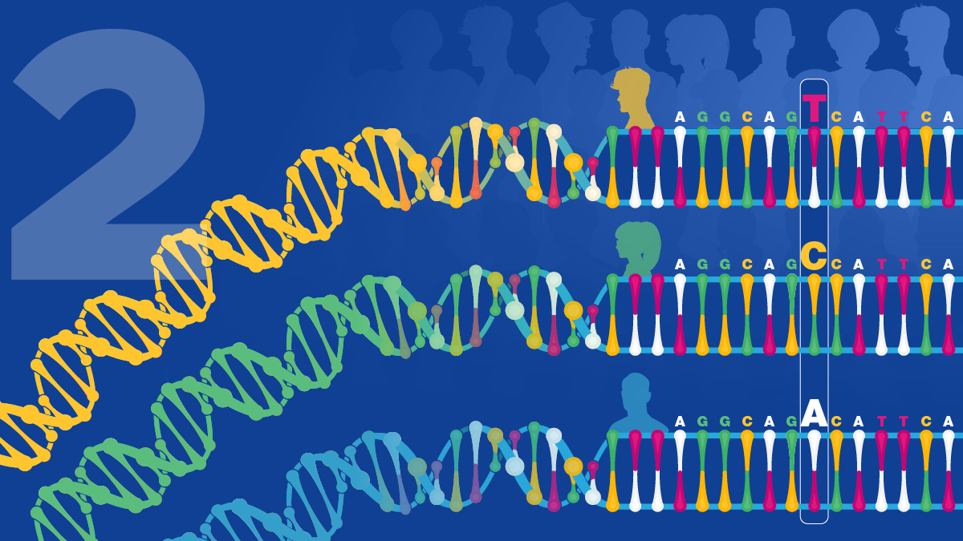
THANK YOU ……

