Slide 1

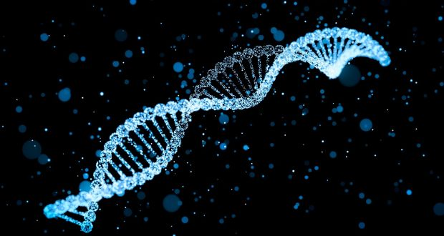
LECTURE (4)
DNA: Genetic Material

Slide 2
Lecture contents
Watson and Crick model
DNA: the genetic material
A comparison between DNA and RNA
Nucleic acids and polynucleotides
Final hints
1
2
3
4
5

Slide 3
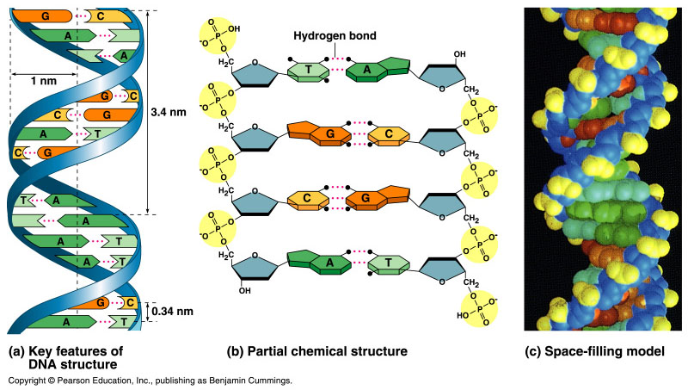
Watson and Crick discovered the double helix by building models to conform to X-ray data
In April 1953, James Watson and Francis Crick shook the scientific world with an elegant double-helical model for the structure of deoxyribonucleic acid or DNA.
Watson and Crick began to work on a model of DNA with two strands, the double helix.

Slide 4
DNA: the Genetic Material
The amino acid sequence of a polypeptide is programmed by a gene.
A gene is a small region in the DNA.
Nucleic acids store and transmit hereditary information.
There are two types of nucleic acids: ribonucleic acid (RNA) and deoxyribonucleic acid (DNA).
DNA also directs mRNA synthesis, thus, controls protein synthesis.
Organisms inherit DNA from their parents.
  Each DNA molecule is very long and usually consists of hundreds to thousands of genes.
  When a cell divides, its DNA is copied and passed to the next generation of cells.
The mRNA interacts with ribosomes to direct the synthesis of amino acids in a polypeptide (protein)

Slide 5
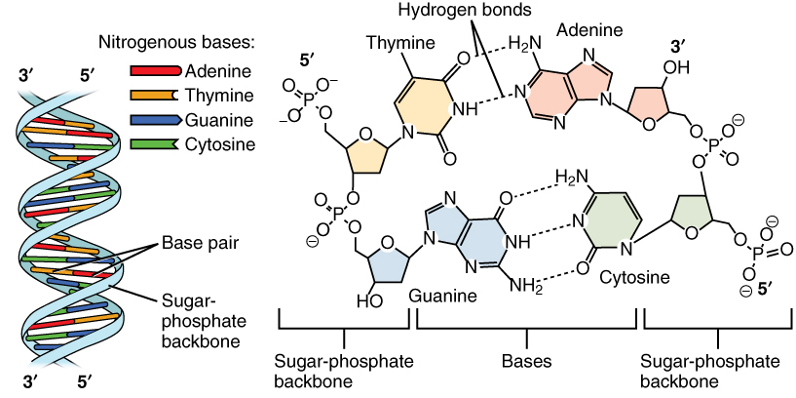
Structure of DNA
3
5
o
o
P
o
o
DNA nucleotide
o
Base
5
Phosphate group
CH₂
4
H
H
1
H
H
3
2
H
o
Deoxyribose
o
P
o
o
The sugar-phosphate backbones of the two polynucleotides are on the outside of the helix.
The PO₄³⁻ group of one nucleotide is attached to the sugar of the next nucleotide in line.
The result is a “backbone” of alternating phosphates and sugars, from which the bases starts.
Base
o
CH₂
H
H
H
H
5
3
3
H
Sugar-phosphate backbone

Slide 6
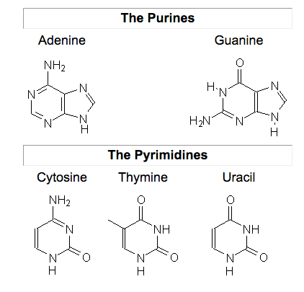
Nitrogenous bases
Pairs of nitrogenous bases (one from each strand) connect the polynucleotide chains with hydrogen bonds.
Most DNA molecules have thousands to millions of base pairs (bP).
In case of RNA

Slide 7
Because of their shapes, only some bases are compatible with each other.
  Adenine (A) always pairs with thymine (T) and guanine (G) with cytosine (C).
With these base-pairing rules, if we know the sequence of bases on one strand, we know the sequence on the opposite strand.
The two strands are complementary.
During preparations for cell division each of the strands serves as a template to order nucleotides into a new complementary strand.
This results in two identical copies of the original double-stranded DNA molecule.
  The copies are then distributed to the daughter cells.
This mechanism ensures that the genetic information is transmitted to the new cells.

Slide 8
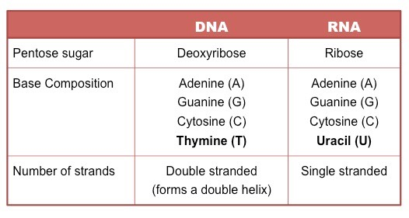
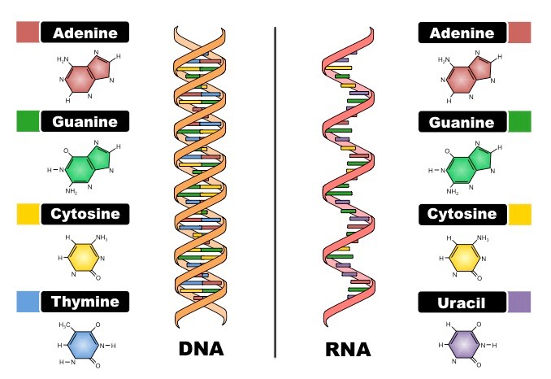
A comparison between DNA and RNA
Deoxiribo-Nucleic-Acid
Ribo-Nucleic-Acid

Slide 9
Nucleic acids and polynucleotides
Nucleic acids are polymers of monomers called nucleotides.
Each nucleotide consists of three parts: a nitrogen base, a pentose sugar, and a phosphate group.
The nitrogen bases (rings of carbon and nitrogen) come in two types: Purines and Pyrimidines.
The pentose sugar joined to the nitrogen base is ribose in nucleotides of RNA and deoxyribose in DNA.
The only difference between the sugars is the lack of an oxygen atom on carbon 2 in deoxyribose.
Polynucleotides are synthesized by connecting the sugars of one nucleotide to the phosphate of the next with a phosphodiester link.

Slide 10
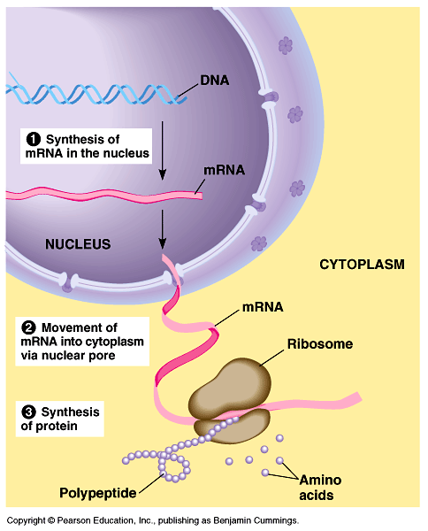
The sequence of nitrogen bases along a DNA or mRNA polymer is unique for each gene.
Genes are normally hundreds to thousands of nucleotides long.
The linear order of bases in a gene specifies the order of amino acids (the monomers of a protein).
The flow of genetic information
The flow of genetic information is from DNA mRNA protein.
  Protein synthesis occurs in ribosomes.
  In eukaryotes, DNA is located in the nucleus, but most ribosomes are in the cytoplasm with
  mRNA as an intermediary.

Slide 11
Final hints
Repeated Sugar - Phosphate
DNA backbone
Sugar–Phosphate-Base
One nucleotide
DNA Molecule
Polynucleotide
DNA Double stranded
RNA single stranded
DNA
A
G
C
T
A
T
C
mRNA
T
U
C
G
A
T
U
A
G

Slide 12
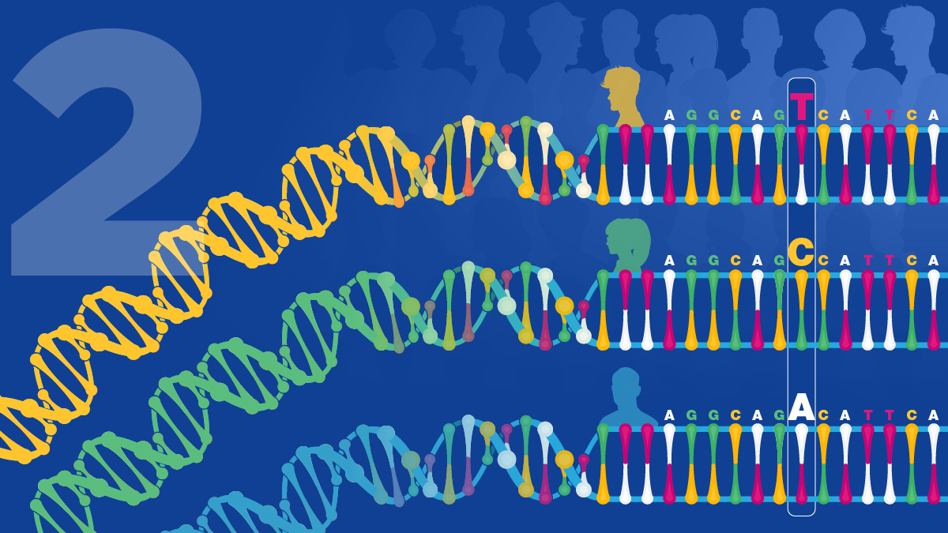
THANK YOU ……

