Slide 1

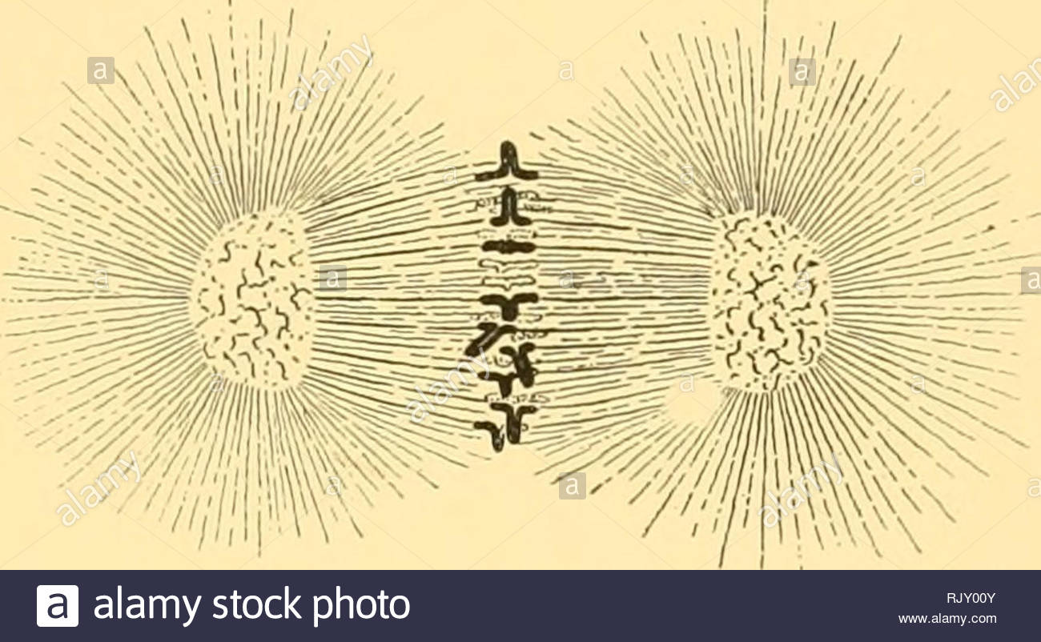
LECTURE (3)
Fertilization and Meiosis

Slide 2
Lecture contents
Fertilization and Meiosis alternate in sexual life cycle
Chromosomes (Sex and autosomes)
Meiosis (Reduction division)
Sexual life cycles produce genetic variation among offspring
1
2
3
4

Slide 3
Fertilization and Meiosis alternate in sexual life cycles
A life cycle of an organism is the generation-to-generation sequence of stages in its reproductive history.
It starts at the conception of an organism until it produces its own offspring.
In humans, each somatic cell (all cells other than sperm or ovum) has 46 chromosomes.

Slide 4
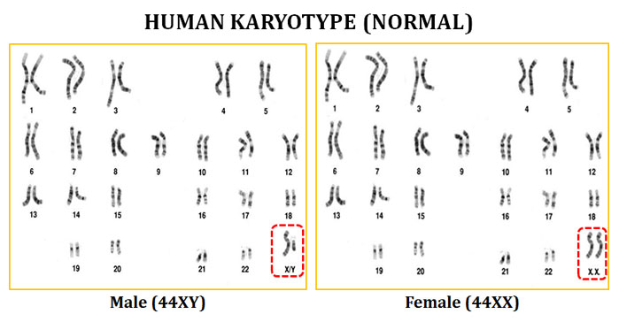
A karyotype display of the 46 chromosomes shows 23 pairs of chromosomes, each pair with the same length, centromere position, and staining pattern.

Slide 5
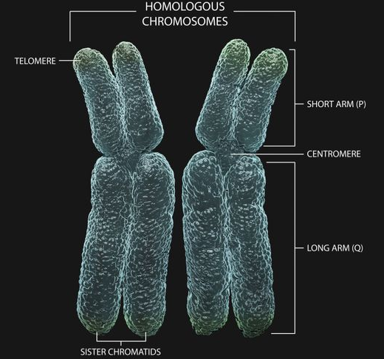
These homologous chromosome pairs carry genes that control the same inherited characters.

Slide 6
Chromosomes (sex and autosomes)
An exception to the rule of homologous chromosomes is found in the sex chromosomes, the X and the Y.
The pattern of inheritance of these chromosomes determine an individual’s sex.
  Human females have a homologous pair of X chromosomes (XX).
  Human males have an X and a Y chromosome (XY).
The other 22 pairs are called autosomes.
We inherit one chromosome of each homologous pair from each parent.
  The 46 chromosomes in a somatic cell can be viewed as two sets of 23, a maternal set and a paternal set.
Sperm cells or ova (gametes) have only one set of chromosomes - 22 autosomes and an X or a Y.

Slide 7
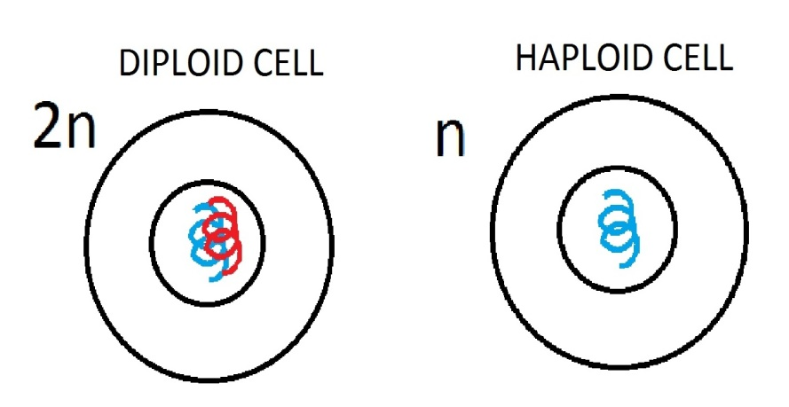
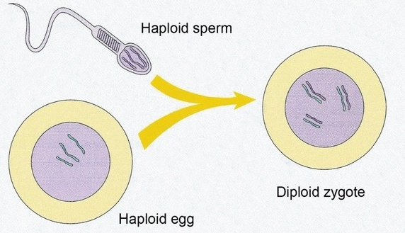
A cell with a single chromosome set is called haploid.
  For humans, the haploid number of chromosomes is 23 (n = 23).
A haploid sperm reaches and fuses with a haploid ovum.
These cells fuse (syngamy) resulting in fertilization.
The fertilized egg (zygote) now has a diploid set of chromosomes from the maternal and paternal family lines.
The zygote and all cells with two sets of chromosomes are diploid cells 46 (2n = 46).

Slide 8
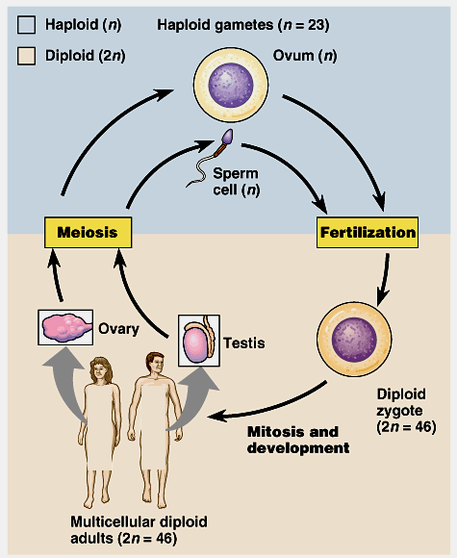
As an organism develops from a zygote to a sexually mature adult, the zygote’s genes are passes on to all somatic cells by mitosis.
Gametes, which develop in the gonads, are not produced by mitosis.
Instead, gametes undergo the process of meiosis in which the chromosome number is halved.
Fertilization restores the diploid condition by combining two haploid sets of chromosomes.
Fertilization and meiosis alternate in sexual life cycles.

Slide 9
Meiosis (Reduction Division)
Reduces chromosome number from diploid to haploid
Many steps of meiosis resemble steps in mitosis.
Both are preceded by the replication of chromosomes.
However, in meiosis, chromosomes replicate once followed by two consecutive cell divisions, meiosis I and meiosis II, which results in four daughter cells.
Each final daughter cell has only half chromosomes number (haploid).
Meiosis reduces chromosome number by copying the chromosomes once, but dividing twice.
  The first division (meiosis I) separates homologous chromosomes.
  The second (meiosis II) separates sister chromatids.

Slide 10
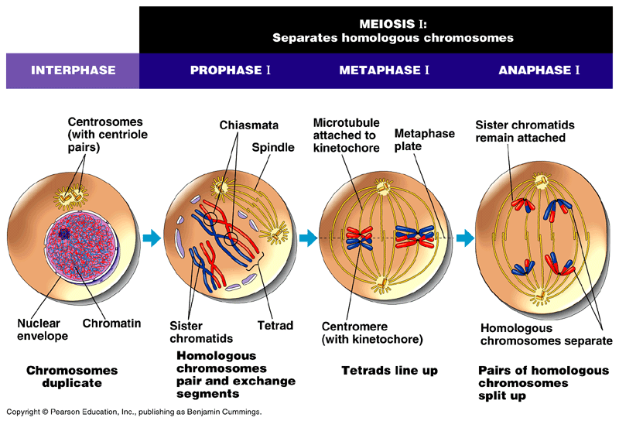
Meiosis (Reduction Division)
A)- Meiosis I:
1)- Interphase the chromosomes are replicated to form sister chromatids.
2)- Prophase I, the chromosomes condense and homologous chromosomes pair up to form tetrads.
Homologous chromosomes attached together (synapsis).
  Chromatids of homologous chromosomes are crossed (at chiasmata) and segments of the chromosomes are exchanged (Crossing Over).

Slide 11
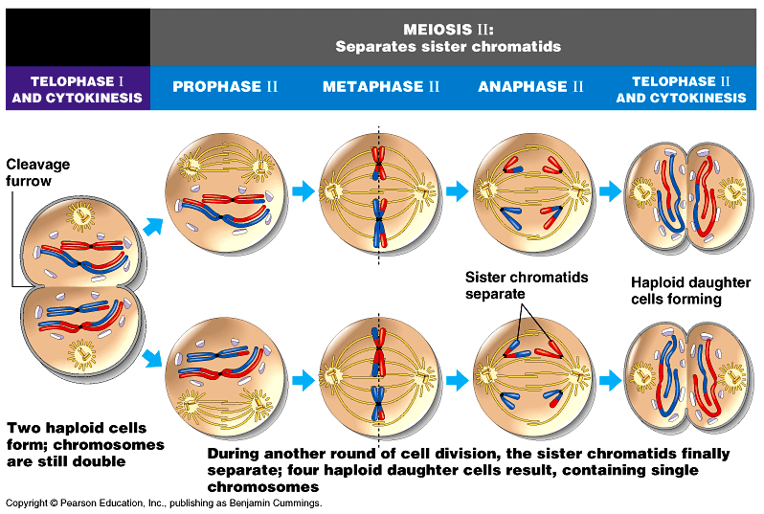
3)- Metaphase I, the tetrads are all arranged at the metaphase plate.
  Microtubules from one pole are attached to the kinetochore of one chromosome of each tetrad, while those from the other pole are attached to the other.
4)- Anaphase I,
the homologous chromosomes separate and are pulled toward opposite poles.
5)- Telophase I, movement of homologous chromosomes continues until there is a haploid set at each pole.
  Each chromosome consists of linked sister chromatids.

Slide 12
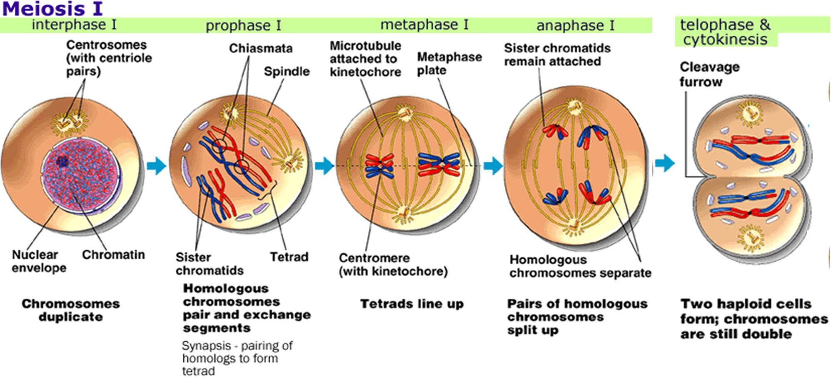

Slide 13
B)- Meiosis II
Prophase II, a spindle apparatus forms, attaches to kinetochores of each sister chromatids, and moves them around.
Metaphase II, the sister chromatids are arranged at the metaphase plate.
3)- Anaphase II, the centromeres of sister chromatids separate and the separate sisters chromatids travel toward opposite poles.
4)- Telophase II, separated sister chromatids arrive at opposite poles.
  Nuclei are formed around the chromatids.
Cytokinesis separates the cytoplasm.
At the end of meiosis, there are four haploid daughter cells.

Slide 14
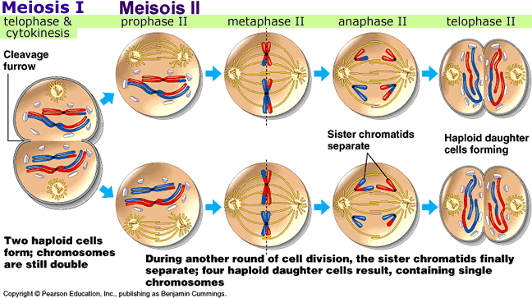

Slide 15
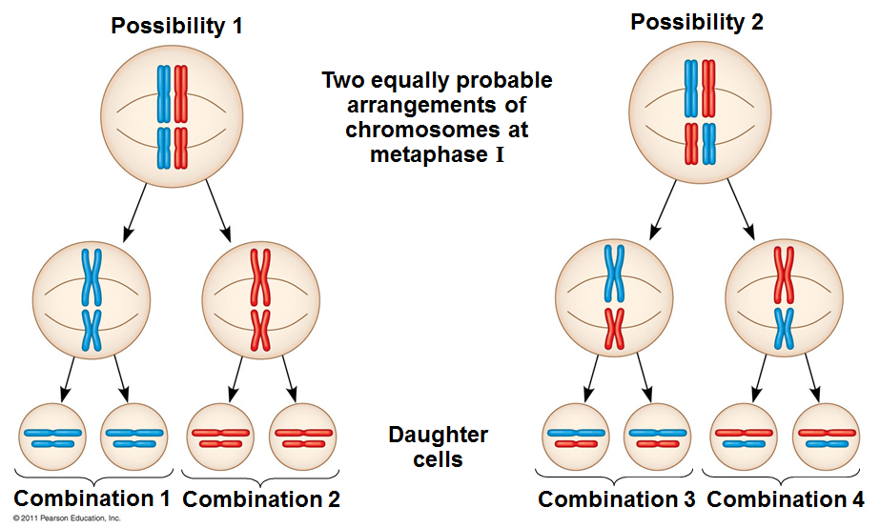
Sexual life cycles produce genetic variation among offspring
Three mechanisms contribute to genetic variation:
  independent assortment
  crossing over
  random fertilization
1)- Independent assortment: of chromosomes contributes to genetic variability due to the random orientation of tetrads at the metaphase plate.
  There is a fifty-fifty chance that a particular daughter cell of meiosis I will get the maternal chromosome of a certain homologous pair and a fifty-fifty chance that it will receive the paternal chromosome.

Slide 16
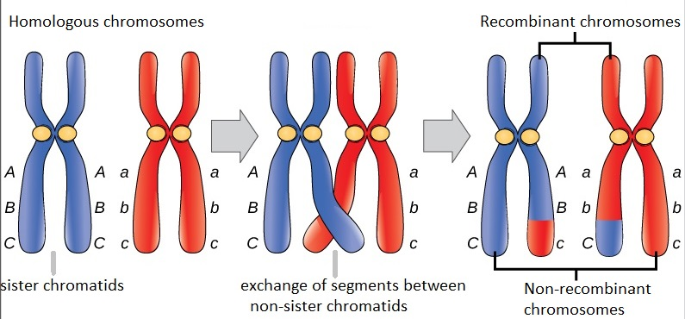
2- Crossing over:
Occurs during prophase I.
The two homologous chromosomes joint together very closely.
Two non-sister chromatids of the homologous chromosomes are crossed over at a chiasma point and exchange corresponding segments.
The resulting chromosomes are called “recombinant chromosomes”.
It is important in genetic variation in sexual life cycle.
3- Random fertilization: it adds to the genetic variation arising from meiosis. Any sperm can fuse with any egg.

Slide 17
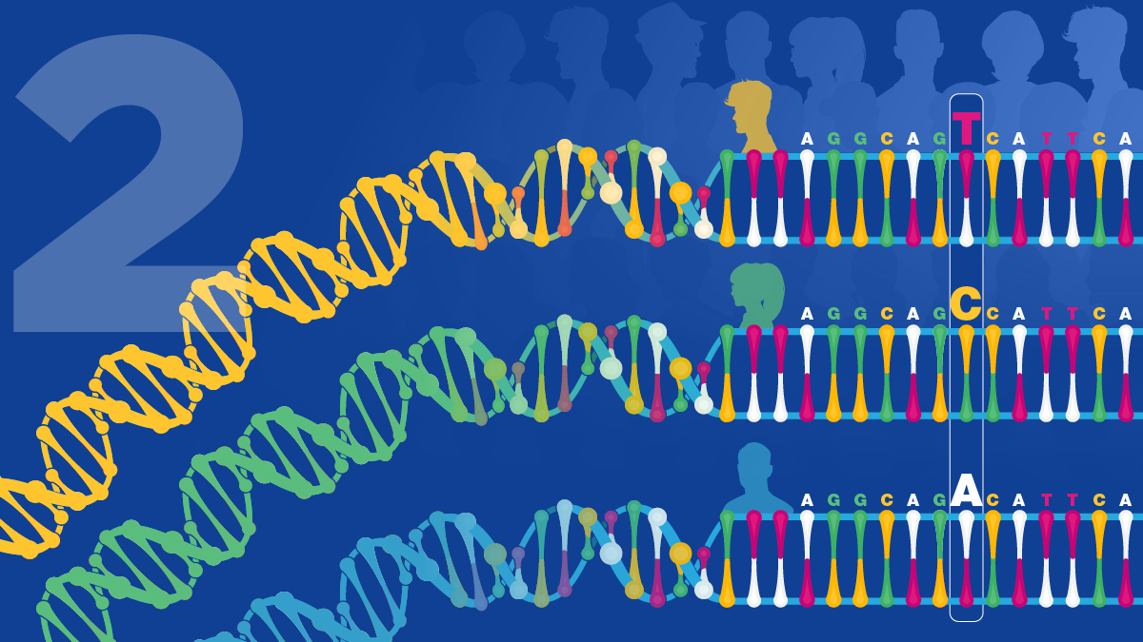
THANK YOU ……

