Slide 1

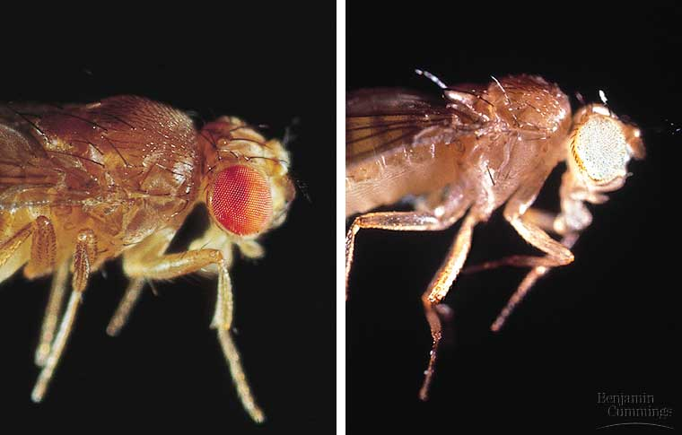
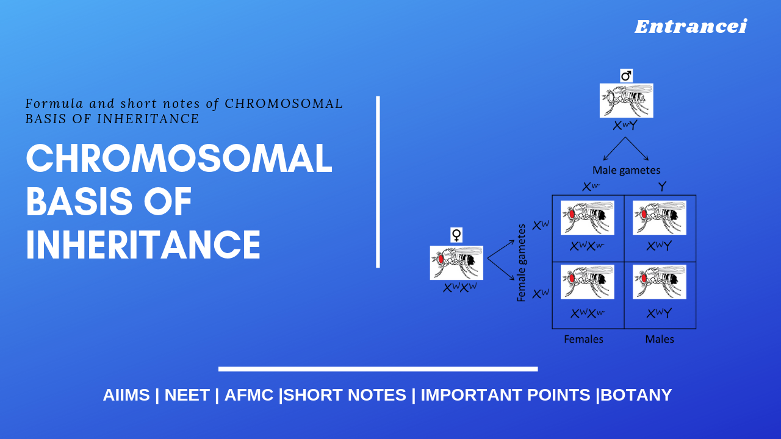
LECTURE (10)
The chromosomal basis of inheritance

Slide 2
Lecture contents
The chromosomal basis of sex varies with organism
Sex-linked genes have unique patterns of inheritance
Chromosomal aberration
Aneuploidy (Chromosomal duplication)
Chromosomal structure-alterations
1
2
3
4
5

Slide 3
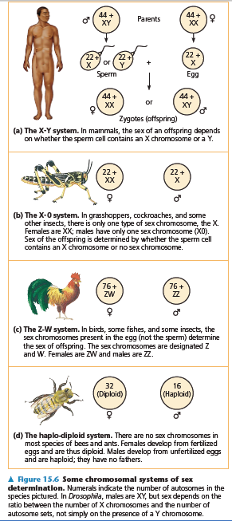
1. The chromosomal basis of sex varies with organism
In human and other mammals, there are two varieties of sex chromosomes, X & Y.
  An individual who inherits two X chromosomes usually develops as a female.
  An individual who inherits an X and a Y chromosome usually develops as a male.
This X-Y system of mammals is not the only chromosomal mechanism of determining sex.
Other options include the X-0 (in locust) system, the Z-W system (in birds), and the haplo-diploid system (in bees).
In Human, the SRY gene (Sex-determining Region of the Y chromosome) modifies embryonic gonads into testes.
Females lack the SRY gene, thus, the embryonic gonads develop into ovaries.

Slide 4
In the X-Y system, Y and X chromosomes behave as homologous chromosomes during meiosis.
  In reality, they are only partially homologous and rarely undergo crossing over
In both testes (XY) and ovaries (XX), the two sex chromosomes segregate during meiosis and each gamete receives one.
  Each egg receives an X chromosome.
  Half the sperm receive an X chromosome and half receive a Y chromosome.
Because of this, each conception has about a fifty-fifty chance of producing a particular sex.

Slide 5
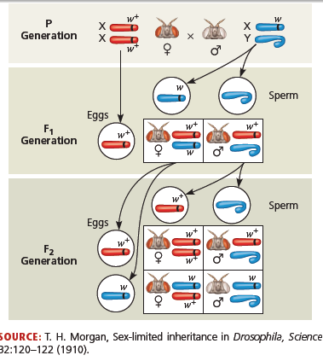
2. Sex-linked genes have unique patterns of inheritance
The sex chromosomes, especially the X chromosome, have genes for many characters unrelated to sex.
These sex-linked genes follow the same pattern of inheritance as the white-eye locus in Drosophila.
If a sex-linked trait is due to a recessive allele, a female have this phenotype only if homozygous.
  Heterozygous females will be carriers.

Slide 6
Sex-linked disorders in human
Duchenne muscular dystrophy: affects one in 3,500 males born in the United States.
  Affected individuals rarely live past their early 20s.
  This disorder is due to the absence of an X-linked gene for a key muscle protein, called dystrophin.
  The disease is characterized by a weakening of the muscles and loss of coordination.
Hemophilia: is a sex-linked recessive trait defined by the absence of one or more clotting factors.
  These proteins normally slow and then stop bleeding.
  Individuals with hemophilia have prolonged bleeding because a firm clot forms slowly.
  Individuals can be treated with intravenous injections of the missing protein.
  This gene is transmitted to offspring via the mothers.
  Thus, Sons borne from hemophilic woman should be exempted from circumcision.

Slide 7
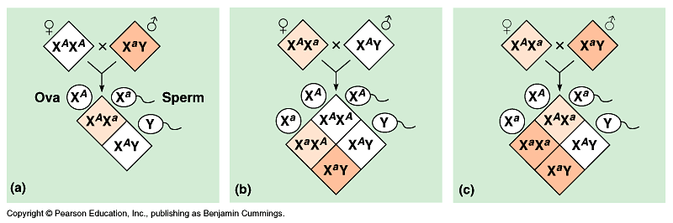
Color blindness: is a disorder inherited as a recessive sex-linked character and affect both males and females.
  A color blind female (XªXª) may be born to a color blind father (XªY) and a carrier mother (X^{A}Xª)
Because males have only one X chromosome (hemizygous), any male receiving the recessive allele from his mother will express the trait.
Therefore, males are far more likely to inherit sex-linked recessive disorders than are females.

Slide 8
Chromosomal aberration
It is common in meiosis and includes:
    Chromosomal deletions/translocations
      Homologous chromatids may break and rejoin at incorrect places, thus, one chromatid will loose more genes than it receives.
    Chromosomal duplications (Polyploidy).
      result from nondisjunction during gamete production in one parent.
A diploid embryo that is homozygous for a large deletion or male with a large deletion to its single X chromosome is usually missing many essential genes and this leads to a lethal outcome.
  Duplications and translocations are very harmful.
Translocation or inversion can alter phenotype because a gene’s expression is influenced by its location.

Slide 9
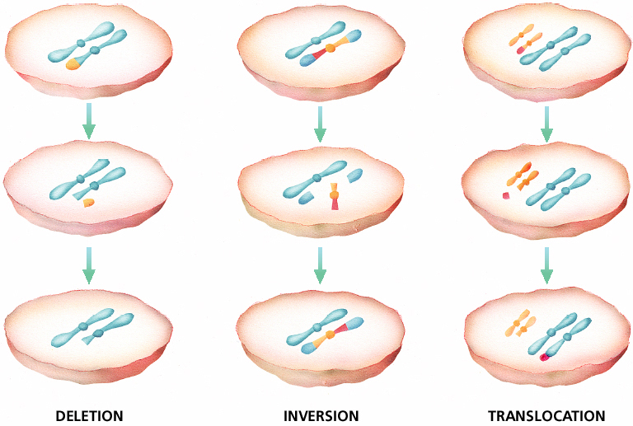
Chromosomal Mutations

Slide 10
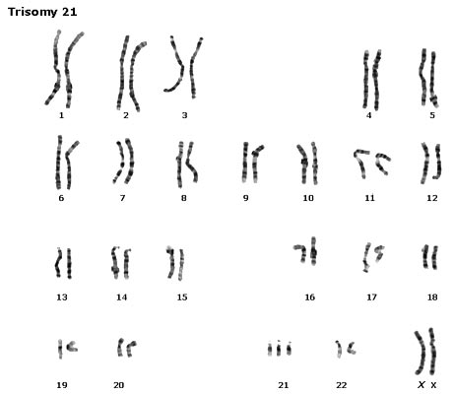
A)- Aneuploidy (Chromosomal duplication)
1- Down syndrome [Polyploidy (2n + 1), trisomy in autosomes]:
Is due to three copies of chromosome 21 (Trisomies).
Although chromosome 21 is the smallest human chromosome, it severely alters an individual’s phenotype in specific ways.

Slide 11
Symptoms of Down Syndrome
Upward slant to eyes.
Small ears that fold over at the top.
Small, flattened nose.
Small mouth, making tongue appear large.
Short neck.
Small hands with short fingers.
In addition, down syndrome always involves some degree of mental retardation, from mild to severe. In most cases, the mental retardation is mild to moderate.

Slide 12
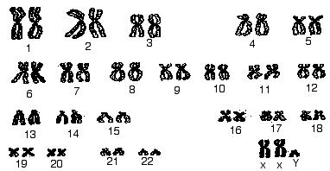
2- Klinefelter’s syndrome [Polyploidy (2n + 1), trisomy in sex chromosomes ],
Disorder occurring due to nondisjunction of the X chromosome.
The Sperm containing both X and Y combines with an egg containing the X, results in a male child.
The egg may contribute the extra X chromosome.
[
(a)- An XXY male, occurs once in every 2000 live births.
These individuals have male sex organs, but are sterile. There may be feminine characteristics, but their intelligence is normal.
Males with some development of breast tissue normally seen in females.
Little body hair is present, and such person are typically tall, have small testes.
Infertility results from absent sperm.
Evidence of mental retardation may or may not be present.
(b)- An XYY male, tend to somewhat taller than average
(c)- A trisomy female (XXX), which occurs once in every 2000 live births, produces healthy females.

Slide 13
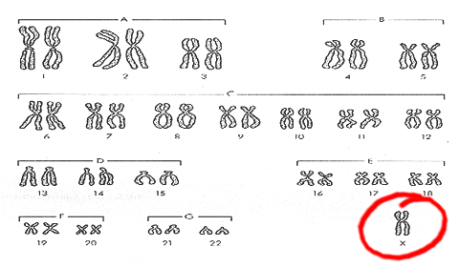
3- Turner’s syndrome, a monosomy female (X0),
Occurs once in every 5000 births, produces phenotypic, but immature females.
Turner syndrome is associated with underdeveloped ovaries, short stature.
Bull neck, and broad chest. Individuals are sterile, and lack expected secondary sexual characteristics.
Mental retardation typically not evident.
Chromosomal or monogenic?

Slide 14
B)- Chromosomal structure-alterations
It can also cause human disorders.
Deletions, even in a heterozygous state, cause severe physical and mental problems.
Cri-du-chat results from a specific deletion in chromosome 5.
- Is due to a missing part of chromosome 5
  These individuals are mentally retarded, have a small head with unusual facial features, and a cry like the mewing of a distressed cat.
  This syndrome is fatal in infancy or early childhood.

Slide 15
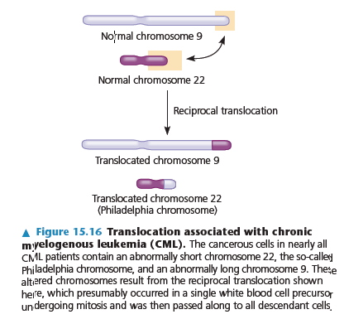
Myelogenous, [leukemia (CML)].
Caused by chromosomal translocations since a fragment of chromosome 22 switches places with a small fragment from the tip of chromosome 9.

Slide 16
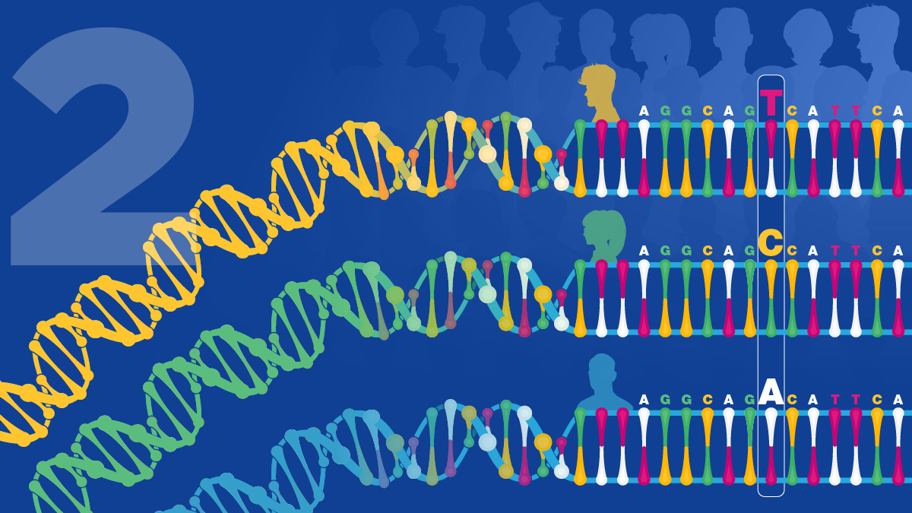
THANK YOU ……

