Slide 1
COMPARING VARIABLES OF ORDINAL OR DICHOTOMOUS SCALES:
SPEARMAN RANK- ORDER, POINT-BISERIAL, AND BISERIAL CORRELATIONS

Slide 2
OBJECTIVE
In this lecture, you will learn the following items:
How to compute the Spearman rank-order correlation coefficient.
How to compute the point-biserial correlation coefficient.

Slide 3
  INTRODUCTION
The statistical procedures in this chapter are quite different from those in the last several chapters. Unlike this chapter, we had compared samples of data. This lecture, however, examines the relationship between two variables.
In other words, this lecture will address how one variable changes with respect to another.

Slide 4
The relationship between two variables can be compared with a correlation analysis. If any of the variables are ordinal or dichotomous, we can use a nonparametric correlation.
The Spearman rank-order correlation, also called the Spearman’s ρ, is used to compare the relationship between ordinal, or rank-ordered, variables.
The point-biserial and biserial correlations are used to compare the relationship between two variables if one of the variables is dichotomous. The parametric equivalent to these correlations is the Pearson product-moment correlation.

Slide 5
In this lecture, we will describe how to perform and interpret a Spearman rank-order, point-biserial, and biserial correlations.

Slide 6
  THE CORRELATION COEFFICIENT
When comparing two variables, we use an obtained value called a correlation coefficient. A population’s correlation coefficient is represented by the Greek letter rho, ρ. A sample’s correlation coefficient is represented by the letter r.
We will describe two types of relationships between variables. A direct relationship is a positive correlation with an obtained value ranging from 0 to 1.0.

Slide 7
As one variable increases, the other variable also increases. An indirect, or inverse, relationship is a negative correlation with an obtained value ranging from 0 to −1.0. In this case, one variable increases as the other variable decreases.
In general, a significant correlation coefficient also communicates the relative strength of a relationship between the two variables. A value close to 1.0 or −1.0 indicates a nearly perfect relationship, while a value close to 0 indicates an especially weak or trivial relationship. A more detailed description of a correlation coefficient’s relative strength is presented.

Slide 8
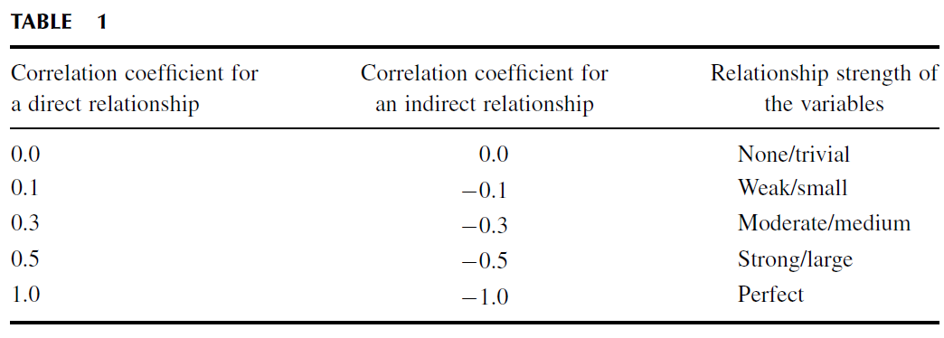
Table 1 summarizes his findings.

Slide 9
There are three important caveats to consider when assigning relative strength to correlation coefficients, however.
First, Cohen’s work was largely based on behavioral science research. Therefore, these values may be inappropriate in fields such as engineering or the natural sciences.
Second, the correlation strength assignments vary for different types of statistical tests.
Third, r-values are not based on a linear scale. For example, r = 0.6 is not twice as strong as r = 0.3.

Slide 10
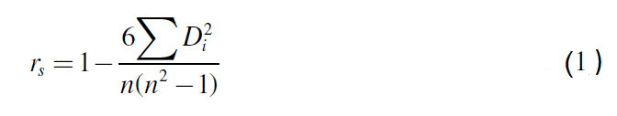
  COMPUTING THE SPEARMAN RANK-ORDER CORRELATION COEFFICIENT
The Spearman rank-order correlation is a statistical procedure that is designed to measure the relationship between two variables on an ordinal scale of measurement if the sample size is n ≥ 4. Use Formula 1 to determine a Spearman rank-order correlation coefficient r_{s} if none of the ranked values are ties. Sometimes, the symbol r_{s} is represented by the Greek symbol rho, or ρ:
where n is the number of rank pairs and D_{i} is the difference between a ranked pair.

Slide 11
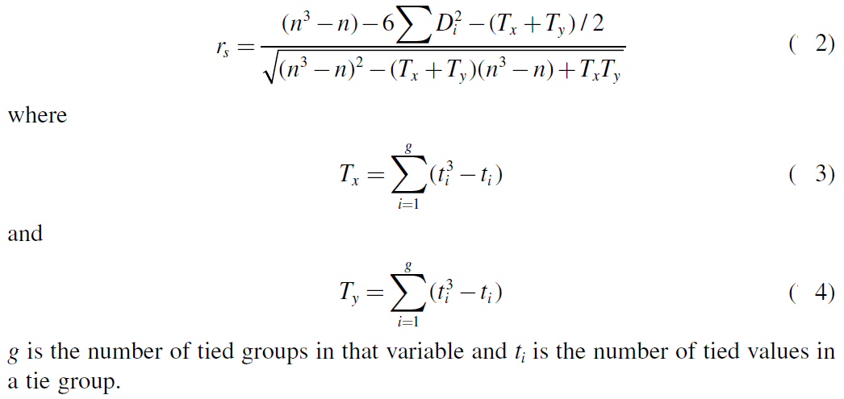
If ties are present in the values, use Formula 2, Formula 3, and Formula 4 to determine r_{s}:
If there are no ties in a variable, then T = 0.

Slide 12
Use Formula 5 to determine the degrees of freedom for the correlation:
df = n − 2 (5)
where n is the number of paired values.

Slide 13
After r_{s} is determined, it must be examined for significance. Small samples allow one to reference a table of critical values, such as (Table B.7).
However, if the sample size n exceeds those available from the table, then a large sample approximation may be performed.

Slide 14
Example
Spearman Rank-Order Correlation (Small Data Samples without Ties)
Eight men were involved in a study to examine the resting heart rate regarding frequency of visits to the gym. The assumption is that the person who visits the gym more frequently for a workout will have a slower heart rate.
Table 2 shows the number of visits each participant made to the gym during the month the study was conducted. It also provides the mean heart rate measured at the end of the week during the final 3 weeks of the month.

Slide 15
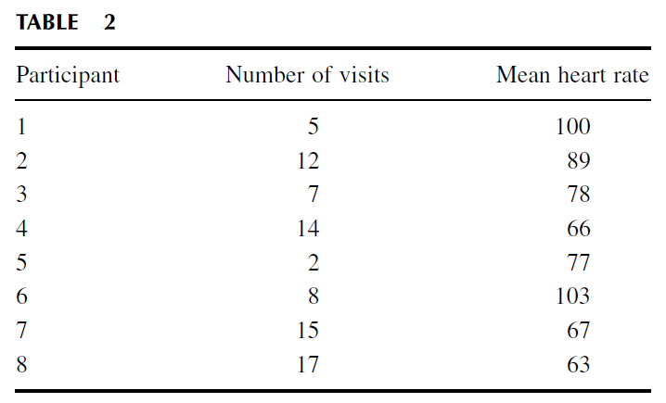

Slide 16
The values in this study do not possess characteristics of a strong interval scale.
For instance, the number of visits to the gym does not necessarily communicate duration and intensity of physical activity. In addition, heart rate has several factors that can result in differences from one person to another. Ordinal measures offer a clearer relationship to compare these values from one individual to the next.
Therefore, we will convert these values to ranks and use a Spearman rank-order correlation.

Slide 17
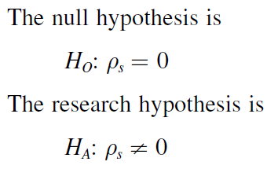
1. State the Null and Research Hypothesis
The null hypothesis states that there is no correlation between number of visits to the gym in a month and mean resting heart rate. The research hypothesis states that there is a correlation between the number of visits to the gym and the mean resting heart rate.

Slide 18
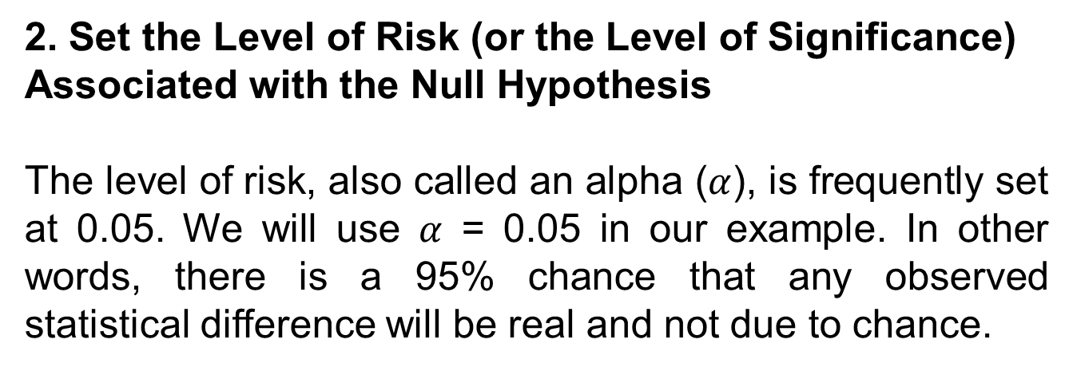

Slide 19
3. Choose the Appropriate Test Statistic
As stated earlier, we decided to analyze the variables using an ordinal, or rank, procedure. Therefore, we will convert the values in each variable to ordinal data. In addition, we will be comparing the two variables, the number of visits to the gym in a month and the mean resting heart rate. Since we are comparing two variables in which one or both are measured on an ordinal scale, we will use the Spearman rank-order correlation.

Slide 20
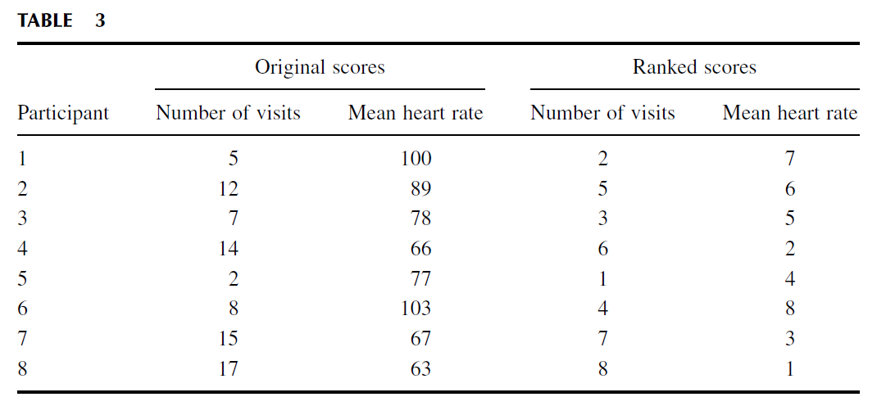
4. Compute the Test Statistic
First, rank the scores for each variable separately as shown in Table 3. Rank them from the lowest score to the highest score to form an ordinal distribution for each variable.

Slide 21
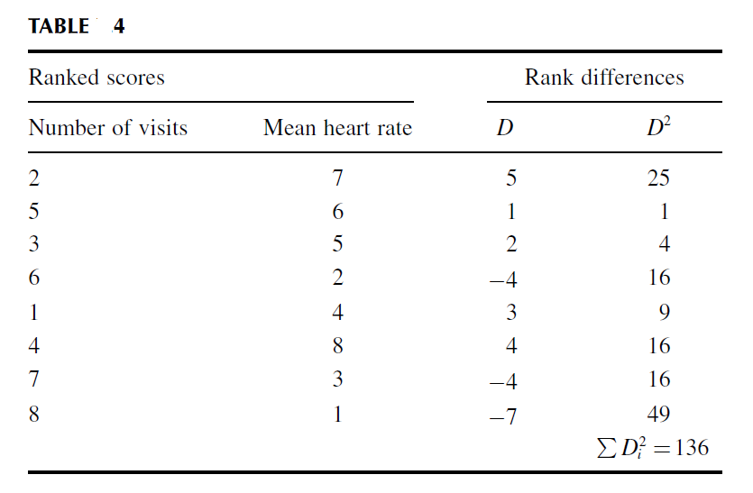
To calculate the Spearman rank-order correlation coefficient, we need to calculate the differences between rank pairs and their subsequent squares where D = rank (mean heart rate) − rank (number of visits).
It is helpful to organize the data to manage the summation in the formula (Table 4).

Slide 22
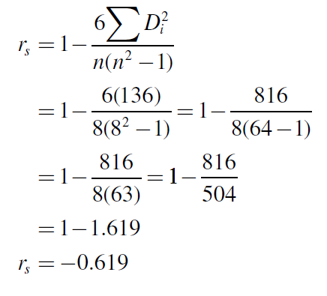
Next, compute the Spearman rank-order correlation coefficient:

Slide 23
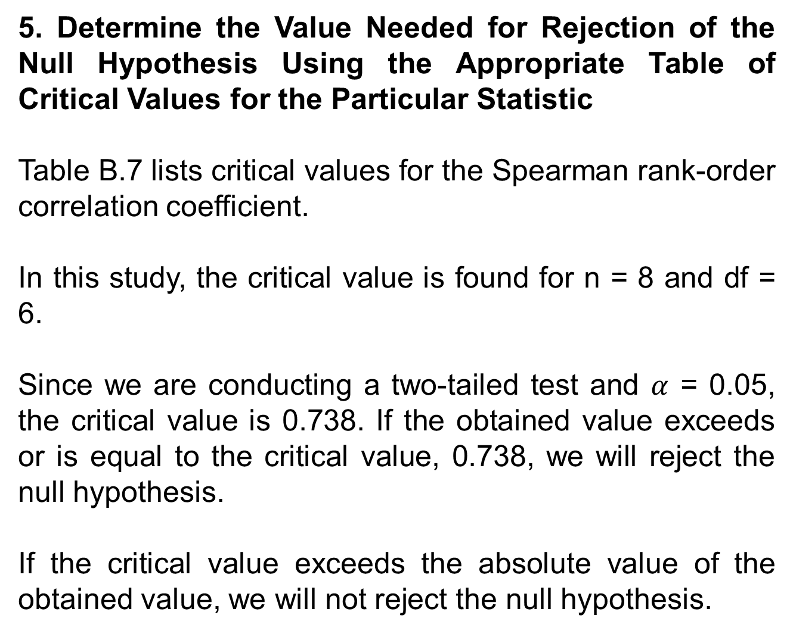

Slide 24
6. Compare the Obtained Value with the Critical Value
The critical value for rejecting the null hypothesis is 0.738 and the obtained value is |r_{s}| = 0.619.
If the critical value is less than or equal to the obtained value, we must reject the null hypothesis. If instead, the critical value is greater than the obtained value, we must not reject the null hypothesis. Since the critical value exceeds the absolute value of the obtained value, we do not reject the null hypothesis.

Slide 25
7. Interpret the Results
We did not reject the null hypothesis, suggesting that there is no significant correlation between the number of visits the males made to the gym in a month and their mean resting heart rates.

Slide 26
8. Reporting the Results
The reporting of results for the Spearman rank order correlation should include such information as the number of participants (n), two variables that are being correlated, correlation coefficient (r_{s}), degrees of freedom (df), and p-value’s relation to .
For this example, eight men (n = 8) were observed for 1 month. Their number of visits to the gym was documented (variable 1) and their mean resting heart rate was recorded during the last 3 weeks of the month (variable 2). These data were put in ordinal form for purposes of the analysis. The Spearman rank-order correlation coefficient was not significant (r_{s(6)} = −0.619, p > 0.05). Based on this data, we can state that there is no clear relationship between adult male resting heart rate and the frequency of visits to the gym.

Slide 27
Example:
Sample Spearman Rank-Order Correlation
(Small Data Samples with Ties)
The researcher repeated the experiment in the previous example using females. Table 5 shows the number of visits each participant made to the gym during the month
of the study and their subsequent mean heart rates.

Slide 28
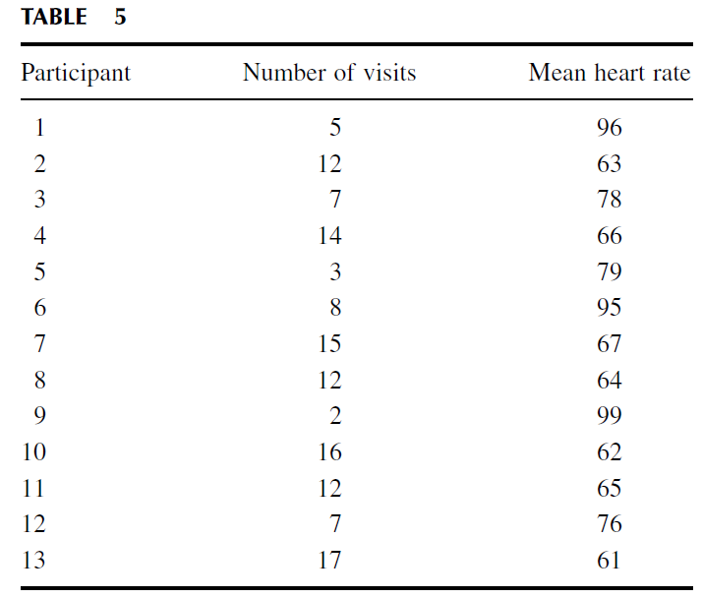

Slide 29
As with the previous example, the values in this study do not possess characteristics of a strong interval scale, so we will use ordinal measures.
We will convert these values to ranks and use a Spearman rank-order correlation.
Steps 1–3 are the same as the previous example. Therefore, we will begin with step 4.

Slide 30
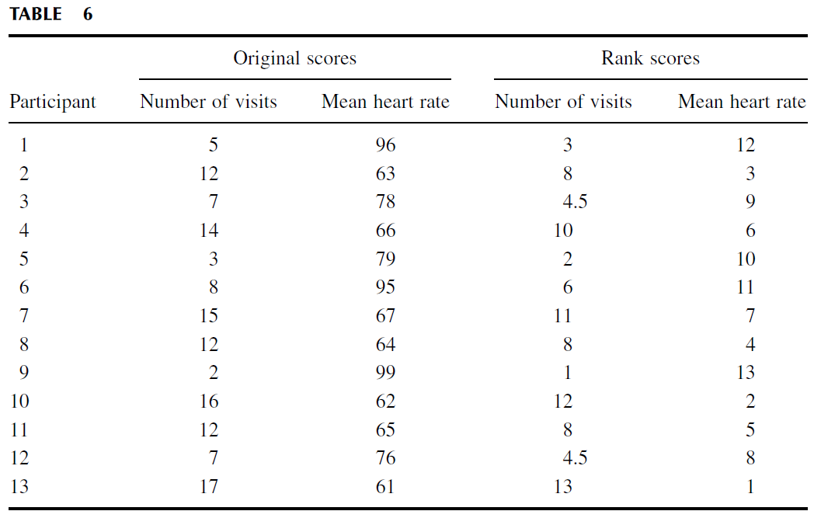
4. Compute the Test Statistic
First, rank the scores for each variable as shown in Table 6. Rank the scores from the lowest score to the highest score to form an ordinal distribution for each variable.

Slide 31
To calculate the Spearman rank-order correlation coefficient, we need to calculate the differences between rank pairs and their subsequent squares where D = rank (mean heart rate) − rank (number of visits). It is helpful to organize the data to manage the summation in the formula (Table 7).

Slide 32
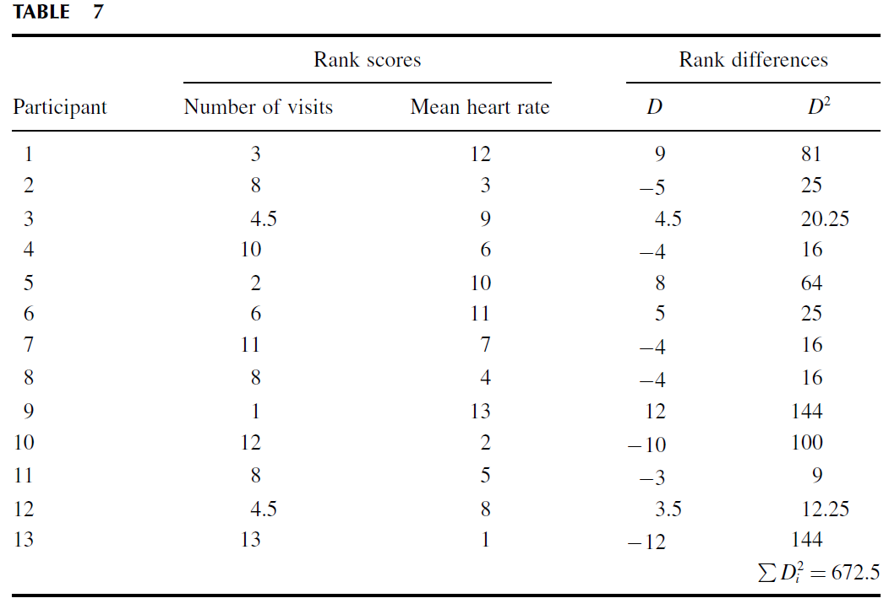

Slide 33
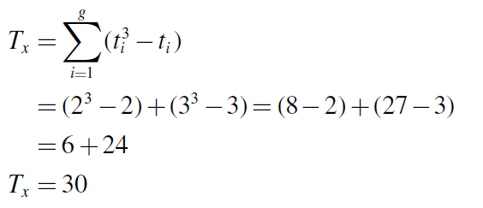
Next, compute the Spearman rank-order correlation coefficient.
Since there are ties present in the ranks, we will use formulas that account for the ties. First, use Formula 3 and Formula 4. For the number of visits, there are two groups of ties.
The first group has two tied values (rank = 4.5 and t = 2) and the second group has
three tied values (rank = 8 and t = 3):

Slide 34
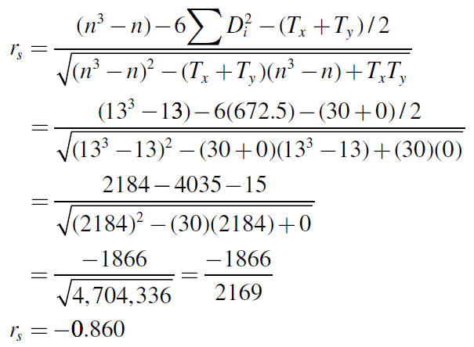
For the mean resting heart rate, there are no ties. Therefore, Ty = 0.
Now, calculate the Spearman rank-order correlation coefficient using Formula 2:

Slide 35
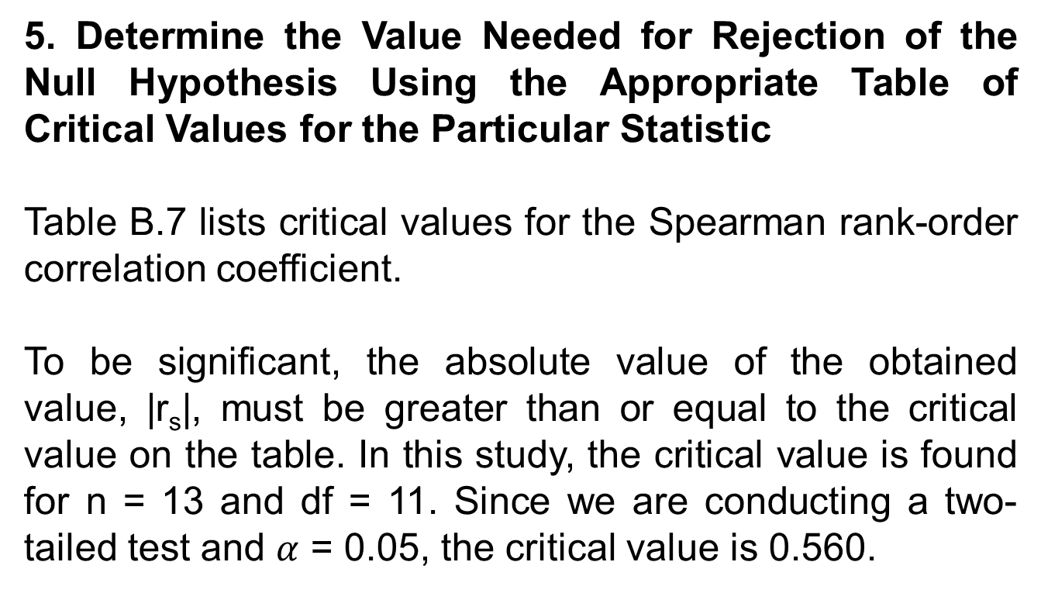

Slide 36
6. Compare the Obtained Value with the Critical Value
The critical value for rejecting the null hypothesis is 0.560 and the obtained value is |r_{s}| = 0.860.
If the critical value is less than or equal to the obtained value, we must reject the null hypothesis. If instead, the critical value is greater than the obtained value, we must not reject the null hypothesis. Since the critical value is less than the absolute value of the obtained value, we reject the null hypothesis.

Slide 37
7. Interpret the Results
We rejected the null hypothesis, suggesting that there is a significant correlation between the number of visits the females made to the gym in a month and their mean resting heart rates.

Slide 38
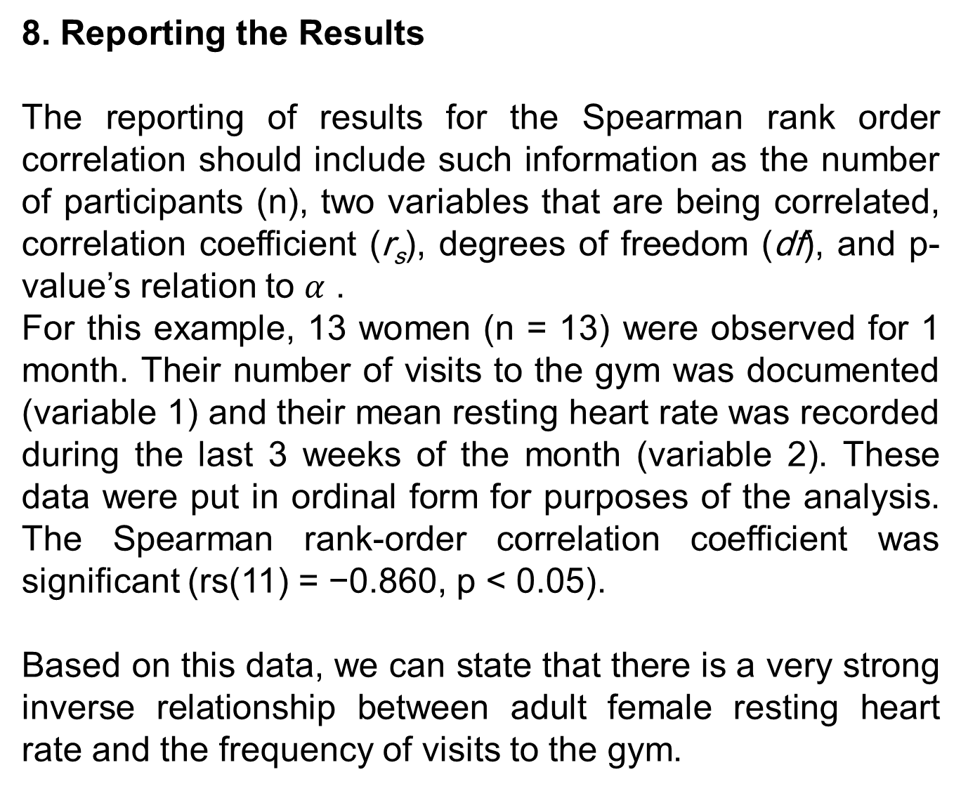

Slide 39
COMPUTING THE POINT-BISERIAL AND BISERIAL CORRELATION COEFFICIENTS
The point-biserial and biserial correlations are statistical procedures for use with dichotomous variables. A dichotomous variable is simply a measure of two conditions.
A dichotomous variable is either discrete or continuous. A discrete dichotomous variable has no particular order and might include such examples as gender (male vs. female) or a coin toss (heads vs. tails). A continuous dichotomous variable has some type of order to the two conditions and might include measurements such as pass/fail or young/old. Finally, since the point-biserial and biserial correlations each involves an interval scale analysis, they are special cases of the Pearson product-moment correlation.

Slide 40

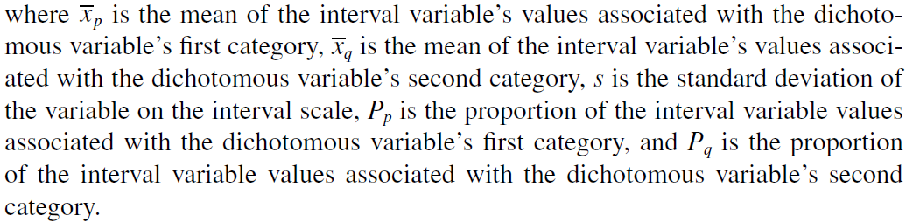
Correlation of a Dichotomous Variable and an Interval
Scale Variable
The point-biserial correlation is a statistical procedure to measure the relationship between a discrete dichotomous variable and an interval scale variable. Use Formula 8 to determine the point-biserial correlation coefficient r_{pb}:

Slide 41
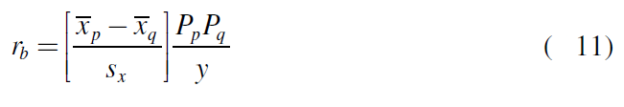
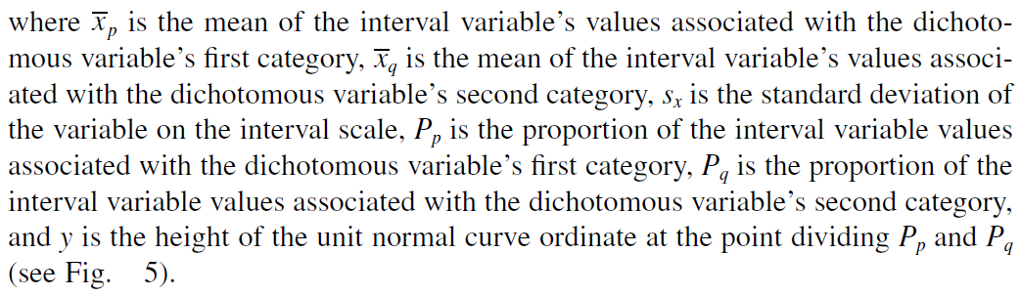
The biserial correlation is a statistical procedure to measure the relationship between a continuous dichotomous variable and an interval scale variable. Use Formula 11 to determine the biserial correlation coefficient r_{b}:

Slide 42
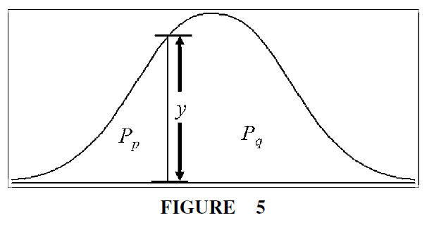

Slide 43
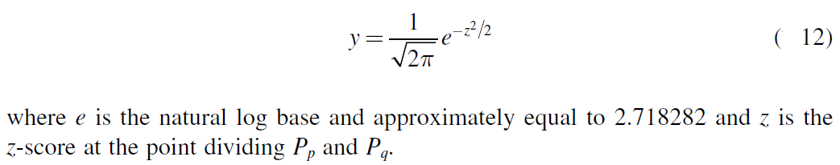
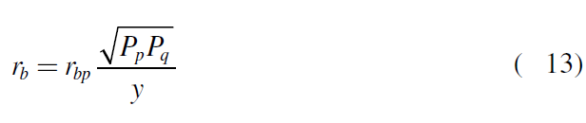
You may use Table B.1 or Formula 2 to find the height of
the unit normal curve ordinate, y:
Formula 13 is the relationship between the point-biserial and the biserial correlation coefficients:

Slide 44
After the correlation coefficient is determined, it must be examined for significance.
Small samples allow one to reference a table of critical values, such as Table B.8.
However, if the sample size n exceeds those available from the table, then a large sample approximation may be performed.

Slide 45
Correlation of a Dichotomous Variable and
a Rank-Order Variable
As explained earlier, the point-biserial and biserial correlation procedures earlier involve a dichotomous variable and an interval scale variable. If the correlation was a dichotomous variable and a rank-order variable, a slightly different approach is needed.
To find the point-biserial correlation coefficient for a discrete dichotomous variable and a rank-order variable, simply use the Spearman rank-order described earlier and assign arbitrary values to the dichotomous variable such as 0 and 1.
To find the biserial correlation coefficient for a continuous dichotomous variable and a rank-order variable, use the same procedure and then apply Formula 13 given earlier.

Slide 46
Example
Point-Biserial Correlation (Small Data Samples)
A researcher in a psychological lab investigated gender differences. She wished to compare male and female ability to recognize and remember visual details. She used
17 participants (8 males and 9 females) who were initially unaware of the actual experiment.
First, she placed each one of them alone in a room with various objects and asked them to wait. After 10 min, she asked each of the participants to complete a 30 question posttest relating to several details in the room.
Table 8 shows the participants’ genders and posttest scores.

Slide 47
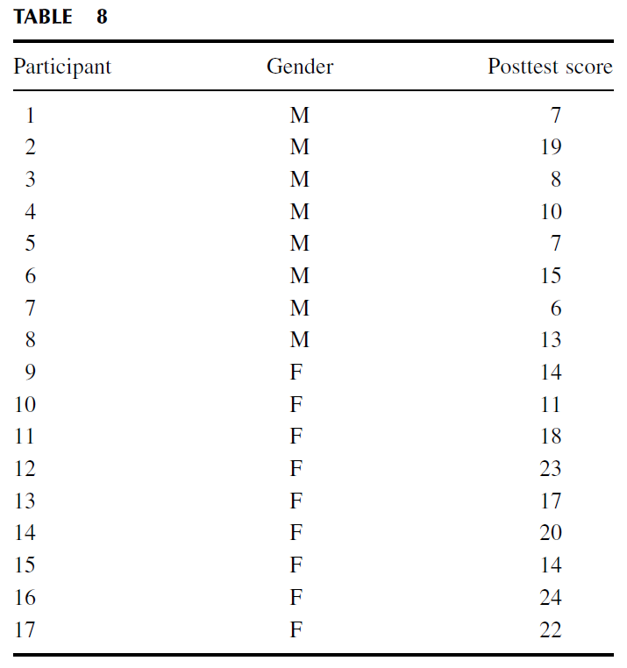

Slide 48
The researcher wishes to determine if a relationship exists between the two variables and the relative strength of the relationship.
Gender is a discrete dichotomous variable and visual detail recognition is an interval scale variable. Therefore, we will use a point-biserial correlation.

Slide 49
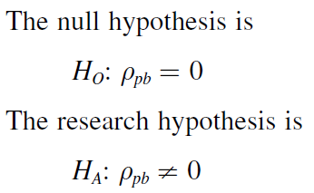
1. State the Null and Research Hypothesis
The null hypothesis states that there is no correlation between gender and visual detail recognition. The research hypothesis states that there is a correlation between gender and visual detail recognition.

Slide 50
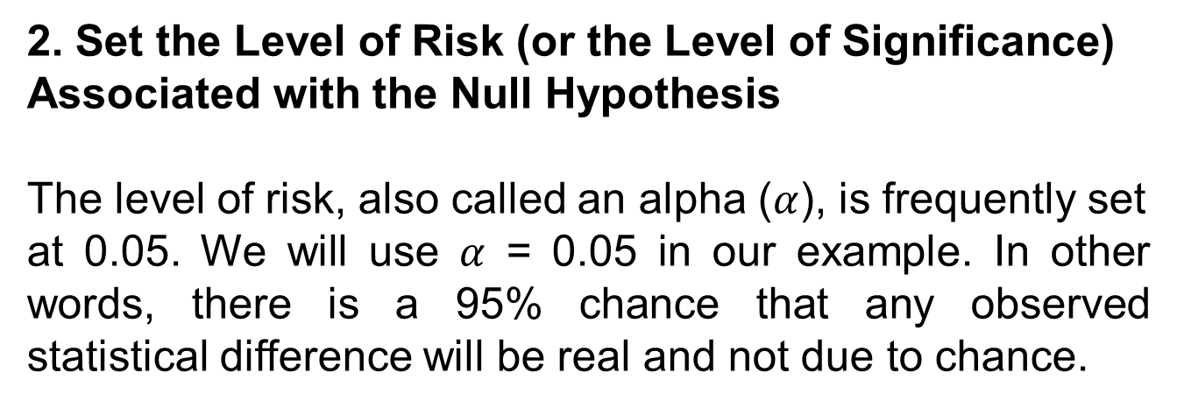

Slide 51
3. Choose the Appropriate Test Statistic
As stated earlier, we decided to analyze the relationship between the two variables. A correlation will provide the relative strength of the relationship between the two variables. Gender is a discrete dichotomous variable and visual detail recognition is an interval scale variable.
Therefore, we will use a point-biserial correlation.

Slide 52
4. Compute the Test Statistic
First, compute the standard deviation of all values from the interval scale data. It is helpful to organize the data as shown in Table 9.

Slide 53
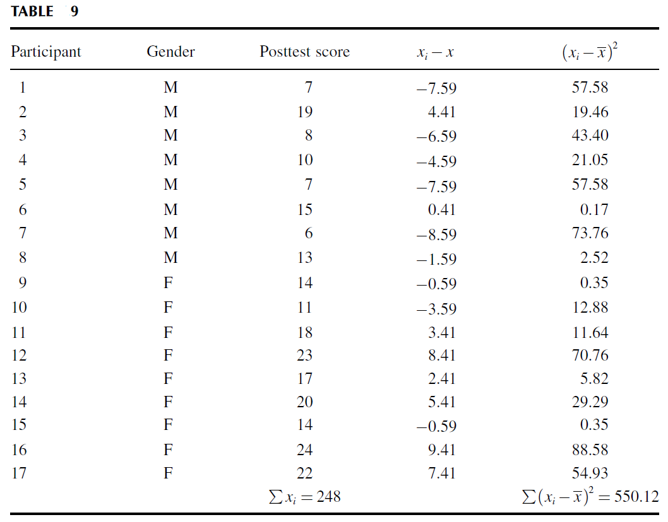

Slide 54
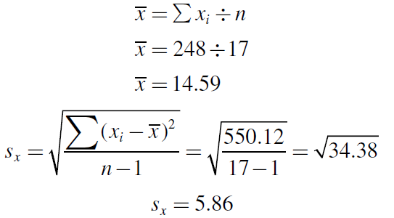
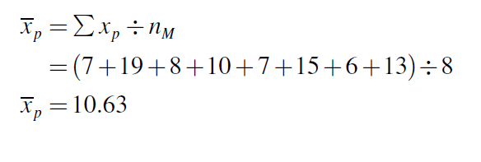
Using the summations from Table 9, calculate the mean and the standard deviation for the interval data:
Next, compute the means and proportions of the values associated with each item from the dichotomous variable. The mean males’ posttest score was

Slide 55
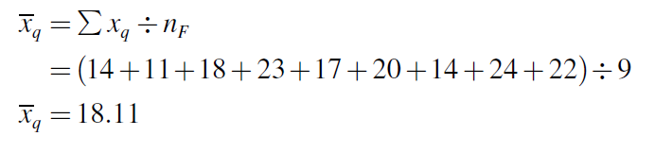
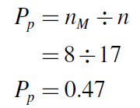
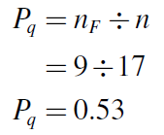
The mean females’ posttest score was
The males’ proportion was
The females’ proportion was

Slide 56
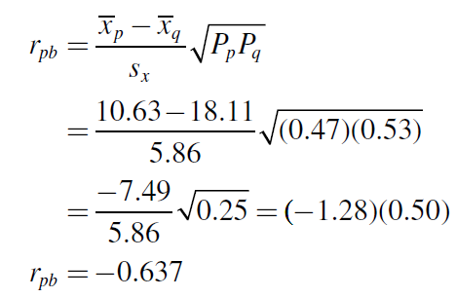

Now, compute the point-biserial correlation coefficient using the values computed earlier:
The sign on the correlation coefficient is dependent on the order we managed our dichotomous variable. Since that was arbitrary, the sign is irrelevant. Therefore, we use the absolute value of the point-biserial correlation coefficient:

Slide 57
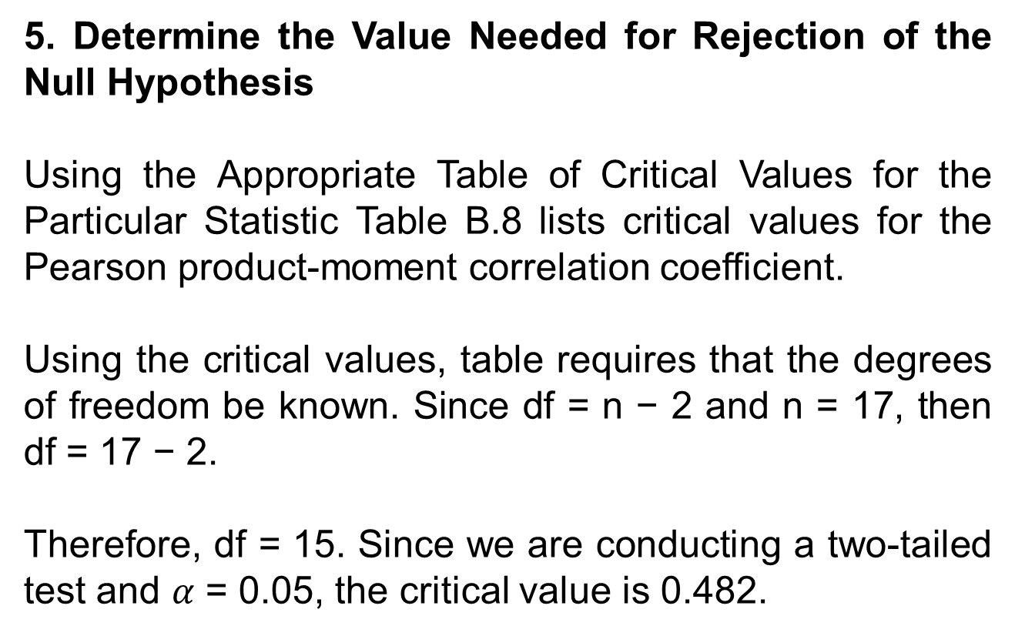

Slide 58
6. Compare the Obtained Value with the Critical Value
The critical value for rejecting the null hypothesis is 0.482 and the obtained value is |r_{pb}| = 0.637.
If the critical value is less than or equal to the obtained value, we must reject the null hypothesis. If instead, the critical value is greater than the obtained value, we must not reject the null hypothesis. Since the critical value is less than the absolute value of the obtained value, we reject the null hypothesis.

Slide 59
7. Interpret the Results
We rejected the null hypothesis, suggesting that there is a significant and moderately strong correlation between gender and visual detail recognition.

Slide 60
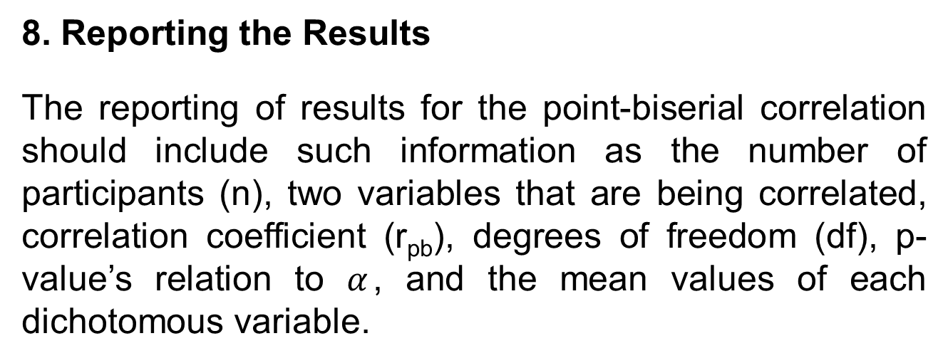
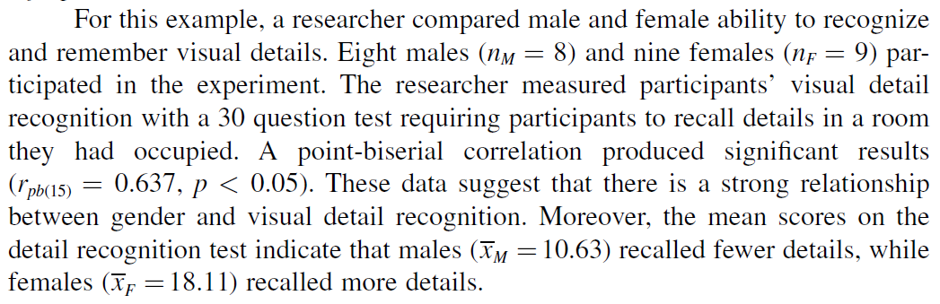

Slide 61
SUMMARY
The relationship between two variables can be compared with a correlation analysis.
If any of the variables are ordinal or dichotomous, a nonparametric correlation is useful. The Spearman rank-order correlation, also called the Spearman’s , is used
to compare the relationship involving ordinal, or rank-ordered, variables. The point biserial and biserial correlations are used to compare the relationship between two variables if one of the variables is dichotomous. The parametric equivalent to these correlations is the Pearson product-moment correlation.
In this lecture, we described how to perform and interpret a Spearman rank order, point-biserial, and biserial correlations.

