Slide 1
Liquid Mixtures
CLS 101: Chemistry for Nursing
Iman AlAjeyan

Slide 2
Mixtures
A mixture is a material system made up by two or more different substances which are mixed together but are not combined chemically.
The air is a mixture of gases, largely nitrogen, oxygen, and carbon dioxide, along with smaller percentages of other substances.

Slide 3
Liquid Mixture
There are 4 types:
Solutions
Suspensions
Colloids
Emulsions

Slide 4
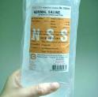
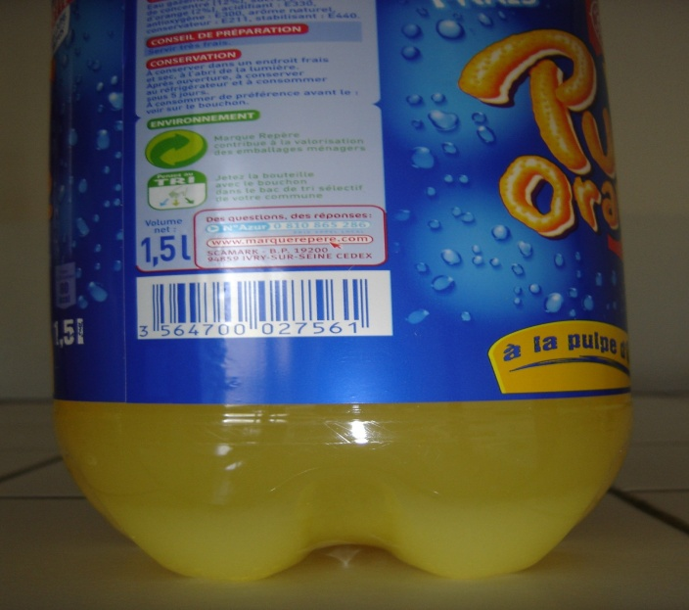
A homogeneous & A heterogeneous mixture
A homogeneous is a substance that is uniform in composition
A heterogeneous mixture of large solid substance in another substance made by mechanical agitation

Slide 5
Solutions
A solution is a homogeneous (A substance that is uniform in composition) mixture of one or more substances called solutes dissolved in another substance called the solvent.
The solute can be solid, liquid, or gas but the solvent is always a liquid. E.g. salt solution, sugar solution,...

Slide 6
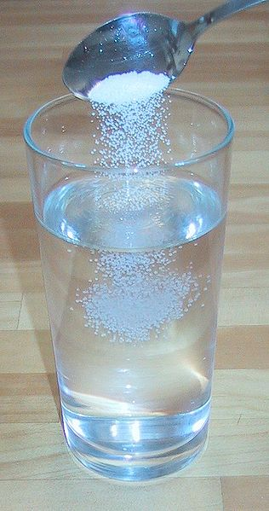
Solution
When the 2 substances totally mix it is called a solution
E.g. Solute + Solvent = Solution
) sugar) + (water) = Solution
We then say sugar is soluble in water, it has dissolved
An aqueous solution is one in which water is the solvent.

Slide 7
Properties of a Solution
Consists of a solute and a solvent.
Have variable composition.
Clear.
Homogenous.
Do not settle.
Can be separated by physical properties.
Can pass through filter paper.

Slide 8
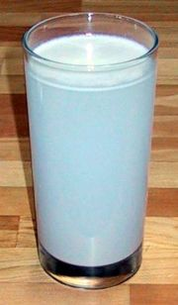
Suspensions
A suspension is a heterogeneous mixture of large solid substance in another substance made by mechanical agitation.
The substances distributed in the background material is not dissolved and will settle out unless the mixture is constantly shaken.

Slide 9
The size of the particles is great enough so they are visible to the naked eye.
The solute is always a solid substance but the solvent can be solid, liquid, or gas. E.g. mud in water, flour in water, some medicines, dust or water in air,...

Slide 10
Properties of a Suspension
Consists of a solid in a solvent.
Heterogeneous.
Not clear.
Settle.
Do not pass through filter paper or membranes.

Slide 11
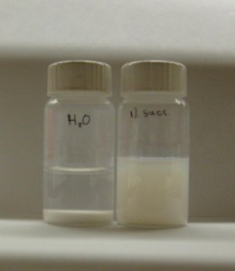
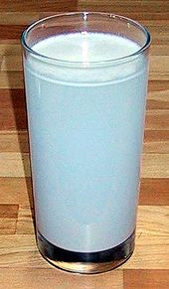
Examples of Suspensions

Slide 12
Colloids
Is a homogeneous solution with intermediate particle size between a solution and a suspension.
The solute can be solid, liquid, or gas substance AND the solvent can also be solid, liquid, or gas. E.g. Foam (Whipped cream), Gel (jelly), smoke, blood,...

Slide 13
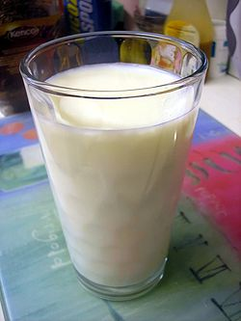
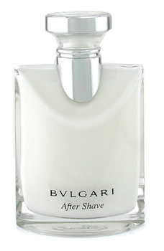
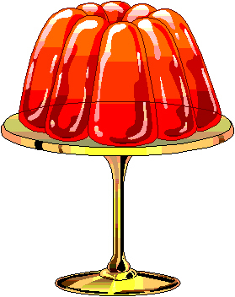
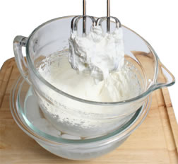
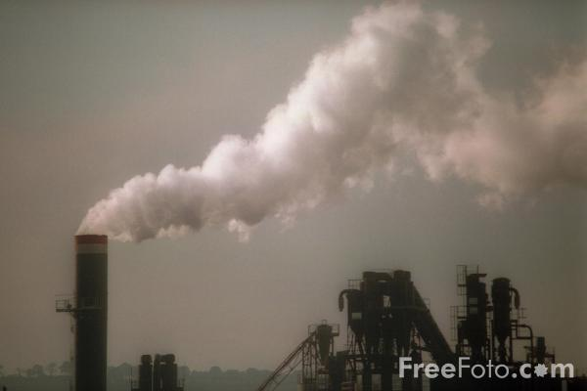
Examples of Colloids

Slide 14
Examples of Colloids
SOLID | LIQUID | GAS
Solid Aerosol E.g.: smoke, cloud, air particulates. | Liquid Aerosol E.g.: fog, mist, hair sprays | NON | GAS
Sol E.g.: pigmented ink, Blood | Emulsion E.g.: milk, mayonnaise, hand cream | Foam E.g.: whipped cream, shaving cream. | LIQUID
Solid sol Example: Certain alloys | Gel E.g.: agar, gelatin, jelly. | Solid Foam E.g.: Marshmallow, pumice | SOLID

Slide 15
Properties of a Colloid
Can be homogenous.
Do not settle.
Pass through filter paper but NOT membranes.

Slide 16
Emulsions
Emulsion is a mixture consists of two or more liquids that do not mix.
There are two kinds of emulsions. An emulsion that settles is called temporary emulsion. An emulsion that doesn’t is called permanent emulsion.
E.g. oil and vinegar.

Slide 17
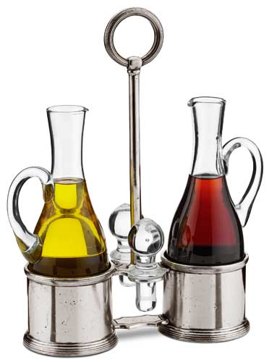
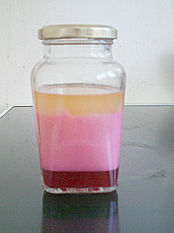
Examples of Emulsions

Slide 18
Any Question?

