Slide 1
ARCH 435
PROJECT MANAGEMENT
Lecture 3: Project Time Planning
Gantt (Bar) Chart Technique

Slide 2
Definition of Planning
Planning is the process of thinking systematically about the future in order to decide
  what our goals are, and
  how we are going to achieve them.
Planning means looking ahead, making preparations, and deciding the best course of action.

Slide 3
Dimensions of Planning
Planning can be viewed from following points:
Subject:- Financial Planning, Time Planning, Quality Planning, Organizational Planning, …….
Organization:- Corporate Planning, Project Planning,..Time:- Long-Range.Planning, Short-Range Planning, Weekly Planning, ….

Slide 4
Why is Time Planning necessary?
The increasing importance of timely completion.
The continuous complexity and growth in the size of the project generates the necessity for specialization. Specialization may lead to a breakdown of communications. Time planning must be found to facilitate communications.
Planning is essential for resource management and the efficient and maximum utilization of resources.
Planning is basis for evaluating progress, controlling the work and making decisions.

Slide 5
Why is Time Planning necessary?
For achieving an increase in production.
Financiers require a workable plan.
Essential in projects when their is transfer of personnel.
Minimum risk of the problems occurring.

Slide 6
Who Needs Time Planning?
Customer/ Client/ Owner
Designer/ Consultant
Project management team (Manager, Engineers)
Cost estimating department
Planning and controlling department
Supervisors, foremen, labors
Supplier
Financiers

Slide 7
Processes of Time Planning
Visualize and define the activities.
Sequence the activities (Job Logic).
Estimate the activity duration.
Schedule the project or phase.
Allocate and balance resources.
Compare target, planned and actual dates and update as necessary.
Control the time schedule with respect to changes.

Slide 8
Visualize and define the activities
An activity is a single work step (element) that has a recognizable beginning and end and requires time for its accomplishment. Activity definition involves identifying and documenting the specific activities that must be performed to produce the deliverables and sub-deliverables.
The technique of decomposition (Work Breakdown) may be used in defining activities. Decomposition involves subdividing project work packages into smaller, more manageable components to provide better management control.
The output from activity definition is the activity list.
The Level of detail of the plan should be considered in this phase

Slide 9
Visualize and define the activities
Case Study: Install a new machine
Activity Code | Activity Description | Depends on | Level | Duration (day)
 | Inspect the machine after installation
 | Hire the operator
 | Install the new machine
 | Inspect and store the machine after delivery
 | Hire labor to install the new machine
 | Train the operator
 | Order and deliver the new machine

Slide 10
Sequence the activities
Sequence the activities or job logic refers to identifying and documenting interactivity logical relationships, i.e. determined order in which the activities are to be accomplished in the project.
Job plan must reflect the practical restraints or limitations that apply to most job activities. The types of restraints are:
    Mandatory dependencies or hard logic (natural dependency),
    Preferred logic (Discretionary dependencies),
    External dependencies,
    Resource restraints and
    Safety restraints.
  Predecessor activities mean coming before, while successor activities mean coming after.
  Overlap the activities to reduce the project time.

Slide 11
Sequence the activities
Case Study: Install a new machine
Activity Code | Activity Description | Depends on | Level | Duration (day)
100 | Inspect the machine after installation | 300 | 4
200 | Hire the operator | None | 1
300 | Install the new machine | 500, 400 | 3
400 | Inspect and store the machine after delivery | 700 | 2
500 | Hire labor to install the new machine | None | 1
600 | Train the operator | 200, 300 | 4
700 | Order and deliver the new machine | None | 1

Slide 12
Estimate the activity duration
Select the time unit (week, day,..) to be used.
Use one of the following tools and techniques for estimating the activity duration:
  Expert judgment
  Quantitatively based durations
    Duration of activity (D)
    = Quantity of work / [Production rate of a crew or equipment * No. of crews].
    Where production rate = Quantity produced in unit of time
    Duration of activity (D)
    = Quantity of work * Unit rate productivity of a crew or equipment
    Where unit rate productivity = Time needs to produce one unit of output

Slide 13
Estimate the activity duration
Case Study: Install a new machine
Activity Code | Activity Description | Depends on | Level | Duration (day)
100 | Inspect the machine after installation | 300 | 4 | 1
200 | Hire the operator | None | 1 | 25
300 | Install the new machine | 500, 400 | 3 | 2
400 | Inspect and store the machine after delivery | 700 | 2 | 1
500 | Hire labor to install the new machine | None | 1 | 20
600 | Train the operator | 200, 300 | 4 | 3
700 | Order and deliver the new machine | None | 1 | 30

Slide 14
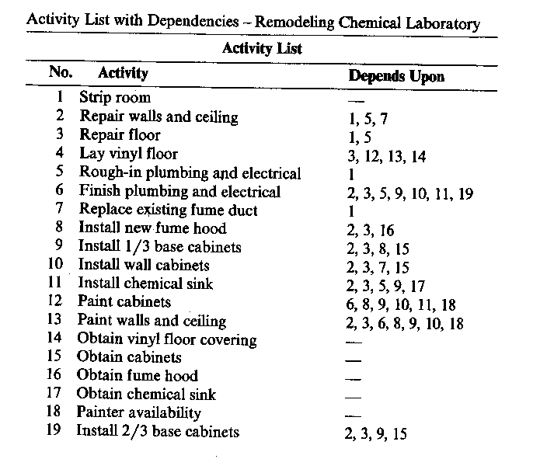
Removal of Redundant Dependencies

Slide 15
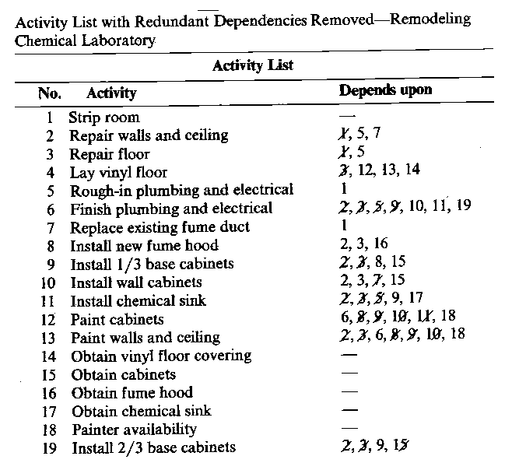
Removal of Redundant Dependencies (Cont.)

Slide 16
Schedule the Project or Phase
Scheduling is the determination of the project time and the timing of the activities comprising the project
In scheduling we consider the questions of:
  how long the project is expected to take, and
  when each activity may be scheduled (starts and ends)
  To schedule the project, the planner needs a Time Planning Technique.

Slide 17
Time Planning Techniques
Practically every project is sufficiently complex that its breakdown and its inner relationships must be recorded on paper or any other media, and not only in the head of the planner.
Therefore as a plan is formulated, some type of "paper model" of the project would be developed to communicate results of the plan to others and to serve as a base for evaluating progress and controlling the work.

Slide 18
Time Planning Techniques
Bar Charts and Linked Bar Charts;
Network Model (Analysis), either
  Activity on arrow,
  Activity on node,
  Precedence Diagram
  PERT (Program Evaluation and Review Technique)

Slide 19
BAR CHART
During World War 1, Henry Gantt developed the Bar chart planning technique.
A bar chart graphically describes a project consisting of well-defined activities, the completion of which marks its end.
An activity is a task whose performance contributes to completion of the overall project.

Slide 20
BAR CHART
All activities are listed in a column at the left side of the diagram.
A horizontal time scale extends to the right of the list.
A bar presenting each activity is drawn between its corresponding scheduled start and finish times.

Slide 21
Uses of Bar Chart Planning Technique
Showing the order of the different activities
Showing when operations should start and finish
Checking what labor or equipment are needed and when
Checking out delivery dates for materials
Explaining to everyone concerned what is due to happen and when
Forecasting cash flow
During execution, the chart used to control the work

Slide 22
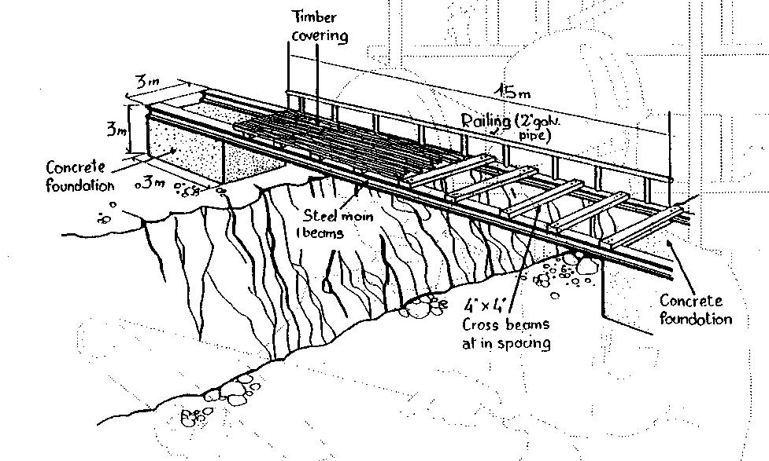
Case study

Slide 23
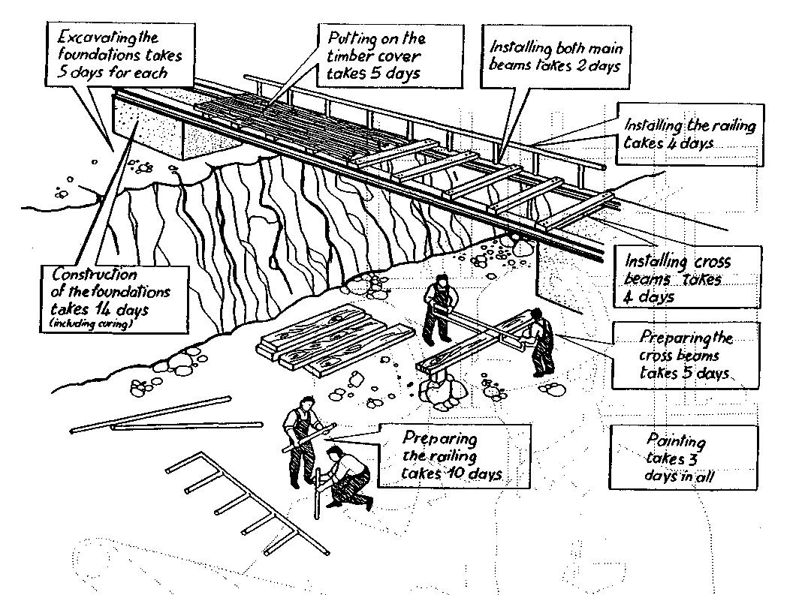
Case study

Slide 24
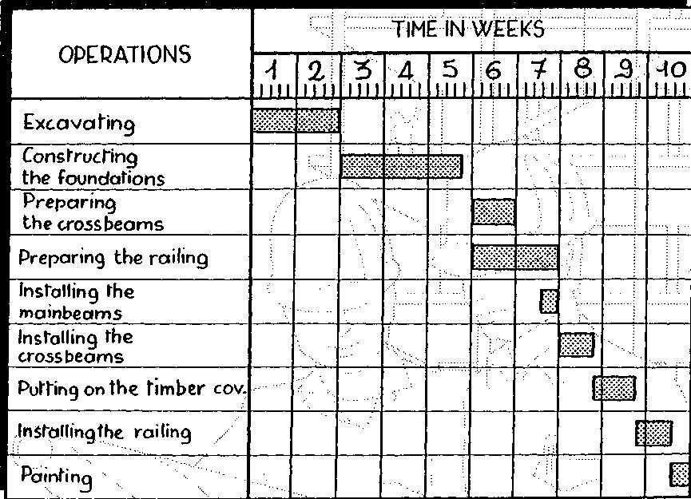
Preparing a Bar Chart

Slide 25
Gant Chart (Example)

Slide 26
Advantages of Bar Chart
Simple graphical form.
Easy understood for all levels of management.
Good form of communication.

Slide 27
Limitations of Bar Chart
Very cumbersome as the number of activities, increases
Logic is not expressed in the diagram
Difficult to use for forecasting the effects of changes, It is therefore limited as a control tool
No indication where management attention should be focused.
Ineffective for project shortening.

Slide 28
Logic is not represented in the Bar Chart

