Slide 1
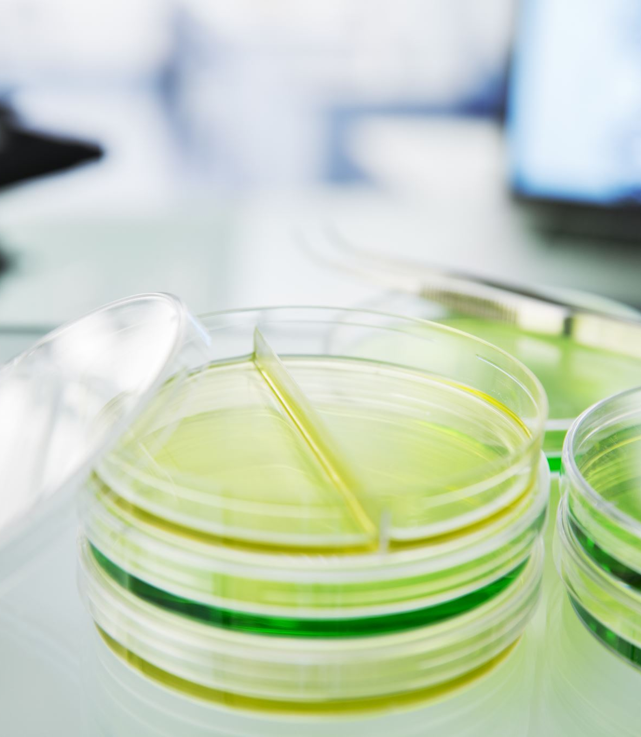
LAB 3 Medical Microbiology
240 MBIO
Dr. Amal Alghamdi
ahamdan1@ksu.edu.sa

Slide 2
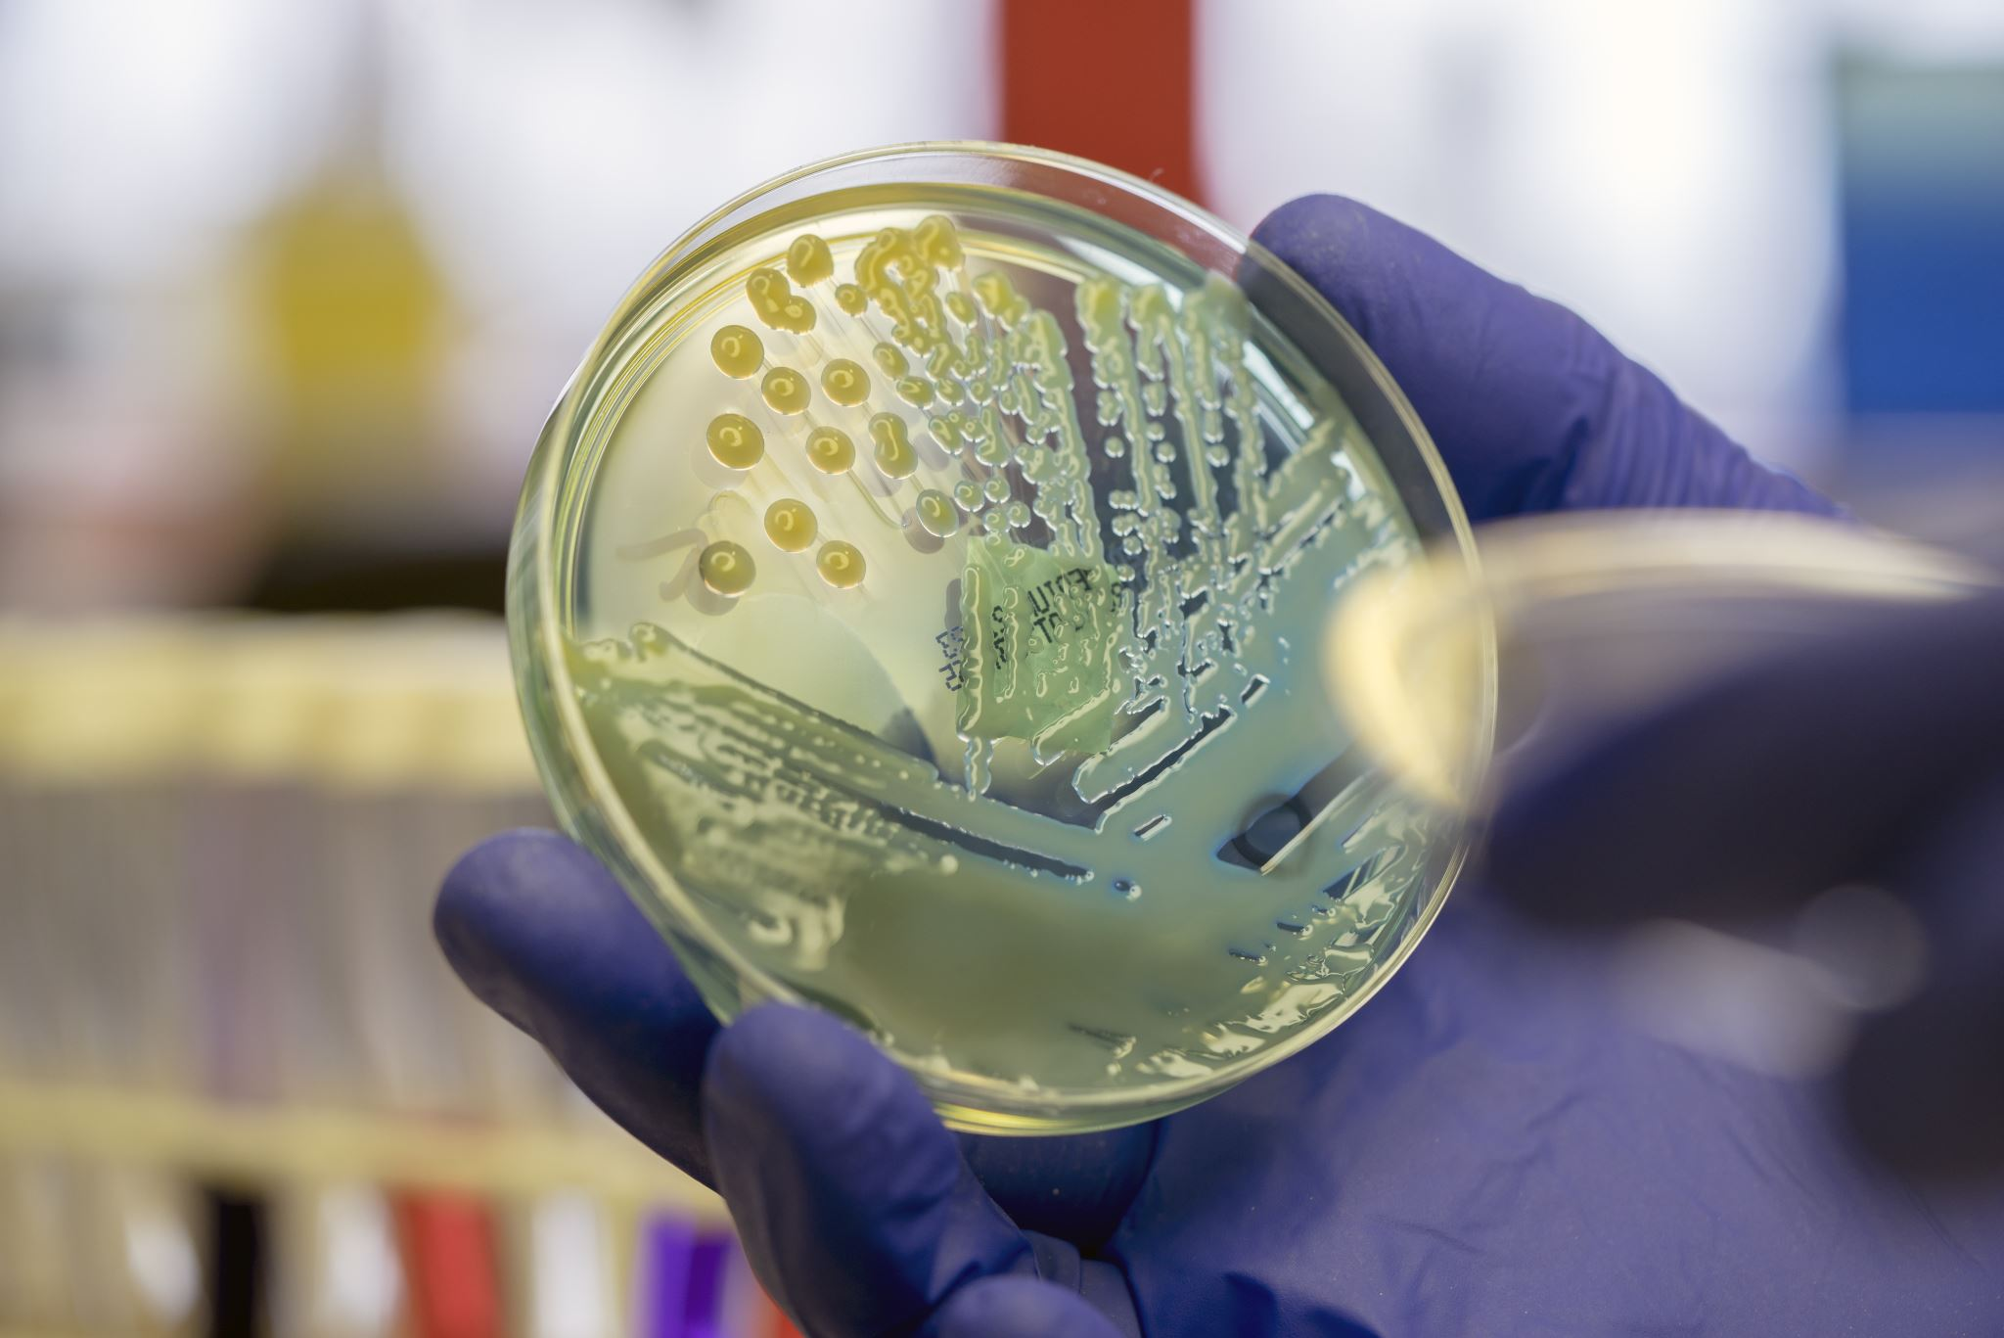
Medical Microbiology
Medical microbiology: It is a branch of both medicine and microbiology that deals with the study of microorganisms, including bacteria, viruses, fungi, and parasites, which are of medical importance and are capable of causing diseases in human beings.
Specimen Handling and Transport
The proper handling of specimens for microbiological analysis requires
Aseptic collection techniques: “No contamination”
Appropriate equipment
Good instructions to the patient.
The use of appropriate containers:
Use plastic containers and tubes

Slide 3
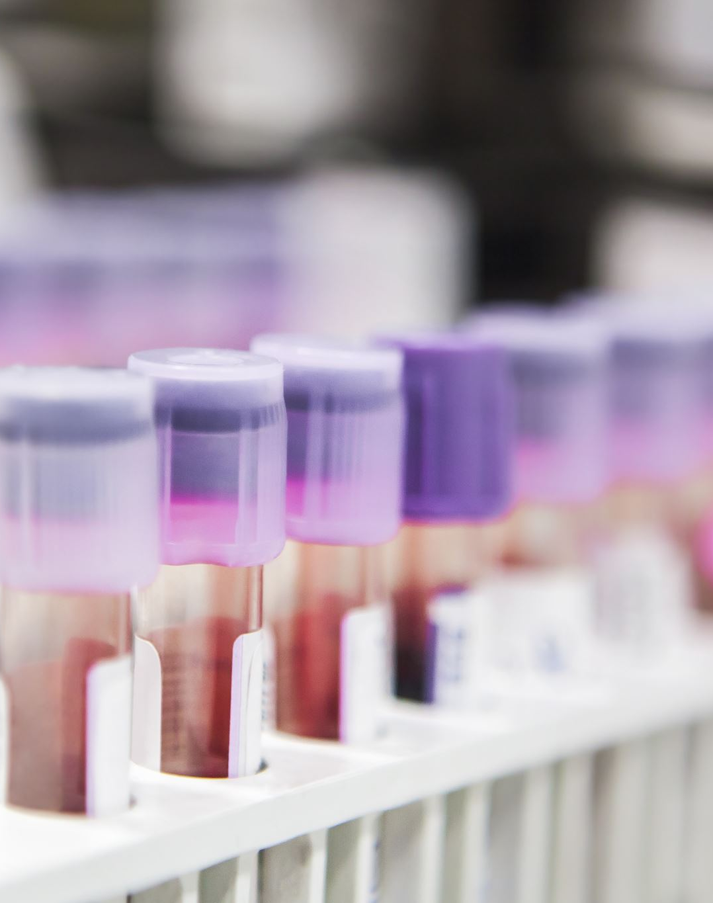
Suitable means for preservation:
The specimens that can be refrigerated in the laboratory- Citrated whole blood, urine, stool samples, and specimens of water, food, and milk.
The specimens that can be stored at room temperature- whole blood required for the serum, cough plates for Bordetella pertussis, and specimens for Neisseria gonorrhea and N. meningitides.
Entamoeba histolytica should be stored at body temperature (37ºC).
Preservatives like buffered glycerol-saline and ethylene diamine tetraacetic acid (EDTA) can be used in keeping fecal samples that are to be tested for enteric pathogens.

Slide 4
Use appropriate culture media
Sterile and Non-sterile Body Sites
Sterile body sites:
These sites usually do not contain any bacteria, so any bacteria found there are significant
Blood
Spinal fluid
Non-sterile body sites:
These sites are open to the external environment and typically contain bacteria
Throat
Feces

Slide 5
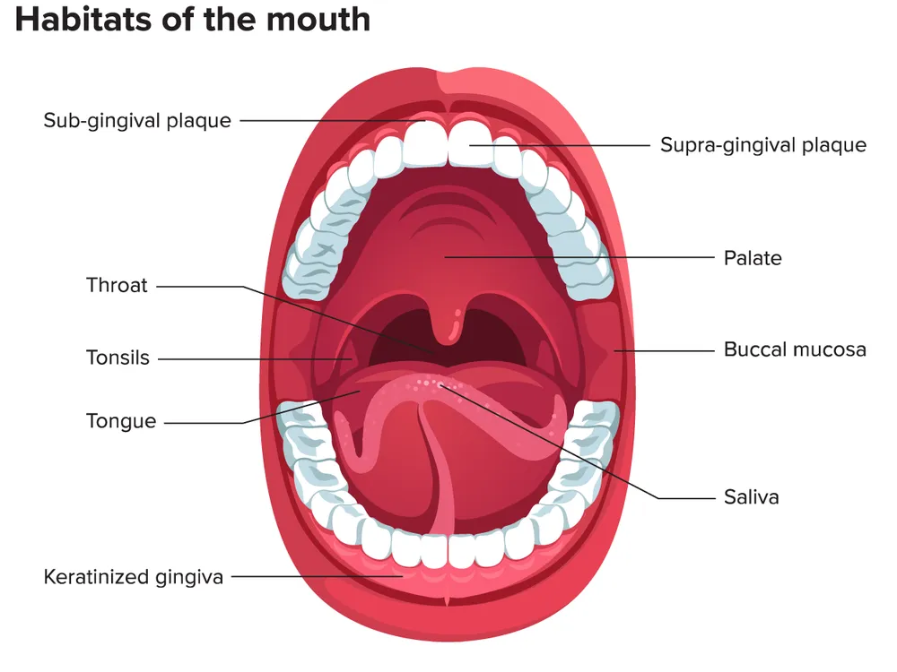
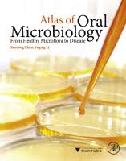
Indigenous flora:
Microorganisms usually are present in many regions of the body.
These populations represent the indigenous flora of the body.
These microorganisms of the body serve several valuable functions.
For example, the intestinal flora produces various vitamins and helps maintain the antibody synthetic system.
Microorganisms of the human body
Mouth Indigenous
Spirochetes
Streptococci
Small bacilli
Veillonella spp.
Micrococci

Slide 6
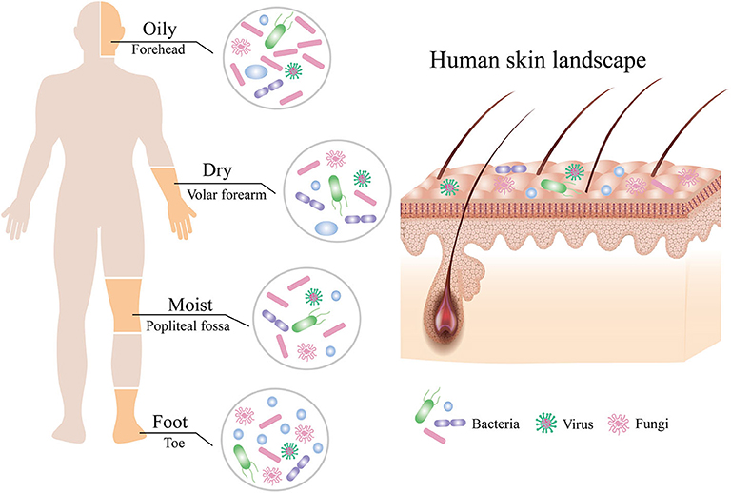
Skin
Aerobic or facultative anerobic Staphylococcus
Anaerobic Propionibacterium spp.

Slide 7
Gastrointestinal tract
E. coli
Proteus spp.
Bacteroides
Clostridium spp.
Fecal Streptococci
Lactobacilli
Protozoa

