Slide 1
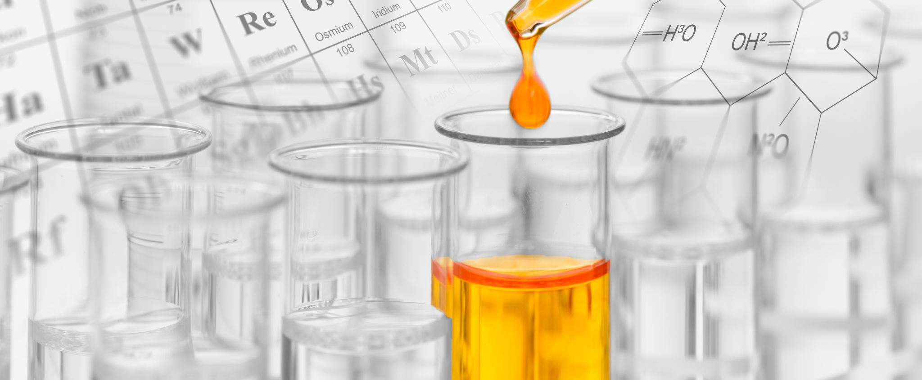
MBI 240
LABORATORY SKILLS
1st Semester 1446 AH
2024
Dr. Amal Alghamdi
ahamdan1@ksu.edu.sa

Slide 2
Dr. K. Perveen
MBI 240
Lab No. | Topic
1 | Microbiology lab organization, safety and management The microscopy techniques
2 | Sterilization techniques Microbiological culture media preparation
3 | Medical microbiology: Isolation of Normal Micro biota from the Human Body
4 | Pure culture techniques Morphology & growth: Bacterial & Fungal Characteristics
5 | Staining Techniques: Smear preparation & Gram staining
6 | Staining Techniques: Endospore staining
7 | Effects of physical factors on microorganisms
8 | Antibiotic production
9 | Effects of Chemical Agents on microorganisms
10 | Microbial enzymatic activity

Slide 3
Assessment task | Proportion of Final Assessment
First Mid-term Test | 15
Second Mid-term Test | 15
Lab Reports, Class performance /Evaluation H.W and assignments | 30
Final Exam | 40
TOTAL | 100
BOOKS
Harley−Prescott: Laboratory Exercises in Microbiology, Fifth Edition
© The McGraw−Hill Companies, 2002
Michael J.F and Pierce B.E.: Microbiology laboratory theory and application Second edition
L. Morton Publisher

Slide 4
LAB 1
Microbiology Laboratory, Organization and Management
A. Laboratory Safety Rules
Always wear a laboratory coat when working in the laboratory classroom.
Put nothing in mouth which may have come in contact with infectious material.
Eating and drinking in the laboratory are not permitted at any time.
Keep your workspace free of all unnecessary materials.
Never pipette by mouth. Use the safety pipetting devices which are provided.
Throw off used pipettes in the appropriate containers.
Any infectious material which may accidentally fall from pipettes to the laboratory bench or floor should be covered with a disinfectant and reported to any instructor immediately.
Any spilled or broken containers of culture material should be covered with a disinfectant and then inform instructor.

Slide 5
Replace caps on reagents, solution bottles, and bacterial cultures after use.
Do not open Petri dishes in the lab unless absolutely necessary.
Take care of the microscope.
Label everything clearly.
When finished for the day, dispose of all used glassware and cultures in the appropriate containers, clear workbench and wash the top with a disinfectant.
Make sure all burners are turned off at the end of the laboratory period.
Take off your gloves on when you leave the laboratory.
Wash hands thoroughly with soap and water before leaving the laboratory.
Familiarize yourself with the location of safety equipment in the laboratory.

Slide 6
Laboratory Safety Equipment
Eyewash and shower
Sinks
Fire Extinguisher
First Aid Kit
Emergency Gas Valve
Flammable – Any substance that will burn if exposed to an open flame
Explosive – A substance that may explode if exposed to heat or flame.
Toxic/Poison – A substance that can lead to death if inhaled, ingested, or absorbed by the skin.
Irritant - A substance that causes inflammation upon contact with skin or mucous membranes.
Environmental - Substances that are harmful to the environment. They must be disposed of properly, not washed down the drain.

Slide 7
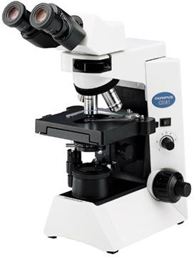
1b. Apparatus and Equipment
Microscope: Used to observ e very small organisms

Slide 8
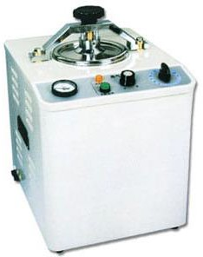
2. Autoclave: It is a wet air type sterilizer.
It is used to sterilize culture media, glassware etc.
Usually autoclave operates at 15 lb/sq. inch steam pressure (121.5 º C) for 15 min.

Slide 9
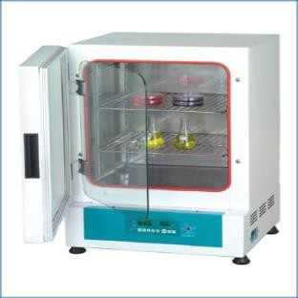
3. Incubator: Provide suitable temperature for the growth of organism.

Slide 10
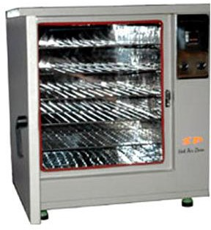
4. Hot Air Oven:
It is a dry air type sterilizer. It is used to sterilize laboratory glassware.
It operates at a temperature of 160 to 180 º C for one and a half hour.

Slide 11
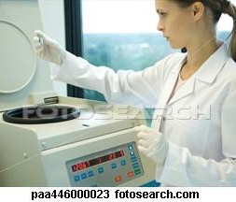
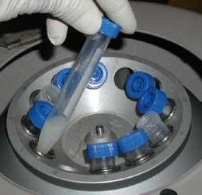
6. Centrifuge: It spins liquid samples to separate their components

Slide 12
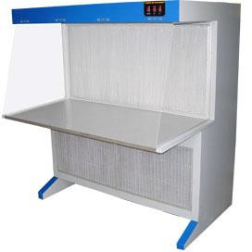
5. Laminar Air Flow: It is a chamber which provides a microbe free environment. It is used for transfer of media for culturing bacteria or fungi or any microbes.

Slide 13
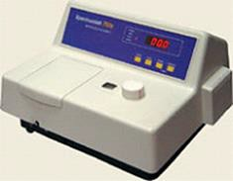
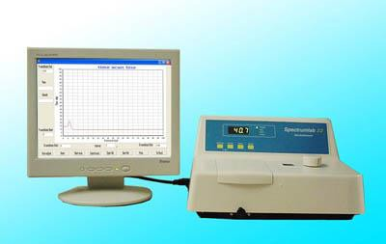
7. Spectrophotometer: It is a device which uses a wavelength to determine the concentration of a compound or particles in a solution or suspension.

Slide 14
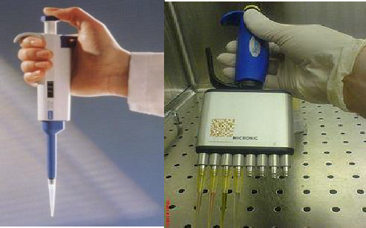
8. Micropipettes: Pipettes are used to accurately measure and dispense small volumes of liquid.

Slide 15
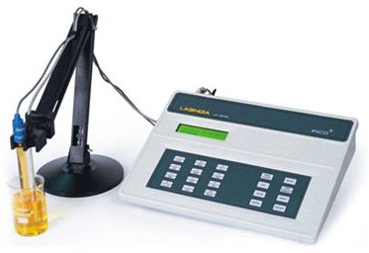
9. pH meter: It is a device used for measuring the pH, which is either the concentration or
the activity of hydrogen ions, of an aqueous solution.

Slide 16
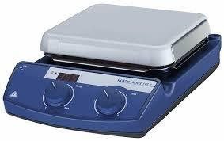
10. Hot plate: In laboratory, hot plates are generally used to heat glassware or its contents.

Slide 17
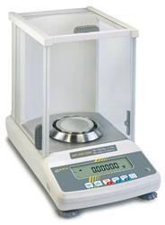
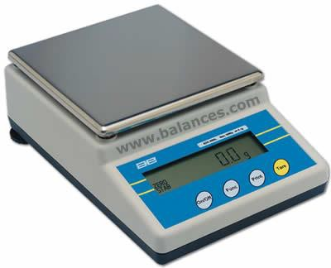
11. Weighing scales: These are devices to measure weight or calculate mass.

Slide 18
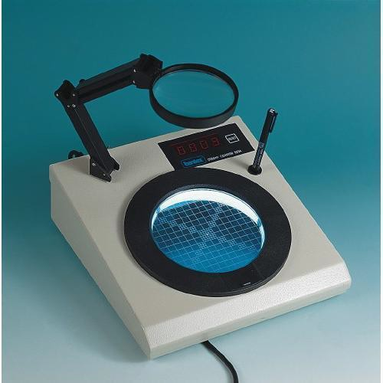
12. Colony counter: Instrument is used for counting of bacterial colonies growing on agar
in petri dishes.

Slide 19
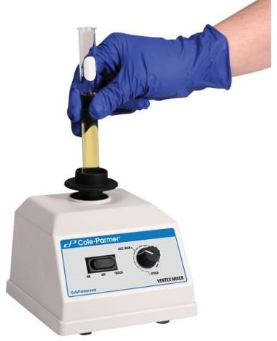
13. Vortex mixer: A vortex mixer, or vortexer, is a simple device used commonly in
laboratories to mix small vials of liquid

Slide 20
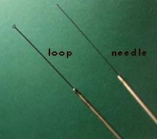
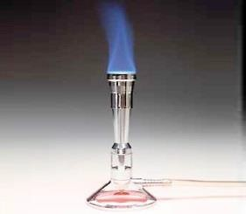
14. Inoculating Loops & Inoculating Needles: Used for inoculating microbes in the liquid media & solid media
15. Bunsen Burner: Source of flame

Slide 21
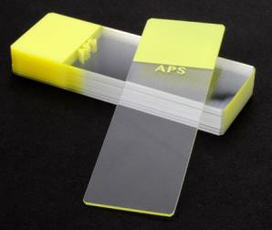
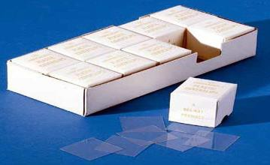
16. Slide: Glass support for specimens
17. Cover Slip: Glass cover for specimens

Slide 22
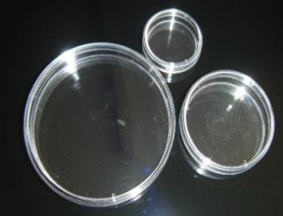
18. Petri Dishes: Petri dishes are often used to make agar plates for microbiology studies.

Slide 23
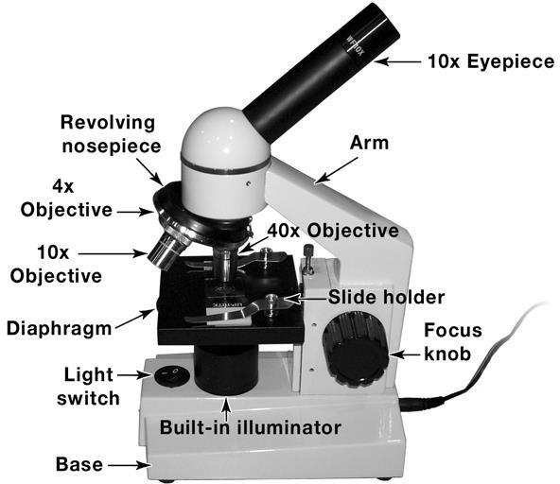
1c. Introduction to Microscopy
"Micro" refers to tiny, "scope" refers to view or look at.
Microscopes are tools used to enlarge images of small objects so as they can be studied.
Light Microscope
The compound light microscope is an instrument containing two lenses, which magnifies the picture.
Because it uses more than one lens, it is sometimes called the compound microscope.
Fig. 1 Light microscope

Slide 24
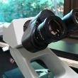
Microscope parts
Eyepiece or Ocular (10x magnification):
One (monocular) or two (binocular) lenses that you look through to see the image
Fig. 2 Binocular

Slide 25
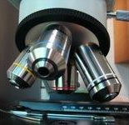
Arm: Supports the upper half of the microscope
Objective Lenses
4x Objective (Red band):
Low power scanning objective
10x Objective(yellow band):
Medium power objective
40x Objective (blue band):
High power objective
100x Objective(black and a white band):
Oil Immersion Objective Lens
Fig. 3 Objective Lenses

Slide 26
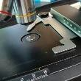
•
Revolving nosepiece: Can be rotated to change objectives
Stage: The platform for holding the slide
Slide holder: Clips to hold slide to stage
Name | Characteristics | Magnification
Low power "scanning" | shortest objective, red stripe | 4 X
Medium power | next shortest, yellow stripe | 10 X
High power | intermediate length, blue stripe | 40, 43 or 45 X
Oil Immersion | longest, black stripe | 100 X
Fig. 4 Stage & Slide holder

Slide 27
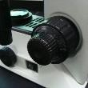
Focus knob: The knob that adjusts the height of the stage
Fig. 5 Knobs
Light switch: Switch to turn on the built-in illuminator

Slide 28
Built-in illuminator: Light source required to view specimens
Base: Supports entire microscope
Power cord: For recharging batteries to illuminator
Diaphragm: Adjusts amount of light entering specimen
Condenser: It focuses light on an object plane

Slide 29
Magnification and Resolution
Magnification: An increase in the apparent size of an object, as under the microscope.
Total magnification: To calculate the total magnification of any specimen being viewed, multiply the power of the eyepiece (ocular lens) by the power of the objective lens being used.
For example, if the eyepiece magnifies 10X and the objective lens magnifies 40X, then 10 x 40 gives a total magnification of 400X.
Resolution: It is the ability to differentiate two objects close together as being separate.

Slide 30
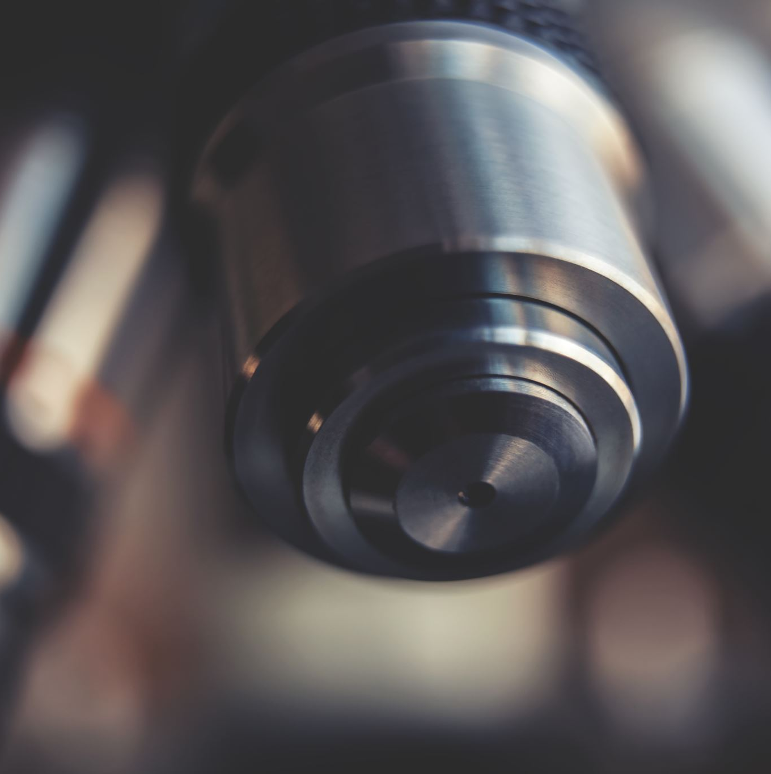
General Rules to Remember While Using the Microscope:
Use light from a microscope lamp unless microscope has internal illumination.
Adjust the condenser so that it is flush with, but not above, the stage.
Place the specimen to be observed directly over the lens of the condenser.
Focus first with low power. Bring down the objective to its lowest point without touching
the slide) and observe the slide as the objective is used by rotating the course adjustment knob in a counter-clockwise direction.

Slide 31
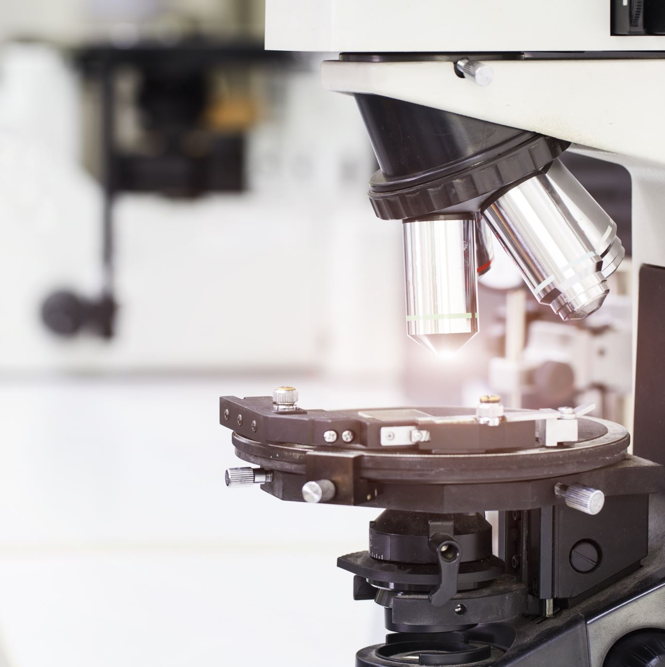
Care of the microscope
Never touch the glass with your fingers.
Always carry the microscope with two hands. Never turn the microscope upside down or the eyepiece could fall out.
Place the microscope on a level surface.
Check to make sure the battery-operated built-in illuminator is working.
Store the microscope with a dust cover to keep it clean.
When you are finished using the microscope, switch to the lowest power objective (4x), lower the stage, switch off the power, cover the microscope with a dust cover, and return the microscope to its storage area.

Slide 32
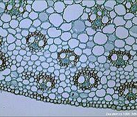
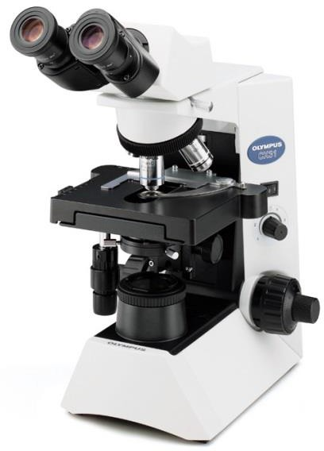
Kinds of Microscopes
Bright field Microscope:
The specimen is illuminated/enlightened by a beam of tungsten light focused on it by a condenser. This specimen appears dark against a bright background.
This microscope is used to observe nonviable, stained preparation.

Slide 33
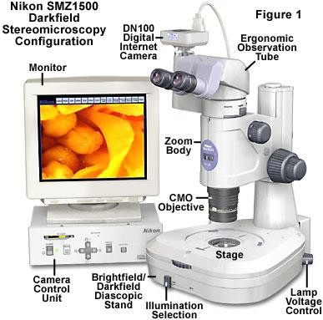
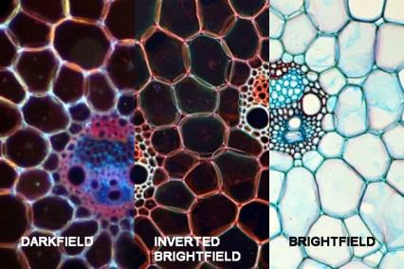
2. Dark field Microscope:
The specimen is not illuminated directly. Specimen appears bright against a dark background.

Slide 34
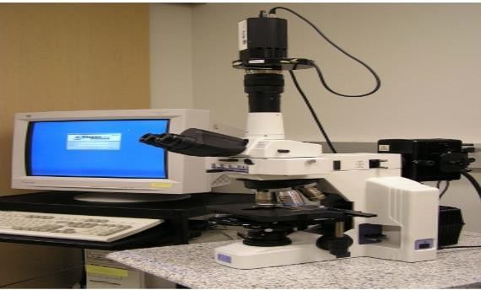
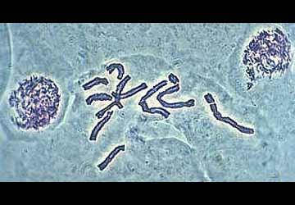
3. Phase-Contrast Microscope:
The unstained microorganisms are observed easily. It has special objectives and a condenser.
The image of the specimen appears dark against a light background.

Slide 35
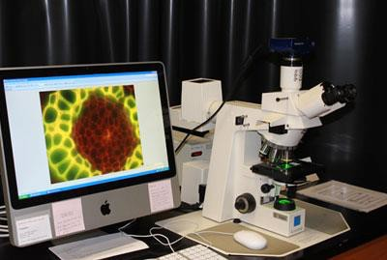
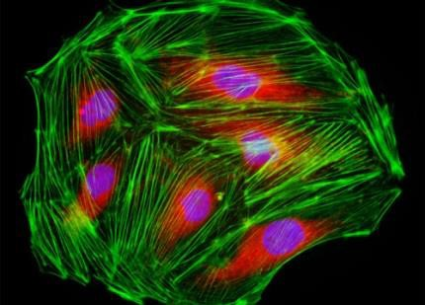
4. Fluorescent Microscope:
This microscope is used to observe the chemically treated specimens with a fluorescent dye.
The specimens are illuminated with an ultraviolet light.
This microscope is used for the detection of antigen-antibody reactions.
The fluorescent portion of the dye becomes visible against the black background.

Slide 36
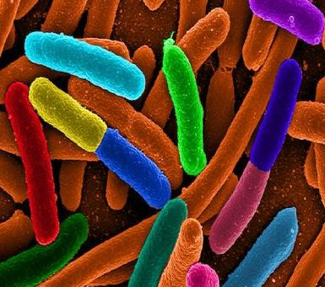
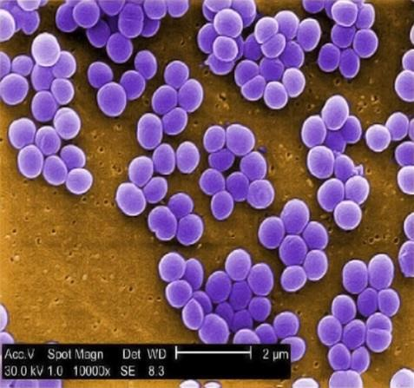
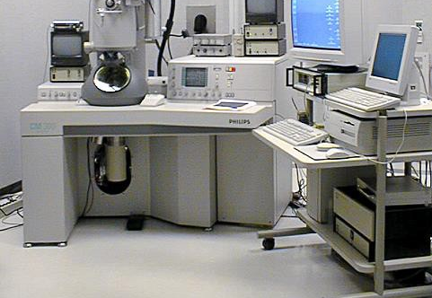
5. Electron Microscope:
It produces an electronically magnified image of a specimen for detailed observation.
It is used to observe submicroscopic cellular particles and viral agents. The specimen is illuminated by a beam of electrons rather than light.

