Slide 1
Protein and Amino acid
Iman AlAjeyan

Slide 2
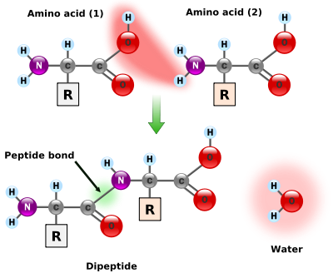
Proteins
Proteins are the most important compound in the body.
Proteins are build up from 20 different amino acids connected together by peptide linkages or peptide bonds.

Slide 3
Amino acids
Amino acids are the building blocks of proteins.
They join together to form short polymer chains called peptides or longer chains called either polypeptides or proteins.
Although more than 300 different amino acids have been described in nature, only 20 are commonly found as constituents of mammalian proteins.

Slide 4
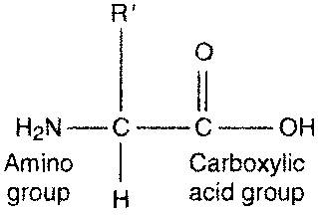
Structure of Amino Acid
Amino acids are molecules containing an amine group, a carboxyl group and a side chain (R-group) that varies between different amino acids.
The key elements of an amino acid are carbon, hydrogen, oxygen, and nitrogen.

Slide 5
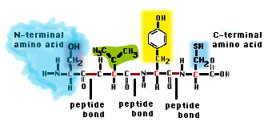
The amino acids present in a peptide chain are amino acid residues.
The amino acid residue with free α-Amino group is the amino-terminal (N-terminal) residue, while the amino acid residue at the other end having free α-Carboxyl group is the carboxyl-terminal (C-terminal) residue.

Slide 6
Amino acids combined in peptide linkages
-NH-CH-CO-NH-CH-CO-
R R
Side chains determine properties of proteins
The basic formula (NH₂CHRCOOH,)

Slide 7
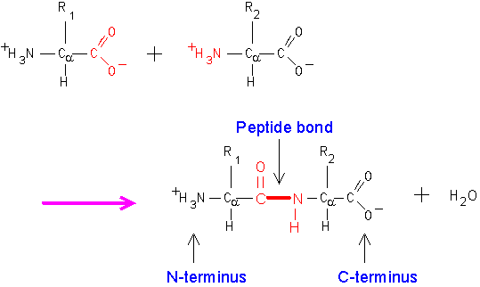
Amino acids combined in peptide linkages

Slide 8
Free amino acid
Common to all α-amino acids of proteins
H
⁺H3N Cα COOH
R
Amino group
carboxyl group
Side distinctive for each
amino acid.
α-Carbon is between the carboxyl
and the amino group

Slide 9
List of Amino Acids
Alanine | Ala | A
Glycine | Gly | G
Leucine | Leu | L
Proline | Pro | P
Threonine | Thr | T

Slide 10
Amino Acids
Arginine | Arg | R(aRginine)
Asparagine | Asn | N(contains N)
Aspartate | Asp | D(asparDic)
Glutamate | Glu | E(glutEmate)
Glutamine | Gln | Q(Q-tamine)
Phenylalanine | Phe | F(Fenylalanine)
Tyrosine | Tyr | Y(tYrosine)
Tryptophan | Trp | W(double ring in the molecule)

Slide 11
Amino Acids
Cysteine | Cys | C
Histidine | His | H
Isoleucine | Iie | I
Methionine | Met | M
Serine | Ser | S
Valine Lysine | Val Lys | V K (near L)

Slide 12
Amino Acids Structures

Slide 13
H
⁺H₃N – C – COOH
H
H
⁺H₃N – C – COOH
CH₃
H
⁺H₃N – C – COOH
CH2
H3C CH3
Glycine
Alanine
Valine

Slide 14
H
⁺H₃N – C – COOH
CH2
CH
H3C CH3
H
⁺H₃N – C – COOH
H - C – CH3
CH2
CH3
H
⁺H₃N – C – COOH
CH2
Leucine
Isoleucine
Phenylalanine

Slide 15
H
⁺H₃N – C – COOH
CH2
C
CH
N
H
H
⁺H₃N – C – COOH
CH2
CH2
S
CH3
H
⁺H₃N – C – COOH
H₂C CH₂
CH2
Tryptophan
Methionine
Proline

Slide 16
H
⁺H₃N – C – COOH
CH₂
OH
H
⁺H₃N – C – COOH
H – C – OH
H
H
⁺H₃N – C – COOH
H – C – OH
CH₃
Serine
Threonine
Tyrosine
H
⁺H₃N – C – COOH
CH₂
C
O NH₂
H
⁺H₃N – C – COOH
CH₂
CH₂
C
O NH₂
H
⁺H₃N – C – COOH
CH₂
SH
Cysteine
Asparagine
Glutamine

Slide 17
H
⁺H₃N – C – COOH
CH₂
C
O OH
H
⁺H₃N – C – COOH
CH₂
CH₂
C
O OH
Aspartic acid
Glutamic acid

Slide 18
H
⁺H₃N – C – COOH
CH₂
C CH
HN NH
C
H
H
⁺H₃N – C – COOH
CH₂
CH₂
CH₂
CH₂
NH₃+
H
⁺H₃N – C – COOH
CH₂
CH₂
CH₂
N – H
C = NH₂+
NH₂
Histidine
Lysine
Arginine

Slide 19
Peptide Bonds
Are covalent bond between the α carboxyl group of one amino acid and the α amino group of another amino acid.
Peptide bonds are formed by the elimination of water.

Slide 20
Peptide Chains
2 amino acids joined by a peptide bond are called: Dipeptide.
3 amino acids joined by 2 peptide bonds are called: Tripeptide.
Few amino acids (4-20) joined by peptide bonds are called: Oligopeptide.
Many amino acids (> 20) joined by peptide bonds are called: Polypeptide.

Slide 21
Amino Acid Classification
Amino acids are usually classified by the properties of their side chain(charge and polarity).
A. Non-polar amino acids
B. polar amino acids
C. Acidic amino acids
D. basic amino acids

Slide 22
Hydrolysis of Peptide Bonds
Peptide bonds are stable under most intracellular conditions. They can be hydrolyzed by boiling with strong acid (6M HCl) or base to give free amino acids.
Peptide bonds can be also hydrolyzed by certain enzymes called Proteases e.g. trypsin.

Slide 23
Sources of Proteins
Proteins from plant sources
Like rice, wheat, corn, beans, …
Proteins from animal sources
Like meat, poultry, milk, fish, …

Slide 24
Functions of Proteins
Proteins have many different biological functions. They have been divided into different classes according to their biological functions.
Enzymes
Have catalytic activity e.g. Trypsin and Hexokinase.
2. Transport proteins
e.g. Hemoglobin: transport O2,
Lipoproteins: transport lipids.

Slide 25
Functions of Proteins
3. Nutrient and storage proteins
e.g. Ovalbumin of egg white, Casein of milk, and Seed proteins.
4. Contractile and motile proteins
These proteins give ability to contract, change shape, or move e.g.
Actin and Myosin of skeletal muscle.

Slide 26
Functions of Proteins
5. Structural proteins
e.g. Hair, finger nails, and feathers consist of insoluble protein "Keratin".
6. Defense proteins
e.g. Antibodies and Blood clotting proteins.
7. Regulatory Proteins
e.g. Hormones: regulate cellular or physiological activity like Insulin.

Slide 27
Classification of Proteins
Simple proteins
Conjugated proteins
Derived proteins

Slide 28
Simple proteins
Are proteins made up of amino acids only and no other chemical group.
Examples: ALBUMINS GLOBULIN

Slide 29
B. Conjugated proteins
Are proteins that contain chemical components in addition to amino acids. They are of different types depending on the chemical component:
Lipoproteins: Lipid + protein e.g. plasma lipoproteins.
Glycoproteins: Carbohydrate + protein e.g. some hormones (FSH, LH, TSH).
Metalloproteins: Metal + protein e.g. Ferritin (iron storage) and Treansferrin (iron transport in blood).

Slide 30
Phosphoproteins: Phosphate + protein e.g. phosphorylase enzyme.
Nucleoproteins: Nucleic Acid (DNA, RNA) + protein e.g. chromosomes.
Chromoproteins: Pigment + protein e.g. Hemoglobin.

Slide 31
C. Derived proteins
These are not naturally occurring proteins and are obtained from simple proteins by the action of chemical, enzymatic, and physical forces on simple and conjugated proteins i.e. denaturation or hydrolysis.

Slide 32
Levels of Protein Structure
There are four organizational levels in protein structure:
Primary structure (1°).
Secondary structure (2°).
Tertiary structure (3°).
Quaternary structure (4°).

Slide 33
PRIMARY STRUCTURE (1°)
The primary structure is its linear sequence of amino acids in a polypeptide chain.
The primary structure is held together by peptide bonds.
A slight change in the amino acid sequence can change the protein.
E.g. Insulin.
Amino terminal at one end and carboxyl terminal at the other.

Slide 34
Proteins are linear polymers of amino acids
R₁
R₂
NH₃＋
C
COO^{ー}
＋
NH₃＋
C
COO^{ー}
＋
H
H
A carboxylic acid condenses with an amino group with the release of a water
H₂O
H₂O
R₁
R₂
R₃
NH₃＋
C
CO
NH
C
CO
NH
C
CO
H
Peptide bond
H
Peptide bond
H
The amino acid sequence is called as Primary Structure
A
F
G
S
T
D
K
A
N
G
S

Slide 35
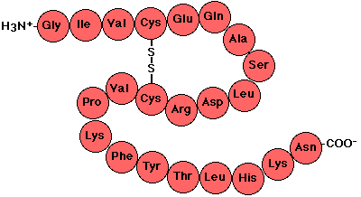
PRIMARY STRUCTURE (1°)

Slide 36
SECONDARY STRUCTURE (2°)
Secondary structure refers to the regular arrangement in space of amino acids that are close to one another in the polypeptide chain.
The secondary structure is held together by hydrogen bonds.
Two types of secondary structure: α-helix, β-pleated sheet.
α-helix is the most common peptide helix e.g. hair or wool.
β-pleated sheet e.g. silk.

Slide 37
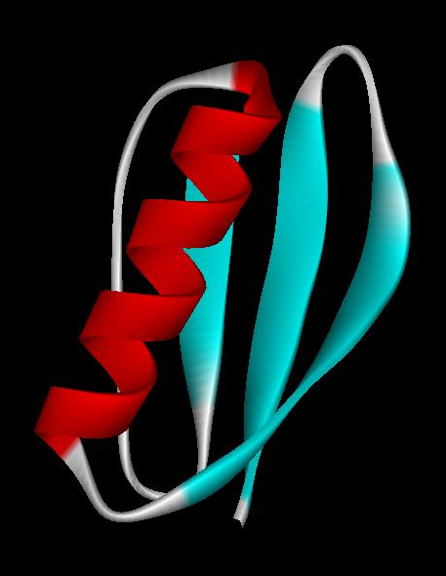
Secondary structures
α-helix and β-sheet, have regular hydrogen-bonding patterns.
α-helix
β-sheet

Slide 38
The Alpha Helix

Slide 39
The Beta Sheet

Slide 40
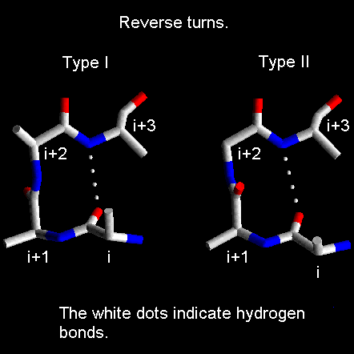
β-bend (Reverse Turn)
Polypeptide chain may fold back or reverse the direction of the chain to form a compact globular shape.

Slide 41
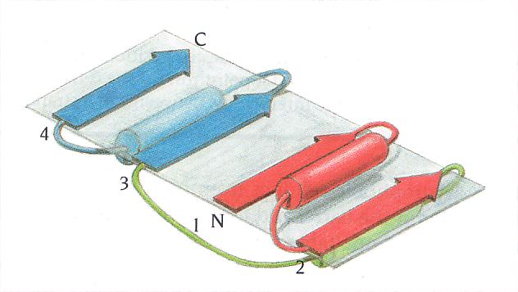
Super Secondary Structure
This refers to clusters of secondary structure e.g. βαβ unit.
Left handed
Right handed

Slide 43
TERTIARY STRUCTURE (3°)
Tertiary structure refers to the specific bending and folding of the coils into specific layers (arrangement of amino acid residues that are far apart in the linear sequence).
It is the complete 3-D structure of the polypeptide.
Bonds Stabilizing the Tertiary Structure are:
Hydrogen bonds.
Disulfide bonds.
Hydrophobic bonds.
Ionic interactions.

Slide 44
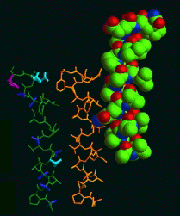
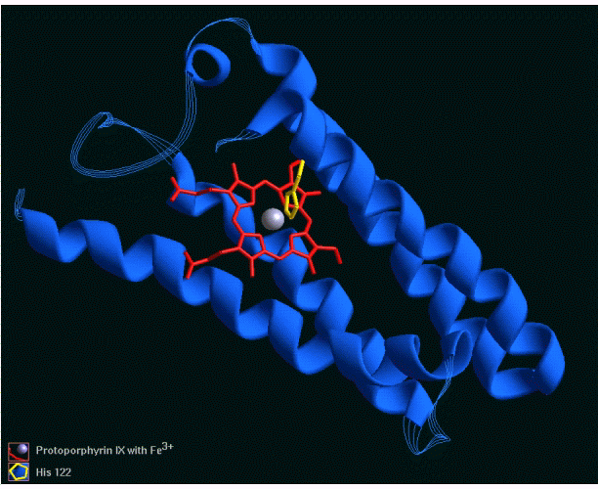
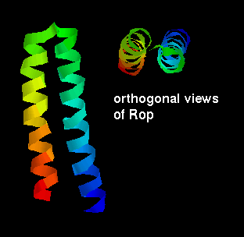
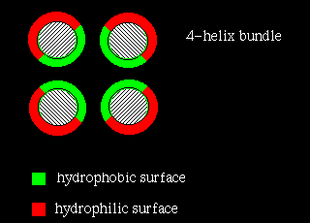
Tertiary Structure Examples: All-α
Cytochrome C four-helix bundle
Alamethicin The lone helix
Rop helix-turn-helix

Slide 45
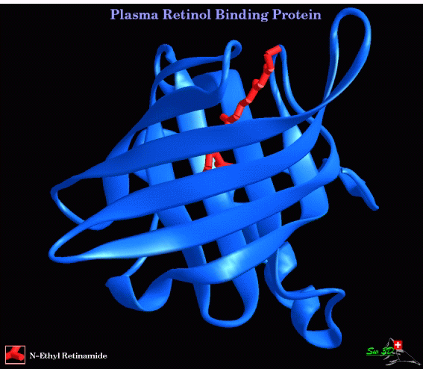
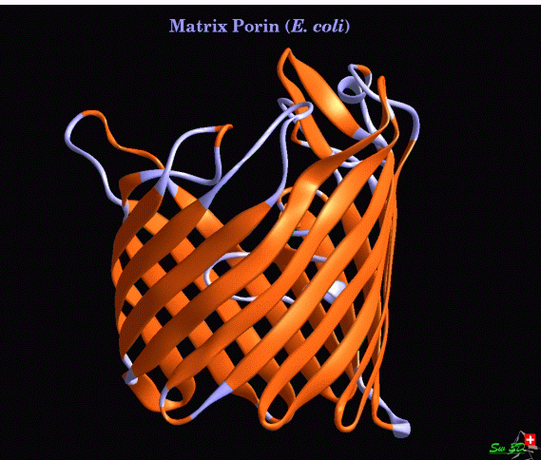
Tertiary structure examples: All-β
β sandwich
β barrel

Slide 46
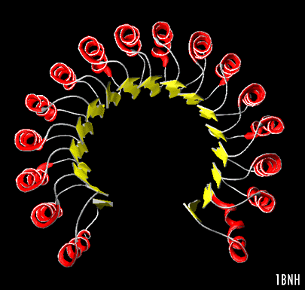
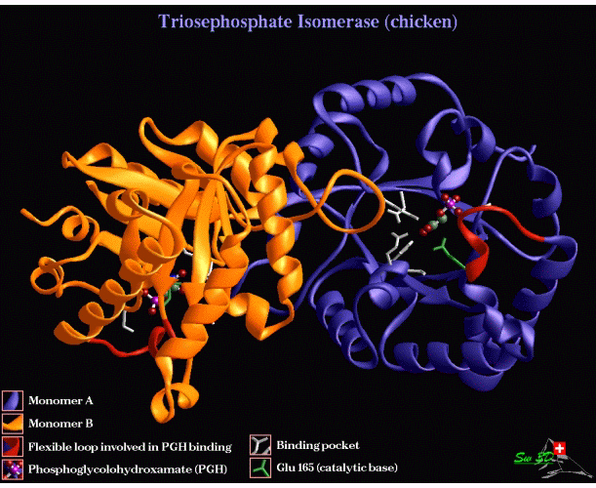
Tertiary structure examples: α/β
Placental Ribonuclease Inhibitor α/β horseshoe
Triose Phosphate Isomerase α/β barrel

Slide 47
QUATERNARY STRUCTURE (4°)
The quaternary structure occurs when several protein units, each with its own primary, secondary, and tertiary structure, combine to form a more complex unit.
E.g.
Hemoglobin: consists of 2 α chains and 2 β chains.

Slide 48
Hemoglobin: consists of 2 α chains and 2 β chains.

Slide 49
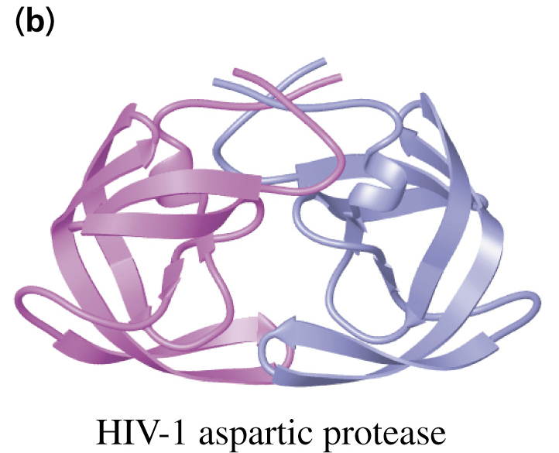
Quaternary Structure of Multidomain proteins

Slide 50
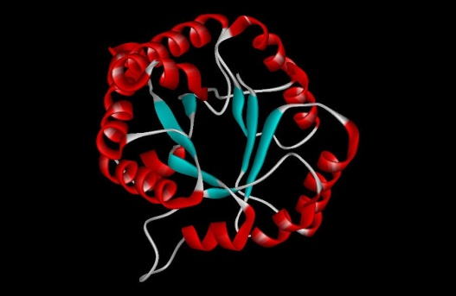
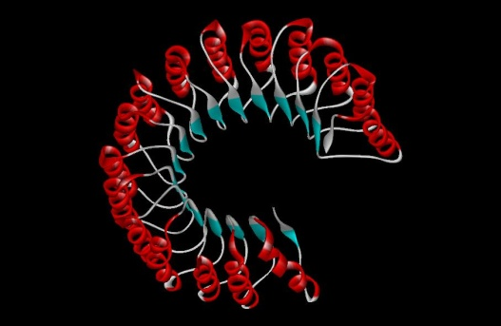
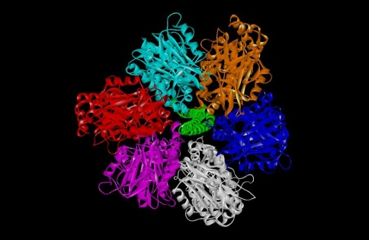
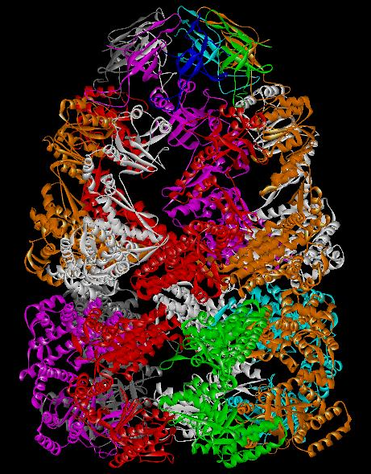
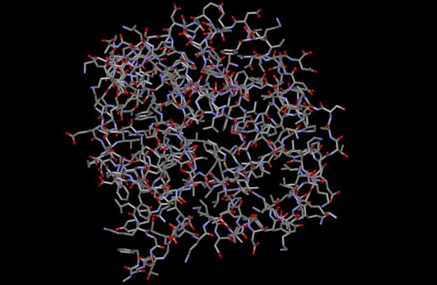
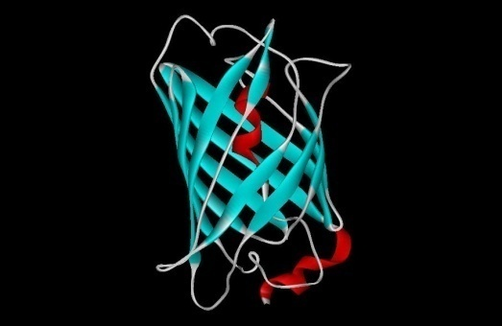
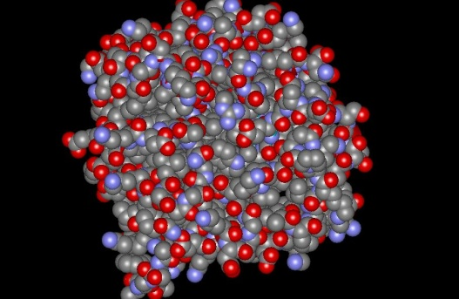
Three-dimensional Structures of Proteins
Tertiary structure
Quaternary structure

Slide 51
Summary
Primary structure (Amino acid sequence)
↓
Secondary structure （α-helix, β-sheet）
↓
Tertiary structure （Three-dimensional structure formed by assembly of secondary structures）
↓
Quaternary structure （Structure formed by more than one polypeptide chains）

Slide 52
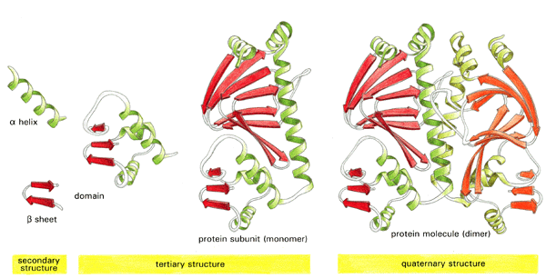
primary structure
ACDEFGHIKLMNPQRSTVWY

Slide 53
Denaturation of Proteins
Denaturation of a protein is the unfolding and rearrangement of the secondary and tertiary structures of a protein without breaking the peptide bonds.
A protein that has lost its biological activity by denaturation is called denatured protein.
Some proteins which were denatured, will regain their original structure and biological activity, by reversing the conditions that caused denaturation. This process is called Reversible denaturation.

Slide 54
Denaturation of Proteins
Denaturing Agents
Denaturing agents are reagents that cause denaturation of proteins. E.g.
Heat
pH e.g. strong acids like concentrated HCl.
Radiation: UV or X-rays.
Alcohol (70%)
Salts of heavy metals e.g. Silver nitrate (AgNO3), Mercuric chloride,..
Oxidizing and reducing agents

