Slide 1
LAB 2 Sterilization techniques & Microbiological culture media preparation
LAB 2
Sterilization techniques &
Microbiological culture media preparation
Dr. Amal Alghamdi
ahamdan1@ksu.edu.sa
Building 5, level 3, office 69

Slide 2
Sterilization of Media and glassware
Sterilization is the process of rendering a medium or material free of all life forms. There are three basic ways to sterilize media and supplies.
Three ways for sterilizing culture media and supplies (glassware):
Steam under pressure (autoclaving)—121ºC at 15 pounds of pressure for 15 minutes
Dry heat—160 to 170ºC for 2 hours
Millipore filtration—passage through filters with pore sizes no greater than
0.22 lm
Autoclaving: The most useful approach is autoclaving, in which items are sterilized by exposure to steam at 121°C and 15 lbs of pressure for 15 minutes or longer, depending on their nature. Under these conditions, microorganisms, even endospores, will not survive for 12 to 13 minutes.
This method is rapid and dependable.

Slide 3
Procedure for Autoclaving
Load the autoclave with the freshly prepared culture media.
Close and lock the autoclave door.
Set the autoclave time for 15 minutes or longer.
Make certain that the autoclave temperature is set to 121°C.
Start the autoclave by pushing the start button or twisting the knob to the start position.
When the period of sterilization is completed, and the pressure in the chamber reads 0,
Carefully open the door and remove the containers, using heat-proof gloves.

Slide 4
Microbiological Culture Media
Microorganisms depend on a number of factors such as nutrients, oxygen, moisture and temperature to grow and divide.
In the laboratory, except for the above factors, the culture medium should be sterile and
contamination of a culture with other organisms should be prevented.
The survival and growth of microorganisms depend on available nutrients and a favorable growth environment.
In the laboratory, the nutrient preparations that are used for culturing microorganisms are called media (singular, medium).
Depending on the type and combination of nutrients, different categories of media can be made.

Slide 5
Media categories:
Complex media are rich in nutrients, they contain water soluble extracts of plant or animal tissue (e.g., enzymatically digested animal proteins such as peptone and tryptone). Usually a sugar, often glucose is added to serve as the main carbon and energy source. The combination of extracts and sugar creates a medium which is rich in minerals and organic nutrients, but since the exact composition is unknown, the medium is called complex.
Defined media are media composed of pure ingredients in carefully measured concentrations dissolved in double distilled water i.e., the exact chemical composition of the medium is known. Typically, they contain a simple sugar as the carbon and energy source, an inorganic nitrogen source, various mineral salts and if necessary growth factors (purified amino acids, vitamins, purines and pyrimidines).

Slide 6
Media categories:
3- Selective/differential media are media based on either of the two categories above supplemented with growth-promoting or growth-inhibiting additives. The additives may be species- or organism-selective (e.g., a specific substrate, or an inhibitor such as cyclohexamide (artidione) which inhibits all eucaryotic growth and is typically used to prevent fungal growth in mixed cultures).
Three physical forms of media are used:
liquid or broth media
semisolid media
solid media

Slide 7
The major difference among these media is that solid and semisolid media contain a solidifying agent (usually agar), whereas a liquid medium does not.
Liquid media (broth), the only difference between broth and agar media is that broths
do not contain an agar component. Nutrient broth, tryptic soy broth, or brain-heart
infusion broth, can be used to propagate large numbers of microorganisms in fermentation studies and for various biochemical tests.
Semisolid media can also be used in fermentation studies, in determining bacterial motility, and in promoting anaerobic growth.
Solid media, such as nutrient agar or blood agar, are used (1) for the surface growth of microorganisms in order to observe colony appearance, (2) for pure culture isolations,
(3) for storage of cultures, and (4) to observe specific biochemical reactions.

Slide 8
Uses of Culture Media
Broth: to grow high concentration of bacteria
Slant: Space-saving solid culture
Plate: Isolating individual colonies, can be used to count bacteria
Deep: Look at motility & oxygen requirement

Slide 9
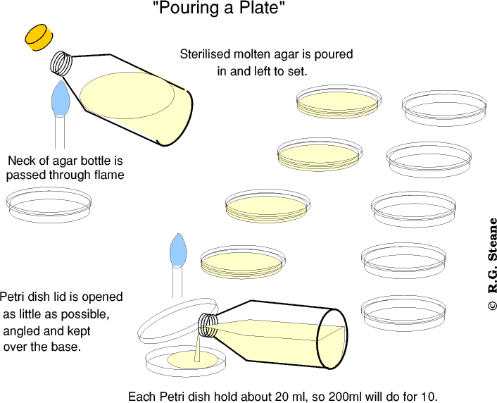
Pouring of Culture Media
Nowadays, we use clear plastic disposable Petri dishes, typically 95 or 100 mm in diameter, 20 per sleeve (packet).
When prepared for inoculation, a plate contains solid agar mixed with nutrient materials to provide a surface for growth.
We prepare agar media by mixing 1 to 2% agar with individual components or using a pre-mixed powder.
Either way, the dry components must be heated to melt the agar, sterilized in a flask or bottle, then poured into the plates using an aseptic technique, preferably in a sterile cabinet (laminar flow hood).

Slide 10
How to prepare a Petri plate
Take liquid agar (in the water bath)
Pour aseptically into the base of the Petri plate.
Wait until solidify (15 minutes).
***Plates are kept inverted so condensation does not drip onto the agar.
To increase the shelf-life of the plates, store in a cool, dry environment until they are used (refrigerator).

Slide 11
Labeling Plate
Make certain that all plates are labeled on the bottom half.
Include the following:
Your initials or identifying
mark Date
Type of specimen

Slide 12
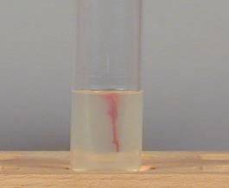
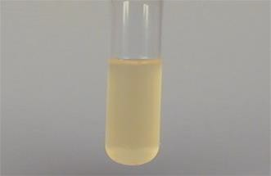
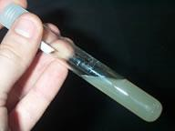
Culture media types:
Plate
Deep
Broth
Slant

