Slide 1
Zoo 109
Lec. 8
Prof. Khalid Al-Ghanim

Slide 2



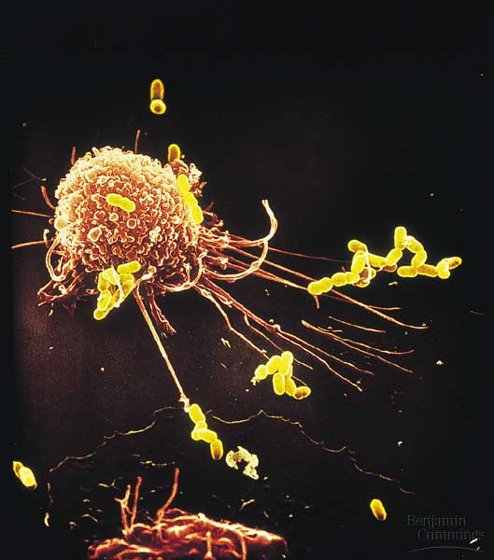
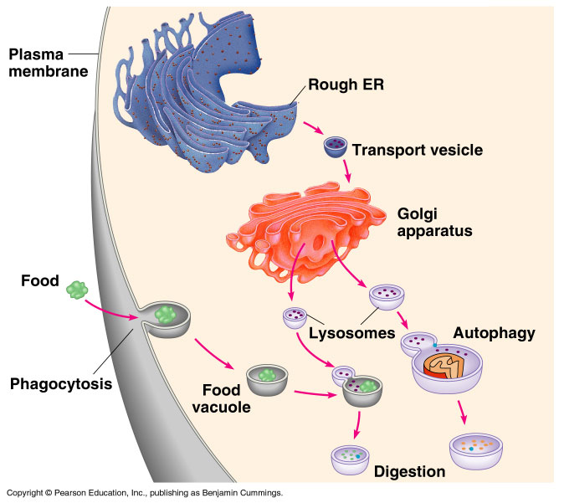
B- Eukaryotic Cell
Copyright © 2002 Pearson Education, Inc., publishing as Benjamin Cummings

Slide 3
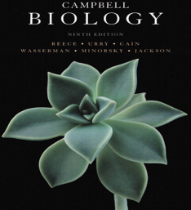

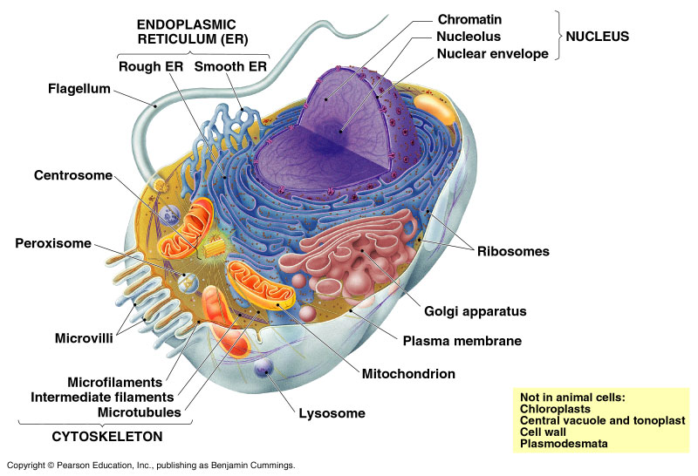
The Cytoskeleton الهيكل الخلوي
Microtubules and microfilaments
A network of fibres شبكة من الالياف that provides structural support تدعيم to the cell. The cytoskeleton also functions in cell motility تحرك الخلية and regulation.
It is made up of 3 types of fibers
  Microfilaments
  Microtubules
  Intermediate filaments
It has 3 main functions:
  Provides mechanical support of the cell and keeps organelles in their fixed locations.
  Helps move materials within the cell
  Plays a major role in cell motility
Copyright © 2002 Pearson Education, Inc., publishing as Benjamin Cummings

Slide 4
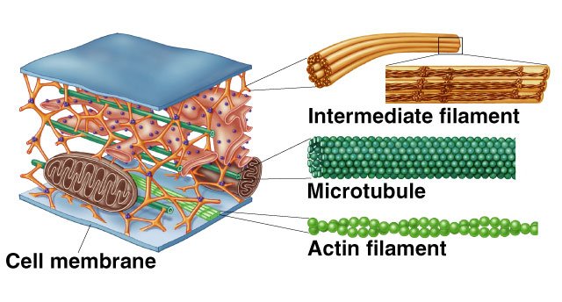
Cytoskeleton
Microfilaments

Slide 5
Cytoskeleton
Cytoskeleton
Microtubules
Microfilaments
Intermediate
filaments
أنيبيبات دقيقة
ألياف دقيقة
ألياف متوسطة
Thick
Thin
Middle
سميكة
رفيعة
متوسطة
Responsible for cell motility, and separation of chromosomes during cell division.
(Tubulin protein)
Support cell motility and transport materials within the cell.
(Actin protein)
Reinforcing the cell shape and fixing position of organelles.
(Fibrous protein)

Slide 6
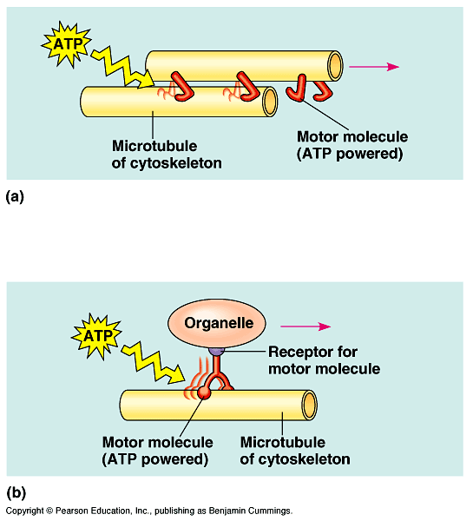
Cytoskeleton
The cytoskeleton is dynamic, dismantling يتفككin one part and reassembling يتجمعin another to change cell shape.
The cytoskeleton plays a major role in cell motility حركة الخلية by interacting with motor proteins. البروتين الحركي.
Motor proteins are able to move along the surface of a suitable substrate (powered by ATP).
Motor proteins are the driving force behind most active transport of proteins and vesicles in the cytoplasm.
Cell Movement
  In cilia and flagella motor proteins pull components
  of the cytoskeleton past each otherعكس بعضهم .
  This is also true in muscle
  cells.

Slide 7
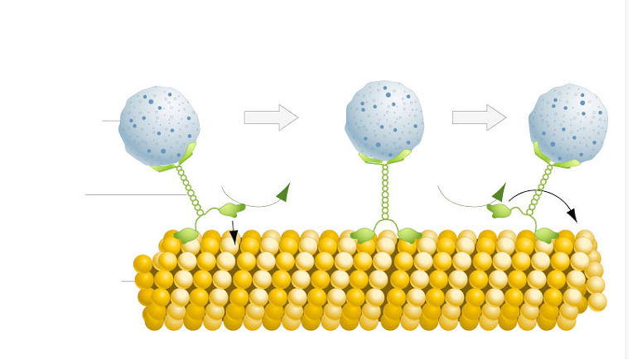
Motor proteins
Motor proteins are a class of molecular motors that are able to move along the surface of a suitable substrate. They are powered by the hydrolysis of ATP and convert chemical energy into mechanical work.
MOTOR PROTEINS "WALKS" ALONG A MICROTUBULE TRACK
Transport vesicle
ATP
ADP+P_{i}
ATP
ADP+P_{i}
Motor proteins
Microtubule

Slide 8
Motor proteins
Interactions of motor proteins and the cytoskeleton circulates materials within the cell.
The cytoskeleton may transmit mechanical signals that rearrange the nucleoli and other structures.
Motor molecules also carry vesicles or organelles to various destinations إلى أماكن مختلفة provided by the cytoskeleton.

Slide 9
Organelle
Motor Protein
P
Energy
Microtubules functions as tracks قضيب that guide motor proteins carrying organelles to their destination المكان المستهدف.
They move chromosomes during cell division

Slide 10
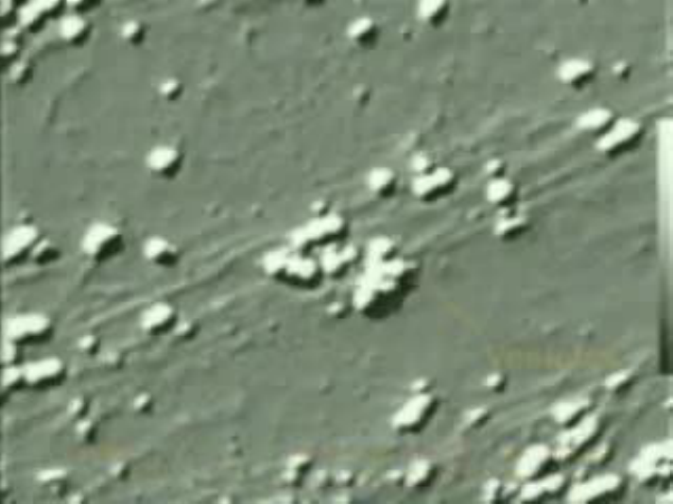
Motor proteins and movement of organelles

Slide 11
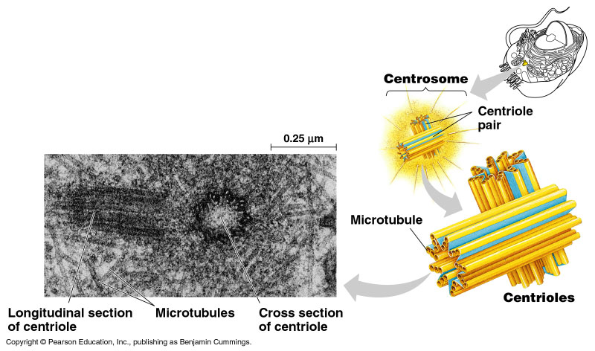
Centrosome
In many cells, microtubules grow out from a centrosome الجسم المركزي near the nucleus.
Centrosome
In animal cells, the centrosome has a pair of centrioles, each with 9 triplets of microtubules تسعة مجموعات ثلاثية الأنيبيبات (9 + 0 pattern) arranged in a ring مُرتبة دائريا.
During cell division the
centrioles replicate تتضاعف.

Slide 12
Cilia and Flagella
Microtubules are the central structural supports both cilia الأهداب and flagella الأسواط.
  Both can move unicellular and small multicellular organisms by propelling دفع water outside the organism.
Movement of cilia & flagella
Cilia usually occur in large numbers on the cell surface.
Flagella usually occur in just one or a few per cell.
Cilia move more like oars مجادبف with alternating power and recovery strokes.
Flagella have an undulatory movement حركة تموجية.
So, They differ in their beating pattern أسلوب الحركة.

Slide 13
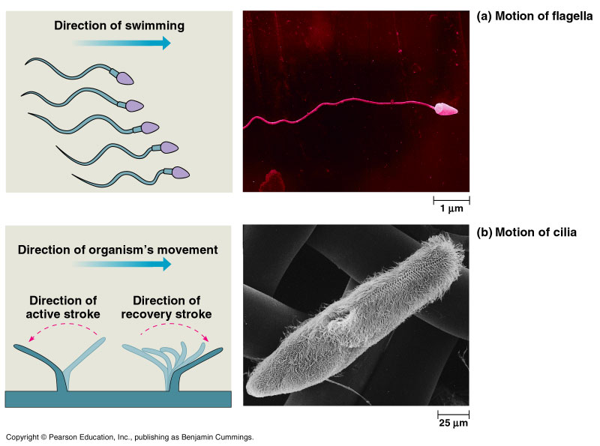
Cilia of Paramecium
cilia

Slide 14
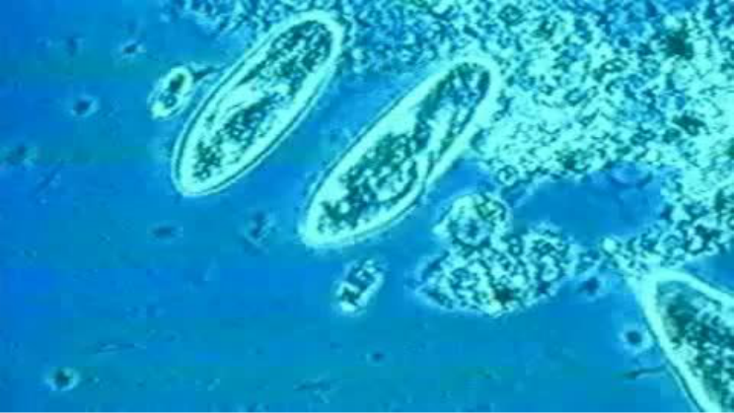
Cilia of Paramecium

Slide 15
Flagellum of sperm
flagellum

Slide 16
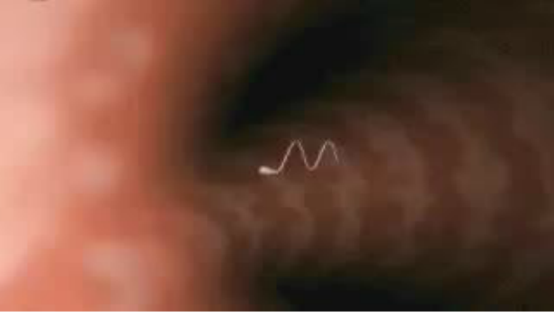
Flagellum of sperm

Slide 17
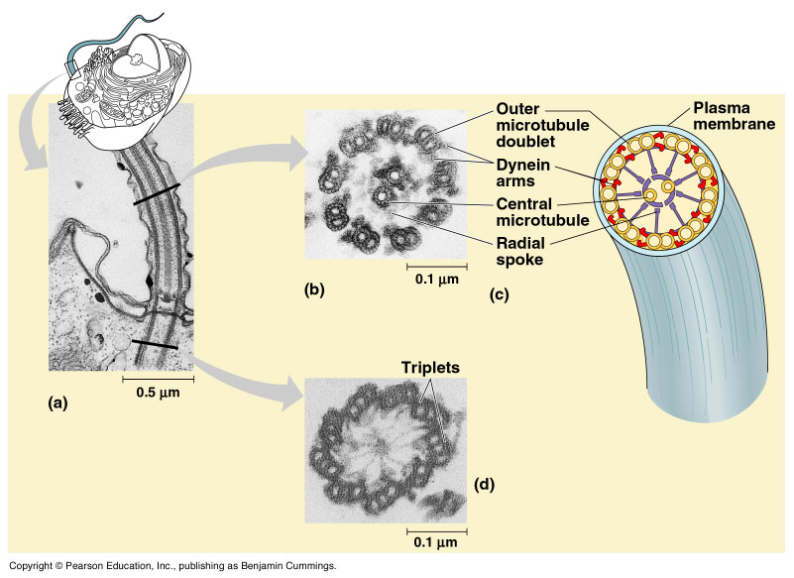
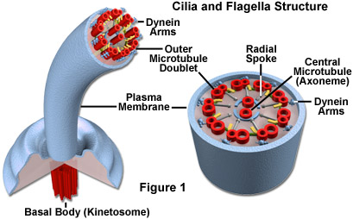
Both cilia and flagella have the same ultrastructure التركيب الدقيق.
Both have a core مركز of microtubules sheathed by the plasma membrane.
  9-doublets (9 + 2 pattern) تسعة مجموعات ثنائية الأنيبيبتان of microtubules arranged around a pair at the center.
  Flexible “wheels” of proteins connect outer doublets to each other and to the core.
  The outer doublets are also connected by motor proteins.
  The structure of cilium and flagellum is identical to that of centriole.

Slide 18
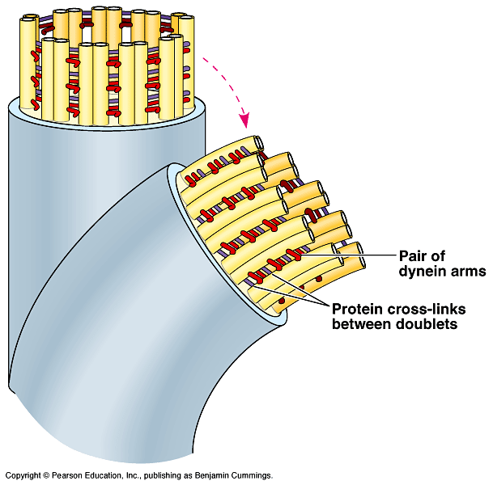
Cilia and Flagella
Cilia and flagella are formed of arms of a motor protein (dynein بروتين الداينين).
  Dynein arms alternately
  grab, move, and release
  the outer microtubules.
  Protein cross-links limit
  sliding and the force is
  expressed as bending إلتواء.
http://www.northland.cc.mn.us/biology/biology1111/animations/flagellum.html

Slide 19
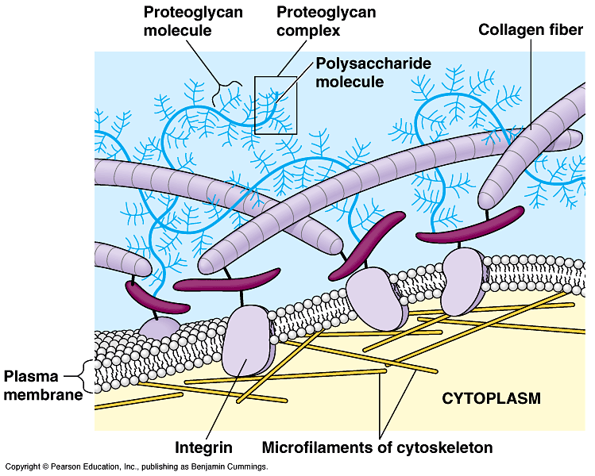
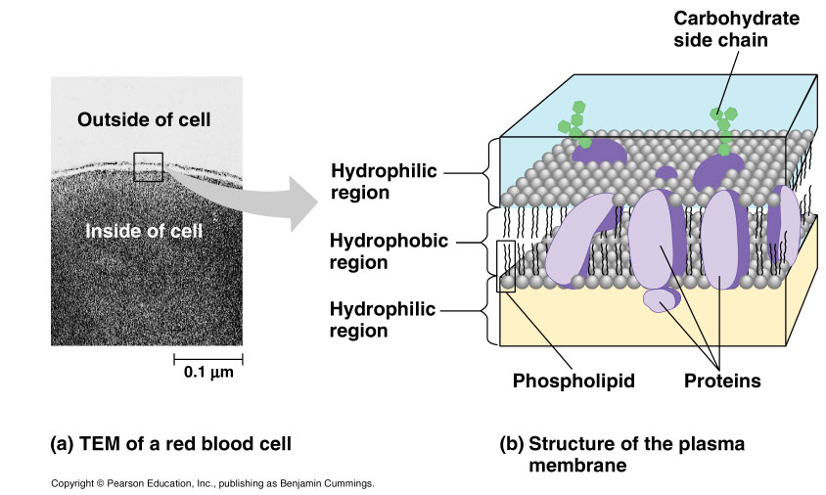
7- Cell membrane
The plasma membrane functions as a selective barrier حاجز إختيارى that allows passage of oxygen, nutrients, and wastes for the whole volume of the cell.

Slide 20
Cell membrane
Composed of a kind of lipids (phospholipids) and proteins
Lipid layer contains hydrophilic and hydrophobic regions
Hydrophilic مُحب للماء
Phospholipid
Hydrophobic كاره للماء
Proteins

Slide 21
Comparison between Prokaryotes and Eukaryotes
Term | Prokaryotes | Eukaryotes
Size | 1-10 µm in diameter | 10-100 µm in diameter
Cell wall | Existed | In plant cell (not animal cell)
nucleus | No nuclear envelope but Nucleoid | True nucleus exists with nuclear envelope
DNA | As fibre in the nucleoid region (plasmids in some cases) | As Chromatin (DNA and protein)
Specialized Organells | Most of them are absent | All are existed
Cell division | By Binary Fission | Meiotic and/or Mitotic

