Slide 1
FISH
Fish are aquatic vertebrates that are cold-blooded, covered with scales, and equipped with two sets of paired fins and several unpaired fins.
Fish are abundant in the sea and in fresh water, with species being known from mountain streams (e.g., char and gudgeon) as well as in the deepest depths of the ocean (e.g., gulpers and anglerfish).

Slide 2
Fish are the most primitive of vertebrates.
There are about 2300 species of fish, which live in the fresh, salty or brackish water. Some species can live in all these types of water during the course of their life.
Their bodies are covered with scales and they have fins to help their mobility. In most fish mobility is a result of waves contracting and then passing along the segmentally arranged muscle blocks on either side of the backbone.
Fish breathe oxygen, which is obtained from the surrounding water. This is done by pushing water over gills, which are made up of a series of folded filaments with a large surface area.
Fish are cold-blooded (known as exothermic), that is they are unable to maintain a body temperature different from that of their surroundings.

Slide 3
In fish, the lateral line is a sense organ used to detect movement and vibration in the surrounding water.
Lateral lines are usually visible as faint lines running lengthwise down each side, from the vicinity of the gill covers to the base of the tail.
Sometimes parts o the lateral organ are modified into electroreceptors, which are organs used to detect electrical impulses. It is possible that vertebrates such as sharks use the lateral organs to detect magnetic fields as well.
The receptors in the lateral line are neuromasts, each of which is composed of a group of hair cells. The hair cells in the lateral line are similar to the hair cells inside the vertebrate inner ear.

Slide 4
CLASSIFICATION:
There are about 28,100 species of fishes known to science, they are divided into 4 classes, 59 orders, 490 families and 4,300 or so genera.
Classification of fish is based on Fishes of The World (3rd Edition) by Joseph S. Nelson 1994.
Phylum Chordata
Subphylum Vertebrata
Supraclass Agnatha ( jawless fishes)
Class Myxinoidea (hagfish)
Class Petromyzontida (lampreys)
Supraclass Gnathostomata (jawed fishes)
Class Chondrichthyes- cartilagenous fish
Subclass Elasmobranchii- Sharks, Skates and Rays
Subclass Holocephali-Chimaeras or ratfishes
Class Osteichthyes - higher bony fishes
Subclass Actinopterygii ray-finned fishes
Subclass Sarcopterygii lobe-finned fishes

Slide 5
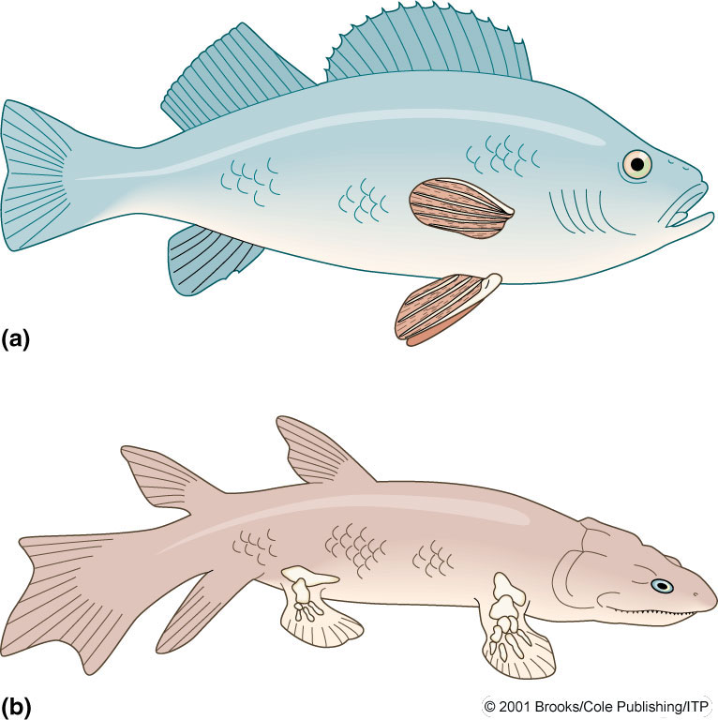
Ray-Finned and Lobe-Finned Fish
Ray-Finned
Lobe-Finned Fish

Slide 6
REPRODUCTIVE STRATIGIES
Fishes have a large range of sexuality (they stand out amongst vertebrates).
Fishes may exhibit hermaphroditism, unisexuality (parthenogenesis),
bisexuality (gonochorism), or a combination of sexualities.
Fish Sexuality
Hermaphroditism
Parthenogenesis:
Unisexuality
Gonochorism:
Bisexuality

Slide 7
1)Hermophroditsm:
In synchronous or simultaneous hermaphroditism, the left gonad is the
ovary and the right one is the testis or vice versa, or there may be an
ovotestis. Although self-fertilization exists, it is rare.
In asynchronous hermaphrodites,the fish start functionally as one sex and then switch to another.
Protoandry-start as males and grow up as females
Protogyny –start as females and grow up as males.
2)Unisexuality or Parthenogenesis
Rarer than hermaphroditism, but it is found in some live-bearers (only
females). Development of young is without fertilization and females produce
only female offspring.
3)Bisexuality:Gonochorism

Slide 8
REPRODUCTIVE PATTERNS
Viviparous:
Several groups of fishes have developed a live-bearing (i.e., giving birth to
free-living larvae or juveniles, rather than laying eggs) life-history pattern. A
prerequisite to this pattern is mating, copulation, and internal fertilization.
Viviparous fishes have internal fertilization and are characterized by the
embryo developing in close contact with the nourishing maternal tissue.
Oviparous:Eggs of the vast majority of fish, especially marine fishes, are released before fertilization—these are the oviparous fishes (literally, “egg-laying” fishes). Males and females swim close together so that the eggs are shed into a cloud of spermatozoa.
Ovoviviparous fish keep the eggs inside of the mothers body after internal fertilization. Each embryo develops in its own egg. The young are 'born alive' like most mammals.

Slide 9
A.Agnatha:Jawless fish
These are primitive eel-like fish whch have cylindrical bodies up to a meter long supported by a cartilaginous skeleton.Their smooth skin lacks scales, and they have no paired fins. Most hagfish eat worms and other nvertebrates.They do not have a true jaw, but a sucker-like mouth and rasping teeth. There are two main types:
A.Lampreys
Lampreys are found in freshwater lakes and streams as well as in salt water.
Adult lampreys swim upstream to lay eggs in the gravel beds of streams.
one or two dorsal fins are present
eyes well developed
sucking mouth; barbels absent;
sexes separate
parasitic (freshwater or anadromous) or non-parasitic (only freshwater)

Slide 10
B. Hagfish
Hagfish, or blind eels, are found only in salt water and feed mainly on dead fish.
eyes are degenerate, lens absent
barbels present around biting mouth
the dorsal fin is absent; the caudal fin extends onto part of the dorsal surface
numerous mucus pores along body expel a slimy substance (hence nickname “slime eels”), for feeding and defense.
ovaries and testes in same individual, but only one functional at a time or season (not hermaphrodite)

Slide 11
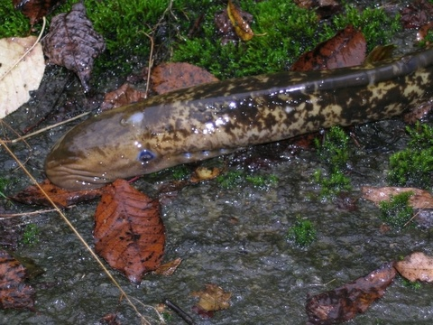
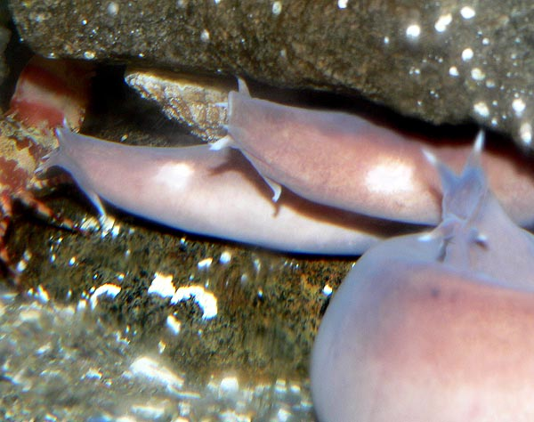
HAGFISH
SEA LAMPREY

Slide 12
The bony and cartilaginous fishes are common in most aquatic habitats.
Features | Bony | Cartilaginous
Skeleton | bone, cartilage | mostly cartilage
Skin | flat scales (eels lack scales) | small, tooth like scales (denticles)
Habitat | salt, fresh, brackish | mostly saltwater
Gills | covered by flap (operculum) | open to outside
Fins | mobile | limited movement
Swim bladder | present (except in bottom dwelling forms) | absent (large liver provides buoyancy)
Movement | can rise and sink in same position | must keep moving to avoid sinking
Reproduction | external fertilization | internal fertilization

Slide 13
B.Cartilaginous fish
Cartilaginous include the sharks, skates and rays. Although these look different, they have many features in common. None of them have any true bone , their skeleton is made of cartilage.
They have strong jaws and their mouth is on the underside of the body, and their eyes are on top. They cannot see food as it enters their mouth.
Some sharks solve this problem by touching their food briefly with their nose first. Some also use a powerful electrosensory system.

Slide 14
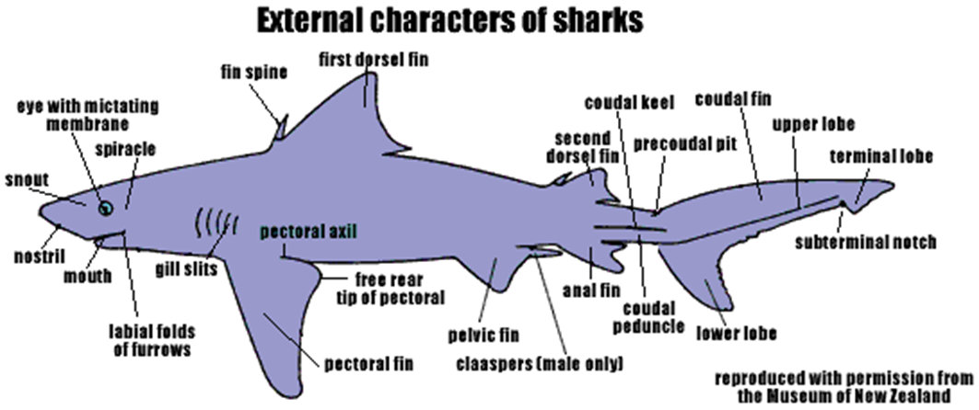

Slide 15
Presence of five to seven gill slits.
shark skin made up of denticles (placoid scales) for protection
lack swim bladder, so need to keep swimming to avoid sinking.
most are predatory, but some are filter feeders of plankton
large olfactory bulb for excellent smelling
efficient intestine with spiral structure
internal fertilization
most bear live young
replaceable teeth in multiple rows along edges of upper
and lower jaws,
placoid scales

Slide 16
C.Bony fish
Bony fish are often regarded as "true" fish. They have a bony skeleton and a single pair of external gill openings covered by a gill cover/operculum.
The mouth is generally at the front of the body and they have a tail fin, with the top and bottom portions nearly the same size.
Presence of swim bladder for buoyancy.
Internally, the intestine of the bony fish is a relatively short tube.
Bony fish reproduce by external fertilisation of eggs.
The female generally produces a large numbers of eggs and releases them into the water. The male releases sperm, normally called milt, into the water. The milt fertilises the eggs.

Slide 17
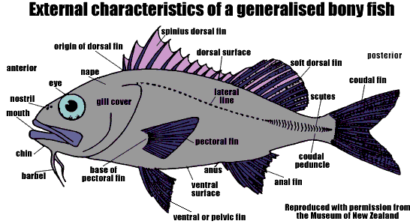

Slide 18
FISH HABITATS:
The reason some fish normally live in freshwater and others live in seawater is that one or the other environment provides them with opportunities that contribute to their survival.
An obvious difference between the two habitats is salt concentration.
Freshwater fish maintain the physiological mechanisms that permit them to concentrate salts within their bodies in a salt-deficient environment;
Marine fish, on the other hand, excrete excess salts in a hypertonic environment.
Fish that live in both environments(MIGRATORY) retain both mechanisms.

Slide 19
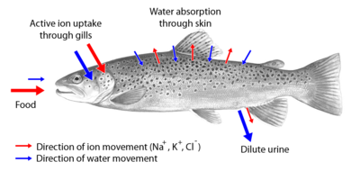
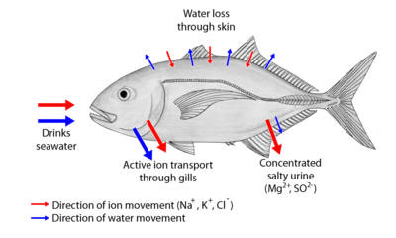
Freshwater
Marine

Slide 20
Migratory fish are classified according to the following scheme:
diadromous fish travel between salt and fresh water. There are three types of diadromous fish:
  anadromous fish live in the sea mostly, breed in fresh water (Greek: 'Ana' is up; The noun is "anadromy") e.g SALMONIDS
  catadromous fish live in fresh water, breed in the sea (Greek: 'Cata' is down) e.g. EELS
  amphidromous fish move between fresh and salt water during some part of life cycle, but not for breeding (Greek: 'Amphi' is both)
potamodromous fish migrate within fresh water only. (Greek: 'Potamos' is river)
oceanodromous fish migrate within salt water only. (Greek: 'Oceanos' is ocean)

Slide 21
Fresh water fish are fishes living the whole or parts of their lifes in fresh water, such as rivers and lakes with a salinity on less than 0,05 %.
41 % of all known species of fish are found in fresh water. Fresh water fish differ physiologically from salt water fish in several aspects.
Carps are common fresh water fish all over the world.
To survive fresh water, the fish needs a range of physiological adaptations in order to keep the ion concentration of the body balanced.
Their gills must be able to diffuse water while simultaneously keeping the salts of the bodily fluids inside.
The scales of the fish also plays a part in the process; fresh water fish that have lost too many scales get a surplus of water diffused in through the skin, causing the fish to die.
Another trait characteristic of fresh water fish are the well developed kidneys. These have to be large because a lot of water passes through them.

Slide 22
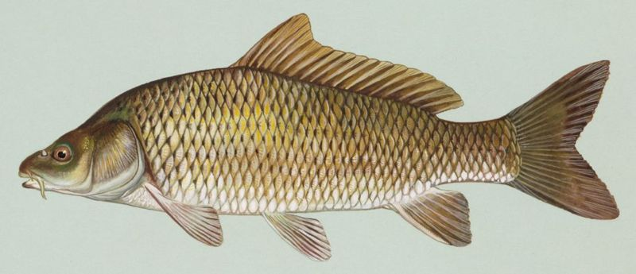
Common carp- Cyprinus carpio

Slide 23
CARPS
Carp is a common name for various freshwater fish of the family Cyprinidae, a very large group of fishes originally from Eurasia and southeast Asia.
Carp usually refers only to several larger cyprinid species such as
Cyprinus carpio (common carp),
Carassius carassius (Crucian carp),
Carp have long been an important food fish to humans, as well as popular ornamental fishes .

Slide 24
Tilapia :
Tilapia is a large genus in the cichlid family (Cichlidae).
The genus Tilapia, as well as closely related genera like Oreochromis and Sarotherodon.
Tilapia is a popular food fish and many species can easily be cultivated in ponds. It has been an important source of protein Africa ,for thousands of years and the Ancient Egyptians cultivated tilapia in ponds along the Nile.
Today, tilapia is a popular food fish all over the world and it is also kept in aquariums.When it comes to tilapia farming, species such as Nile tilapia (Oreochromis niloticus) and Mozambique tilapia (Oreochromis mossambicus) are appreciated since they grow fast and refrain from breeding until they are comparatively old.
Oviparous ,substrate or mouth brooders.

Slide 25
MARINE FISH
A. Sharks
Belong to the class Chondrichthyes have to keep swimming, otherwise they will sink to the bottom of the ocean.
This characteristic has led to two distinct forms of sharks: the pelagic and benthic forms. The pelagic sharks move constantly through the water and rely on this movement to pass water across the gills for respiration.
The benthic forms lie on the bottom and take in water through a pair of holes at the top of their head called spiracles.
Sharks are a type of fish with a full ca rtilaginous skeleton and a streamlined body. They respire with the use of five to seven gill slits.
Sharks have a covering of dermal denticles to protect their skin from damage and parasites and to improve fluid dynamics; they also have replaceable teeth.
Shark gill slits are not covered like other fish, but are in a row behind its head.

Slide 26
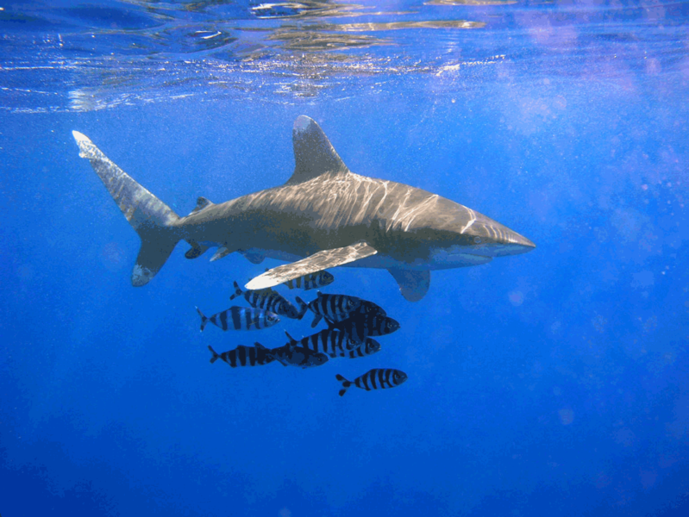
Oceanic whitetip shark, Carcharhinus longimanus

Slide 27
Unlike bony fish, sharks do not have gas-filled swim bladders for buoyancy. Instead, sharks rely on a large liver, filled with oil that contains squalene.
The buoyant liver may constitute up to 30% of their body mass. Its effectiveness is limited, so sharks employ dynamic lift to maintain depth and sink when they stop swimming.
Osmoregulation
In contrast to bony fish, the blood and other tissue of sharks and Chondrichthyes in general is isotonic to their marine environments because of the high concentration of urea and trimethylamine N-oxide (TMAO), allowing them to be in osmotic balance with the seawater.
This adaptation prevents most sharks from surviving in fresh water, and they are therefore confined to a marine environment.

Slide 28
SKATES AND RAYS
Batoidea is a superorder of cartilaginous fish containing more than 500 described species in thirteen families. Batoids include stingrays, skates, electric rays, guitarfishes and sawfishes.
Batoids are flat-bodied, and, like sharks, are a species of cartilaginous marine fish, meaning they have a boneless skeleton made of a tough, elastic substance.
Most batoids have 5 ventral slit-like body openings called gill slits that lead from the gills.
Batoid gill slits lie under the pectoral fins on the underside, whereas a shark's are on the sides of the head.
Most batoids have a flat, disk-like body, with the exception of the guitarfishes and sawfishes, while most sharks have a streamlined body.
Many species of batoid have developed their pectoral fins into broad flat wing-like appendages.
The anal fin is absent.

Slide 29
The eyes and spiracles are located on top of the head.
Bottom-dwelling batoids breathe by taking water in through the spiracles, rather than through the mouth as most fishes do, and passing it outward through the gills.

Slide 30
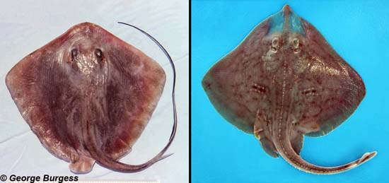
What are the differences between rays (left) and skates (right)?
The major difference between rays and skates is in their reproductive strategies. Rays are live bearing (viviparous) while skates are egg laying (oviparous).
Also, skates typically have a prominent dorsal fin while the dorsal fin is absent or greatly reduced in rays.

Slide 31
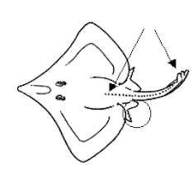
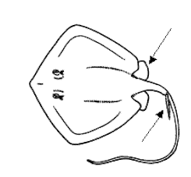
Most rays are kite-shaped with whip-like tails possessing one or two stinging spines while skates have fleshier tails and lack spines.
Rays protect themselves with these stinging spines or barbs while skates rely on thorny projections on their backs and tails to for protection from predators.
Another difference is that rays are generally much larger than skates.
SKATE
RAY

