Slide 1
AMPHIBIANS
LECTURE 4

Slide 2
AMPHIBIANS
Amphibians (class Amphibia) are a taxon of animals that include all living tetrapods (four-legged vertebrates) ,are ectothermic (cold-blooded)and generally spend part of their time on land.
Most amphibians do not have the adaptations to an entirely terrestrial existence found in most other modern tetrapods .There are around 6,200 described, living species of amphibians.
Amphibians are able to breathe by using lungs or gills or through their skin.
Amphibians are characterized by a glandular skin without external scales.
An amphibian’s skin requires moisture and is one of the ways through which it breathes, therefore a certain degree of dampness is required for an amphibian to survive on land.
Amphibians are totally dependent on water as part of their life cycle and water quality is an important issue to them.

Slide 3
They have gills during development (and in adulthood in some), eggs that may have jelly coats but develop without formation of extra-embryonic membranes such as the amnion .
Most amphibians also have four limbs. Limbs and lungs are adaptations for life on land.

Slide 4
CLASSIFICATION
KINGDOM- Animalia
PHYLUM- Chordata
SUBPHYLUM- Vertebrata
SUPERCLASS- Tetrapoda
CLASS- Amphibia
ORDER- Anura
ORDER- Caudata
ORDER- Gymnophonia

Slide 5
Skin
An amphibian has a very thin skin which isn't covered by fur, feathers, or scales. This makes them vulnerable to dessication (drying) and abrupt temperature change, but also offers several advantages. Amphibians can breath through the entire surface of their bodies. In the case of the lungless salamanders ,gas exchange through the skin alone provides sufficient oxygen.
Water is also absorbed through an amphibian's skin making drinking unnecessary. Senses
Like the lateral line of bony fishes, some amphibians, amphibian larvae, and aquatic amphibians also have pores on their bodies, called lateral line organs, that are sensitive to vibrations in the water,used in catching prey, detecting predators.
Their nervous systems are complex and have attributes to facilitate both aquatic and terrestrial life. All amphibians hear. Frogs and salamanders (except those which live in permanently dark locations) have good vision. Vision is nearly lost in caecilians, whose eyes are covered by skin and sometimes bone. They perceive by chemical cues.

Slide 6
Voice production is largely an attribute of frogs. Salamanders and caecilians produce noises, coughs, and grunts, but apparently not for communication. Frogs have complex sound production and perception systems, with species-specific warning, defensive, and breeding communications.

Slide 7
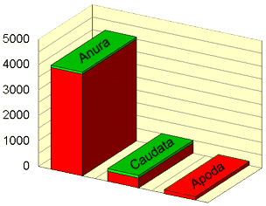
There are three orders in the Class Amphibia:
Anura (frogs and toads),
Caudata (salamanders),
and Apoda (caecilians).
The order Anura has the most species, with 4000 members worldwide, and 81 in North America.
Of 390 salamander species that exist worldwide, only 112 reside in North America. The third amphibian group, the caecilians, is smaller still with a total of only 162 species restricted to the tropics.

Slide 8
1.ANURANS: The frog is an amphibian in the order Anura (meaning "tail-less’)Adult frogs are characterised by
long hind legs,
a short body,
webbed digits,
protruding eyes and
the absence of a tail.
three eyelid membranes: one is transparent to protect the eyes underwater, and two vary from translucent to opaque.
a tympanum on each side of the head, which is involved in hearing and, in some species, is covered by skin.
Most frogs have a semi-aquatic lifestyle, but move easily on land by jumping or climbing. They typically lay their eggs in puddles, ponds or lakes, and their larvae, called tadpoles, have gills and develop in water.

Slide 9
Adult frogs follow a carnivorous diet, mostly of arthropods, annelids and gastropods. Frogs are most noticeable by their call, which can be widely heard during the night or day, mainly in their mating season.
Most frogs do in fact have teeth of a sort. They do not have anything that could be called teeth on their lower jaw, so they usually swallow their food whole.
The distribution of frogs ranges from tropic to subarctic regions, but most species are found in tropical rainforests.Frogs are unusual because they lack tails as adults and their legs are more suited to jumping than walking.
Many frogs, especially those that live in water, have webbed toes. The degree to which the toes are webbed is directly proportional to the amount of time the species lives in the water.
For example, the completely aquatic African dwarf frog (Hymenochirus sp.) has fully webbed toes.

Slide 10
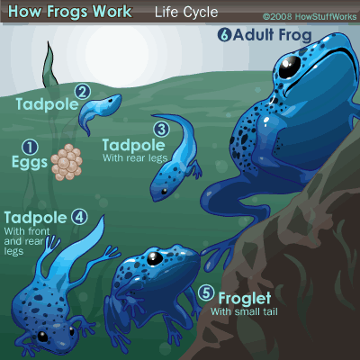
REPRODUCTION

Slide 11
Once at the breeding ground, male frogs call to attract a mate, collectively becoming a chorus of frogs. In most frogs, a signal produced by the male has evolved that serves to attract females. This is the vocal call, and it allows for species-specific identification and location, both for the female frog and the herpetologist.
The male and female frogs then undergo amplexus. This involves the male mounting the female and gripping her tightly.
Fertilization is external: the egg and sperm meet outside of the body. The female releases her eggs, which the male frog covers with a sperm solution. The eggs then swell and develop a protective coating. The eggs are typically brown or black, with a clear, gelatin-like covering.

Slide 12
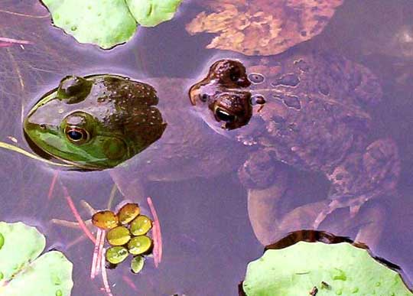
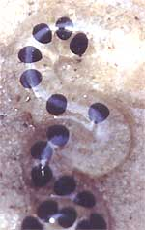
Amplexus
The black specks on frog eggs are frog embryos suspended in the eggs' gelatinous mass.

Slide 13
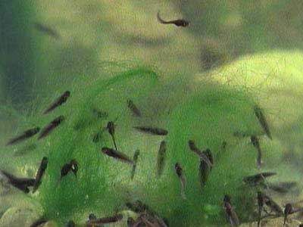
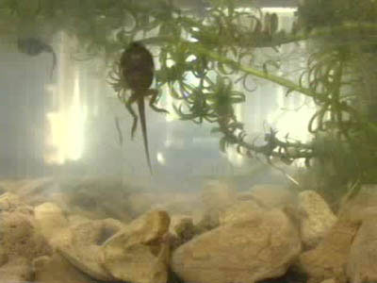
Eggs hatch and continue life as larvae called tadpoles Tadpoles are aquatic, lack front and hind legs, and have gills for respiration and tails with fins for swimming. Tadpoles are typically herbivorous, feeding mostly on algae, including diatoms filtered from the water through the gills.
Tadpoles
Tadpole with developing hind limbs

Slide 14
Metamorphosis of the tadpole larva into an adult frog is one of the most striking transformations in all of biology (Figure on next slide ).
In amphibians, metamorphosis is initiated by hormones from the tadpole's thyroid gland, and these changes prepare an aquatic organism for a terrestrial existence.
In anurans (frogs and toads), the metamorphic changes are most striking, and almost every organ is subject to modification.
The changes in form are very obvious.
For locomotion, the hindlimbs and forelimbs differentiate as the paddle tail recedes.
The cartilaginous skull of the tadpole is replaced by the predominantly bony skull of the young frog.
The horny teeth the tadpole uses to tear up pond plants disappear as the mouth and jaw take a new shape, and the fly-catching tongue muscle of the frog develops.
Meanwhile the large intestine characteristic of herbivores shortens to suit the more carnivorous diet of the adult frog. The gills regress, and the lungs enlarge.

Slide 15
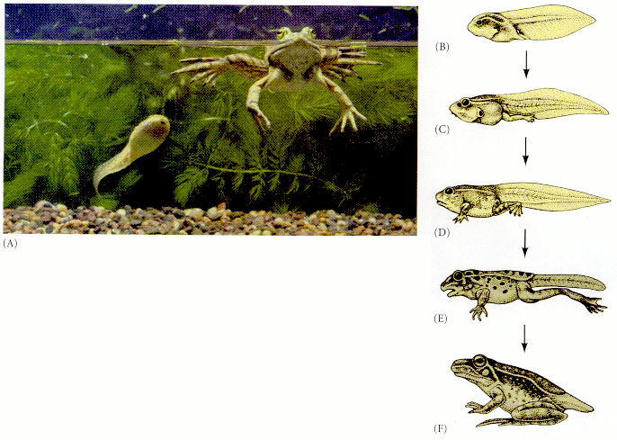
Metamorphosis of the frog Rana. (A) Huge changes are obvious when one contrasts the tadpole and the adult bullfrog. Note especially the differences in jaw structure and limbs. (B) Premetamorphic tadpole. (C) Prometamorphic tadpole, showing hindlimb growth. (D) Onset of metamorphic climax as forelimbs emerge. (E, F) Climax stages.

Slide 16
The final stage of development from froglet to adult frog involves apoptosis (programmed cell death) and resorption of the tail.
After metamorphosis, young adults may leave the water and disperse into terrestrial habitats, or continue to live in the aquatic habitat as adults.
Almost all species of frogs are carnivorous as adults, eating invertebrates such as arthropods, annelids and gastropods.

Slide 17
CAUDATA:
Order: Caudata (Urodela) – newts and salamanders - amphibians with short legs, a long trunk and a well-developed tail.
Salamander is the common name applied to approximately 500 species of amphibians typically with slender bodies, short legs, and long tails.
The moist skin of these amphibians usually makes them reliant on habitats in or near water or under some protection on moist ground, often in a swamp. They live in rooks,creeks,ponds and other moist locations such as under rocks.
Some species are aquatic throughout life, some take to the water intermittently, and some are entirely terrestrial as adults.

Slide 18
An adult salamander has a slender, elongated body with a long tail, and in most cases, two pairs of legs roughly equal in size.
Most salamanders are dull in color, but some, such as fire salamanders, have brilliant yellow, orange, or red markings.
Those salamanders that spend all or part of their lives on land tend to be slight, with small heads, slender bodies.
Aquatic salamanders, such as the amphiuma, are usually larger, and they often have reduced limbs. Some aquatic salamanders, such as the greater siren, have no hind legs at all.
They lay shelless eggs in water. They are capable of regenerating lost limbs.

Slide 19
Most salamanders have well-developed eyes.
They also have nasal sensory organs capable of detecting chemical changes in the environment.
Most salamanders are carnivorous .Salamanders eat insects, worms, snails, and small fish.
Adult salamanders that live in water prey on the larvae of frogs, known as tadpoles.
Salamanders also have glands in the skin that secrete a thick layer of mucus. On land, this mucus prevents the skin from drying out, and in water, it helps maintain the correct balance of salt and water in salamanders’ body fluids

Slide 20
Salamanders are the only amphibians that have long tails as adults. They use these tails, which are often as long as their bodies, for balance in walking and propulsion in swimming.
The tails of aquatic salamanders are often compressed to aid in swimming, whereas those of terrestrial species are more rounded. Some salamanders have the ability to regenerate their tails if they are lost.
Like all amphibians, salamanders have delicate, permeable skin through which water and gases, such as oxygen and carbon dioxide, can enter and leave the body.
Salamanders continue to grow past sexual maturity and must periodically shed their skin. After shedding, they often eat the skin.

Slide 21
Most adult salamanders have saclike lungs for breathing air and use their permeable skin only as a source of supplemental oxygen.
Some species never develop lungs and instead obtain oxygen through gills or through their skin and the mucous membranes of their mouths and throats.
Some salamanders, such as the mudpuppies and waterdogs, keep external gills throughout their lives.
The gills, as in fish, are red in color due to the high blood concentration necessary for oxygen absorption from the water.
Gill size may be related to the water quality. In warm, slow-moving, low-oxygen waters, salamanders often have larger gills than those found in cool, flowing, high-oxygen waters.
Salamanders do not have ears, but may be able to detect vibrations through their legs and jaws. In the water, vibrations are detected by the lateral line system, rows of sensors found on the head.

Slide 22
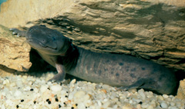
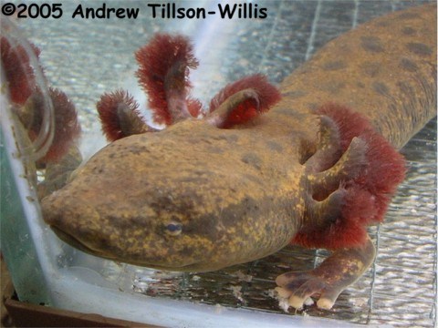
External gills

Slide 23
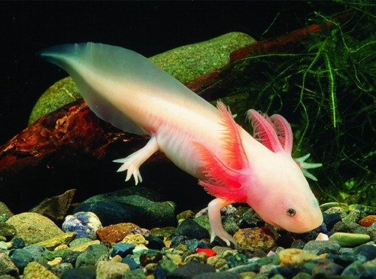
REPRODUCTION
In salamanders that give birth to live young, the larval stage takes place within the body of the mother. Only some salamander larvae actually live in a body of water such as a pond or stream.
All salamanders have a larval stage in which they have external, feathery gills for breathing in water. Among salamanders that lay their eggs on land, the larval stage occurs inside the egg.
feathery gills

Slide 24
Many salamander larvae undergo a transformation called metamorphosis, in which their bodies change in ways that make them better suited to life on land than life in the water.
Metamorphosis begins when the hypothalumus of the salamander brain sends a signal to the pituitary gland to release its hormones. These hormones of the pituitary then stimulate the thyroid to begin its own release of hormones to the rest of the organism.
Depending upon the response of the organism to these factors, metamorphosis may or may not occur. Instead neoteny may be the end result.

Slide 25
Many salamanders, including mud puppies, undergo partial metamorphosis and as adults retain some larval characteristics, such as gills.
In neoteny, the juvenile (larval) form is slowed down, while the gonads and germ cells mature at their normal rate.
In progenesis, the gonads and germ cells mature rapidly, while the rest of the body matures normally. In both instances, the animal can mate while in its larval form.

Slide 26
The axolotl ,Ambystoma mexicanum, is a neotenic salamander. Larvae of this species fail to undergo metamorphosis, so the adults remain aquatic and These amphibians retain many characteristics of larvae for their entire lives, except that they develop reproductive organs.
Whereas other amphibian species cannot reproduce in this non-metamorphosized state, the axolotl has no problem in doing so, becoming sexually mature in the larval form (a condition called 'neotony'), with the females laying up to 1000 eggs each 3-6 months.

Slide 27
Mexican axolotl- Ambystoma mexicana

Slide 28
CAECILLIANS
Caecilians, order Gymnophiona, or Apoda, are perhaps the least studied amphibians. The strange wormlike caecilians live either mostly underground or underwater.
Having evolved in dark habitats, they have almost completely lost their eyes, and instead have a sensory tentacle, the tip of which is shown here just in front of the mouth. The roughly 185 species of caecilians are nearly all tropical in distribution.
Caecilians lack appendages, and have powerful heads and highly ossified sculls for burrowing, highly acute olfactory systems, and are the only amphibians to possess dermal scales.

Slide 29
Caecilians are long-bodied, limbless amphibians that look similar to earthworms because of segmental rings around their body.
Although they are not exactly amphibian-looking, their bones, teeth, fat bodies and other structures show that they are related to salamanders and frogs.
Their skin is slimy and smooth in adults and their color is dark gray. Adults' eyes are often small and useless.
To compensate for their eyes, a sensory organ in the form of a tentacle lies on the upper jaw behind the nostril that carries chemical messages.
Like all amphibians, caecilians breathe primarily through their skin but will occasionally come to the surface to breathe air through their lungs.

Slide 30
Caecilians have several rows of sharp teeth that they use for capturing small animals such as earthworms, termites, and beetles. In addition, they occasionally eat small frogs and lizards.
Caecilians differ from most other amphibians in that their reproduction always involves internal fertilization, meaning that the egg and sperm join within the female’s body.
Aquatic caecilians, also known as rubber eels, are found in Colombian and Venezuelan lowland rivers and streams. Looking more like large worms than the legless amphibians they are, they can grow up to 22 inches in length and have slimy smooth dark gray skin.

Slide 31
Among many of the other species, females lay their eggs underground near streams, and the hatchlings wiggle their way to the water, where metamorphosis gradually occurs.
Among other egg-laying species, the embryos undergo metamorphosis inside of the eggs, and the hatchlings emerge with adult body structures.

Slide 32
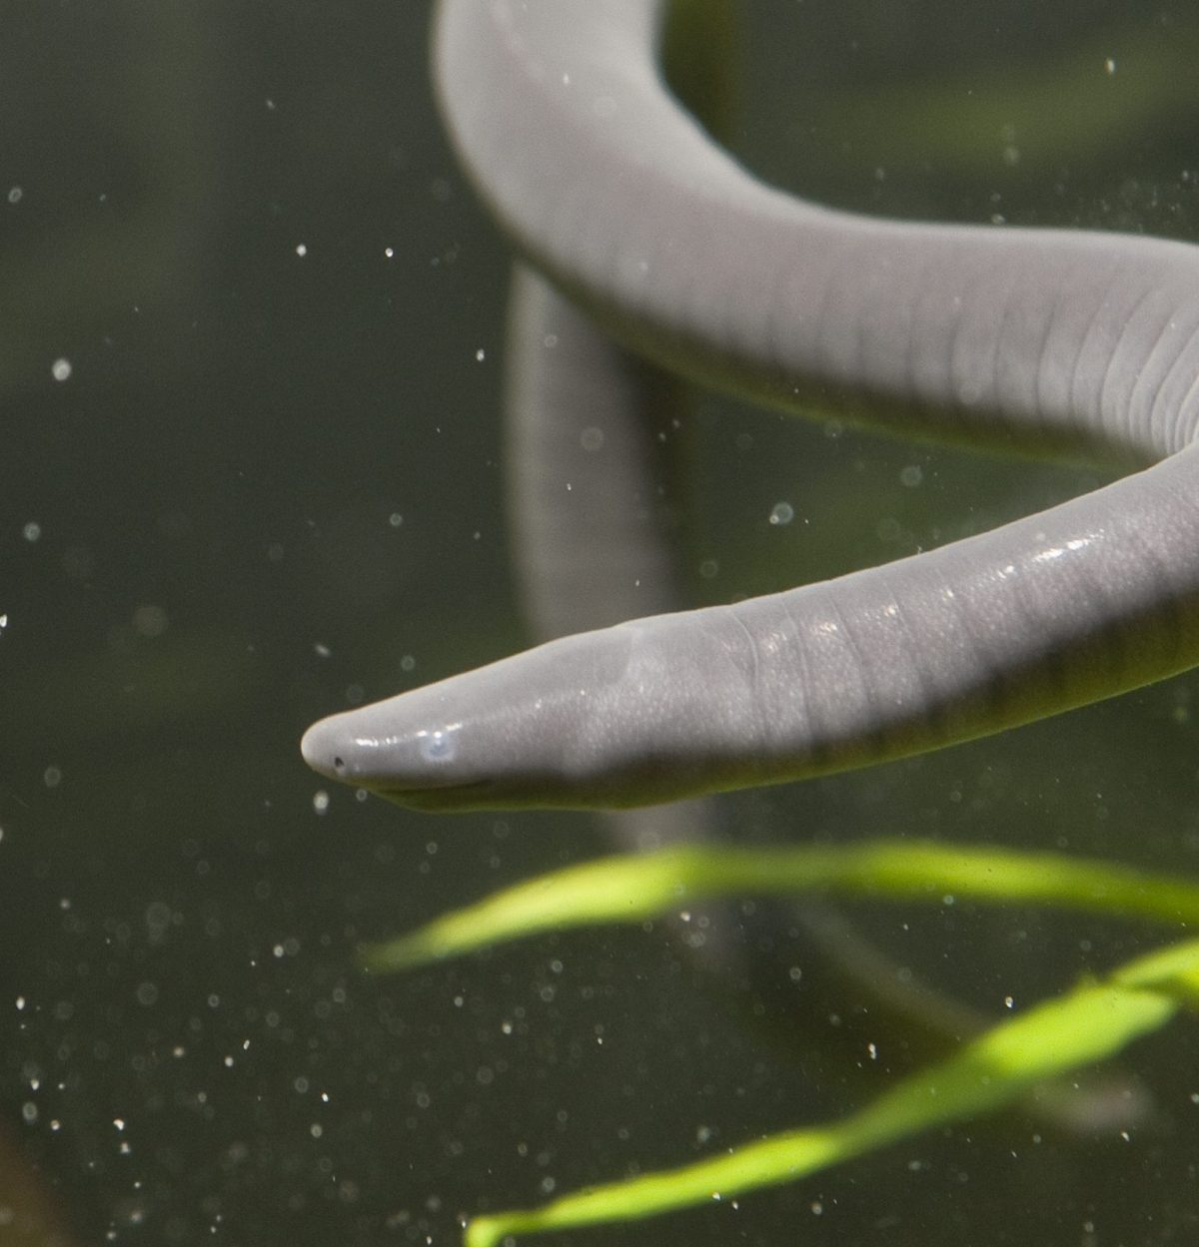
Aquatic caecilian

Slide 33
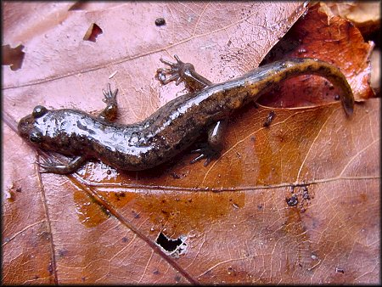
Dusky Salamander (Desmognathus ochrophaeus)

Slide 34
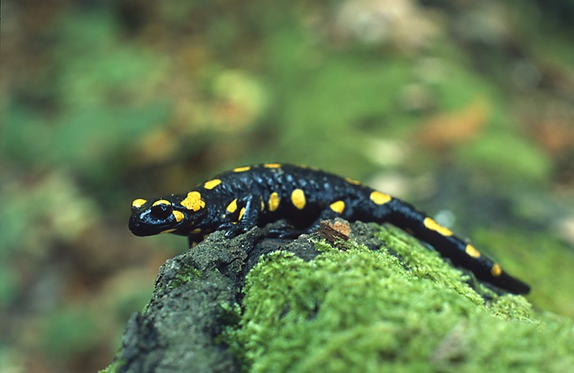
Salamander salamandera

