Slide 1
AQUATIC REPTILES
Turtles, Crocodiles, Snakes
Lecture 3

Slide 2
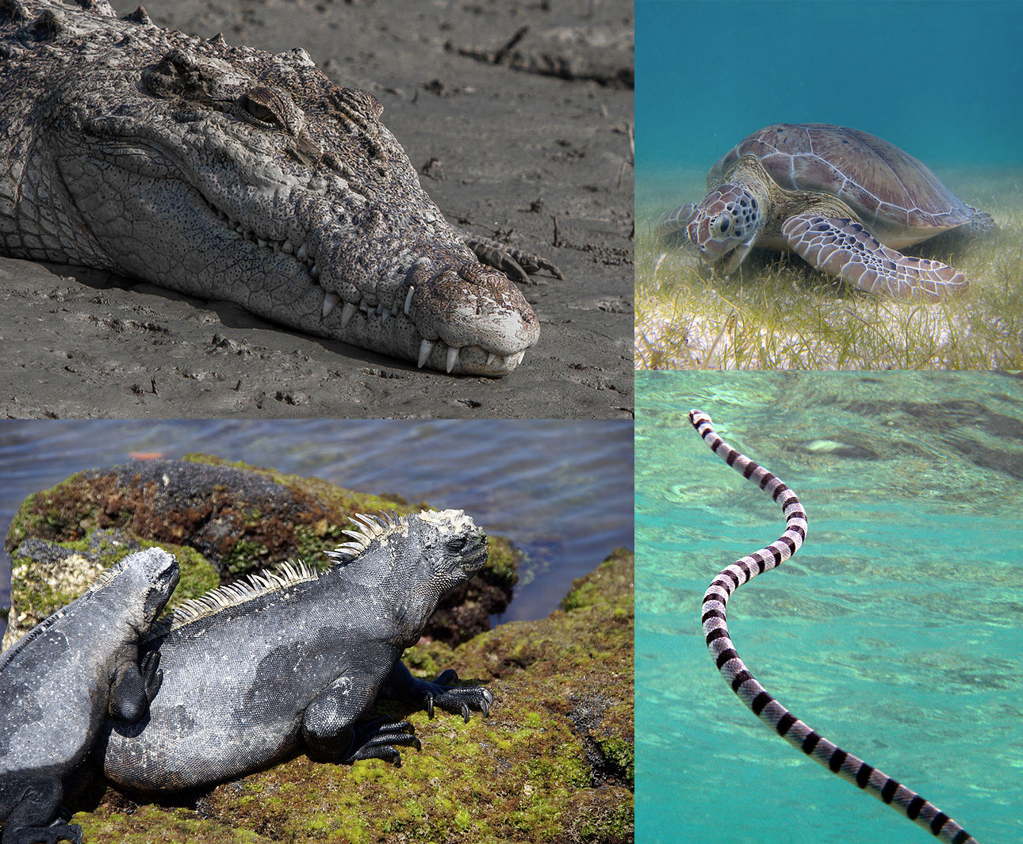

Slide 3
AQUATIC REPTILES
Reptiles are cold-blooded vertebrates that have skin covered in scales and are air-breathing.
Aquatic reptiles are vertebrates that do not correspond to a single group, but there are several types which live in different habits.
Some of them are exclusively aquatic, while others are considered semi-aquatic because they spend a large part of their time on land. They may do so to lay eggs, sunbathe or even breathe.

Slide 4
CHARACTERISTICS of AQUATIC REPTILES
Depending on the type, they can inhabit fresh or salt water.
Some species manage to dive to great depths, so they can withstand the pressure of deep sea environments.
In certain cases, the limbs have been modified to facilitate locomotion in the water through swimming.
Species of marine reptiles have mechanisms to expel excess salt through the use of specialized glands that may be in the mouth, eyes or nose, depending on the species.
They have a common feature of valve nostrils which allow them to stop water entering when submerged.
The diet varies according to the type of aquatic reptile, some being strictly carnivorous predators, others omnivores and some herbivores.
In certain cases, they have quite marked migratory habits, while others remain in the same habitat throughout their lives.

Slide 5
Types of aquatic reptiles
According to traditional taxonomy, the Reptilia class is made up of the following orders:
Testudines (turtles and tortoises)
Squamata (snakes, blind shingles, and lizards)
Crocodilia (crocodiles, alligators and caimans)
Within these orders we find different types of marine and freshwater reptiles.

Slide 6
Testudines
Turtles are a common example of aquatic reptiles, although there are species with exclusively terrestrial habits.
These animals have a characteristic shell or carapace. Rather than a separate part of the body, they are a modified extension of the spine and ribs.
Turtles lay their eggs on land. For this reason, they do not live exclusively in water. They also need to break the surface water to breathe. Turtles are are usually omnivorous animals, although some tend to be more herbivorous in the adult phase. In terms of habitat, there are both freshwater and marine turtles. Some examples are found in the following species:
Saltwater Turtles :
Loggerhead sea turtle (Caretta caretta)
Green sea turtle (Chelonia mydas)
Hawksbill sea turtle (Eretmochelys imbricate)
Freshwater turtles :
Snake necked turtle
Razor-backed musk turtle

Slide 7
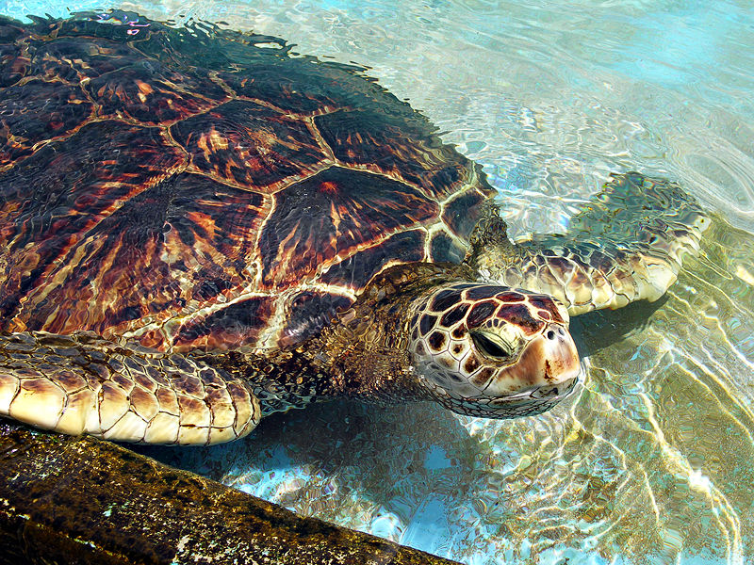
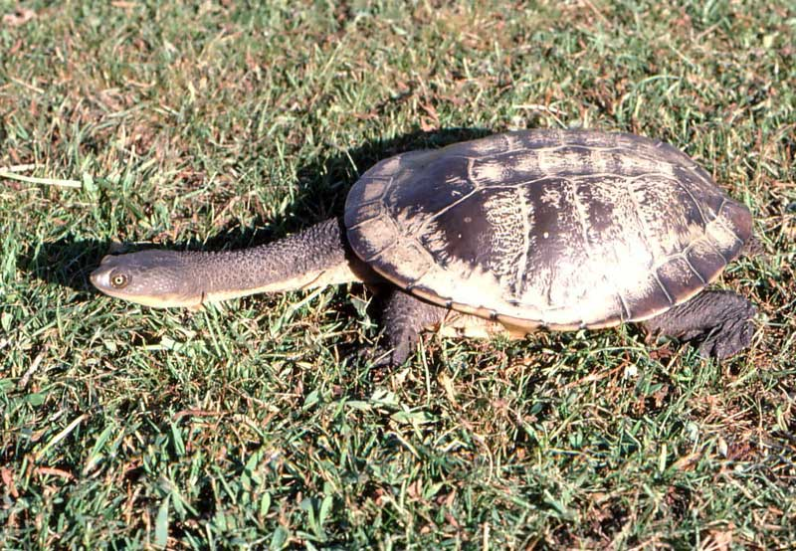
SEA TURTLE
FRESHWATER TURTLES
Hawaiian Green Sea Turtle
Snake-necked Turtle

Slide 8
Order Testudinata
Pleurodira.
Cryptodira
Suborders
The Cryptodira is the larger of the two groups and includes all the marine turtles, the terrestrial tortoises, and many of the freshwater turtles.
The Pleurodira are sometimes known as the side-necked turtles, a reference to the way they withdraw their heads into their shells. This smaller group consists primarily of various freshwater turtles

Slide 9
1)SHELL
The upper shell of the turtle is called the carapace. The lower shell that encases the belly is called the plastron. The carapace and plastron are joined together on the turtle's sides by bony structures called bridges. In most turtles, the outer layer of the shell is covered by horny scales called scutes that are part of its outer skin, or epidermis. Scutes are made up of a fibrous protein called keratin.
Aquatic and soft-shelled turtles have lighter shells that help them avoid sinking in water and swim faster with more agility. These lighter shells have large spaces called fontanelles between the shell bones. The shell of a leatherback turtle is extremely light because they lack scutes and contain many fontanelles
2) LIMBS
The front limbs of sea turtles are long and wing-like, and formed into flippers; the back limbs are paddles (not really flippers) with a membrane joining all five of the toes. Sea turtles "fly" through the water, using the up-and-down motion of the front flippers.

Slide 10
3)Some aquatic turtles, such as snapping turtles and soft-shelled turtles, have eyes closer to the top of the head.
These species of turtles can hide from predators in shallow water where they lie entirely submerged except for their eyes and nostrils.
4)Sea turtles possess glands near their eyes that produce salty tears that rid their body of excess salt taken in from the water they drink.
5)Most aquatic turtles have flat, streamlined shells which aid in swimming and diving.

Slide 11
Reproduction
Male and female sea turtles do not differ externally until they approach maturity.
Adult males have longer, thicker tails, because the male reproductive organ is housed in the base of the tail. In males, the tail may extend beyond the hind flippers.
Like other turtles, sea turtles lay eggs. They must come ashore to do so.
Females nest a few weeks after mating.
Females usually nest during the warmest months of the year. The exception is the leatherback turtle, which nests in fall and winter.
Females may spend two or more hours out of water during the nesting period.
A mature nesting female hauls herself onto the beach until she finds suitable sand on which to create a nest.
Using its hind flippers, the female proceeds to dig a circular hole 40 to 50 centimeters deep. After the hole is dug, the female then starts filling the nest with eggs one by one until it has deposited around 150 to 200 eggs.

Slide 12
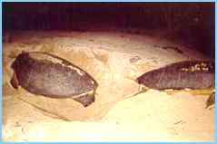
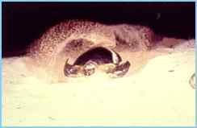
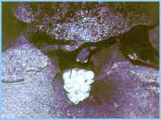
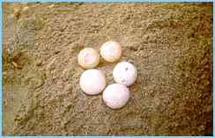
A turtle prepares to nest: (from top to bottom) using her front flippers, the turtle creates the "body pit" and, with her hind legs, digs the egg chamber, where she deposits more than a hundred eggs.

Slide 13
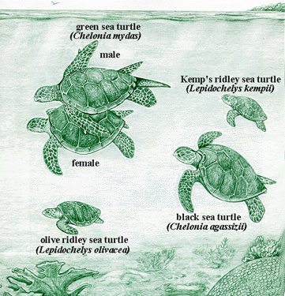
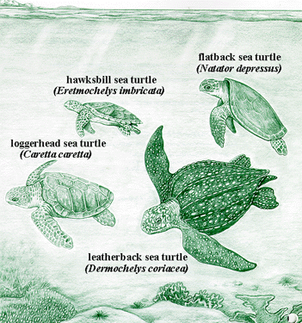
Incubation takes about 2 months. The length of incubation and the gender of the hatchling depends on the temperature of the sand. Darker sands maintain higher temperatures, decreasing incubation time and increasing the frequency of female hatchlings. When the eggs hatch, these hatchlings dig their way out and seek the ocean.

Slide 14
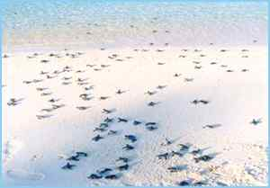
Soon after they emerge from their shells, young turtles leave their natural nest (top and middle photos) and scurry to the water (bottom photo) to begin their seaward journey.

Slide 15
Squamata
Some species of aquatic snake are highly poisonous. These animals have adapted to life in a marine environment without any problem. In fact, they are often not well adapted to life on land.
In general, the entire reproductive cycle occurs in the water with certain exceptions, such as the genus Laticauda. These are types of oviparous animals and lays their eggs on land. They tend to be predators of other animals that live in the sea.
Some examples of these aquatic reptiles are:
Beaked sea snake (Enhydrina schistosa)
Olive sea snake (Aipysurus laevis)
Yellow-bellied sea snake

Slide 16
A term which includes some members of the Colubridae family, of very low or nil venomicity, and true sea-snakes of the family Hydrophiidae, which have very powerful venom but keep mostly to the open sea. They can be a hazard if blown to shore in rough weather. They have a capability of staying under water for as long as 8 hours.

Slide 17
Most snakes are capable of swimming fairly well, but some types (aquatic snakes) specialize in the medium.
Some of their more obvious adaptations are the placement of their eyes and nostrils higher in the head allowing them to breathe and see without raising their head above water, and the flattening of their tail.
The tail is used like a fin, moved side-to-side like a fish to propel themselves.
These snakes often prey on fish and other unsuspecting marine animals. These snakes often dive to great depths, staying underwater for long periods of time.
The lung has become very large and extends almost the entire length of the body, although it seems likely that the rear portion developed to aid buoyancy, rather than to exchange gas. The extended lung may also serve as a means of storing air for dives.
Sea snakes in general are able to respire through their skin.
In sea snakes, the posterior sublingual glands, located under and around the tongue sheath, to allow them to expel salt with their tongue action.[

Slide 19
Reproduction
Except for a single genus, all sea snakes are ovoviviparous; the young are born alive in the water where they live out their entire life cycle.
In some species, the young are quite large: up to half as long as the mother.
The one exception is the genus Laticauda, which is oviparous; its five species all lay their eggs on land.

Slide 20
Crocodilia
This group is made up of three families that include commonly known animals such as crocodiles (Crocodylidae), alligators and caimans (Alligatoridae), and gharials (Gavialidae).
They all have semi-aquatic habits. Most live in tropical areas, although some exceptions can be found in North America and China.
They are carnivorous animals that stalk their prey using speed and strength. They all have a similar body shape(streamlined), although they vary in size.
Although most live in freshwater ecosystems, there are species that tolerate marine or brackish environments.
They feed mostly on vertebrates like fish, reptiles, and mammals, sometimes with invertebrates like mollusks and crustaceans, depending on species.

Slide 21
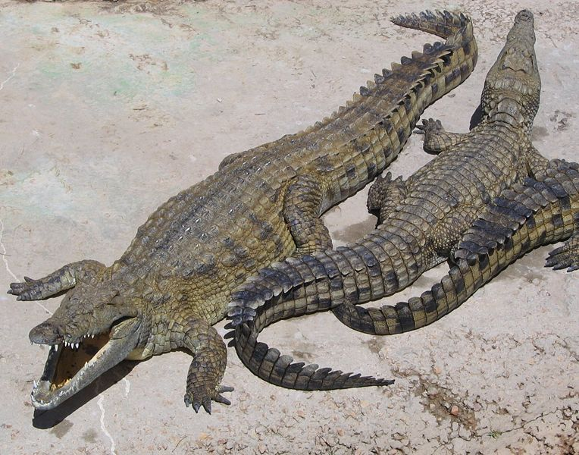
Nile crocodile Crocodylus niloticus
The largest species of crocodile is the Saltwater Crocodile, found in northern Australia and throughout South-east Asia.The largest living crocodile is a 7.1 m (23.3 ft) long saltwater crocodile, in Orissa, India. It lives in Bhitarkanika Wildlife Sanctuary

Slide 22
As cold-blooded predators, they are lethargic, therefore survive long periods without food, and rarely need to actively go hunting.
Despite their slow appearance, crocodiles are top predators in their environment, and various species have been observed attacking and killing sharks.
A crocodile’s physical traits allow it to be a successful predator.

Slide 23
They have streamlined bodies.
They have webbed feet which, although not used to propel the animal through the water, allow it to make fast turns and sudden moves in the water or initiate swimming.
Webbed feet are an advantage in shallower water where the animals sometimes move around by walking.
They have extremely powerful jaws capable of biting down with immense force, by far the strongest bite of any animal.
They have sharp teeth for tearing and holding onto flesh, but cannot open their mouth if it is held closed.

Slide 24
Reproduction
Crocodiles reach sexual maturity at 12 to 15 years when they are about 2-3 m long and weigh 70-100 kg. Mature males form a dominance hierarchy during the breeding season.
Courtship is elaborate, with females thrusting vertically out of the water, and males thrashing about in an impressive display of power. Mating occurs in the water.
The female selects a suitable sand bank for her nest, usually high up and near to cover so that she can keep watch over the eggs; good sites are used year after year by the same female.
During the night she digs a hole 30-41 cm deep, using her front feet and her snout.

Slide 25
The female defends the nest site against predators (including other crocodiles, particularly males) for the next 90 days, going without food though she may visit the water to drink
. Three months later, the young crocodiles begin to emit high pitched cheeping noises from within the eggs which is audible up to 20 m away. On hearing this, the female digs open the nest and releases the hatchlings which use a special egg tooth to break through their shells.
Then their mother gently transports them to the water's edge in the elastic gular pouch of her throat so that they can clean themselves.
Crocodiles can "choose" the sex of their offspring by controlling the temperature of the nest. Cooler temperatures of 26 - 30°C produce female crocodiles, while hotter temperatures of 31 - 34°C produce males.

