Slide 1
MARINE MAMMALS
Lecture-2

Slide 2
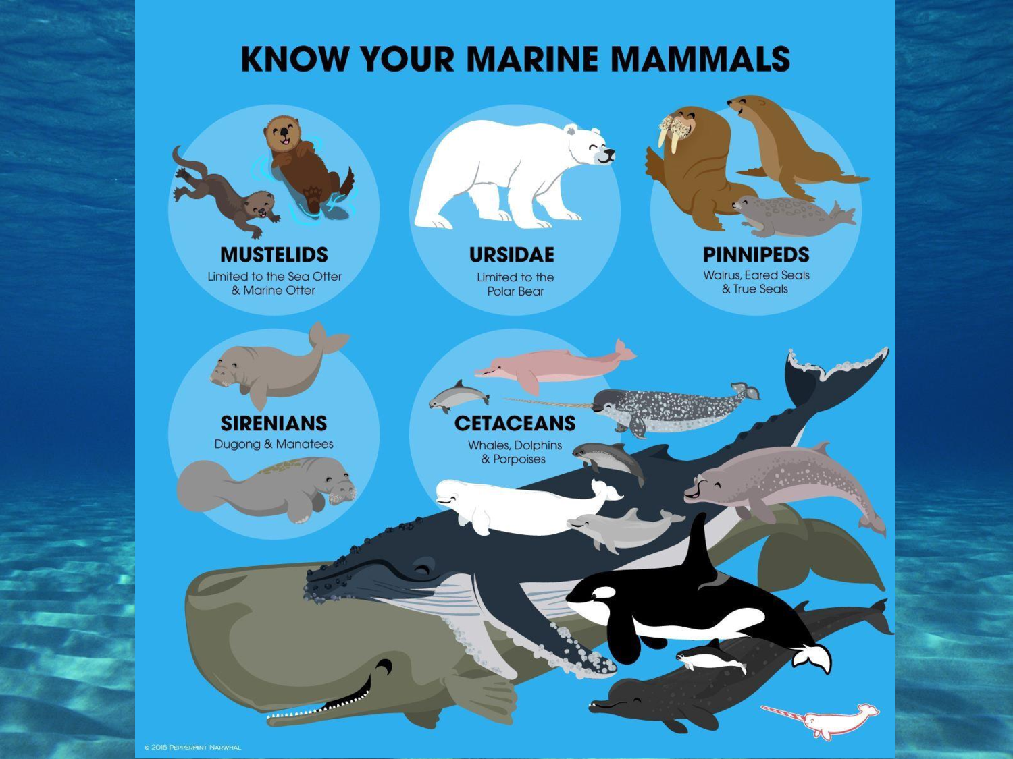

Slide 3
CLASSIFICATION:
Order CETACEA: Cetaceans
Suborder Mysticeti: Baleen whales (14 or 15 species)
Suborder Odontoceti: Toothed whales (around 73 species)
Order SIRENIA: Sirenians
family Trichechidae: manatees (3 species)
family Dugongidae: dugong (1 species)
Order CARNIVORA
superfamily Pinnipedia
family Phocidae: true seals (around 20 species)
family Otariidae: eared seals (around 16 species)
family Odobenidae: walrus (1 species)
family Mustelidae
sea otter (Enhydra lutris)
marine otter (Lontra felina)
family -Castoridae
Beaver

Slide 4
ADAPTATIONS OF MARINE MAMMALS
streamlined shape for efficient movement through viscous medium, with no protruding ears, and little or no hair to slow them down
insulating blubber, a thick layer of fat and oil, which keeps their bodies warm and buoyant. This layer is thinner in warmer temperatures, and thicker in colder climates.
soft skin .
limbs evolved into fins and flippers dorsal fin for balance, side flippers for balance and steering,
tail fluke's up and down movement provides powerful propulsion(pushes forward) through the water
deep diving ability, due to:
the proteins in muscles use and store oxygen efficiently
their ability to tolerate high levels of carbon dioxide

Slide 5
slower heartbeat while diving.
blood is shunted away from areas that can tolerate low oxygen and to heart, lungs, brain where it is needed most.
blowhole on top allows animal to surface to breathe while keeping most of body underwater
camouflage coloration/countershading--dark top blends in with dark depths when viewed from above; light belly blends in with sunlit surface when seen from below
ability to communicate over hundreds, even thousands of miles underwater;
echolocation which makes them able to avoid obstacles and find prey in murky depths

Slide 12
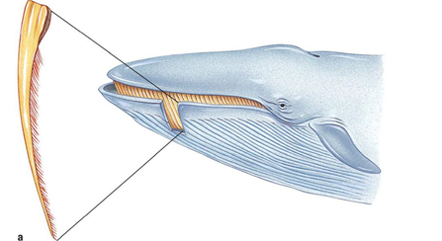
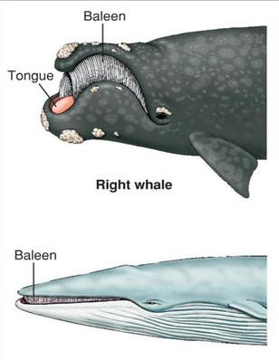
Baleen
Blue whale

Slide 13
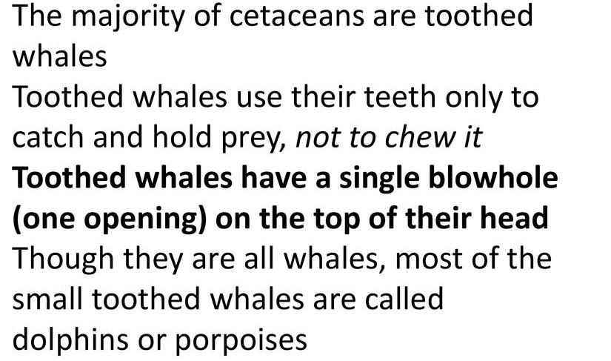

Slide 14
Family:Delphinidae
Most have dorsal fins, which are usually curved, but much variation exists.
Some species have striking color patterns over their bodies; others are more or less uniform.
The group includes bottlenose dolphins, killer whales etc.
The shape of the head of many delphinids is distinctive; the forehead appears to bulge over the beak-like rostrum due to the presence of a lens-shaped fatty deposit called a "melon.“
This structure may help focus the sound emitted by these animals in echolocation and feeding.
One blowhole.

Slide 16
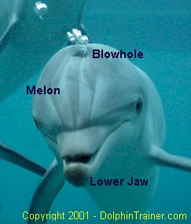
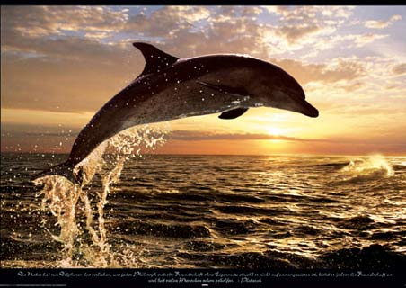
Dolphin

Slide 17
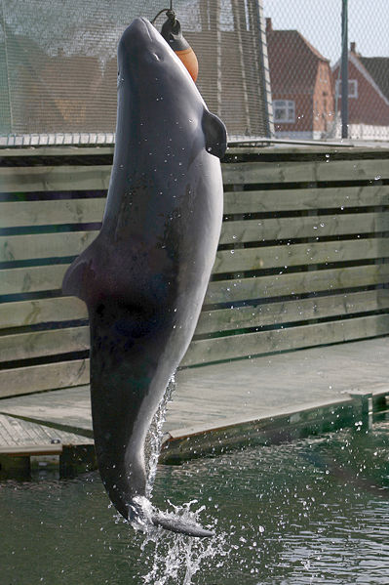
Family Phoceonidae: Porpoises
Porpoises tend to be smaller but stouter than dolphins.
They have small, rounded heads and short and blunt jaws instead of beaks.
While dolphins have a round, bulbous “melon", porpoises do not.
In addition, a porpoise's dorsal fin is generally triangular, rather than curved like that of many dolphins and large whales.

Slide 18
Cetacean Reproduction:
In order to maintain their streamlined shape the genitals and mammary glands are hidden within the body.
Sexual maturity occurs from 2 to 20 years depending on the species and the gender.
Pregnancy varies from 8 to 16 months.
A single calf is born usually tail first and must be lifted to the surface for the first breath. In some species the mother and calf are assisted by other females who will lift the calf with their own bodies.
Heat loss is a danger with all small animals because of the surface to volume ratio so cetacean calves are generally quite large at birth.
Their growth rate is extremely rapid and is supported by very nutritious milk. The fat content can be as high as 50% compared to human milk which is only about 3% fat.

Slide 20
Members of the extant order Sirenia are found in aquatic habitats throughout the tropics and subtropics.
Sirenians are the only completely aquatic mammals that are herbivores.
Because of their herbivorous nature, all sirenians are found in relatively shallow waters where sunlight can penetrate and stimulate plant growth.
The combination of these factors means that sirenians are restricted to warm shallow coastal waters, estuaries, and rivers, with healthy ecosystems that support large amounts of seagrass and/or other vegetation.

Slide 21
The order of sirenians contains five species in two families
Dugongidae and
Trichechidae).
The four living species of the Sirenia are the dugong, Amazonian manatee, West Indian manatee and African manatee.
One species (Steller's sea cow) is extinct. The members of the order Sirenia are believed to be relatives of the elephants.
Sirenians
Dugongidae
Dugongs
Trichechidae)
Manatees

Slide 22
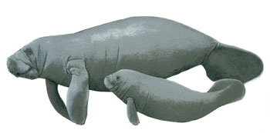
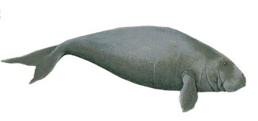
Manatees
Dugong

Slide 23
1.They both have fusiform bodies, although manatees have paddle-like tails while dugongs have notched(divided) tails.
2. Both can be found in saltwater, however dugongs are confined to saltwater only while manatees usually migrate to freshwater sources during winter.
3. Manatees can eat almost any sea plants as well as some algae while dugongs are limited to sea grass only.
4. Manatees have a generally shorter snout compared to dugongs.
5.Manatees also don’t have incisors while dugongs have tusks.
Both animals are considered vulnerable to extinction and strict laws are in place for their conservation.

Slide 25
Pinnipeds
Seals, Sea Lions, and Walrus: Pinnipeds
Pinnipeds are carnivores that have adapted to an amphibious marine existence.
They forage/feed at sea but most come ashore or onto ice at some time of the year to mate, give birth, suckle their young, or to molt.
Many of their anatomical features reflect compromises needed to succeed in both marine and terrestrial environments.
Externally, pinnipeds share many characteristics with terrestrial carnivores (fissipeds) due to their need for mobility on land.
Pinnipeds have four webbed flippers used to propel their spindle-shaped bodies.

Slide 26
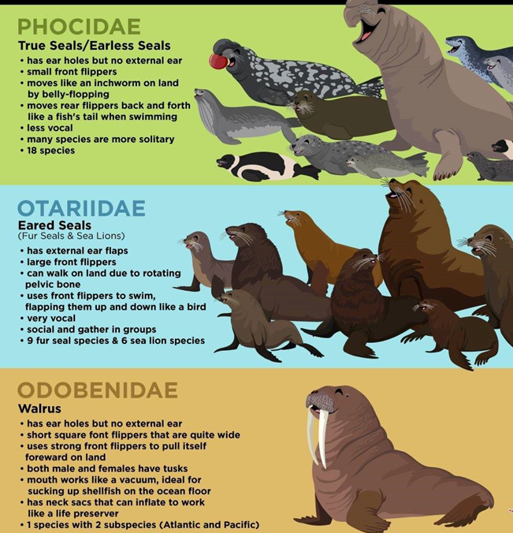

Slide 27
REPRODUCTION:
Pinnipeds often come ashore or haul out on ice to breed, often travelling long distances fom their feeding grounds to suitable mating grounds with a high level of reproductive synchrony.
Almost all pinnipeds are polygynous, i.e. males breed with up to several dozen females in a season.
Some form of competition, either for females or territories, some of which can be violent, is an integral part of the male breeding strategy among most pinnipeds.
Females have a postpartum oestrus allowing them to mate soon after giving birth.
Subsequent implantation of the embryo is delayed (embryonic diapause) thus removing the need to come ashore (haul-out) twice, once to give birth and again later to mate. After giving birth mothers suckle their young for a variable length of time.
Embryonic diapause, a condition of temporary suspension of development of the mammalian embryo.

Slide 28
Sea Otter:Adapted to marine life.
The front and back feet are fully webbed; large lungs allow long dives and provide buoyancy; and thick fur provides insulation.
Sea otters can also drink salt water and thus can remain at sea for several days at a time.
Sea otters are usually solitary but are sometimes seen in groups—gatherings of up to 2,000 have been observed along the coast of Alaska.
Sea otters have thick underfur that traps air to form an insulating layer against the chilly waters (they have no insulating fat).
They feed mainly on sea urchins, crabs, and various shellfish. Fish are also eaten. Captured prey is eaten at sea while the otter swims on its back. Rocks are typically used to break open crabs and shellfish, whereas sea urchins are crushed with the forefeet and teeth.
Females give birth in water to only one young, which remains dependent on the mother until six to eight months of age.

Slide 29
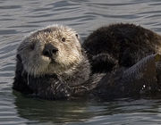
A sea otter

Slide 31
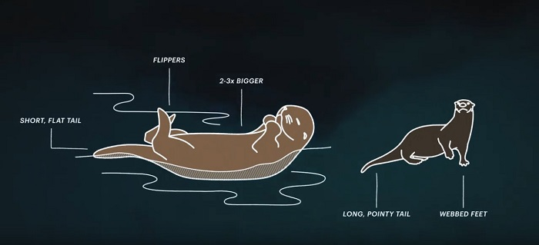
Sea otter
River otter

