Slide 1
Zoo 109
Lec. 15
Prof. Khalid Al-Ghanim

Slide 2
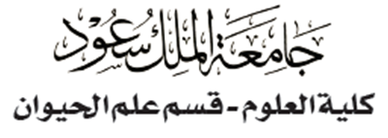


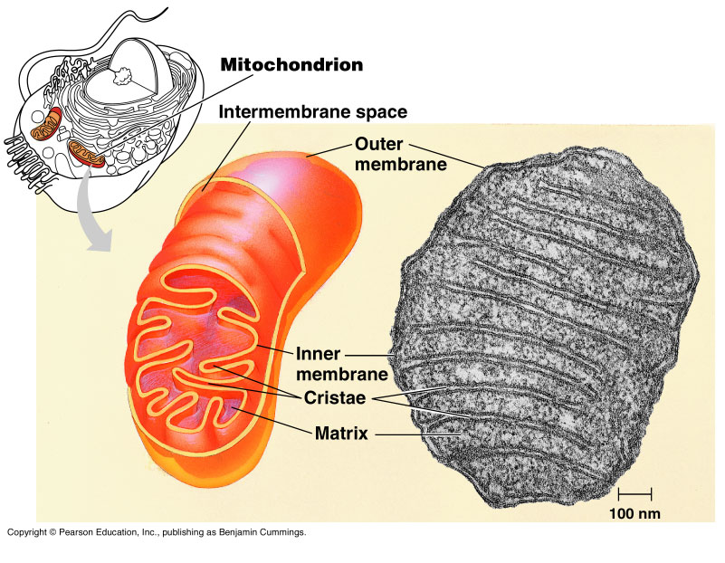
CELLULAR RESPIRATION: Harvesting chemical energy
Copyright © 2002 Pearson Education, Inc., publishing as Benjamin Cummings

Slide 3
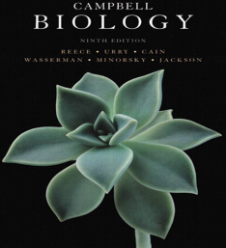

3- Electron transport chain: (oxidative phosphorelation)
Only 4 of 38 ATP ultimately produced by respiration of glucose are derived from substrate-level phosphorylation (2 from glycolysis and 2 from Krebs Cycle).
The vast majority of the ATP (90%) comes from the energy in the electrons carried by NADH and FADH₂.
The energy in these electrons is used in the electron transport chain to power لتدعم ATP synthesis.
Thousands of copies of the electron transport chain are found in the extensive surface of the cristae (the inner membrane of the mitochondrion).
Electrons drop in free energy as they pass down the electron transport chain.
Copyright © 2002 Pearson Education, Inc., publishing as Benjamin Cummings

Slide 4
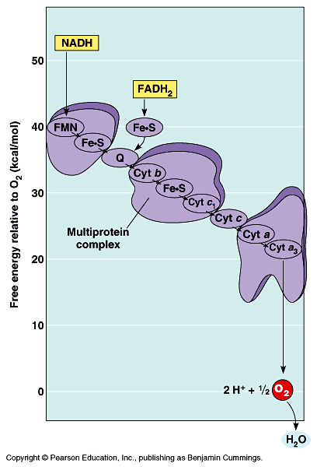
Electron transport chain
Electrons carried by NADH are transferred to the first molecule in the electron transport chain (the flavoprotein; FMN).
The electrons continue along the chain which includes several Cytochrome proteins and one lipid carrier.
The electrons carried by FADH₂ have lower free energy and are added to a later point in the chain.
Electrons from NADH or FADH₂ ultimately pass to oxygen.
The electron transport chain generates no ATP directly. Rather, its function is to break the large free energy drop from food to oxygen into a series of smaller steps that release energy in manageable amounts كميات مناسبة.
Fig. 9.13

Slide 5
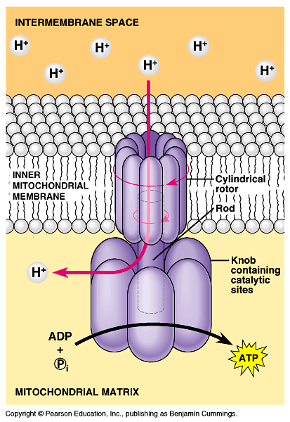
Electron transport chain
ATP-synthase, in the cristae actually makes ATP from ADP and P_{i}.
ATP used the energy of an existing proton gradient to power ATP synthesis.
  This proton gradient develops between the intermembrane space and the matrix.
  This concentration of H⁺ is the proton-motive force.
The ATP synthase molecules are the only place that will allow H⁺ to diffuse back to the matrix (exergonic flow of H⁺).
This flow of H⁺ is used by the enzyme to generate ATP a process called chemiosmosis.
Chemiosmosis: (osmos = puch)
It is the oxidative phosphorelation that results in ATP production in the inner membrane of mitochondria.

Slide 6
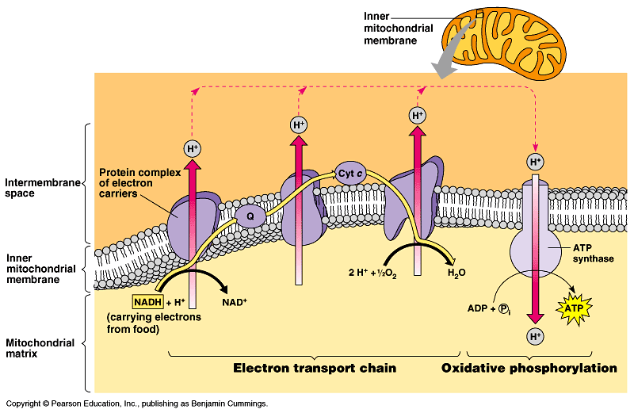
Energy of NADH and FADH₂ give a maximum yield
of 34 ATP is produced by oxidative phosphorylation.

Slide 7
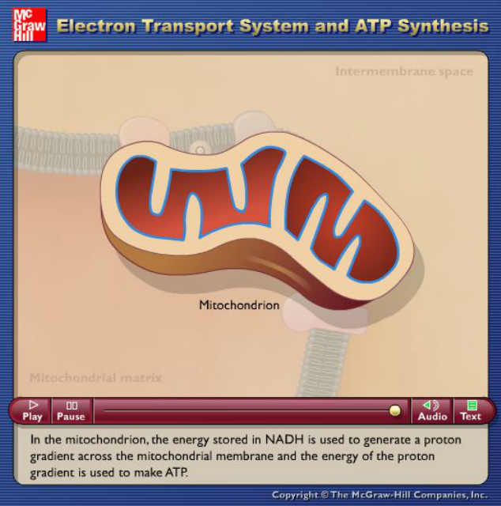
Source: http://highered.mcgraw-hill.com/sites/dl/free/0072437316/120060/ravenanimation.html

Slide 8
Cellular respiration generates many ATP molecules for each sugar molecule it oxidizes
During respiration, most energy flows from glucose NADH electron transport chain proton-motive force ATP.
Some ATP is produced by substrate-level phosphorylation during glycolysis and the Krebs cycle, but most ATP comes from oxidative phosphorylation (through electron transport chain).
Energy produced in Glycolysis and Krebs cycle gives a maximum yield of 4 ATP by substrate-level phosphorylation.
Energy produced in electron transport chain gives a maximum yield of 34 ATP by oxidative phosphorylation via ATP-synthase.
Substrate-level phosphorylation and oxidative phosphorylation give a bottom line of 38 ATP.

Slide 9
Summary of Electron Transport Chain (ETC)
General electron pathway food→NADH→ETC→oxygen.
ETC is a series of electron carriers located in the inner membrane of the mitochondria
NADH supplies two electrons to the ETC NAD⁺ + 2H→ NADH + H^{+.}
In the ETC electrons move through the chain reducing and oxidizing the molecules as they pass.
The ETC is made mostly of proteins.
The NADH molecules transport the electrons to the ETC -FADH₂ is added at a lower energy level.
The electrons move down the mitochondrial membrane through the electron carriers
A concentration gradient is generated -positive in the intermembrane space.
At the end of the ETC oxygen accepts hydrogen and one electron to form water.
The H⁺ ions that passed through the proteins into the cytoplasm flow through ATP synthase into the mitochondrial matrix.
The energy generated by the proton movement creates ATP by joining ADP and P_{i.}
NADH produces 3 ATP per molecule.
FADH₂ produces 2 ATP per molecule

Slide 10
Summary of Cellular Respiration
- Glycolysis occurs in the cytosol and breaks glucose into two pyruvates
- Krebs Cycle takes place within the mitochondrial matrix, and breaks
a pyruvate into CO₂ and produce some ATP and NADH.
- Some steps of Glycolysis and Krebs Cycle are Redox in which
dehydrogenase enzyme reduces NAD⁺ into NADH.
- Some of ATP is produced at these two steps via (substrate-level-
phosphorylation).
- Electron Transport Chain accepts e⁻ from NADH and passes these e⁻
from one protein molecule to another.
- At the end of the chain, e⁻ combine with both H⁺ and O₂ to form H₂O
and release energy.
- These energy are used by mitochondria to synthesis 90% of the cellular
ATP via ATP-synthase, a process called Oxidative Phosphorylation, in
the inner membrane of mitochondria.

Slide 11
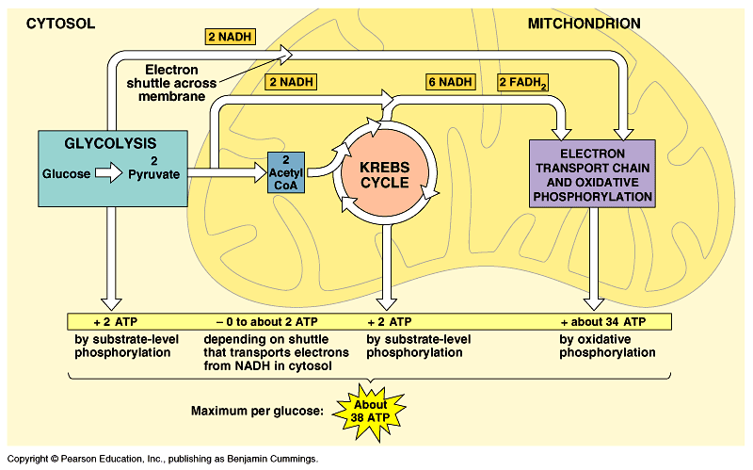
Summary of cell respiration

Slide 12

Summary of cell respiration
http://highered.mcgraw-hill.com/sites/dl/free/0072437316/120060/ravenanimation.html
Press the Play bottom

Slide 13
Definitions: تعريفات
Chemiosmosis: a process via which oxidative phosphorylation
takes place at the end of the Electron Transport Chain to produce 90% of ATP via ATP-synthase.
Or, is the process in which ATP synthesis powered by the flow of H+ back across ATP synthase.
ATP-synthase: an enzyme presents in the inner mitochondrial
membrane and used in making ATP by using H+ (protons).
NAD⁺: Nicotinamide adenine dinucleotide, which is a co-enzyme that helps electron transfer during redox reactions in cellular respiration.
FAD: Flavin adenine dinucleotide, which is an electron acceptor that helps electron transfer during Krebs Cycle and Electron Transport Chain in cellular respiration.

Slide 14
Fermentation: Enables يُمَكِن some cells to produce ATP without the help of oxygen
Oxidation refers to the loss of electrons to any electron acceptor, not just to oxygen.
  In glycolysis, glucose is oxidized to 2 pyruvate molecules with NAD⁺ as the oxidizing agent (not O₂).
  Some energy from this oxidation produce 2 ATP.
  If oxygen is present, additional ATP can be generated when NADH delivers its electrons to the electron transport chain.
Glycolysis generates 2 ATP when oxygen is absent (anaerobic لاهوائي).
Anaerobic catabolism of sugars can occur by fermentation.
Fermentation can generate ATP from glucose by substrate-level phosphorylation as long as there is a supply of NAD⁺ (the oxidizing agent) to accept electrons.
  If the NAD⁺ pool is exhausted إسـتـُنفـِذ, glycolysis shuts down.
  Under aerobic هوائى conditions, NADH transfers its electrons to the electron transfer chain, recycling NAD⁺.
Under anaerobic conditions, various fermentation pathways generate ATP by glycolysis and recycle NAD⁺ by transferring electrons from NADH to pyruvate.

Slide 15
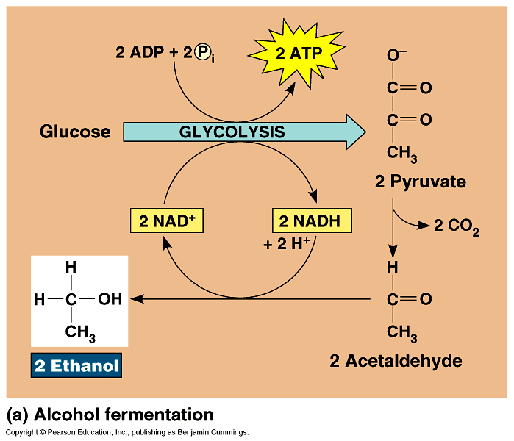
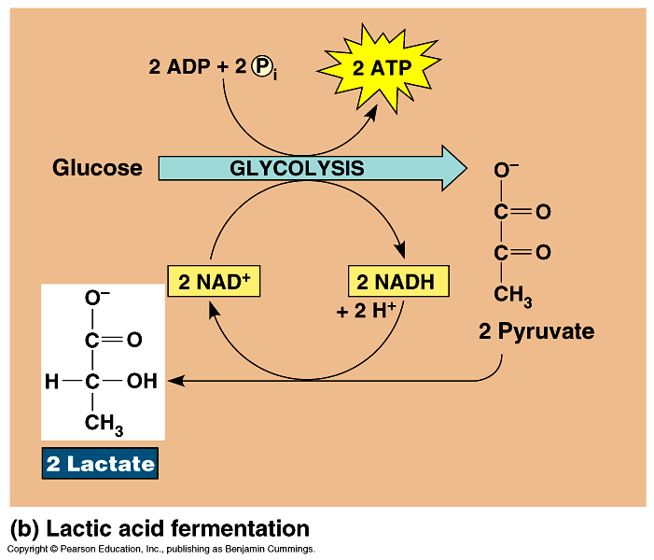
Fermentation
Alcohol fermentation: the pyruvate is converted to ethanol in two steps.
  First, pyruvate is converted to acetaldehyde by the removal of CO₂.
  Second, acetaldehyde is reduced by NADH to ethanol.
  Alcohol fermentation by yeast is used in
  winemaking.
Lactic acid fermentation: the pyruvate is reduced directly by NADH to form lactate (ionized form of lactic acid).
  Lactic acid fermentation by some fungi and bacteria is used to make cheese and yogurt.
  Muscle cells switch from aerobic respiration to lactic acid fermentation to generate ATP when O₂ is scarce نادر.
    The waste product, lactate, may cause
    muscle fatigue, but ultimately it is
    converted back to pyruvate in the liver.

Slide 16
Examples of anaerobic respiration:
A)- During exercise our bodies require a lot of energy
  The body can only supply a limited amount of oxygen for cellular respiration.
  Energy is not produced at the rate required.
  Cells will use anaerobic respiration to release extra energy
  This produces lactic acid (a waste product).
B)- We use yeast to make bread
CO₂ produced causes bread to rise by creating air pockets
The ethanol (alcohol) produced is evaporating during baking

Slide 17
Summary of anaerobic respiration
Without oxygen
Pyruvate remains in the cytoplasm (no link reaction, no Krebs cycle).
Pyruvate is converted into waste and removed from the cells.
No ATP is produced (except from glycolysis).
In humans the waste = lactate (lactic acid).
In yeast the waste = ethanol and CO_{2.}
Once the pyruvate is converted into waste, the cells can go through glycolysis again.
If pyruvate was not converted into waste the cells would not go through glycolysis.

Slide 18
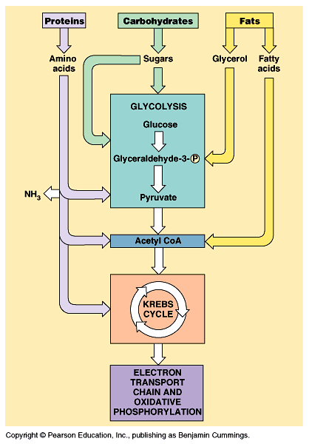
Fat and Protein Breakdown
Fats
have more energy per gram than carbohydrates or proteins.
fatty acid chains are oxidized and broken into smaller 2 carbon chains.
the 2 carbon chains are converted into acetyl CoA to enter the Kreb’s cycle.
Proteins
must be converted into individual amino acids.
excess amino acids are converted by enzymes into intermediated of glycolysis and Krebs cycle.
amino acids go through deamination (amino groups are removed)
nitrogenous wastes from the amino groups are released as wastes.
new compounds enter glycolysis or Krebs.

Slide 19
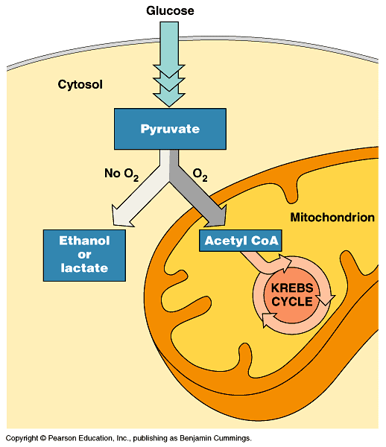
Some organisms (facultative anaerobes اللاهوائية اختياريا), including yeast and many bacteria, can survive using either fermentation or respiration.
At a cellular level, human muscle cells can behave as facultative anaerobes, but nerve cells cannot.
Proteins and fats, can also enter the respiratory pathways, including glycolysis and the Krebs cycle, like carbohydrates.

