Slide 1
LAB 4 Morphology & growth: Bacterial & Fungal characteristics
240 MBIO
Dr. Amal Alghamdi
ahamdan1@ksu.edu.sa

Slide 2
When a single bacterial cell is deposited on a solid or in a liquid medium, it begins to divide. One cell produces two, two produce four, four produce eight, and so on. Eventually, a colony appears where the original organism was.
When grown on a variety of media, microorganisms will exhibit visible physical differences in appearance in their isolated colonies and their growth. These differences are called
cultural characteristics or morphology.
Cultural characteristics or morphology may be used as an aid in identifying and classifying some organisms.
These physical characteristics are often specific for the type of bacteria making the colony and can be used as a means of recognition.
Cultural characteristics or morphology are determined by culturing microorganisms in nutrient broth and on nutrient agar plates and slants.
After incubation, the characteristics are observed.

Slide 3
Terms Used for Growth in Nutrient Broth
Uniform fine turbidity – finely dispersed growth throughout (cloudy)
Flocculent – flaxy aggregates dispersed throughout
Pellicle – thick, padlike growth on the surface
Sediment – concentration of growth at the bottom of the broth culture may be granular, flaxy, or flocculent.
Ring formation – a ring of growth on the surface

Slide 4
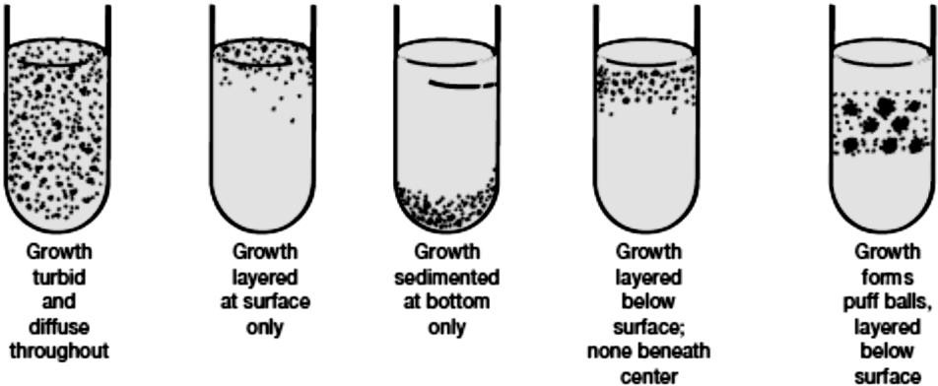
Colony Morphology in broth media

Slide 5
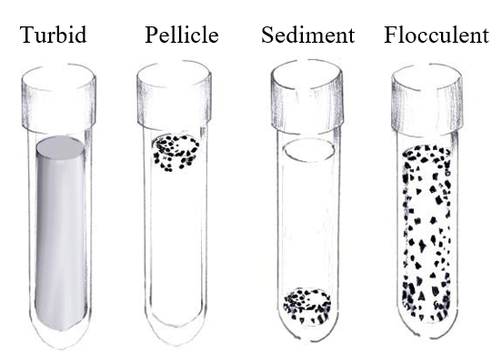
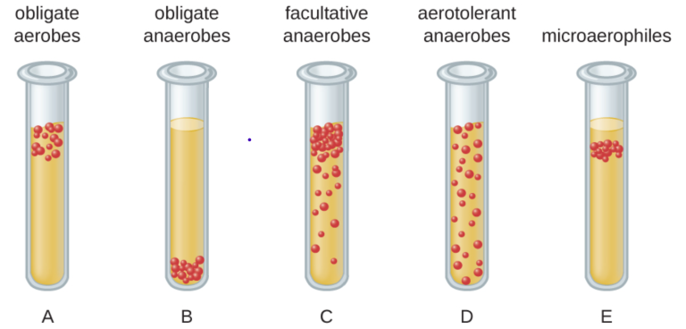
Growth Patterns on Broth media

Slide 6
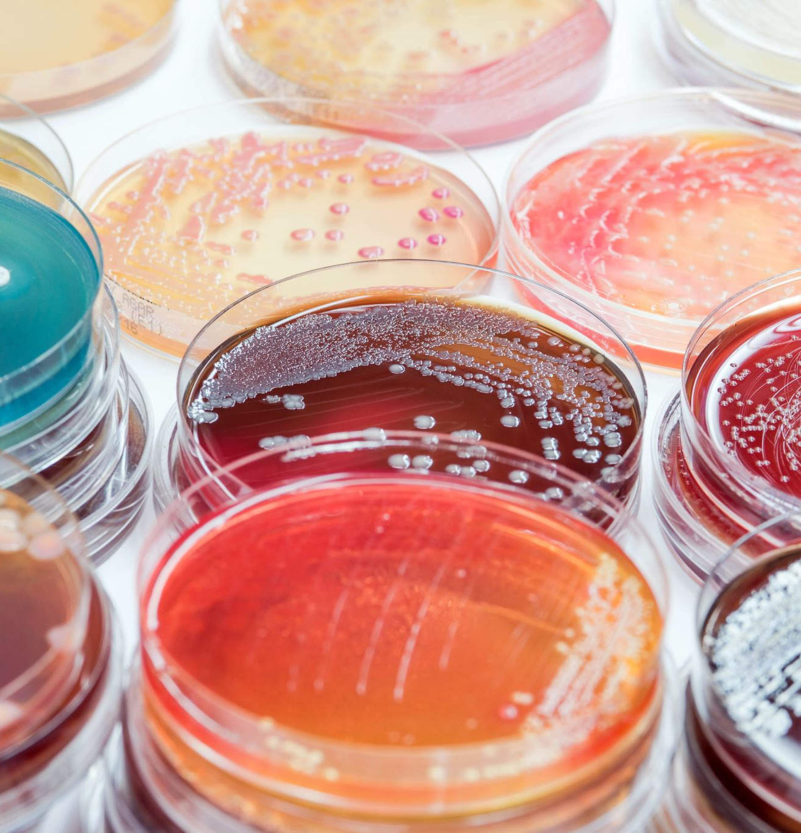
Terms Used for Growth on Nutrient Slants
Abundance of growth - the amount of growth is designated as none, slight, moderate, or large.
Pigmentation – chromogenic bacteria may produce intracellular pigments that are responsible for the color of the colonies on the agar surface.
3. Optical characteristics - these characteristics are based on the amount of light transmitted through the growth: opaque (no light transmitted), translucent transmission), or transparent (full transmission).

Slide 7
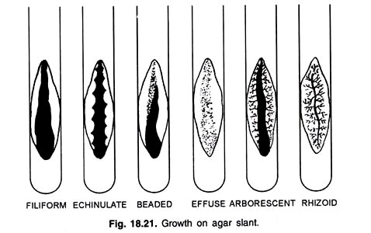
Growth Patterns on Agar Slant

Slide 8
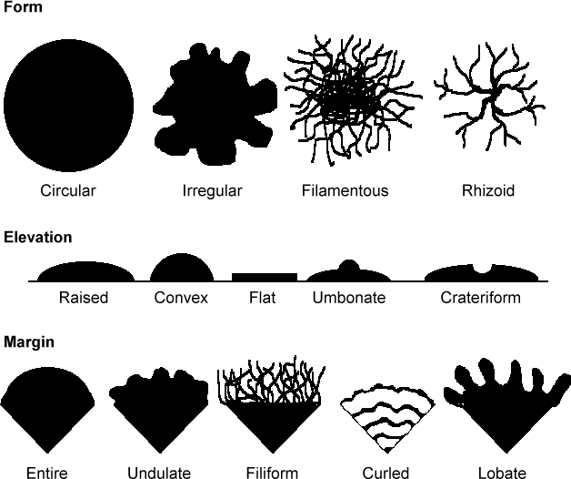
Characteristics of bacteria on agar plates

Slide 9
Characters of Fungi
A Fungus (singular), Fungi (Plural).
Fungi are eukaryotic plant-like organisms that lack chlorophyll.
The study of fungi is called Mycology.
Some fungi grow as a single-celled entity, termed yeast that grows either by a budding process or via binary fission.
Threads of cells are called hyphae. Fungal hyphae repeatedly branch to form a network of filaments termed mycelium (sing., mycelia).
Fungi are identified based on macro and microscopic characteristics.
Molds are commonly cultured on fungal-selective or enriched media such as Saboraud Dextrose agar (SDA), Corn Meal agar, and Potato Dextrose agar (PDA).

Slide 10
Common spores of Asexual reproduction fungi
The two most common types of asexual reproductive spores produced by fungi are conidiospores and sporangiospores. Conidiospores are borne externally in chains on an aerial hypha called a conidiophore.

Slide 11
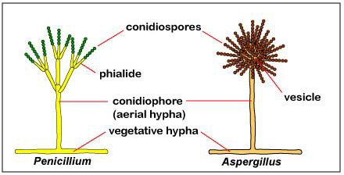
Penicillium is one of the most common household molds and is a frequent food contaminant. The conidiospores of Penicillium usually appear grey, green, or blue and are produced in chains on finger-like projections called phialides coming off from the conidiophore.
Penicillium and Aspergillus are examples of molds that produce conidiospores.
Aspergillus is another common contaminant. Although usually nonpathogenic, it may become opportunistic in the respiratory tract of a compromised host and, in certain foods, can produce mycotoxins.
The conidiophore terminates in a ball-like structure called a vesicle.
Its conidiospores, which typically appear brown to black, are produced in chains on phialides coming off from the vesicle.

Slide 12
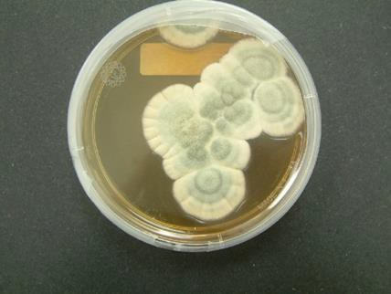
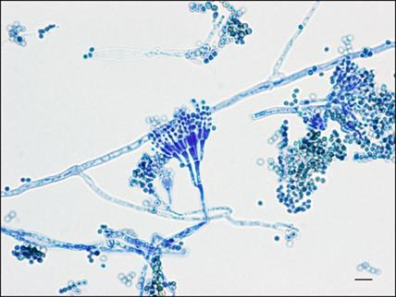
Name of fungus | Macro morphology (on agar plate) | Microscopic morphology
Penicillium

Slide 13
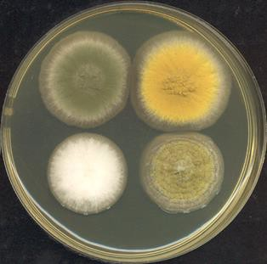
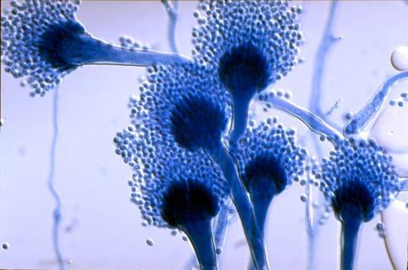
Name of fungus | Macro morphology (on agar plate) | Microscopic morphology
Aspergillus

Slide 14
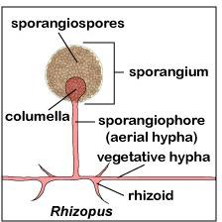
Sporangiospores are produced within a sac or sporangium on an aerial hypha called a sporangiophore.
Rhizopus is an example of a mold that produces sporangiospores.
Although usually nonpathogenic, it sometimes causes opportunistic o wounds and respiratory infections in the compromised host.
At the end of its sporangiophore is dome-shaped end called a columella that extends
into a sac-like structure called a sporangium. Its sporangiospores, typically brown or black, are produced within the sporangium .
Anchoring structures called rhizoids are also produced on the vegetative hyphae.

Slide 15
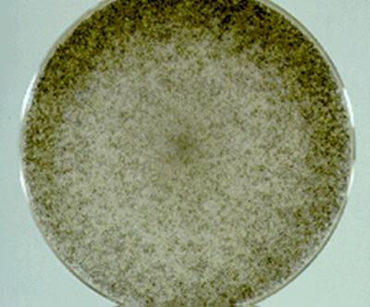
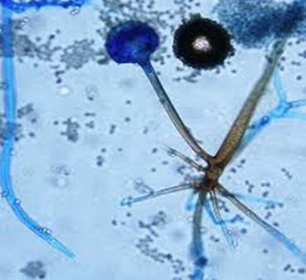
Some common fungi
Name of fungus | Macro morphology (on agar plate) | Microscopic morphology
Rhizopus

Slide 16
Fusarium grows fast with varying colony color depending on the isolates.
Woolly to cottony, flat, spreading colonies. Within a few days, cover the entire agar plate. Conidia are the spores produced by Fusarium.
There are two types- macro and micro-conidia, both of which can be seen under the microscope. Macroconidia are multi-celled, while microconidia are single - celled.

Slide 17
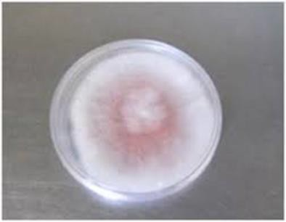
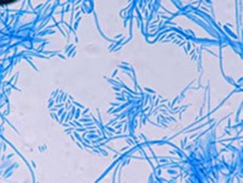
Name of fungus | Macro morphology (on agar plate) | Microscopic morphology
Fusarium

Slide 18
Alternaria develop and grow as elongated chains with conidiophores that are dark brown in color.
In favorable conditions (moisture or rain, nutrition), spores, referred to as conidia, are produced (growing as buds from the conidiophores) from the conidiophores asexually.

Slide 19
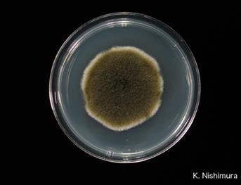
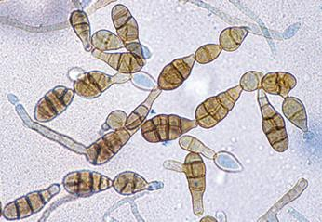
Name of fungus | Macro morphology (on agar plate) | Microscopic morphology
Alternaria

Slide 20
Dermatophytes
The dermatophytes are a group of molds that cause superficial mycoses of the hair, skin, and nails and utilize the protein keratin, that is found in hair, skin, and nails, as a nitrogen and energy source. Infections are commonly referred to as ringworm or tinea infections.
The three common dermatophytes are Microsporum, Trichophyton, and Epidermophyton. These organisms grow well at 25°C.

Slide 21
Microscopic Slides to identify
Penicillium
Aspergillus
Rhizopus
Fusarium
Alternaria

Slide 22
Home work
1- Answer in Word doc.
2- Give me a complete answer.
3- continue the previous report and fill the tables for results of the isolation of Microflora by describing the growth characters on both NA and PDA.

