Slide 1
BCH 462- Biotechnology & Genetic engineering [Practical]
Lab (7) Restriction Fragment Length Polymorphism (RFLP)
Notes:
https://www.researchgate.net/publication/235406524_Forensic_DNA_Profiling_and_Database

Slide 2
Restriction enzymes [R.E]
A restriction enzyme is a DNA-cutting enzyme that recognizes specific sites in DNA.
Are found in bacteria (and other prokaryotes).
They recognize and bind to specific sequences of DNA, usually 4–8 bp in length, called restriction sites.
Because they cut within the molecule, they are often called endonucleases.
Each restriction enzyme recognizes just one or a few restriction sites.
A restriction enzyme will make a double-stranded cut in the DNA molecule.
💡 Pause and Think why restriction enzymes were originated in bacteria?
1- Sticky ends
2- Blunt ends
Notes:
*A bacterium uses a restriction enzyme to defend against bacterial viruses called bacteriophages, or phages. When a phage infects a bacterium, it inserts its DNA into the bacterial cell so that it might be replicated. The restriction enzyme prevents replication of the phage DNA by cutting it into many pieces.
- https://www.thermofisher.com/sa/en/home/life-science/cloning/cloning-learning-center/invitrogen-school-of-molecular-biology/molecular-cloning/restriction-enzymes/restriction-enzymes-genome-mapping.html

Slide 3
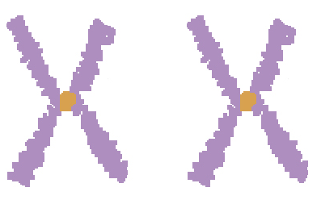
Genetic polymorphism is a difference in DNA sequence among individuals.
Polymorphisms and genetic variations
Individuality in humans and other species derives from their genetic polymorphism.
Genetic polymorphism is defined as the inherited genetic differences among individuals in over 1% of normal population.
💡 Pause and Think How gene polymorphism is different from gene mutation?
Homologous human chromosomes differ in sequence, on average, every ~1250 bp.
Father
Mother
Homologous Chromosomes
Notes:
Genetic polymorphism is a difference in DNA sequence among individuals, groups, or populations. Sources include single nucleotide polymorphisms (SNPs), sequence repeats, insertions, deletions, and recombination.
* The main difference between mutation and polymorphism is the frequency of occurrence of each type of variants within the population**

Slide 4
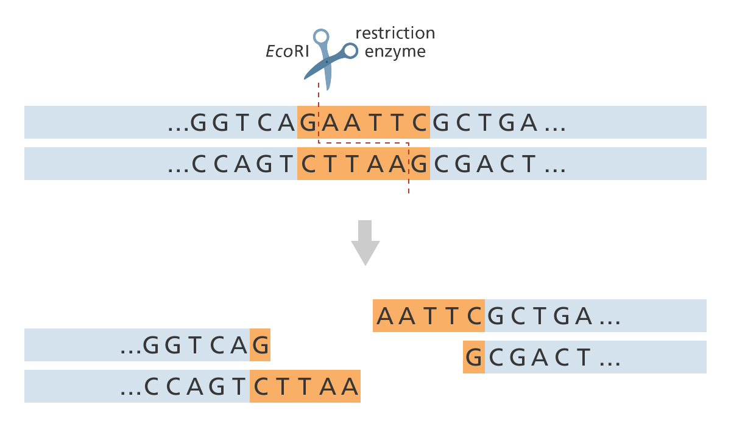
These genetic differences create and eliminate restriction sites.
1- Restriction site can be created
T → A
1.a In normal state
1.b In disease
2- Restriction site can be eliminated
A → T
2.a In normal state
2.b In disease
Notes:
restriction sites

Slide 5
Same Chromosome
(Allele I)
(Allele II)
Remember Every person has two copies of each gene, one inherited from each parent.

Slide 6
Polymorphisms and genetic variations
Some of the sequence changes affect recognition sites for restriction enzymes, resulting in variation in the size of DNA fragments produced by digestion with a particular restriction enzyme.
The distance between the cleavage sites of a certain restriction endonuclease differs between individuals.
The length of the DNA fragments.
The number of resulting DNA fragments differs.
(Allele I)
(Allele II)
Notes:
resulting DNA fragments

Slide 7
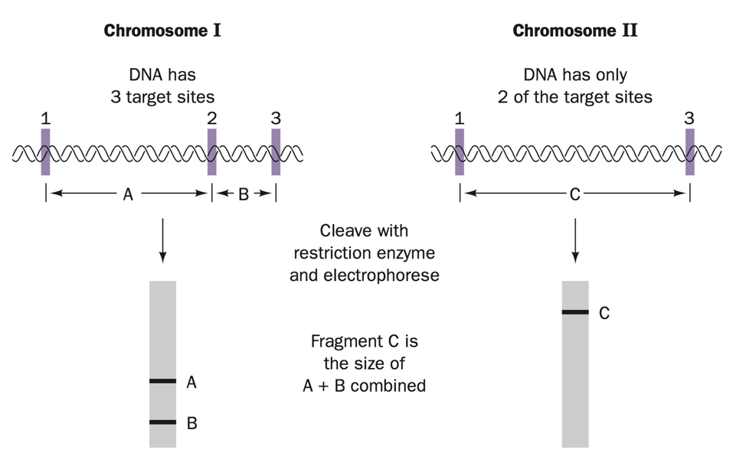
Same Chromosome
(Allele I)
(Allele II)
3 kb
1 kb
4 kb
4 kb
3 kb
1 kb
Genetic polymorphism can create or abolish restriction endonuclease (RE) recognition sites, thus affecting quantities and length of DNA fragments resulting from RE digestion.
Notes:
Gel electrophoresis *

Slide 8
Restriction fragment length polymorphism (RFLP)
Restriction Fragment Length Polymorphism (RFLP) is a technique in which organisms may be differentiated by analysis of patterns derived from cleavage of their DNA.
Restriction fragment length polymorphism (RFLP) is an inherited difference in the pattern of restriction, which is type of polymorphism that results from variation in the DNA sequence.
Simply, the variations in the restriction DNA fragments length between individuals of a species is called RFLP.
It was invented in 1984 by the English scientist Alec Jeffreys.
RFLPs may disrupt the function of the gene or may have no biologic consequences depending on their occurrences at known gene loci and/or in sequences that have no known function.
Notes:
(RFLP) *

Slide 9
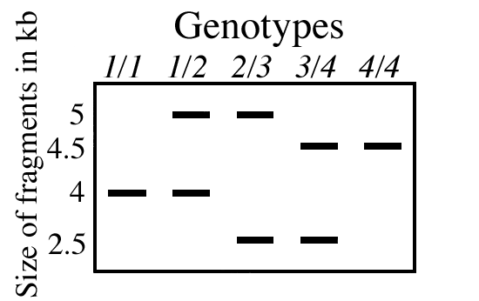
Cleaving site for same restriction enzymes
A/A
A/B
B/C
C/D
D/D
4 kb
Allele A
5 kb
Allele B
2.5 kb
Allele C
4.5 kb
Allele D
DNA samples from five individual mice were digested with the same restriction enzyme.
Notes:
Genotyping*
homozygous - heterozygous *
some people will be homozygous and reveal a single band; others (e.g., all the family members shown below) will be heterozygous with each allele producing its band.

Slide 10
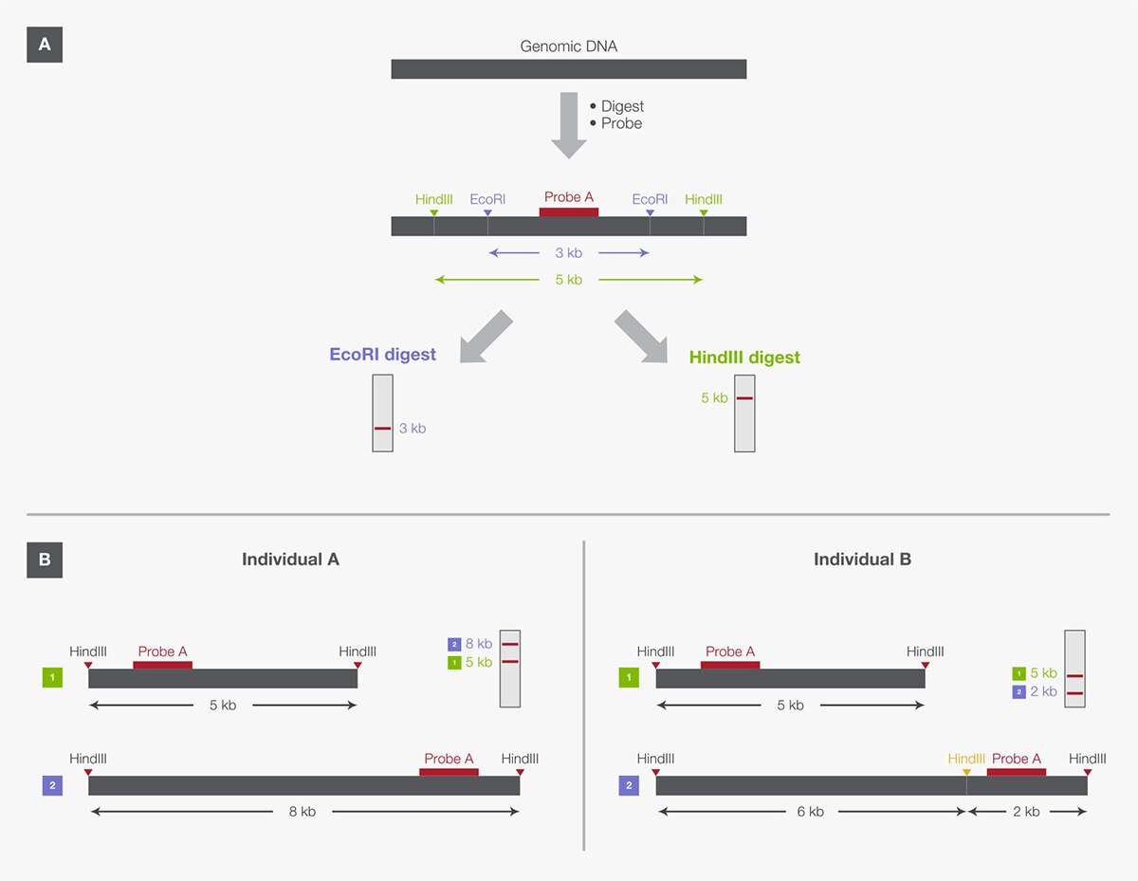
Simplified RFLP fingerprinting. (A) Different RFLP markers are obtained from digestion of the same sample with two restriction enzymes separately, EcoRI and HindIII. (B) Two individuals (A and B) are distinguished by HindIII digestions of two alleles (1 and 2).
Notes:
RFLPs and restriction enzymes can also be used to detect DNA differences between two individuals. Figure 2B illustrates probe hybridization and detection on a simplistic level, comparing two individuals for HindIII-based RFLPs of two alleles (labeled “1” and “2”). In this example, probe A detects different restriction fingerprints in the two individuals due to loss or gain of a HindIII restriction site on allele 2. In most cases, however, fragment length variability between individuals is a result of insertion or deletion of DNA sequences outside of the restriction sites, caused by natural recombination and replication. RFLP analysis is also used in applications such as genetic counseling, plant and animal breeding programs, and disease monitoring.

Slide 11
Practical Part 🧬
Notes:
Questions
https://www.chegg.com/homework-help/questions-and-answers/question-12-cystic-fibrosis-autosomal-recessive-disease-characterized-lack-functional-chlo-q38464684\
https://www.chegg.com/homework-help/questions-and-answers/accompanying-human-pedigree-parents-1-2-heterozygous-recessive-allele-cystic-fibrosis-cf-a-q42165546
https://www.chegg.com/homework-help/questions-and-answers/q1-rflp-closely-linked-cystic-fibrosis-cf-gene-detected-pcr-amplification-10-kb-fragment-d-q30650035

Slide 12
Principle
Restriction endonucleases cut long DNA into short fragments.
Each restriction endonuclease targets different nucleotide sequences (restriction site).
The distance between the cleavage sites of a certain restriction endonuclease differs between individuals.
Hence, the length of the DNA fragments will differ across both individual organisms and species.

Slide 13
RFLP workflow
1st DNA Extraction.
2nd Perform PCR for the region of interest. “not always”
3rd DNA Fragmentation by RE.
4th Gel Electrophoresis.
5th Blotting “Southern blot procedure”.
6th Hybridization of membrane to a labeled DNA probe
7th Visualization of Bands.
Notes:
probe" — a molecule of single-stranded DNA that is complementary to a run of nucleotides in one or more of the restriction fragments and is radioactive (or fluorescent).

Slide 14
RFLP steps
The first step in this process is to isolate the DNA from the target.
Once the the DNA is isolated from the sample it is subjected to restriction digestion using restriction enzymes.
The digested DNA sample is then subjected to gel electrophoresis, in which the DNA is separated based on its size.
Many DNA fragments with slight differences in length are produced.
The gel is then exposed to a chemical to denature double-stranded DNA to become single- stranded.
This is followed by Southern blotting where DNA is transferred from gel to nylon membrane.
The nylon membrane is then exposed to solution with radioactive complementary nucleotide probes that hybridize to specifically chosen DNA sequences on nylon membrane.
The membrane is then placed against X- ray film, where hybridized radioactive probes cause exposure of X-ray film, producing an autoradiogram.
RFLP analysis is carried out to detect differences in pattern to confirm polymorphisms.
Notes:
RFLP is the co dominant marker thus can estimate heterozygosity.

Slide 15
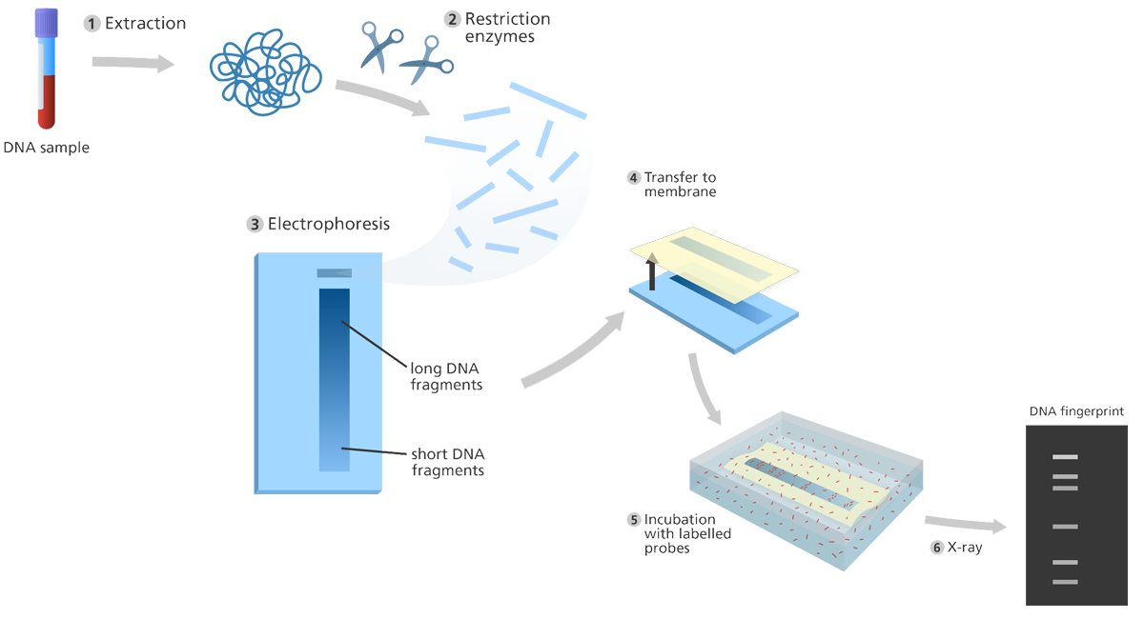
Overview of RFLP technique

Slide 16
Applications of RFLP
It can be used as a vital tool in genome mapping
Genetic disease analysis such as cystic fibrosis and sickle cell anemia.
It is useful in genetic fingerprinting and the identification of samples retrieved from crime scenes (forensic applications).
It has a role in the determination of paternity cases and the source of a DNA sample.
It can be used to determine the disease status of an individual (i.e. mutations detection).
Notes:
- Genome mapping: assigning/locating of a specific gene to particular region of a chromosome.
DNA fingerprinting is a chemical test that shows the genetic makeup of a person. (Restriction pattern)
And regions of DNA close to one another tend to get passed down together whereas farther away regions might not. So if a disease mutation arises near a polymorphic region the disease mutation will tend to get co-inherited with those polymorphisms
So when scientists were trying to find the causative mutations for genetic diseases like cystic fibrosis they could compare the DNA fingerprints of family members with and without the disease to see whether people with the disease tended to have a band size that people without the disease didn’t. This could hint that the disease gene might be somewhere in that piece and then scientists could further investigate

Slide 17
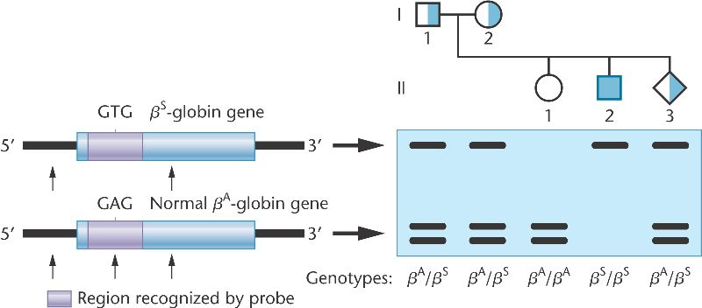
Example of using RFLP in the detection of sickle cell anemia
A → T of the β-globin gene
Legend
Heterozygote
(carrier)
Male
Female
Fetus
Homozygote
Notes:
The normal allele has a GAG sequence recognized by the MstII restriction enzyme, produces 2 fragments on a Southern blot, while the mutant β^{s} allele contains a GTG sequence resulting in a single large fragment.
The gene defect is a known mutation of a single nucleotide (see single-nucleotide polymorphism – SNP) (A to T) of the β-globin gene, which results in glutamic acid (E/Glu) being substituted by valine (V/Val) at position 6

Slide 18
Example of using RFLP in the detection of phenylketonuria
PKU is inherited in families in an autosomal recessive pattern.
What is the expected disease status of the children/fetus ?
Allele a.
Normal PAH gene
5’
3’
5 kb
Cleaving site for restriction enzymes
Allele b.
Mutant PAH gene
5 kb
5’
3’
3 kb
2 kb
3 kb
2 kb
Legend
Male
Female
Fetus
Carrier
Affected
Notes:
phenylalanine hydroxylase deficiency (PAH deficiency), also called phenylketonuria (PKU), is an inherited disease in which the body cannot properly process the amino acid phenylalanine due to a deficient enzyme called phenylalanine hydroxylase

Slide 19
Example of using RFLP in the detection of phenylketonuria
PKU is inherited in families in an autosomal recessive pattern.
What is the expected disease status of the children/fetus ?
Allele a.
Normal PAH gene
5’
3’
5 kb
Cleaving site for restriction enzymes
Allele b.
Mutant PAH gene
5 kb
5’
3’
3 kb
2 kb
3 kb
2 kb
Legend
Male
Female
Fetus
Carrier
Affected
Notes:
phenylalanine hydroxylase deficiency (PAH deficiency), also called phenylketonuria (PKU), is an inherited disease in which the body cannot properly process the amino acid phenylalanine due to a deficient enzyme called phenylalanine hydroxylase

Slide 20
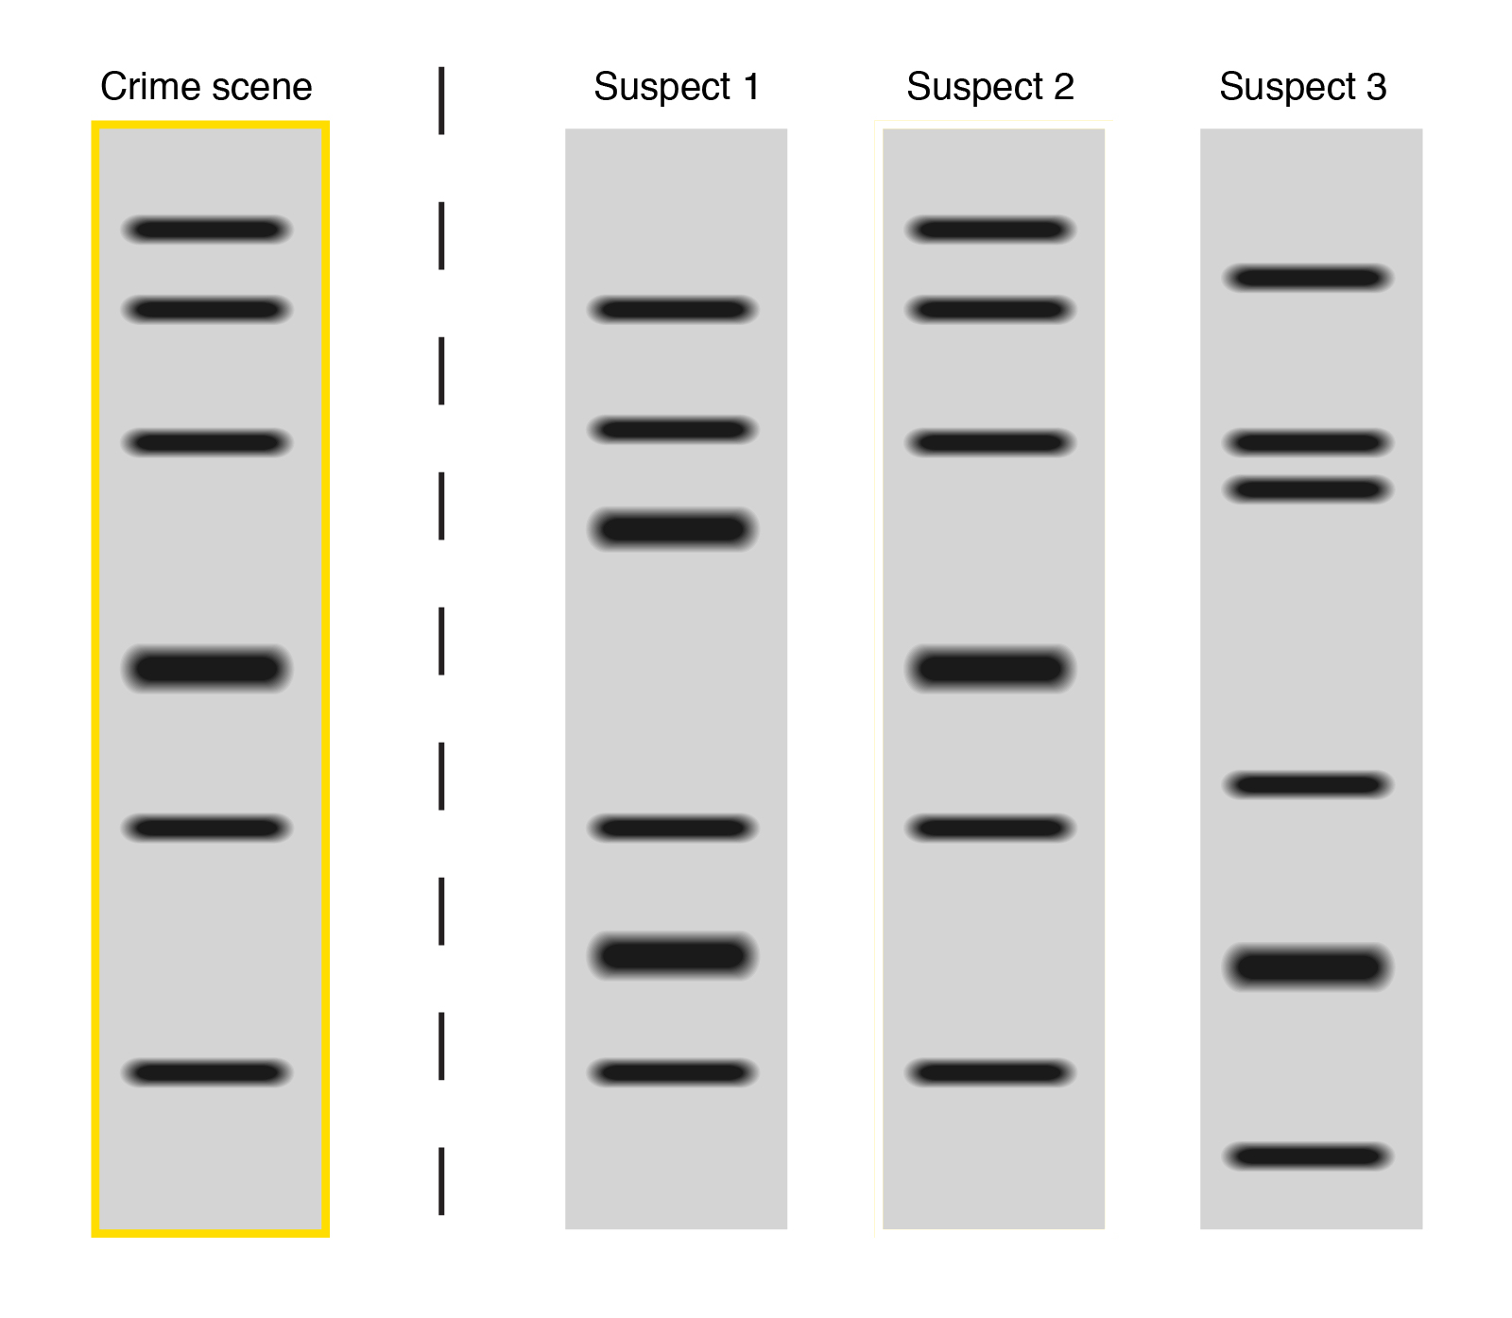
Example of using RFLP in criminal investigations

Slide 21
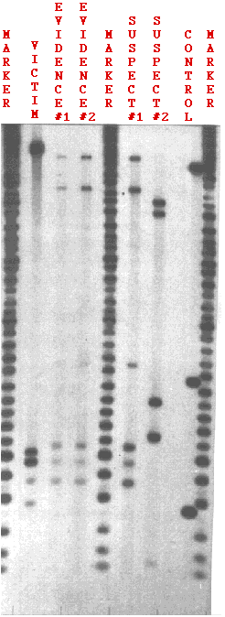
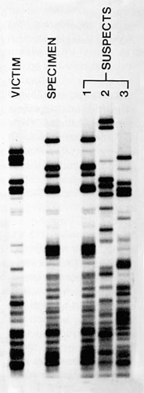
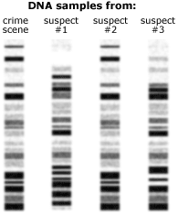
Examples of using RFLP in criminal investigations
One the basis of this test, which suspect is considered to be guilty of crime?
loci
Notes:
semen removed from the vagina of the rape victim (EVIDENCE #2);
a semen stain left on the victim's clothing (EVIDENCE #1);
the DNA of the victim herself (VICTIM) to be sure that the DNA didn't come from her cells;
DNA from two suspects (SUSPECT #1, SUSPECT #2);
a set of DNA fragments of known and decreasing length (MARKER). They provide a built-in ruler for measuring the exact distance that each fragment travels.
the cells of a previously-tested person to be sure the probes are performing properly (CONTROL).

Slide 22
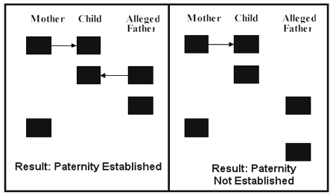
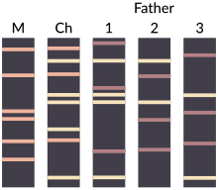
Example of using RFLP in paternity test
Notes:
1

Slide 23
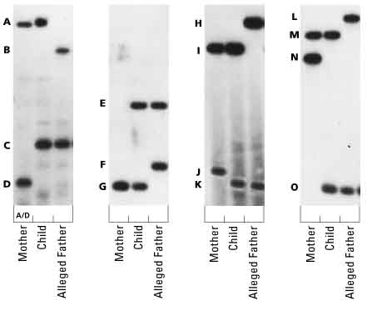
How is the father of the identical twins?
Notes:
11

