Slide 1
يمحرلا نحمرلا الله مسب
140 MICRO
LAB 5 : PURIFICATION OF MICROORGANISM

Slide 2
Culture
The organism growing on the media plate is called as culture
Colony
The number of cells of any organism living together

Slide 3
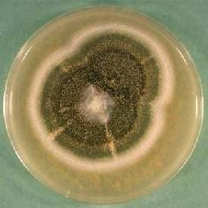
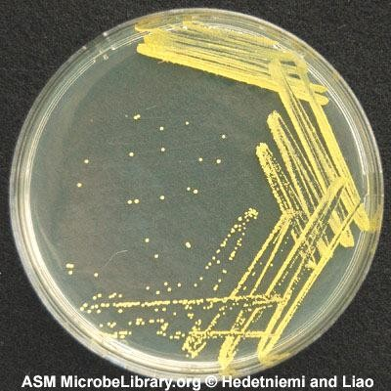
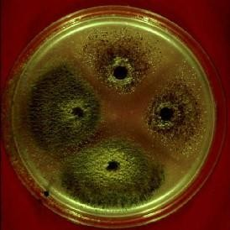
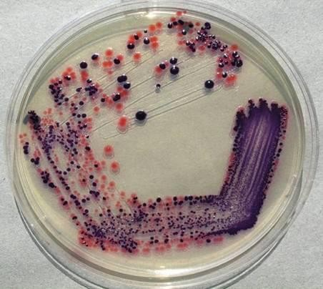
Types of Culture
2-Contaminated culture
More than one type of organism growing on the media plate
1-Pure Culture
Only one type of microorganism growing on the media plate

Slide 4
Purification of microorganism

Slide 5
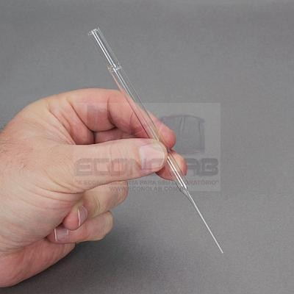
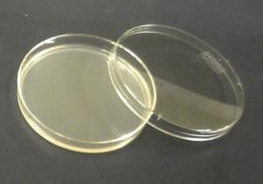
Purification of Fungi:
Use a cork borer or pasture pipet.
Flame cork borer using alcohol 70% and allow to cool.
Cut few discs from the edge of an actively growing fungal colony.
Inoculate it (surface facing down) on the center another media plate with the help of flamed forceps
Incubate it for 3-5 days
Pure culture of the organism will grow.

Slide 6
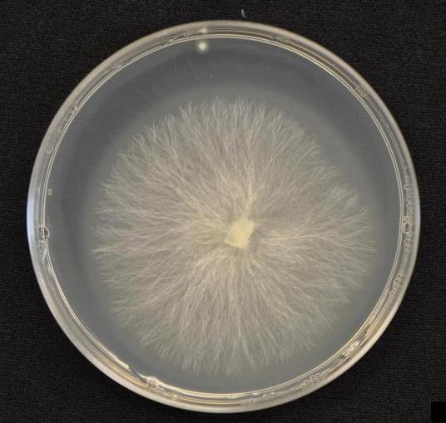
Result

Slide 7
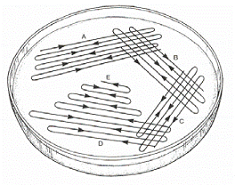
Purification of Bacteria :
Streak plate Method
Streak inoculum onto one portion of the plate
Sterilize the loop
Streak through the first inoculum and spread into second section
Repeat several times
Incubate it for 24 h. ,
a single colony will be observed .

Slide 8
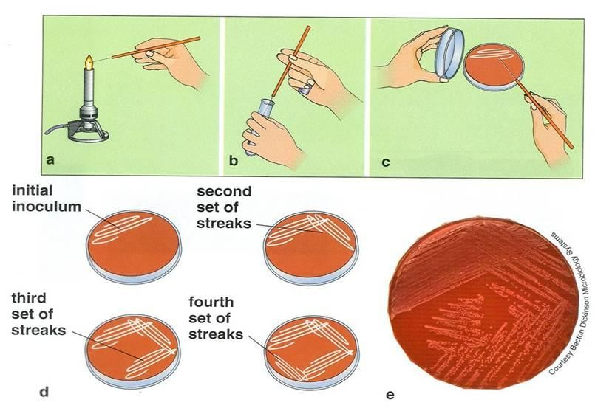

Slide 9
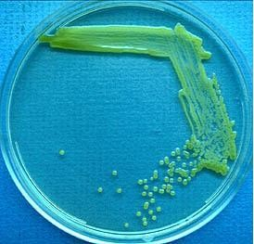
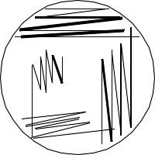
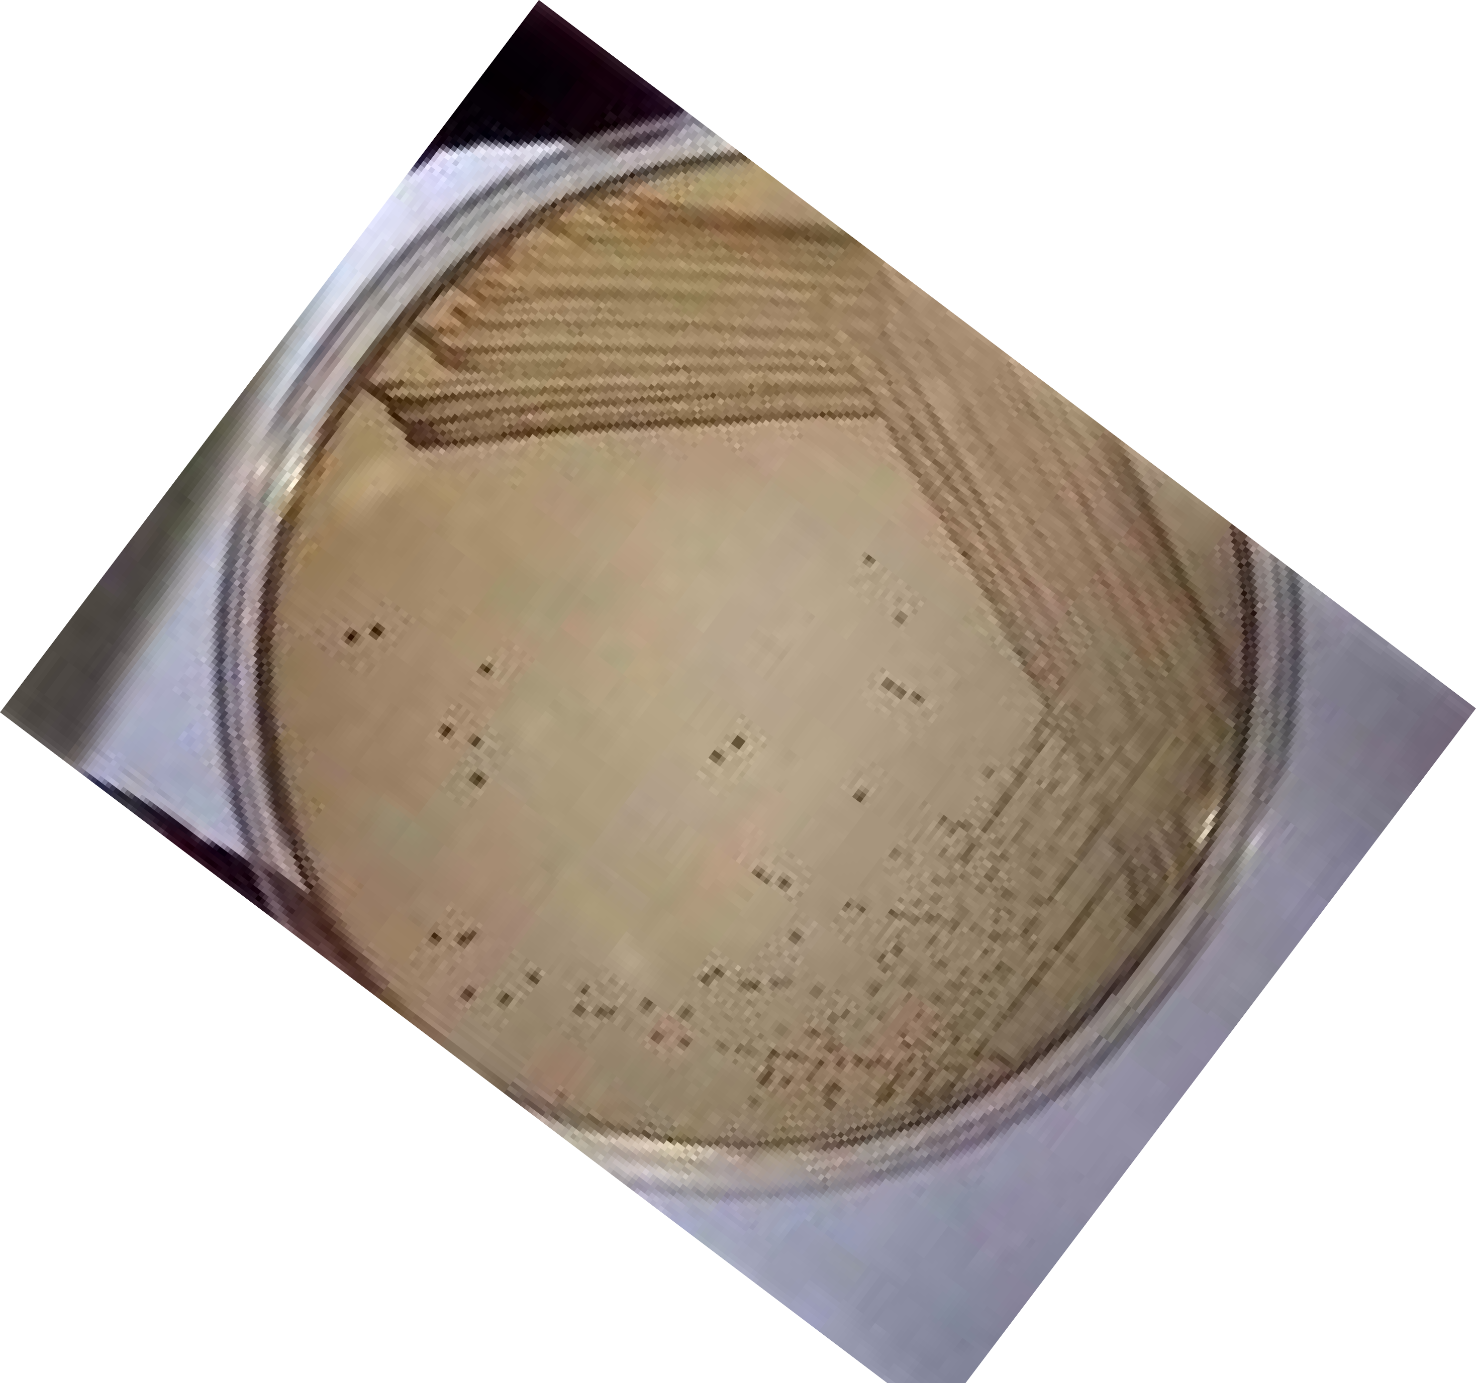
Result
1
Nice isolation!
1
2
4
2
3
Streak pattern
4
3
Bacterial growth pattern

Slide 10
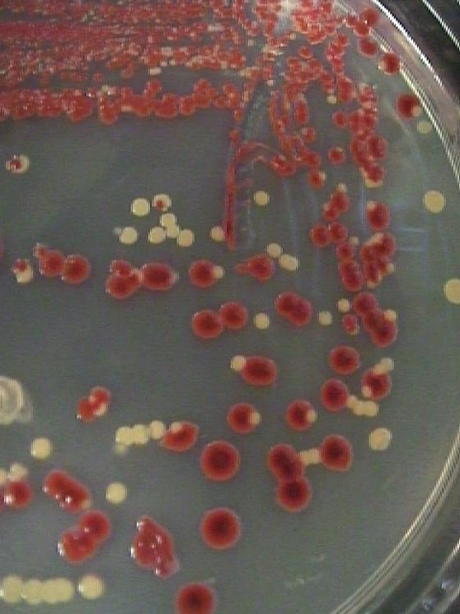
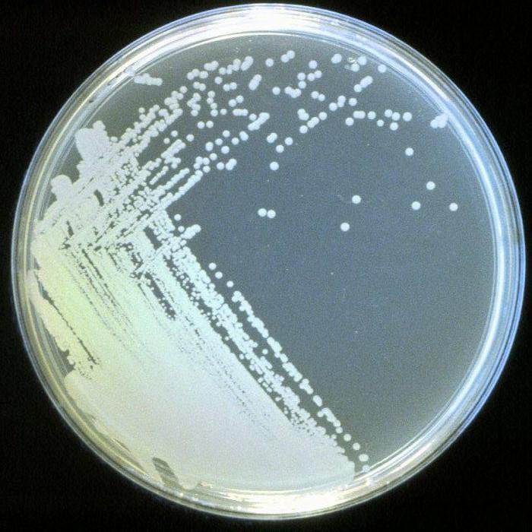
Which streak plate culture started as a pure culture. How can you tell?
_{An}swer: the one on the right, because all colon^{ies look alike.}

Slide 11
Watch
https://www.youtube.com/watch?v=_1KP9zOtjXk

Slide 12
Characters of colony

Slide 13
Characters of colony
Form
What is the basic shape of the colony? For example, circular,
filamentous, etc.
Margin
What is the magnified shape of the edge of the colony?
Elevation
What is the cross sectional shape of the colony? Turn the Petri dish on end.
Surface
How does the surface of the colony appear? For example, smooth, rough, dull , wrinkled etc.
Pigmentation
For example, white, red, purple, etc.

Slide 14
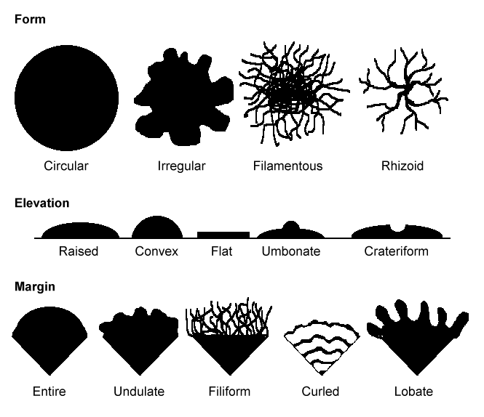

Slide 15
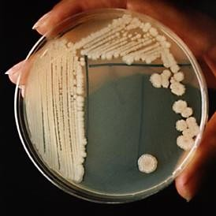
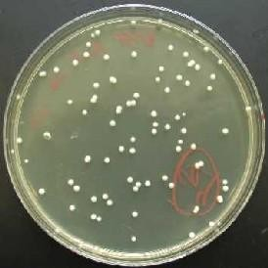
Most bacterial colonies appear white, cream, or yellow in color, and fairly circular in shape.

Slide 16
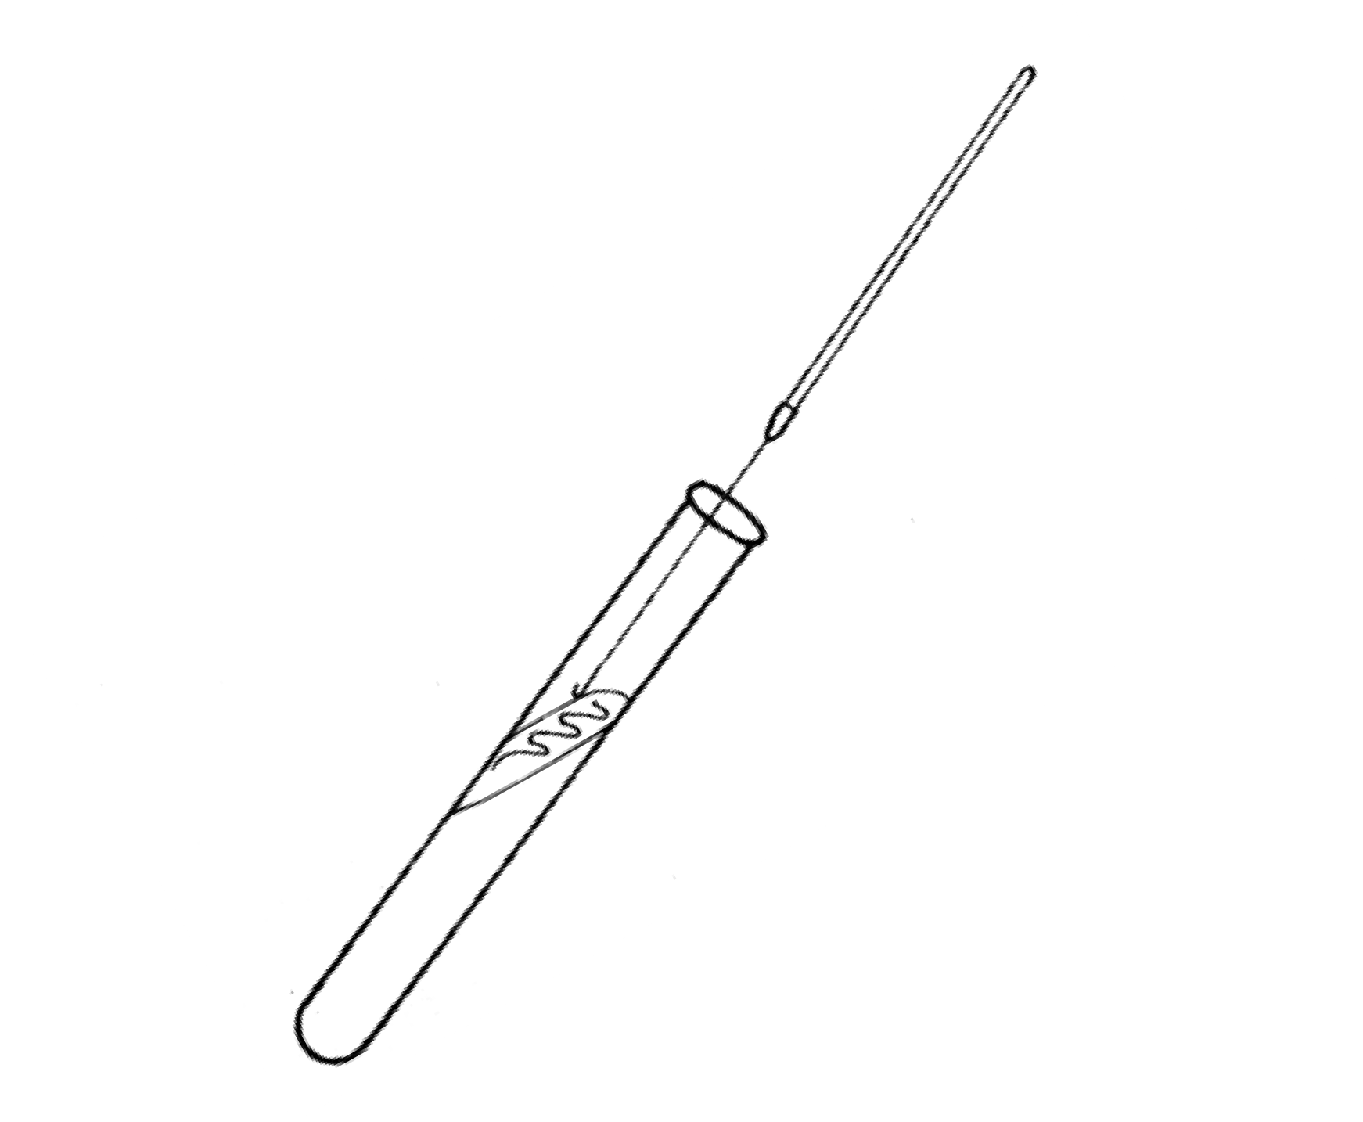
Inoculated Agar Slant
Label the sterile nutrient agar slant with the source of the culture .
Sterilize the loop.
Remove a loopful of broth from the culture tube.
Insert the loop into the sterile agar slant tube and starting at the base of the slant, draw the loop up the slant. Do not penetrate the agar. Sterilize the loop.
Incubate the slant at 37C for 24-48 hours.
Observe the slant for growth.

Slide 17
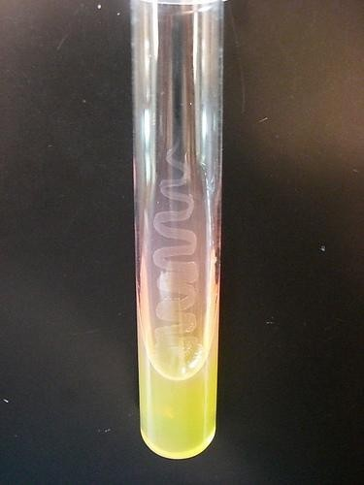
Result
Inoculated Agar Slant, after incubation

Slide 18
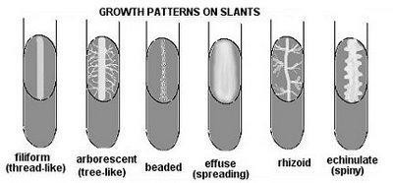
MORPHOLOGY ON SLANT AGAR

Slide 19
Liquid medium
In a liquid medium, the region in which the organism grows depends on the oxygen requirement of that particular species.

Slide 20
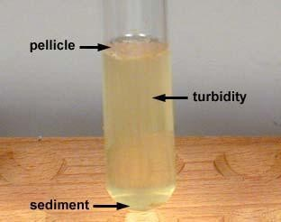
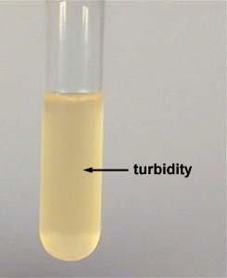
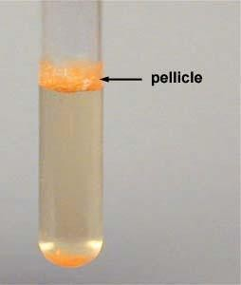
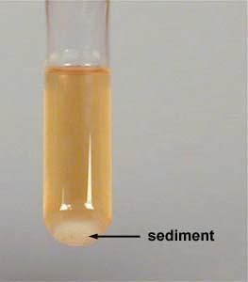
Liquid medium
*Turbid
*Pellicle
((thick growth at the top of the tube))
*Sediment

Slide 21
How to characters of colony?
https://www.slideshare.net/HiwrHastear/culture-
characteristic-of-bacteria

Slide 22
The End
ينارهشلا قورش.أ يدماغلا لمأ.أ

