Slide 1
Cryptococcus Neoformans

Slide 2
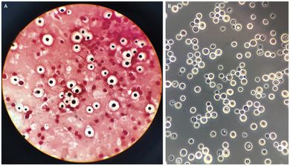
Cryptococcus Neoformans
An encapsulated yeast (polysaccharide capsule)
Opportunistic fungal pathogen
Can cause life-threatening Cryptococcosis.
Can live in both plants and animals
Often found in birds droppings
Can cause disease in apparently immunocompetent
as well as immunocompromised hosts (mainly IDS patients)

Slide 3
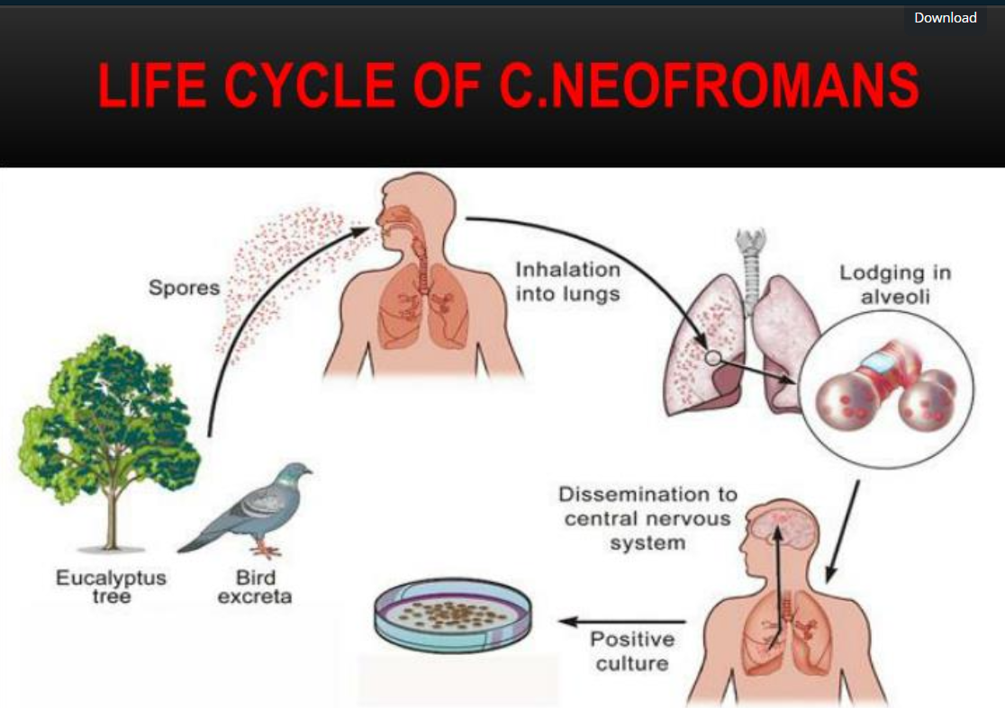

Slide 4
Cryptococcosis
Cryptococcosis is an illness caused by infection with Cryptococcus fungi
(Cryptococcus gattii and Cryptococcus neoformans )
Most people breathe in the fungus without having symptoms. But in some people, the fungus grows in their lungs or travels through their body to their brain, making them sick
Cryptococcus infection in the lungs, called cryptococcal pneumonia or pulmonary cryptococcosis (cough, shortness of breath, chest pain, fever)
Cryptococcus infection in the brain called cryptococcal meningitis (Fever.
Headache ,Neck pain or stiffness, nausea, vomiting, sensitivity to light)

Slide 5
Virulence factors
1-Polysaccharide capsule:
A-Inhibit phagocytosis of yeast (how?)
Most epitopes that bind to the macrophage receptors (mainly cell wall components) are at the cell wall, and the presence of the capsule “hides” them from the phagocytic cell.
B-Inhibit other host immune responses

Slide 6
Virulence factors
2-Melanin (dark pigments) Production:
which provides protection from environmental stresses
It can also bind and decrease the susceptibility to antifungal drugs
3-Mannitol Production:
which is correlated with increased resistance to osmotic, heat, and oxidative stress

Slide 7
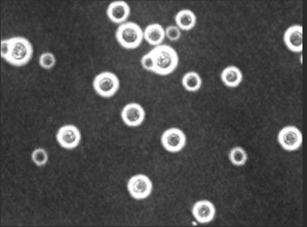
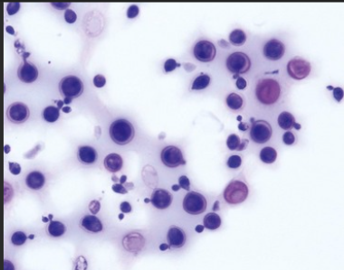
Laboratory Diagnosis
Microscopy
Negative staining: India Ink and Nigrosin: The particles of ink pigment do not enter the capsule that surrounds the spherical yeast cell, resulting in a clear zone around the cells
Gram stain:
Reveals Gram positive, budding yeast cells.
surrounded by a halo or clear area- reveals capsule.
KOH Preparation: used for sputum
Negative staining
Spherical-Gram ve+

Slide 8
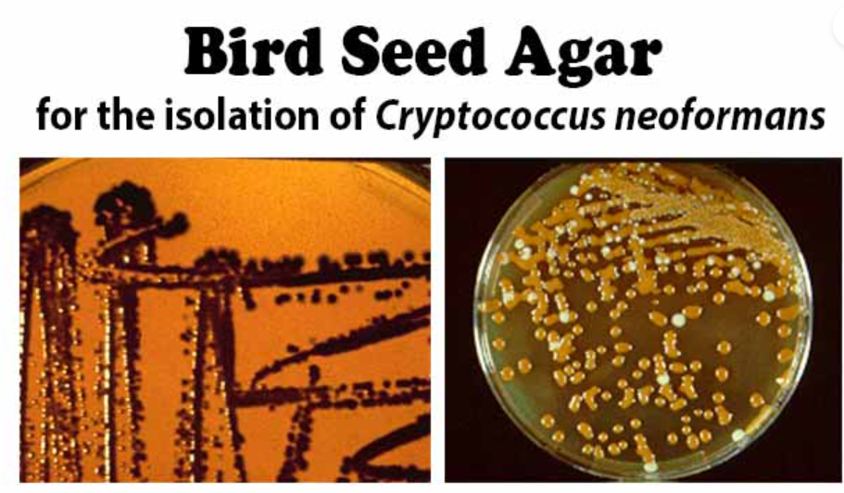
2- Culture (Bird Seed Agar for the isolation of Cryptococcus neoformans)
Bird seed agar
solid medium used for selective and differential isolation of Cryptococcus neoformans from clinical specimens
Principle
Niger seeds extract contains caffeic acid.
Caffeic acid is important because C. neoformans uses it to synthesize melanin via enzymatic activity.
Melanin production results in brown to black pigmented colonies, which are easily distinguishable from non-pigmented colonies of other organisms.
Positive: Development of brown to black pigmented smooth colonies.

Slide 9
3-Immuno-serology Ag detection
Detects polysaccharide antigen of C. neoformans in fluids.
High titre in serum, intermediate in Cerebrospinal fluid (CSF) and lowest in urine.
Bronco- alveolar lavage (BAL): also tested for Cryptococcal Ag.

