Slide 1
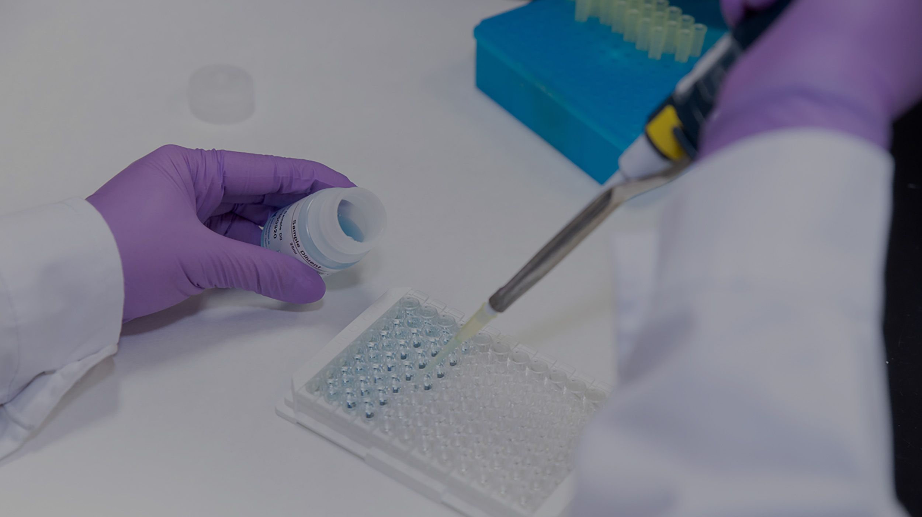
Medical Mycology
Systemic Fungal infection
(Aspergillosis)
Lab 4

Slide 2
Systemic Fungal infection
Most systemic fungal infections are caused by Opportunistic fungal** pathogens
Fungi that are nonpathogenic in the immunocompetent host, mostly exist as part of the normal flora in the upper respiratory tract.
Common in immunocompromised hosts.

Slide 3
Examples of some organisms isolated most frequently from immunocompromised patients :
Aspergillus spp (cause Aspergillosis)
Candida spp.
Cryptococcus spp

Slide 4
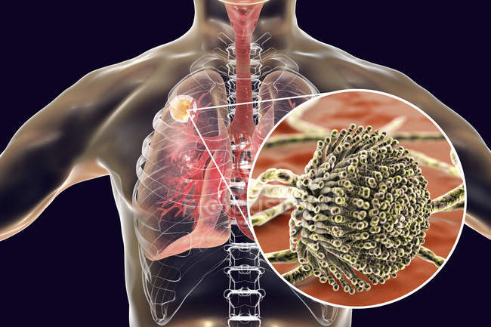
Aspergillosis

Slide 5
Aspergillosis
What is Aspergillosis?
Aspergillosis: Systemic infection caused by several types of Aspergillus fungi
Aspergillus is usually found outdoors, in dead leaves, plants, soil or compost. It’s occasionally found in moist environments indoors.
How do you get an Aspergillus infection?
It can also get into your body through a cut in your skin
Most people breathe in Aspergillus spores every day without getting sick.
Inhaling Aspergillus spores from the air can cause an allergic reaction or an infection in your sinuses or lungs.
It can move to other parts of your body if your immune system can’t fight off the infection.

Slide 6
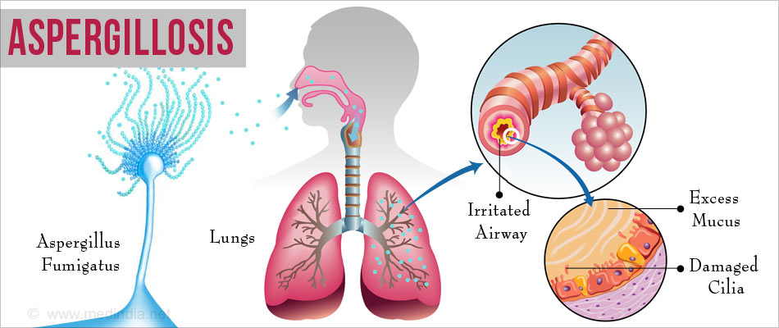
Aspergillosis
Many different species of the fungi Aspergillus can cause aspergillosis
, such as: Aspergillus fumigatus, Aspergillus flavus, Aspergillus niger.
The infection, usually affects the respiratory system and may lead to breathing problems.
Cough
Wheezing
Coughing up blood
Shortness of breath
Chest pain
Skin lesions

Slide 7
Types of Aspergillosis
Allergic broncho-pulmonary aspergillosis (ABPA):
Aspergillus causes inflammation in the lungs and allergy symptoms such as coughing and wheezing.
Allergic Aspergillus sinusitis:
Aspergillus causes inflammation in the sinuses

Slide 8
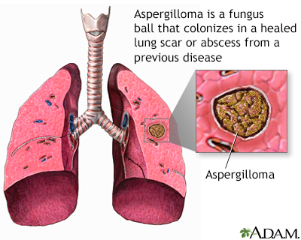
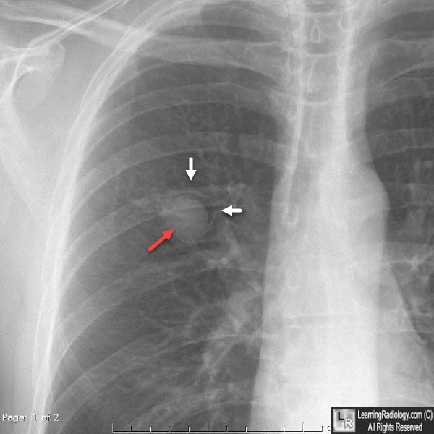
Aspergilloma:
also called a “fungus ball.”, it is a ball of Aspergillus that grows in the lungs or sinuses.
Certain chronic lung (pulmonary) conditions, such as tuberculosis ,can cause air spaces (cavities) to form in the lungs.
When people with lung cavities are also infected with aspergillus, fungus mycelium may find their way into the cavities and grow into tangled masses (fungus balls) known as aspergillomas.

Slide 9
Types of Aspergillosis
Invasive aspergillosis
This is the most severe form of aspergillosis.
It occurs when the infection spreads rapidly from the lungs to the brain, heart, kidneys or skin.
Invasive aspergillosis occurs in people whose immune systems are weakened as a result of cancer chemotherapy, bone marrow transplantation or a disease of the immune system.
Untreated, this form of aspergillosis may be fatal
Cutaneous (skin) aspergillosis:
Aspergillus enters the body through a break in the skin (for example, after surgery or a burn wound) and causes infection, usually in people who have weakened immune systems.

Slide 10
Serological tests

Slide 11
Aspergillosis
Serological tests
Galactomannan (GM) aspergillus specific antigen (polysaccharide,) found in the cell wall and released during the growth phase of invasive aspergillosis
Can be detected in serum samples
Highly immunogenic antigen (immunogen)***
***Antigens that are capable of inducing an immune response via inducing Ab production

Slide 12
Diagnostic tests:
(Serological tests)
Useful in diagnosing systemic mycoses but less so in diagnosing other fungal infections.
Fungal polysaccharides or proteins may be shed into body fluids during the course of infection, which can be detected using specific antibodies
Require patient’s body fluid such as: Blood, Cerebrospinal fluid CSF, Urine, Bronchoalveolar Lavage fluid (BALF)

Slide 13
Diagnostic tests:
(Serological tests)
Ab detection
Diagnosis of systemic mycoses
Assess the response to treatments
Ag detection
Useful during the early stage of infection (before producing Abs)
Useful in patients with impaired immune system- Why?
*the immune system in those patients often failed to produce antibodies

Slide 14
Why Serology?
Ags and Abs are easier to detect compared to finding the organism directly
Ags and Abs are produced in large quantities and can be found in body fluids such as: Blood, Cerebrospinal fluid CSF, Urine, Bronchoalveolar Lavage fluid (BALF)
Rapid test, as the result can be obtained within few hours.
Notes:
Why Serology?

