Slide 1
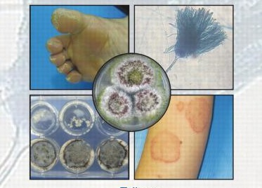
Medical Mycology
470 MBIO
Lab4-A

Slide 2
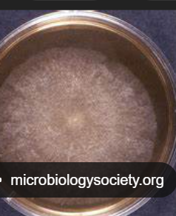
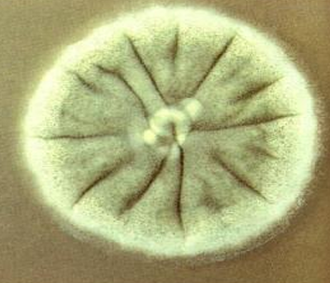
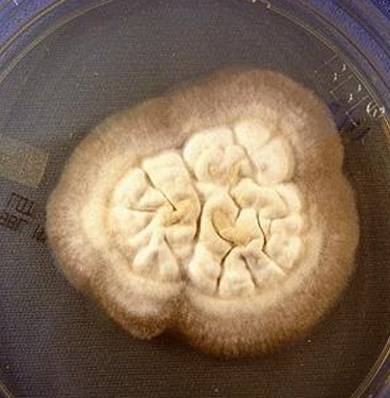
Colony Morphology
Colony morphology is a method that scientists use to describe the characteristics of an individual colony of fungi growing on any media
1-Surface topography:
1-Flat: Flat colonies predominate in mycology
2-Rugose: colonies have radial grooves that radiate from the center of the culture
3-Folded: colonies have random folds
.
Flat
Rugose
Folded

Slide 3
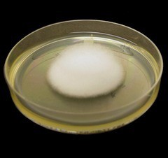
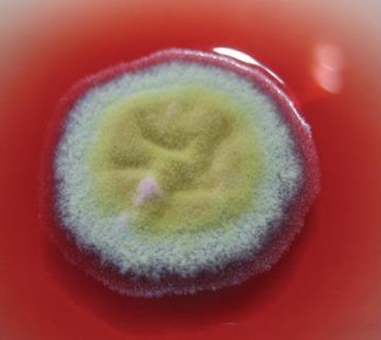
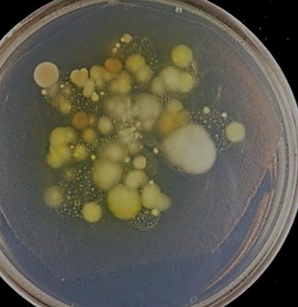
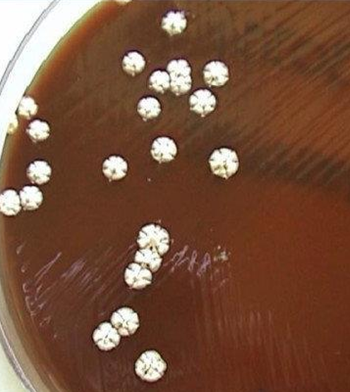
2-Surface texture:
Cottony: when the fungus produces large quantities of long aerial hyphae
Granular (powdery): are formed by fungi that conidiate or sporulate heavily
Glabrous (smooth, creamy):colonies closely resemble colonies of bacteria
Chalky
Cottony
Granular (powdery)
Glabrous (smooth
Chalky

Slide 4
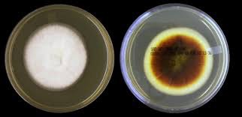
Colony Morphology
3-Pigmentation:
Fungi may be colorless or brightly colored.
Color may be on fungus itself,
on its sporulating apparatus,
or on the bottom of the colony (reverse pigmentation).
reverse pigmentation

Slide 5
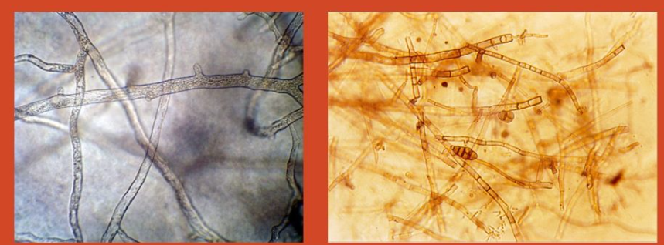
4-Mycelium/spores:
The following microscopic criteria are used to make a genus/species identification of the fungal isolate
  Determine the structure of the hyphae. Are they : Septate or aseptate
  Branching or not branching
  Pigmented or not pigmented
  The size, shape, and arrangement of the spores
  Aseptate Septate

Slide 6
Tasks
Take a picture of the isolation plate
Describe fungal growth
Next lab:
Stain fungal growth (draw and describe the mycelium/spores)
culture purification

