Slide 1
MEIOSIS
Lab 2

Slide 2
The form of cell division by which GAMETES, with HALF the number of CHROMOSOMES, are produced.
DIPLOID (2n) →HAPLOID (n)
Meiosis is SEXUAL reproduction.
TWO divisions (MEIOSIS I and MEIOSIS II).

Slide 3
Sex cells divide to produce GAMETES (sperm or egg).
Occurs only in GONADS (testes or ovaries).
Male: SPERMATOGENESIS –sperm
Female: OOGENESIS - egg or ova

Slide 4
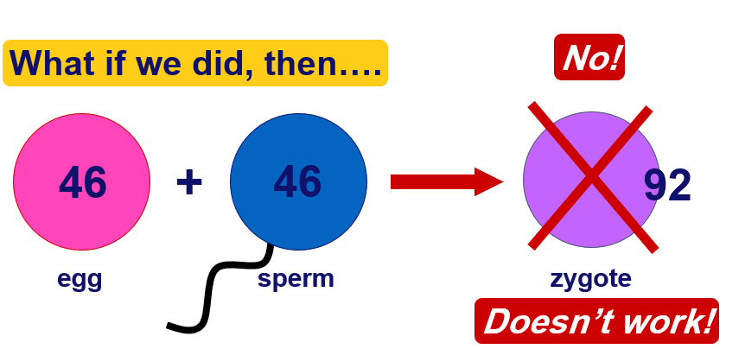
Can we make egg & sperm by mitosis?

Slide 5
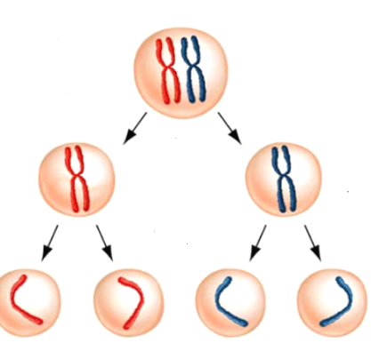
Interphase I:
Similar to mitosis interphase.
Nucleus and nucleolus visible.
Meiosis I (four phases):
Cell division that reduces the chromosome number by one-half.
Four phases:
a. Prophase I
b. Metaphase I
c. Anaphase I
d. Telophase I

Slide 6
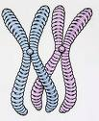
Prophase I
Longest and most complex phase (90%).
Nucleus & Nucleolus disappear
Spindle forms
Chromosomes coil & Synapsis (pairing) occurs
Tetrads form & Crossing over Occurs

Slide 7
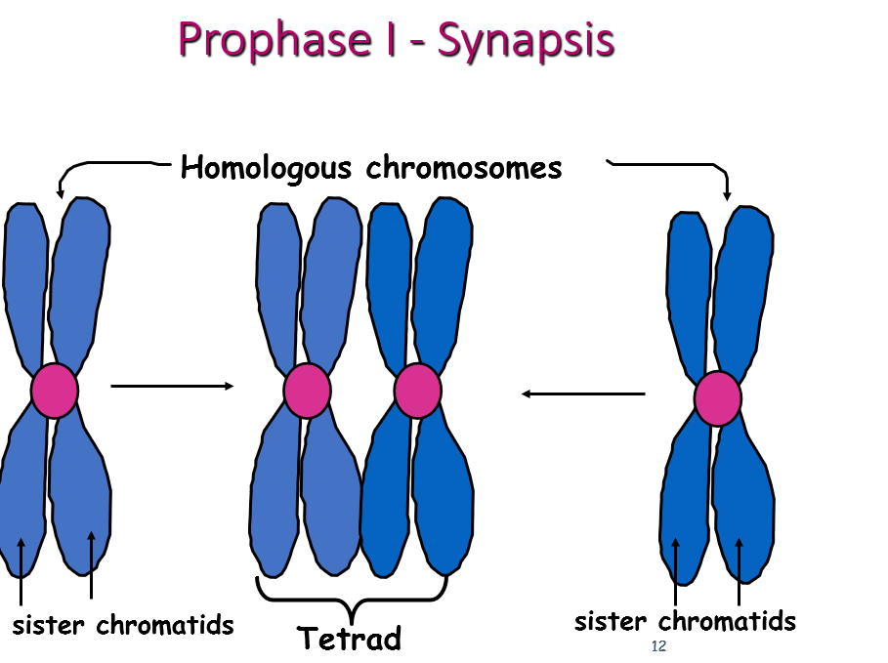

Slide 8
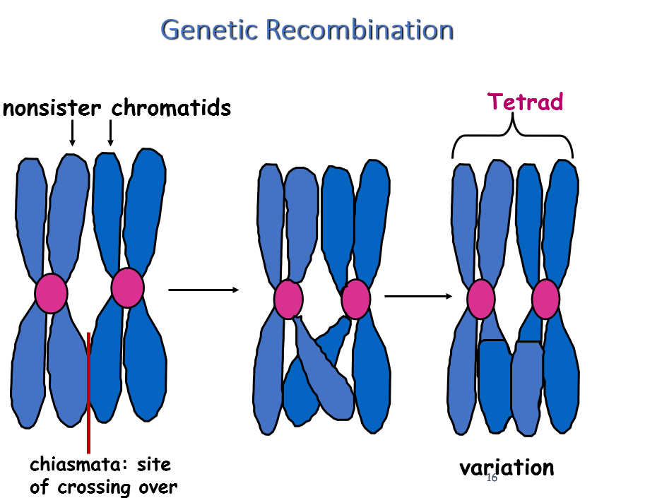

Slide 9
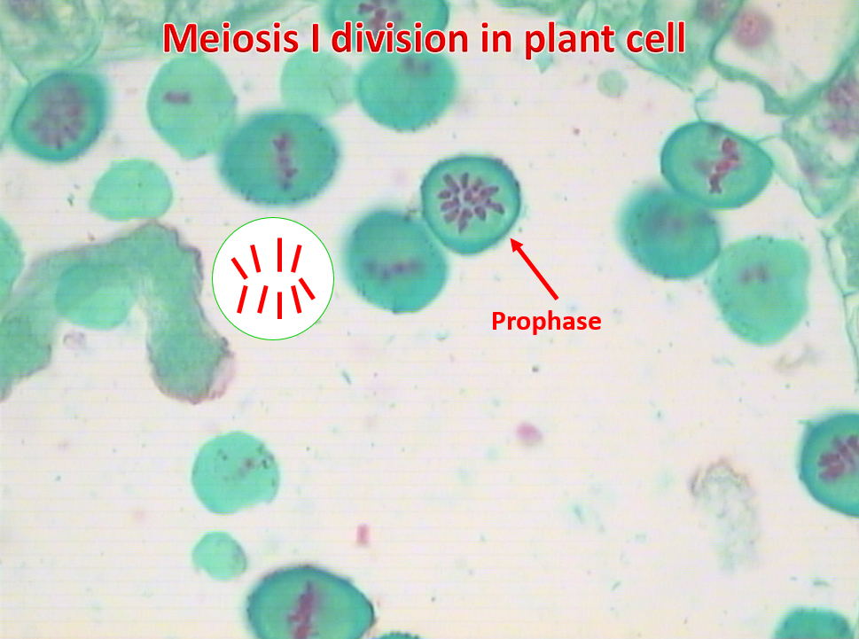

Slide 10
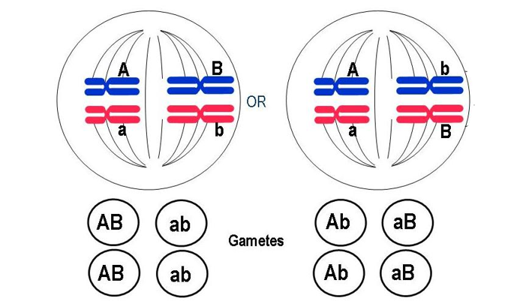
Metaphase I
Shortest phase
Tetrads align on the equator.
Independent assortment occurs – chromosomes separate randomly causing GENETIC RECOMBINATION

Slide 11
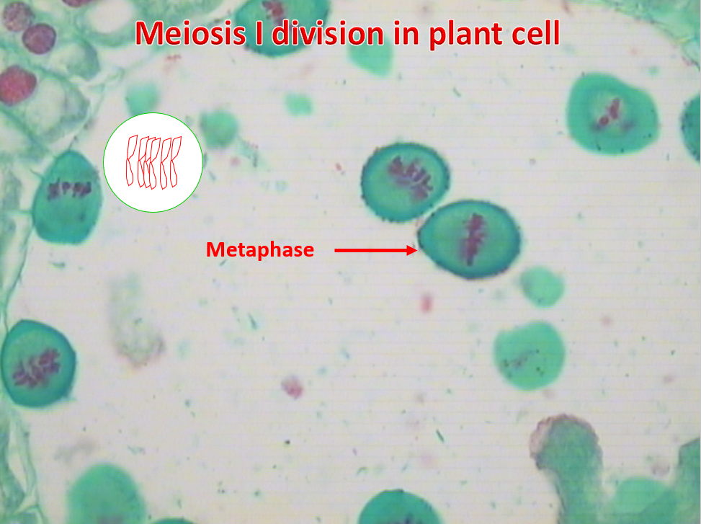

Slide 12
Anaphase I
Homologous chromosomes separate and move towards the poles.
Sister chromatids remain attached at their centromeres.

Slide 13
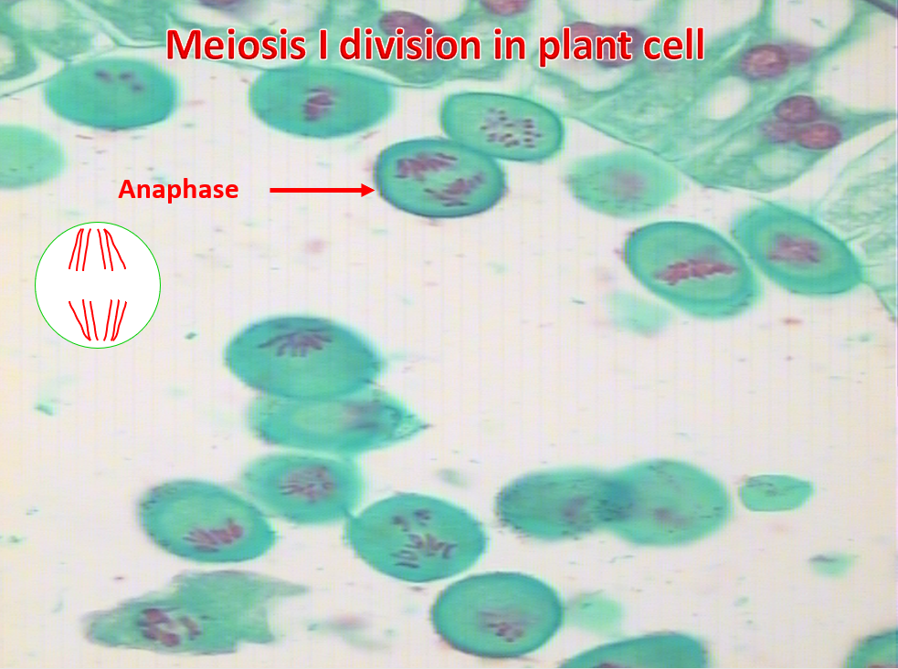

Slide 14
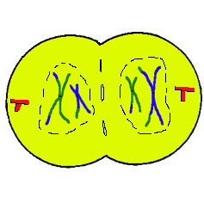
Telophase I
Each pole now has haploid (1n) set of chromosomes.
Cytokinesis occurs and two haploid daughter cells are formed.

Slide 15
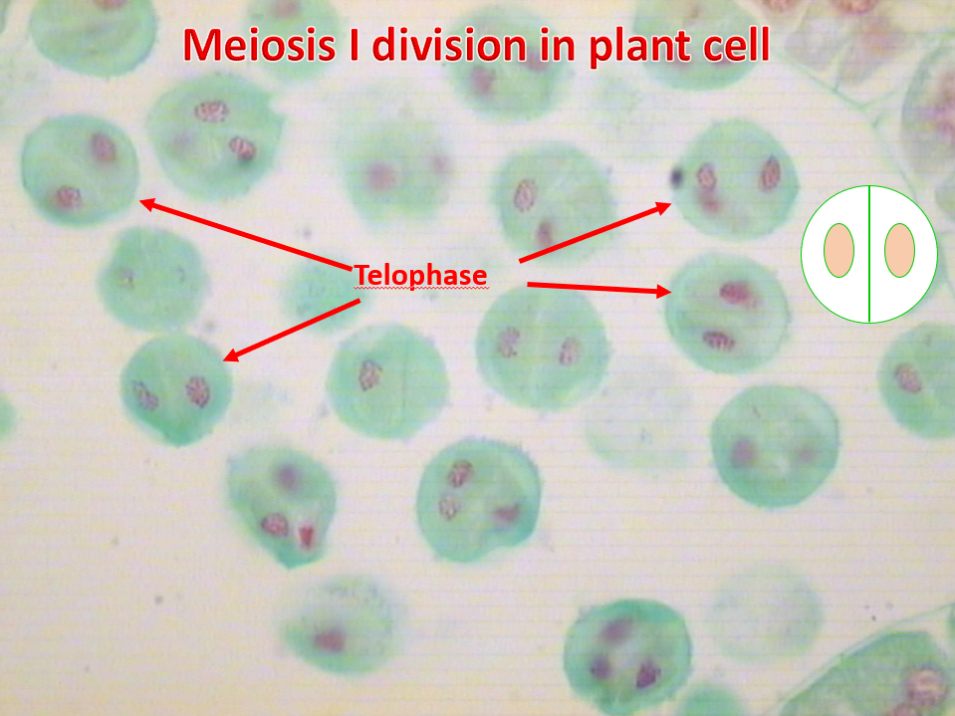

Slide 16
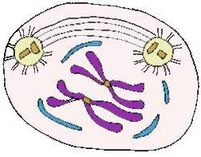
Meiosis II
No Interphase II or very short
No DNA Replication
Remember: Meiosis II is similar to mitosis

Slide 17
Prophase II
Same as Prophase in mitosis
    Nucleus & nucleolus disappear
    Chromosomes condense
    Spindle forms

Slide 18
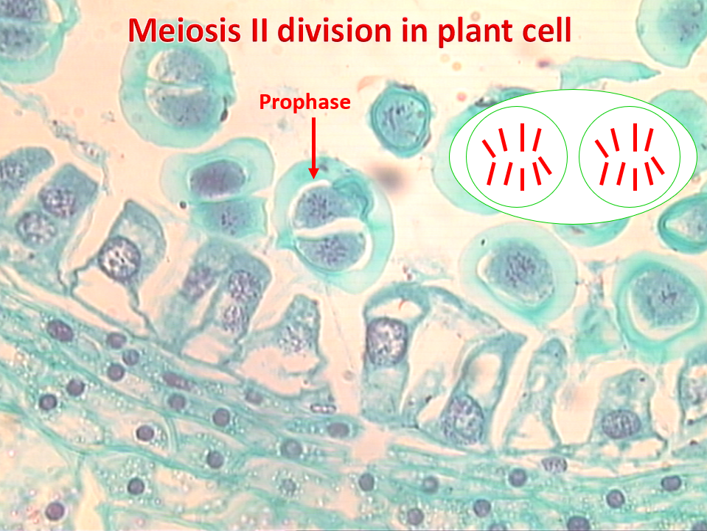

Slide 19
Metaphase II
Same as Metaphase in mitosis

Slide 20
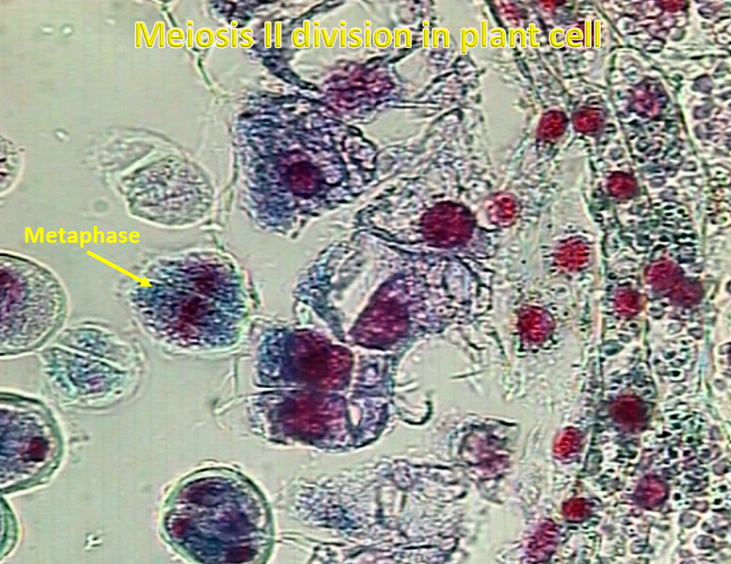

Slide 21
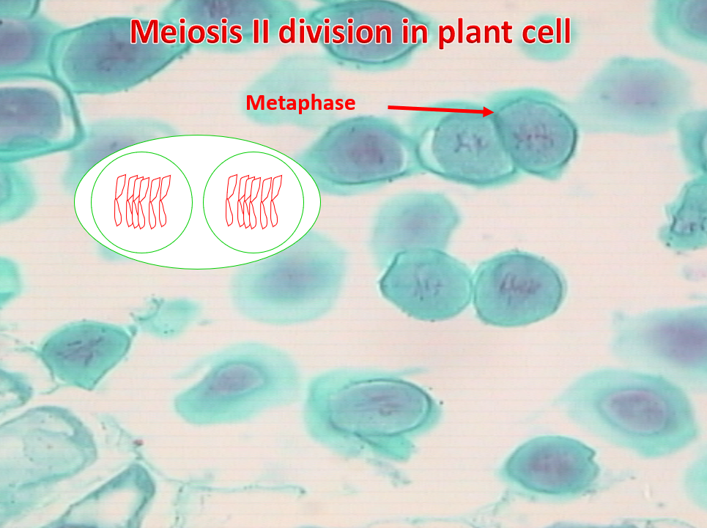

Slide 22
Anaphase II
Same as Anaphase in mitosis
SISTER CHROMATIDS separate

Slide 23
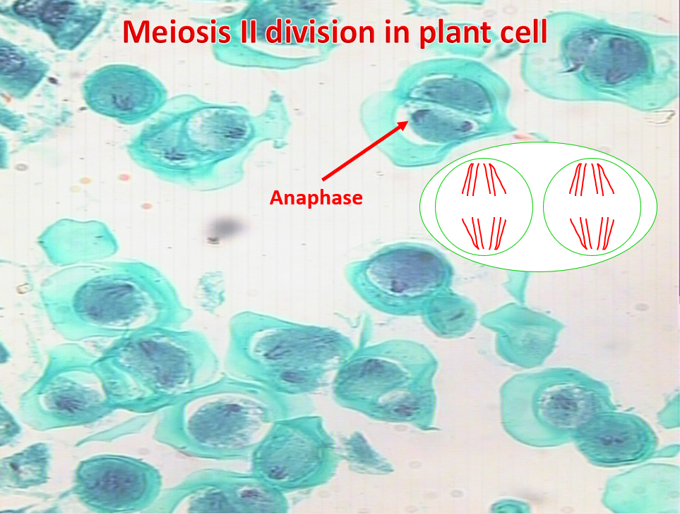

Slide 24
Telophase II
Same as Telophase in mitosis.
Nuclei and Nucleoli reform, spindle disappears
CYTOKINESIS occurs.
Remember: FOUR HAPLOID daughter cells are produced.
Called GAMETES (eggs and sperm)

Slide 25
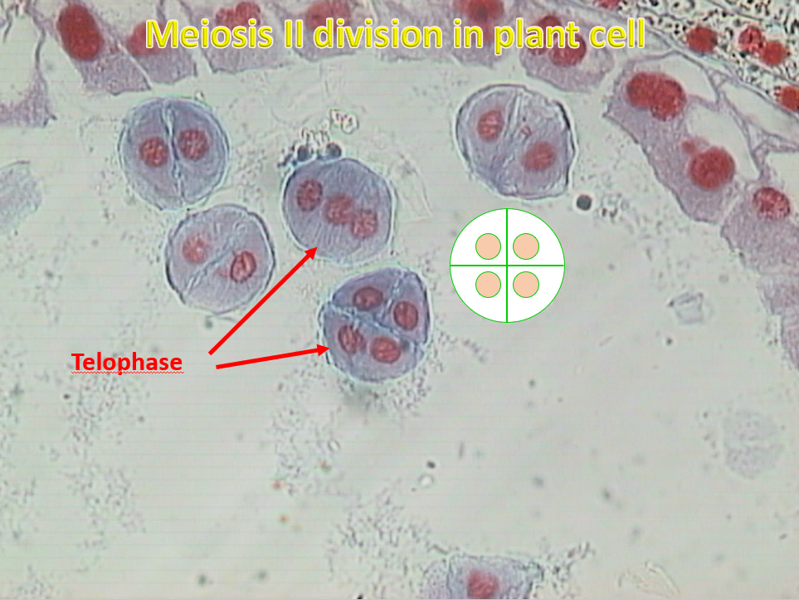

Slide 26
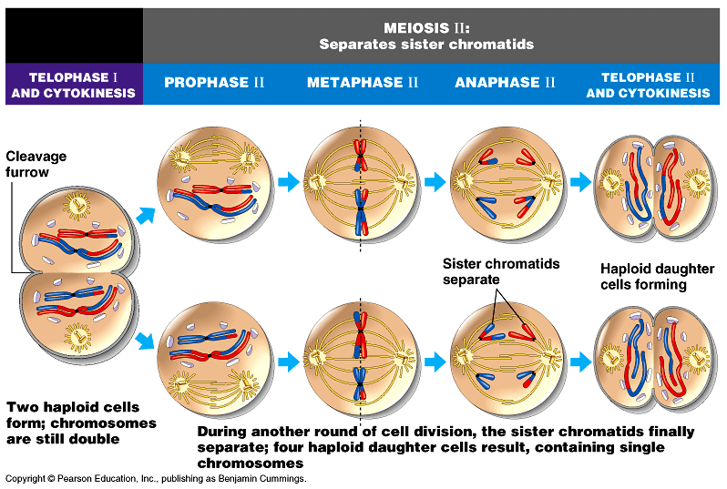

Slide 27
COMPARISON MITOSIS and MEIOSIS
Meiosis | Mitosis
Occurs in germ cells (immature reproductive cells) | Occurs in somatic (body) cells.
Production of gametes (sex cells) | Growth, development, replacement & repair.
Produce 4 daughter cells. | Produces 2 daughter cells.
Daughter cells are haploid (1N). | Daughter cells are diploid (2N).

Slide 28
Thank you

