Slide 1
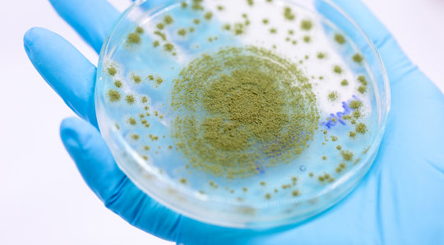
Medical Mycology
Lab2

Slide 2
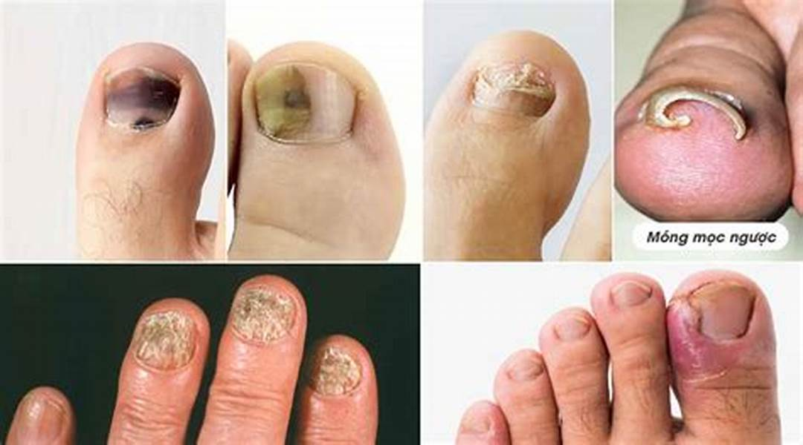
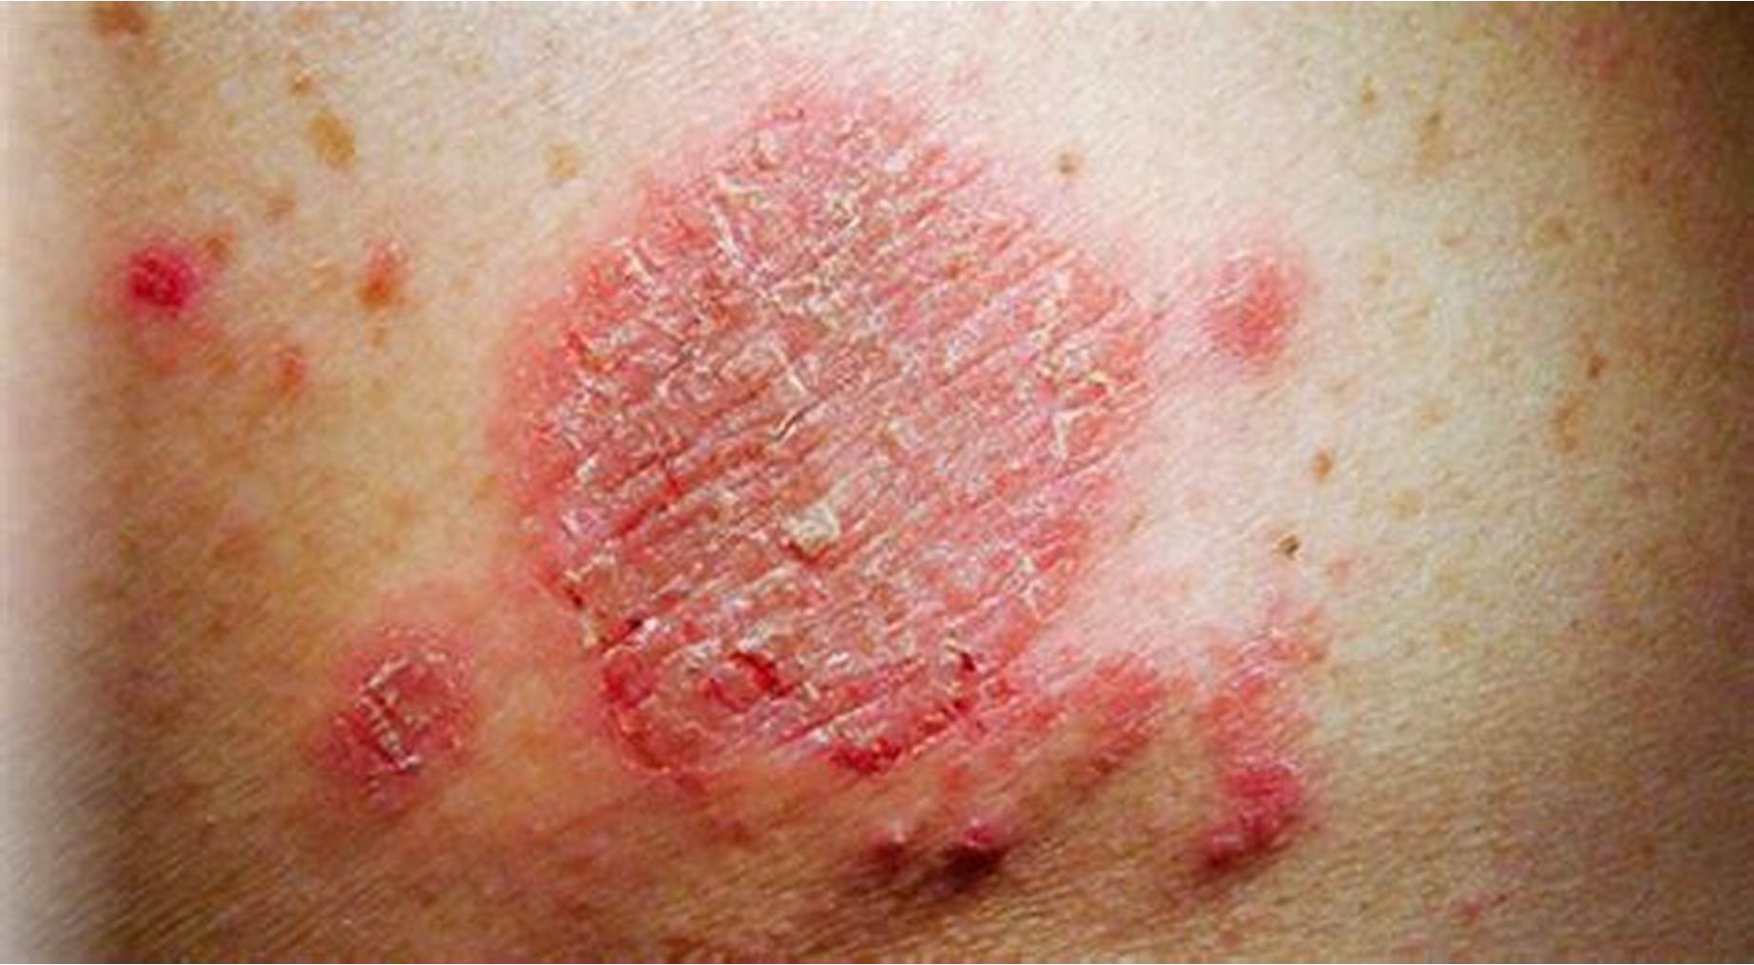
Mycosis

Slide 3
What is Mycosis ?
Mycosis (plural mycoses), in humans and animals, an infection caused by any fungus that invades the tissues.
Classification Based on
**The Site of infection
Superficial or Cutaneous mycoses
Subcutaneous mycoses
Systemic mycoses

Slide 4
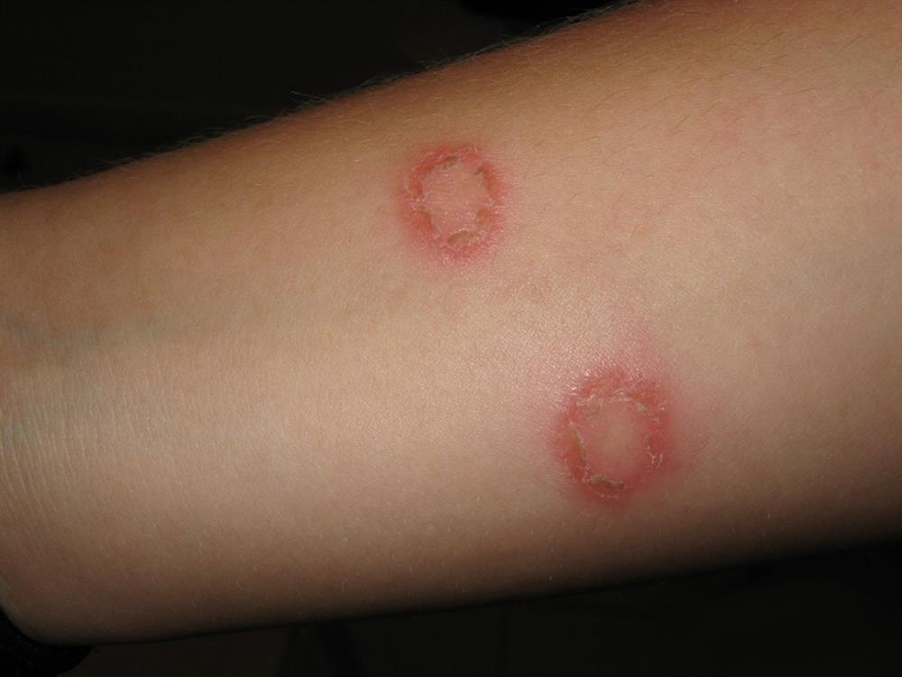
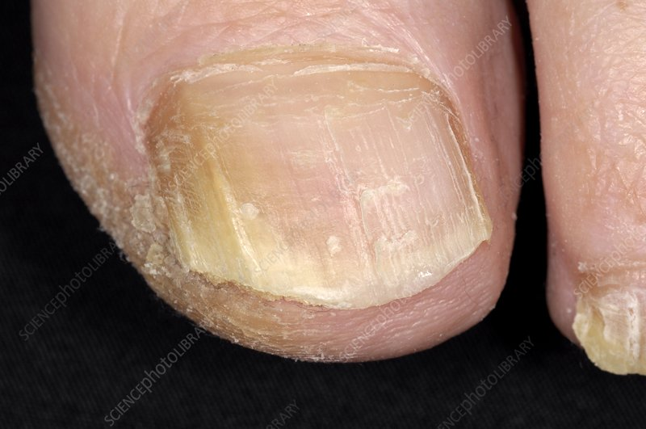
1) Superficial or Cutaneous mycoses :
Caused by fungi that affect the superficial layers of skin, hair, and nails
Examples of superficial fungal infections include
1-Ringworm: caused by Dermatophytes ( which is a group of
filamentous fungi)
2-Onychomycosis. Many types of fungi cause infections of
your fingernails or toenails.
This can cause discolored and cracked nails.

Slide 5
1) Superficial or Cutaneous mycoses :
Examples of superficial fungal infections include
3-Candidiasis. Caused by Candida (usually Candida albicans) causes skin and mucous membrane infections
Candida can naturally present on the skin and mucous membranes.
When the amount of Candida is low, it is harmless, but when it starts to overgrow, it can damage the skin and nearby tissues.
*weak immune system is often the reason for Candida overgrowth.

Slide 6
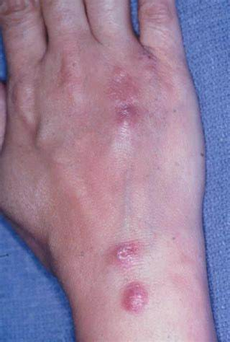
2) Subcutaneous mycoses:
Subcutaneous mycoses cause infections of the skin and underlying tissue
The wounds/cuts in the skin allows fungi from the environment to enter the skin and gain access to deeper tissues.
One of the major forms is Sporotrichosis also known as rose handler’s/Gardener’s disease, caused by Sporothrix schenckii
Symptoms of this form include nodular lesions or bumps in the skin
Naturally found in soil, and usually affects farmers , gardeners, and agricultural workers

Slide 7
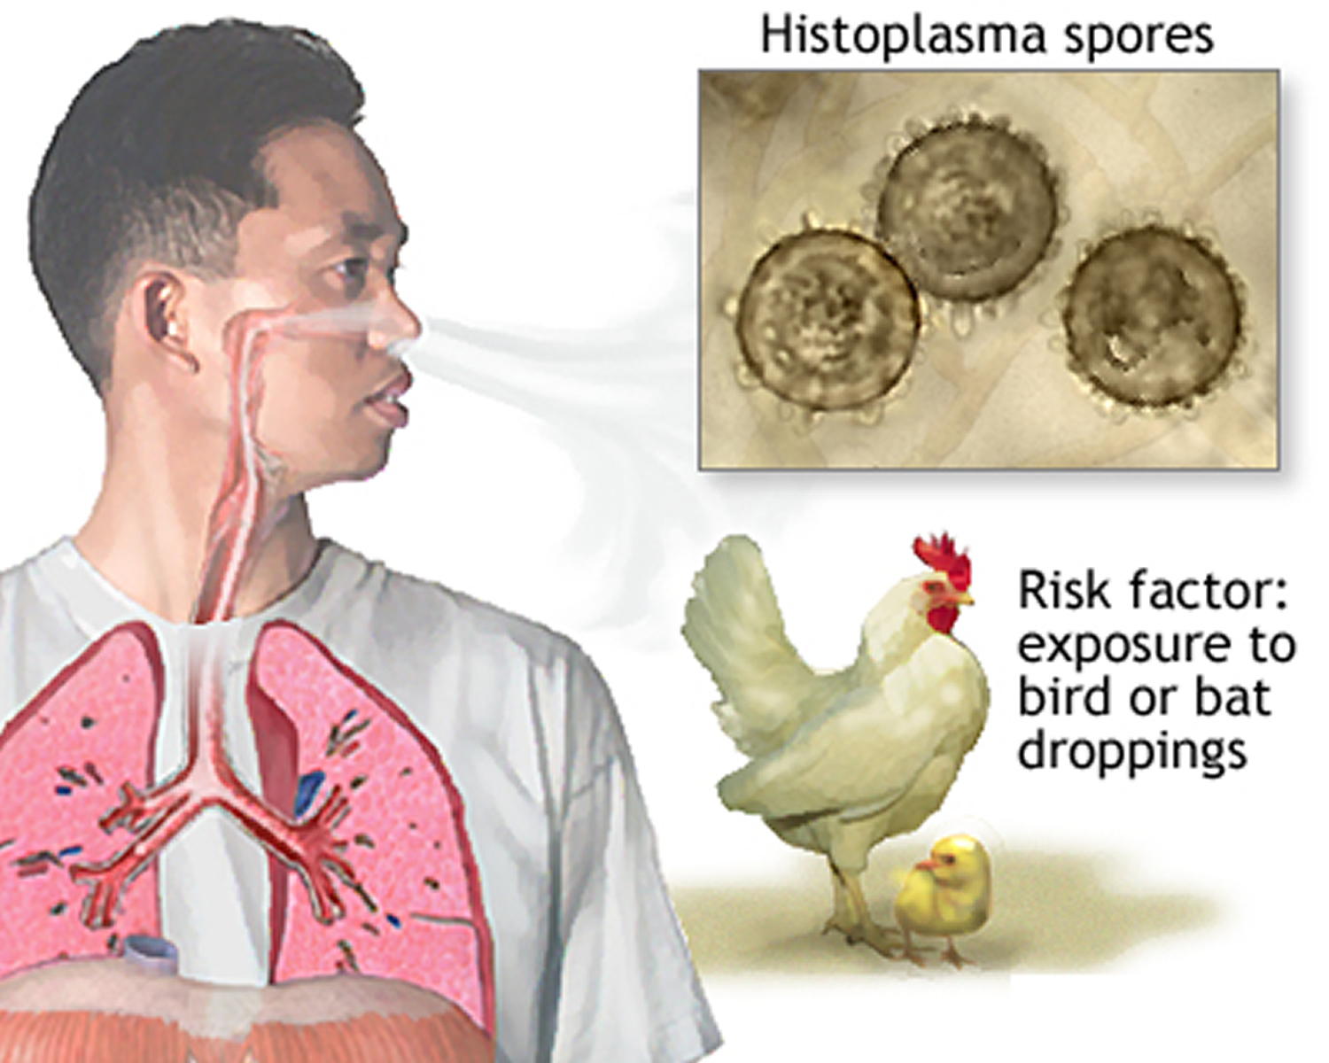
3) Systemic mycoses:
affect internal organs (e.g., lungs, brain, gastrointestinal tract , blood)
The fungi can spread via the bloodstream to multiple organs
Often causing multiple organs to fail and eventually resulting in the death of the patient
Example: Histoplasmosis
is a fungal infection caused by the fungus
(Histoplasma capsulatum)
which grows in soil and material contaminated
with bat and bird droppings
Notes:
gastrointestinal tract

Slide 8
For the next lab

Slide 9
Isolation of human samples for laboratory diagnosis of fungal infections
1-Specimens collection:
* Use sterile tools (forceps, scissors, nail clipper, swaps)
Skin scrapings, nail clippings and hairs can be collected and transported to the lab in an envelope (dark color card- Why?)
To dry out the sample which can help to reduce the level of bacterial contamination
For easy visualization
- The card then, must be folded, sealed, and labeled.
Mycology Specimen Collection (youtube.com)
Start at 2.05

Slide 10
1-Specimens collection:
*Petri dish, or plastic containers can be used ( also need to be sealed and labeled)
* Use parafilm to seal Petri dish and the plastic containers
2. Specimens from mucous membrane (ex. mouth) may be directly inoculated in culture medium or smeared on clean slide by swab or culture loop.
** collect the samples 24h before the lab

Slide 11
laboratory diagnosis of fungal infections
Early and accurate diagnosis of fungal infection is critical for effective treatment.
Common approaches/methods for the laboratory diagnosis of fungal infections are:
Direct microscopic examination of clinical samples
Culture of the organism
histopathology
Serological tests
Molecular diagnostics

Slide 12
1-Direct Microscopic Examination
Direct microscopic examination of clinical specimens such as : skin scrapings, hair, and nails is a common method
It provides a rapid diagnosis of some fungal infections.

Slide 13
Various dyes can be used to stain and examine fungal features (e.g. spores, hyphae etc) which helps in the identification.
Potassium Hydroxide - KOH (10-20%):
A recommended method for the direct microscopic examination (Next lab)
Lactophenol-cotton blue (LCB) :
Lactophenol: preserves fungal structures and kills the fungus. Cotton blue: stains the fungal elements
Calcofluor white:
Fluorescent Stain- excellent to examine the morphology of pathogenic fungi
Binds with cellulose and chitin contained in the cell walls of the fungi
You will need fluorescence microscope which requires skills to work with
It is expensive
Giemsa Stain:
It is a Nucleic acid stain.
Methylene blue is the basic dye that is responsible for staining the acidic components of the cell, particularly the nucleus
5% Giemsa stain solution for 20–30 minutes

Slide 14
Potassium hydroxide preparation (KOH)
KOH is a strong alkali.
Method | Potassium hydroxide preparation (KOH mount)
Use | Clearing of specimens to make fungi more visible (How?)***
Time Required | 5 min; if clearing is not complete, an additional 5-10 min is necessary.
Advantages | Rapid detection of fungal elements
Disadvantages | Requires experience because background artifacts are often confusing clearing of some specimens may require an extended time.
Method | Potassium hydroxide preparation (KOH mount)
Use | Clearing of specimens to make fungi more visible (How?)***
Time Required | 5 min; if clearing is not complete, an additional 5-10 min is necessary.
Advantages | Rapid detection of fungal elements
Disadvantages | Requires experience because background artifacts are often confusing; clearing of some specimens may require an extended time.
*** When specimen such as nails or skin is mixed with 10-20 % KOH, it softens, digests and clears the tissues (e.g., keratin present in skins) surrounding the fungi (leaving alkali-resistant fungi intact)
so that the hyphae and spores can be seen under a microscope.

Slide 15
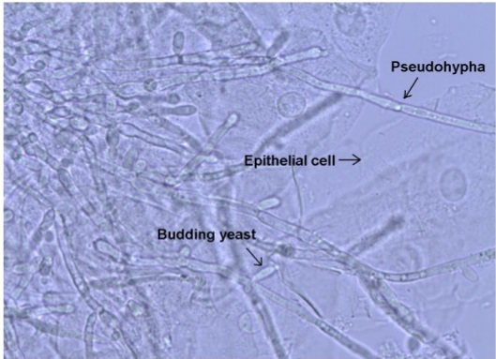
Preparation of the KOH mount
Using a pipette/dropper, place a drop of KOH solution on a clean slide.
Transfer small quantity of the specimen with the tip of a scalpel into the KOH drop.
Put a clean cover slip over the drop gently so that no air bubble is trapped.
Place the slide on hot plate for few minutes.
Use 10X or 40X objectives to describe fungal isolate
Skin Scraping for Fungal identification (youtube.com)
Results
Negative (Normal) : The absence of the fungus in the sample
Positive (abnormal): when some Fungus observed in the samples
Notes:
Results

Slide 16
2. Culture
Fungi are frequently cultured on Sabouraud dextrose agar (SDA) which facilitates the appearance of the slow-growing fungi by inhibiting the growth of bacteria.
**Inhibition of bacterial growth is due to the low pH of the medium and use of antibiotics.
Fungi develop varying characteristics on different media, so it is important to describe the characteristics on a standard medium such as Sabouraud Dextrose Agar (SDA).
Medically important fungi are normally described by their appearance on SDA, which is one reason this medium continues to be used as the primary isolation medium

Slide 17
Fungal colony is identified by rapidity of growth, color, and morphology
Colony characteristics of the isolate, and the nature of the asexual spores, mycelium are sometimes sufficient to identify the common pathogens.
The inoculated media should be incubated at 25 – 37 C for (7 days -14 days and up to 4 weeks)
Culture method is time-consuming in most cases

Slide 18

There are signs of fungal infection, however you got a negative culture result…Why !!!!
Inadequate specimen (not enough)
The presence of non-viable hyphae elements in the distal region of a nail
An uneven colonization of a nail with the fungus
Anti-fungal treatment used prior to collection of the specimen
A delay in the specimen reaching the laboratory
Incorrect laboratory procedures
Slow growth of the organism
Notes:
Negative Culture result

Slide 19
Students tasks next lab
Use KOH to examine the presence of any fungus in the samples (Evaluated 1Mark)
Inoculate collected samples ( mainly nails/ dry skin) from people that we think they have fungal infection) into SDA media and incubate for 14 days ( ? Maybe 1 or 2)

