Slide 1
Lab Exercise #9
Zoo- 145
Determination of Human Blood Group

Slide 2
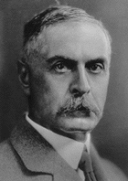
Lab Exercise # 9
Zoo- 145
The ABO Blood Group System
Karl Landsteiner (1900) reported the blood groups in Human blood for the first time and described three types of blood groups
Later, Decastello Sturli (1902) found the fourth blood group
Landsteiner has been awarded Noble Prize for his research on blood groups and since then, the blood group system is more popularly known as the Steiner A, B and O system.

Slide 3
Lab Exercise # 9
Zoo- 145
On the red blood cells the substance responsible for causing incompatibility amongst different types of blood at the time of transfusion to another person are present and these are proteins and named as agglutinogens, antigens.
Likewise, the antibodies which are present or produced in the serum are the globulins.
Rhesus factor (Rh) is the additional antigen available in the human blood.
Since it has been reported for the first time in the Rhesus monkeys so it is called the Rhesus Factor
RBCs that are "Rh positive" express the antigen designated D
If your blood does contain the Rh antigen, your blood is said to be Rh positive (Rh+). If your blood does not contain the Rh antigen, your blood is said to be Rh negative (Rh-).

Slide 4
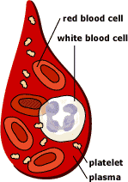
Lab Exercise # 9
Zoo- 145
What is blood made up of?
An adult human has about 4–6 liters of blood circulating in the body.
Blood consists of several types of cells floating around in a fluid called plasma.
The red blood cells (RBCs) contain haemoglobin, a protein that binds oxygen. RBCs transport oxygen to, and remove carbon dioxide from the tissues.
The white blood cells fight infection.
The platelets help the blood to clot, if you get a wound for example.
The plasma contains salts and various kinds of proteins.

Slide 5


Lab Exercise # 9
Zoo- 145
ABO blood grouping system
Blood group A
If you belong to the blood group A, you have A antigens on the surface of your RBCs and B antibodies in your blood plasma.
Blood group B
If you belong to the blood group B, you have B antigens on the surface of your RBCs and A antibodies in your blood plasma.

Slide 6


Lab Exercise # 9
Zoo- 145
Blood group AB
If you belong to the blood group AB, you have both A and B antigens on the surface of your RBCs and no A or B antibodies at all in your blood plasma.
Blood group O
If you belong to the blood group O (null), you have neither A or B antigens on the surface of your RBCs but you have both A and B antibodies in your blood plasma.

Slide 7
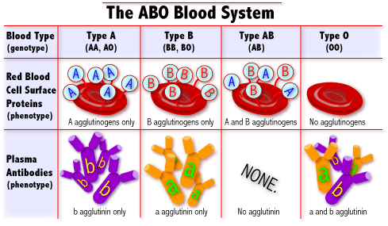
What are blood types?
Blood Types
AA or AO = Type A
BB or BO = Type B
OO = Type O
AB = Type AB
There are 3 alleles or genes for blood type: A, B, & O. Since we have 2 genes, there are 6 possible combinations.
http://learn.genetics.utah.edu/units/basics/blood/types.cfm

Slide 8
Lab Exercise # 9
Zoo- 145
ABO inheritance and genetics
The ABO gene is autosomal (the gene is not on either sex chromosomes)
The ABO gene locus is located on the chromosome 9.
A and B blood groups are dominant over the O blood group
A and B group genes are co-dominant
Each person has two copies of genes coding for their ABO blood group (one maternal and one paternal in origin)

Slide 9
Lab Exercise # 9
Zoo- 145
Who can give you blood and receive blood from you?
Universal Donor
People with TYPE O blood are called Universal Donors, because they can give blood to any blood type.
People with TYPE AB blood are called Universal Recipients, because they can receive any blood type.
Rh + → Can receive + or -
Rh - → Can only receive -
O
A
B
AB
Universal Recipient

Slide 10
Lab Exercise # 9
Zoo- 145
Possible Blood group Genotypes
Parent Allele | A | B | O
A | AA | AB | AO
B | AB | BB | BO
O | AO | BO | OO

Slide 11
Lab Exercise # 9
Zoo- 145
The ABO blood groups
The table shows the four ABO phenotypes ("blood groups") present in the human population and the genotypes that give rise to them
Blood Group
Antigens on RBCs
Antibodies in Serum
Genotypes
A
A
Anti-B
AA or AO
B
B
Anti-A
BB or BO
AB
A and B
Neither
AB
O
Neither
Anti-A and anti-B
OO

Slide 12
Antigen | Antibody | Rh Factor | Blood group (phenotype) | Genotype
A | b | Present + | A+ | I^{A}I^{A} I^{A} i
A | b | Absent - | A- | I^{A}I^{A} I^{A} i
B | a | Present + | B+ | I^{B}I^{B} I^{B} i
B | a | Absent - | B- | I^{B}I^{B} I^{B} i
AB | - | Present + | AB+ | I^{A}I^{B}
AB | - | Absent - | AB- | I^{A}I^{B}
- - | a, b a, b | Present + Absent - | O+ O- | ii ii

Slide 13
Lab Exercise # 9
Zoo- 145
Method
A clean slide is marked by glass marker to make three separate column A, B, and D.
A small drop of blood is collected on each of three columns and antiserum A, B, and D is added in the respective places and allowed the blood to mix well by using tooth pick.
The agglutination in column A and B determines the blood groups .
Observation
If the reaction is in the A column only the blood group is A and if the reaction is in the column B then the blood group is B only.
The reaction in both columns denotes the blood group AB whereas no reaction determines the blood group O only.
About column D the reaction reflects the presence of the Rhesus factor i.e.. generally label led as + and its absence is marked with - means no reaction in the column D.

Slide 14
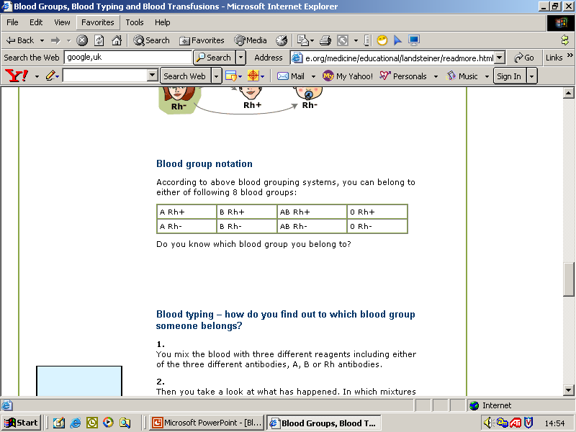
Lab Exercise # 9
Zoo- 145
Do you know which blood group you belong to?
According to above blood grouping systems, you can belong to either of following 8 blood groups:

Slide 15
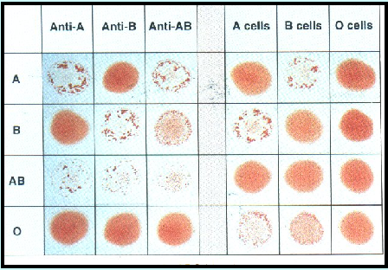
Illustration of the forward and reverse grouping reaction patterns of the ABO groups using a blood group tile
http://www.bh.rmit.edu.au/mls/subjects/abo/resources/genetics1.htm

