Slide 1
Lab Exercise # 8
Zoo- 145
CELL DIVISION
MEIOSIS

Slide 2
Lab Exercise # 8
Zoo- 145
Meiosis
Meiosis (Gr. Meiouni = to reduce; sis = process) has been reported for the first time by J. B. Farmer (1905)
It is special type of cell division (reduction division)
It occurs in germ (sex) cells or in gonads (testes and ovaries) during
Mother cell gives four daughter cells each one contains haploid number of chromosomes (n)
It is much more complicated than mitosis because it has long process
Function of meiosis: formation of the gametes

Slide 3
Lab Exercise # 8
Zoo- 145
Meiosis
Meiosis is the type of cell division by which germ cells (eggs and sperm) are produced
One parent cell produces four daughter cells
Daughter cells have half the number of chromosomes found in the original parent cell

Slide 4
Lab Exercise # 8
Zoo- 145
Meiosis
In Meiotic Division the nucleus divides twice and the chromosomes divide once only
The meiotic cell division has two subdivisions in sequence:
1- The first meiosis: Reductional division (2n -- n)
2- The second meiosis: Equational division (similar to mitosis)

Slide 5
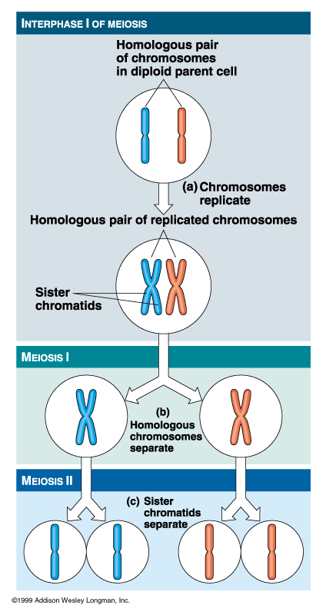
MEIOSIS
Two Parts:
Meiosis I:
  Separation of homologous pairs
Meiosis II:
  Separation of sister chromatids

Slide 6
Stages of Meiosis
Lab Exercise # 8
Zoo- 145
Meiosis - I
Prophase I
Metaphase I
Anaphase I
Telophase I
Leptotene
Zygotene
Pachytene
Diplotene
Diakinesis
Meiosis - II
Prophase II
Metaphase II
Anaphase II
Telophase II

Slide 7
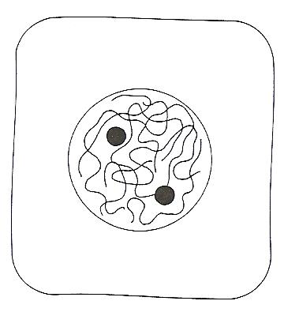
Lab Exercise # 8
Zoo- 145
Meiosis - I
Prophase I
Leptotene
Thin long and beaded chromosomes become visible in the nucleus

Slide 8
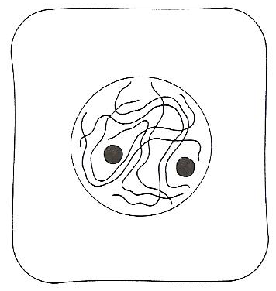
Lab Exercise # 8
Zoo- 145
Prophase I
Zygotene
Homologous chromosomes form pairs and each chromosome divides in two chromatids to form tetrad

Slide 9
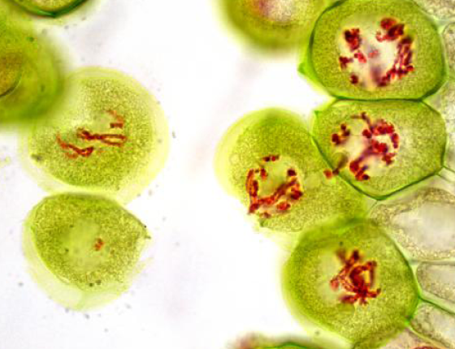
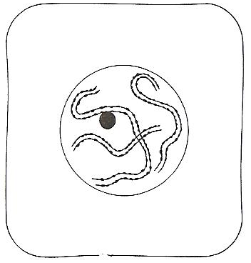
Lab Exercise # 8
Zoo- 145
Prophase I
Pachytene
Crossing over takes place between the homologous pairs of the chromosomes

Slide 10
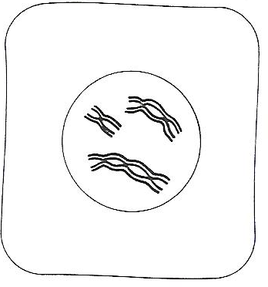
Lab Exercise # 8
Zoo- 145
Prophase I
Diplotene
After crossing over new sets of chromosomes are formed by separation form the pairs

Slide 11
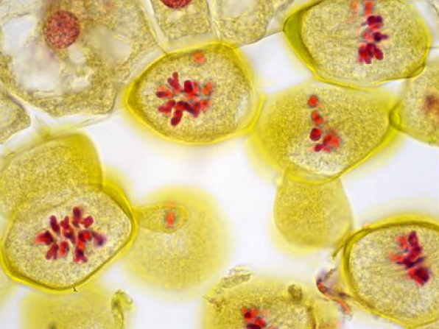
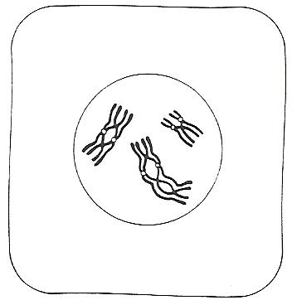
Lab Exercise # 8
Zoo- 145
Prophase I
Diakinesis
Chromosomes are consolidated in short and thick forms of chromosomes

Slide 12
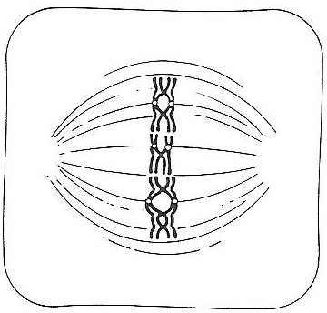
Lab Exercise # 8
Zoo- 145
Metaphase I
Chromosomes fall on the medium line of the cell and each chromosome

Slide 13
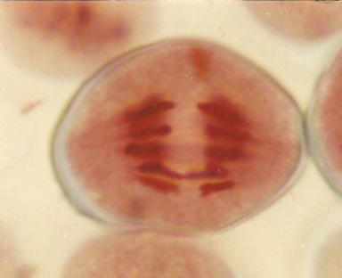
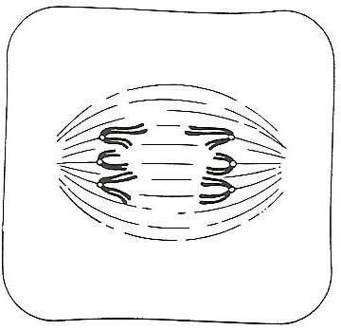
Lab Exercise # 8
Zoo- 145
Anaphase I
Half of the chromosomes go to the opposite poles

Slide 14
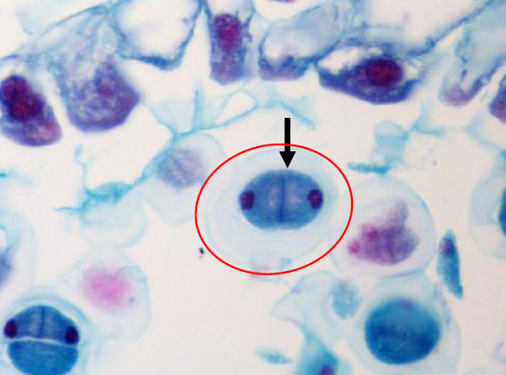
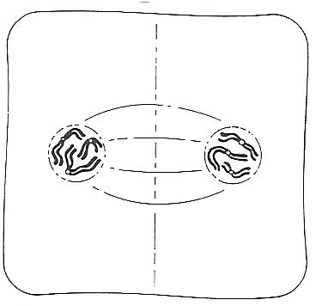
Lab Exercise # 8
Zoo- 145
Telophase I
Two nuclei are formed, each with half number of chromosomes
Chromosomes disappear in the two daughter nuclei

Slide 15
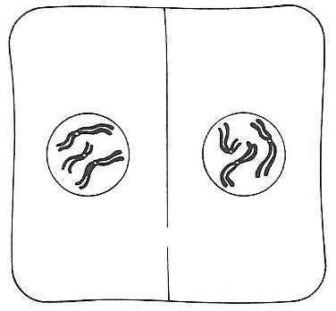
Lab Exercise # 8
Zoo- 145
Meiosis - II
Prophase II
Chromosomes become visible in each of the two daughter nuclei

Slide 16
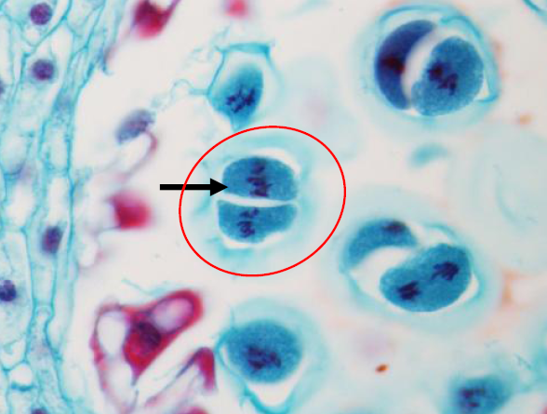
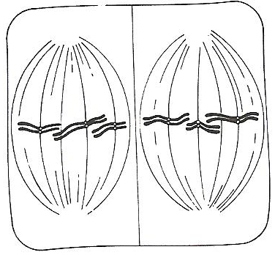
Lab Exercise # 8
Zoo- 145
Metaphase II
Each chromosome fall in the median line of the two daughter cells and each chromosome divides in two chromatids

Slide 17
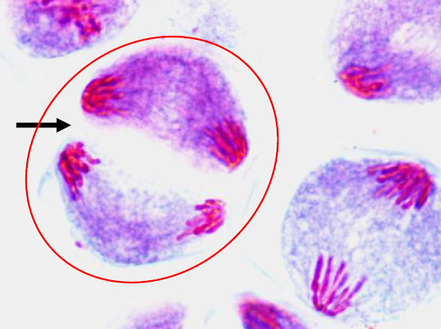
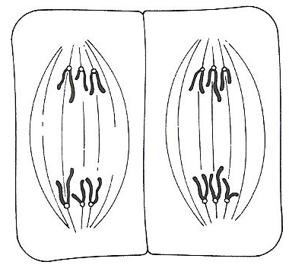
Lab Exercise # 8
Zoo- 145
Anaphase II
Each chromosome breaks into two chromatids
Halves of the chromosomes move to the opposite poles in each of the two daughter cells

Slide 18
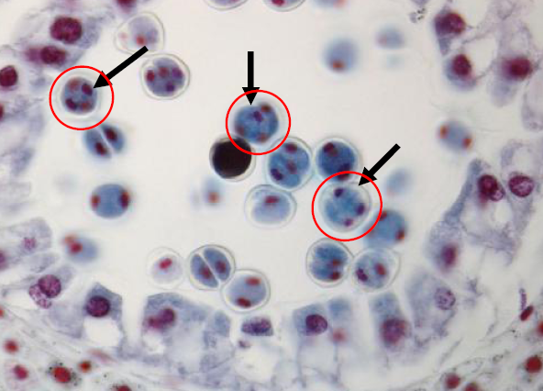
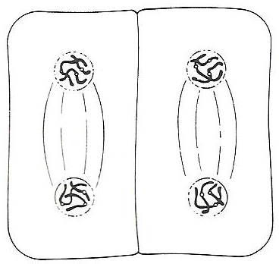
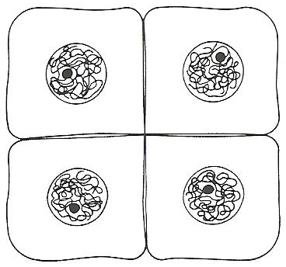
Lab Exercise # 8
Zoo- 145
Telophase II
Four daughter nuclei are formed and each daughter cell with half number of chromosomes and each cell is not identical

Slide 19
Lab Exercise # 8
Zoo- 145
COMPARISON-- MITOSIS and MEIOSIS
Mitosis:
  Occurs in somatic (body) cells
  Growth, development, replacement & repair
  Produces 2 daughter cells
    Clones of parent and each other
  Daughter cells are diploid (2N)
Meiosis:
  Occurs in germ cells (immature reproductive cells)
  Production of gametes (sex cells)
  Produce 4 daughter cells
    Distinct from parent and each other
  Daughter cells are haploid (1N)

