Slide 1
Lab Exercise # 7
Zoo- 145
CELL DIVISION
MITOSIS

Slide 2
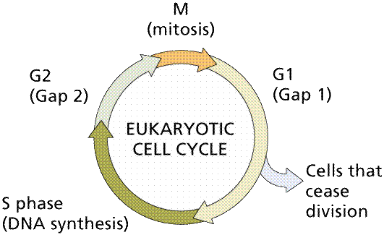
Lab Exercise # 7
Zoo- 145
Cell cycle: is the changes which occur in the cell during its division (mitosis) and during its rest (interphase).
OR
sequence of phases in the life cycle of the cell

Slide 3
Lab Exercise # 7
Zoo- 145
Types of cell divisions
1- Amitosis (direct cell division)
It is simple division
It occurs in lower animals as amoeba and in certain cells of placenta and embryo
Function of this type: reproduction of the cells

Slide 4
Lab Exercise # 7
Zoo- 145
2- Mitosis (indirect cell division)
· The term mitosis (mitos= threads, osis= process)
· It occurs in general cell of the body (somatic cells) except the nerve cell
· Mother cell gives two daughter cells each one contains diploid number of chromosomes (2n)
· Function of this type: responsible for growth of the organism and repair of damaged tissues.
3- Meiosis (reduction cell division)
· Is special type of cell division
· It occurs in germ (sex) cells or in gonads (testes and ovaries) during
formation the gametes (sperms and unfertilized ova)
· Mother cell gives four daughter cells each one contains haploid number of chromosomes (n)
· It is much more complicated than mitosis because has long process
· Function of this type: formation of the gametes

Slide 5
Mitosis
The process of cell division which results in the production of two daughter cells from a single parent cell.
The daughter cells are identical to one another and to the original parent cell.

Slide 6
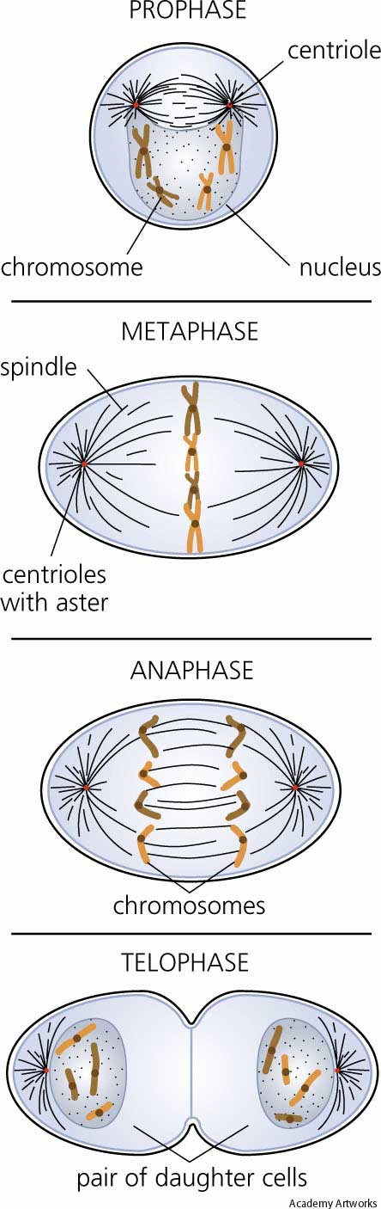




Mitosis can be divided into stages
Prophase
Metaphase
Anaphase
Telophase

Slide 7
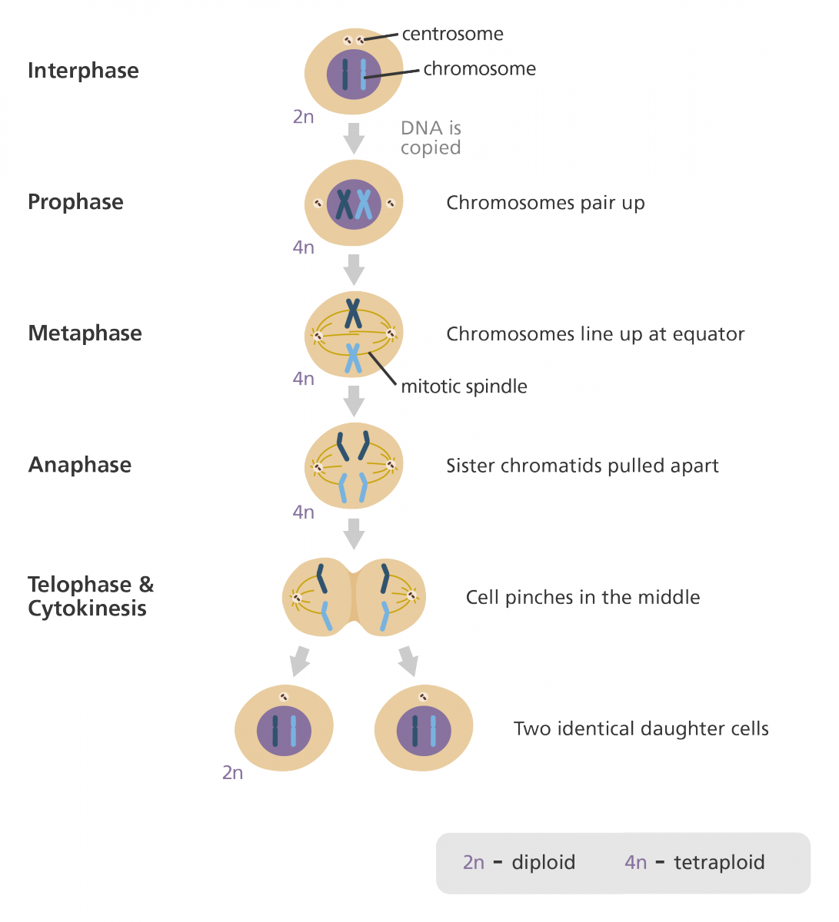

Slide 8
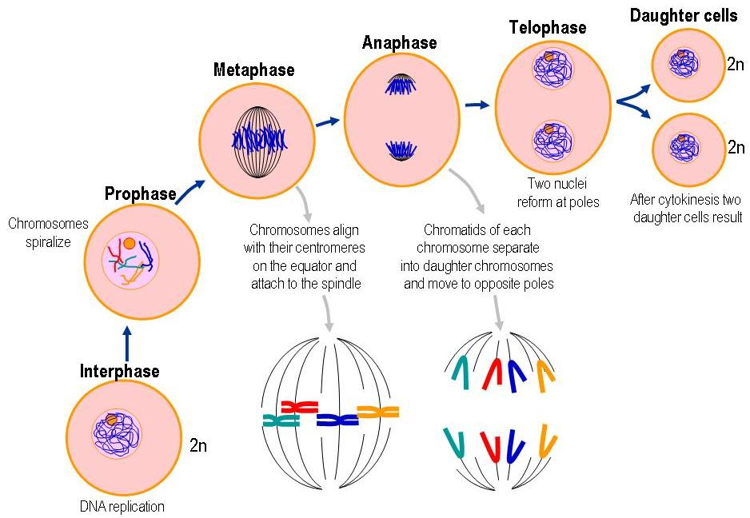

Slide 9
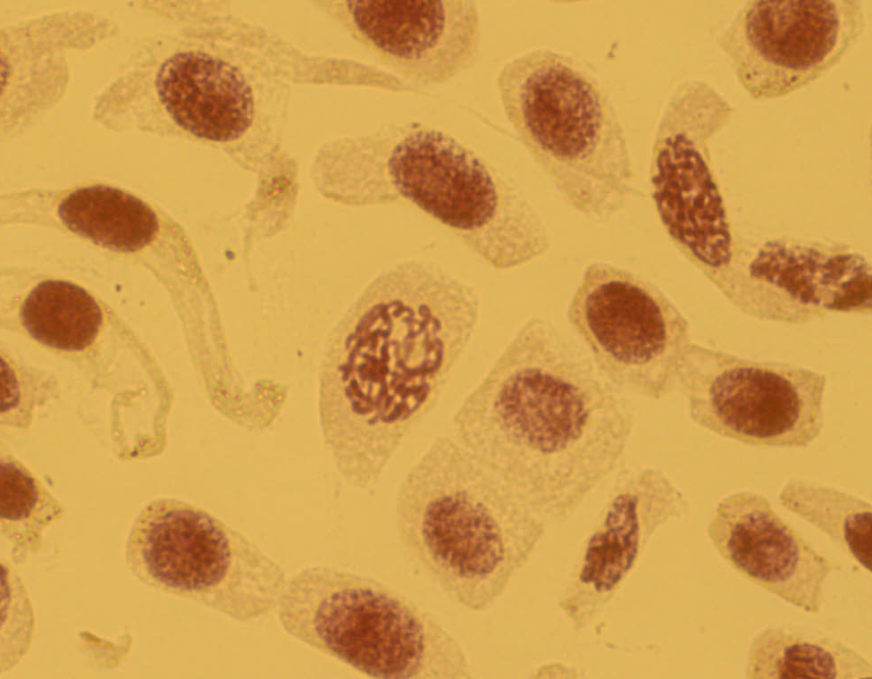
1- Prophase
Plant cell
Animal cell
· Each pair of centrioles move to one pole of dividing cell
· Nuclear membrane and nucleolus are disappear
· Chromosomes become visible

Slide 10
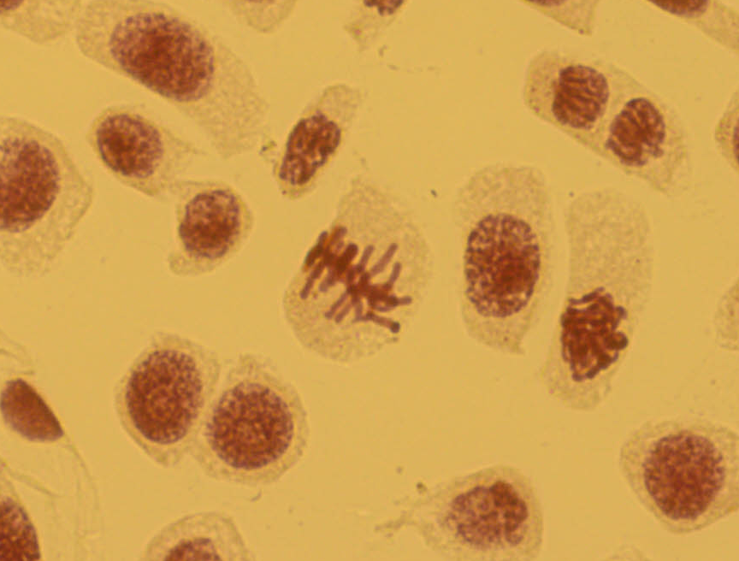
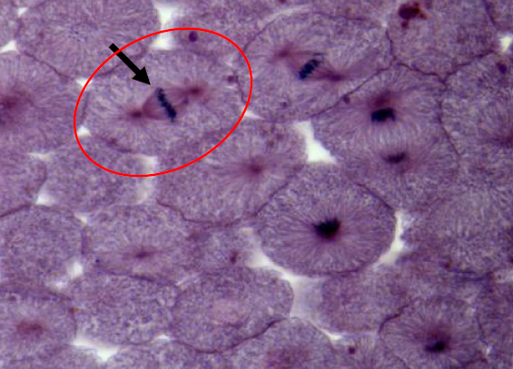
2- Metaphase
Plant cell
Animal cell
The spindle fibers(chromosomal and cytoplasmic) are well developed
The chromosomes are align at the equatorial (middle) plate of the cell

Slide 11
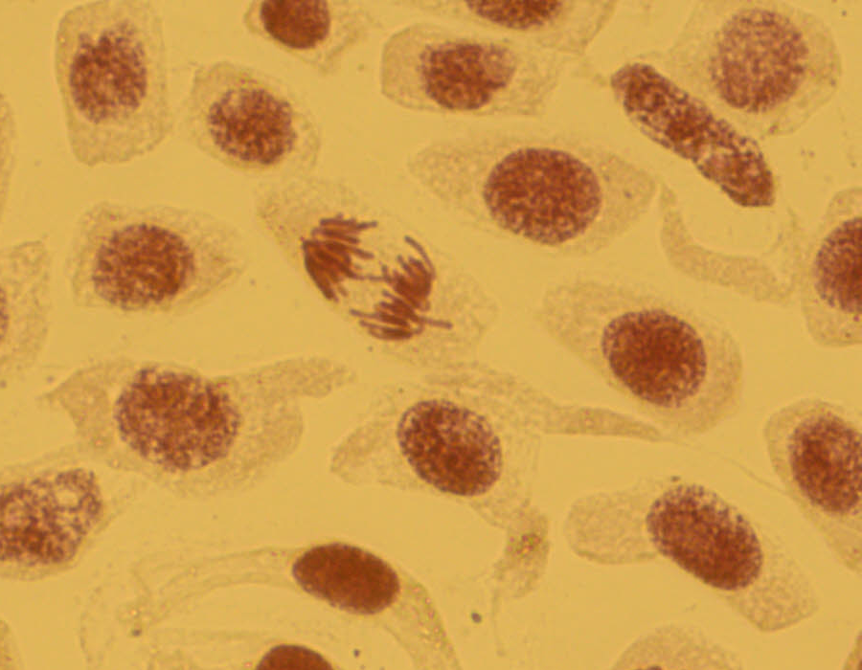
3- Anaphase
Plant cell
Animal cell
· Each chromosome split into two chromatids at the centromere
· Half number of chromosomes move to one pole of dividing cell and the other half move to the opposite pole

Slide 12
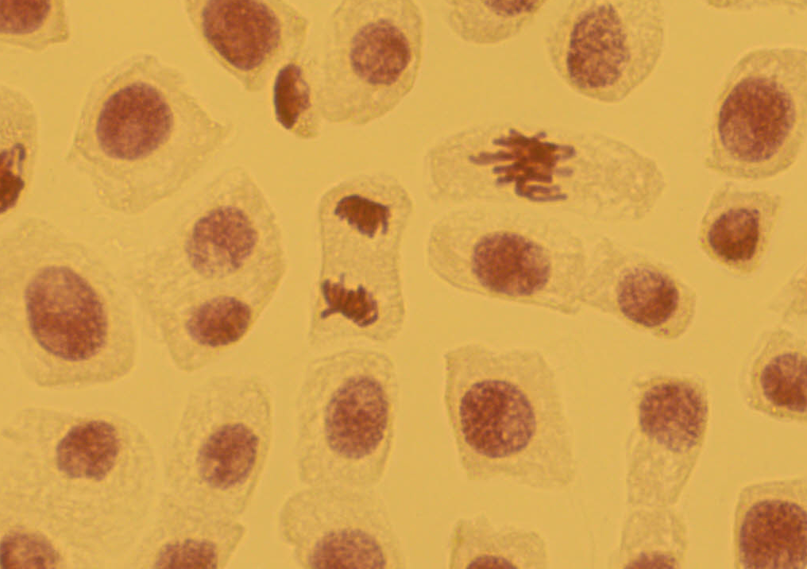
4- Telophase
Plant cell
Animal cell
· Two nuclei of two daughter cells are formed
· Nuclear membrane and nucleolus are reappear
· Karyokinesis follows by cytokinesis to form 2 independent daughter cells

Slide 13
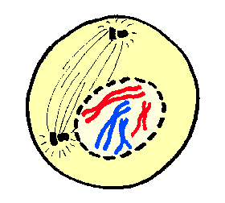
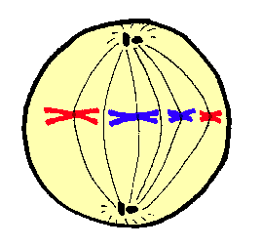
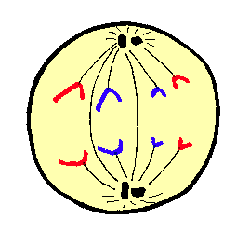
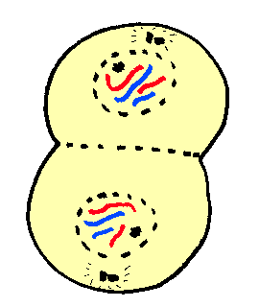
Summary of Mitosis
Prophase
Each pair of centrioles move to one pole of dividing cell
Nuclear membrane and nucleolus are disappear
Chromosomes become visible
Metaphase
The spindle fibers (chromosomal and cytoplasmic) are well developed
The chromosomes are align at the equatorial (middle) plate of the cell
Anaphase
Each chromosome split into two chromatids at the centromere
Half number of chromosomes move to one pole of dividing cell and the other half move to the opposite pole
Telophase
Two nuclei of two daughter cells are formed
Nuclear membrane and nucleolus are reappear

