Slide 1
Lab Exercise # 7
Zoo- 145
HISTOLOGY
Study the Histological
Features of Reproductive system

Slide 2
Lab Exercise # 7
Zoo- 145
Male Reproductive System
Two Testes
Different tubules
Accessory Glands
Epididymis
Seminal Vescicle
Vas Deference
Prostate Gland
Ejaculatory duct
Cowper’s Gland
The Testis is both an exocrine and an endocrine organ.
The exocrine portion consists of a series of highly coiled seminiferous tubules that make sperm
the endocrine portion consists of specialized cells called interstitial cells (also called Leydig cells) that secrete testosterone.
The Interstitial Cells lie in the connective tissue between adjacent coils of seminiferous tubules

Slide 3
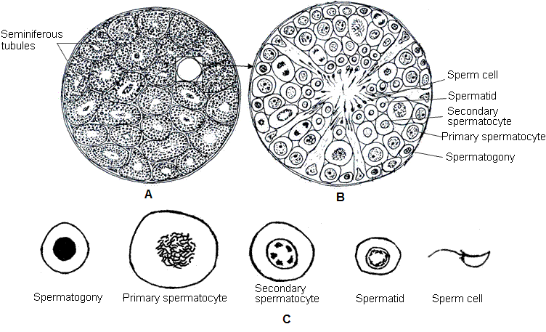
The Testis
The testes are oval bodies that average about 1.5 to 3 inches (4 to 7 centimeters) in length and 20 to 25 milliliters in volume. The testes have two primary functions:
Producing sperm (which carry the man's genes)
Producing testosterone (the primary male sex hormone)
The epididymis is a collection of coiled microscopic tubes that collects sperm from the testis
The vas deferens is a firm tube that transports sperm from the epididymis. The urethra .
The prostate.
The seminal vesicles

Slide 4
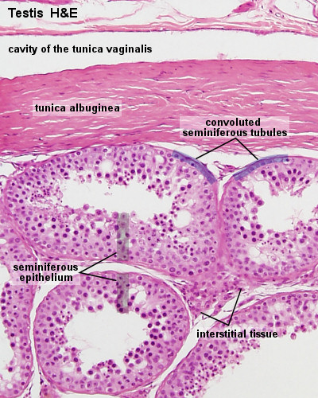
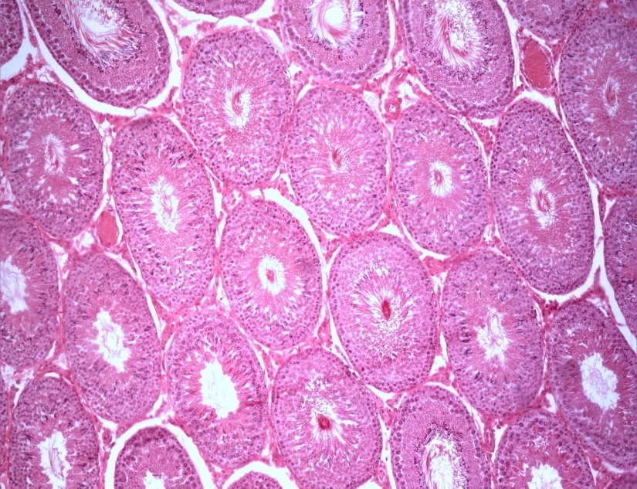
Lab Exercise # 7
Zoo- 145
The Testis
Testis is composed of functional units termed seminiferous tubules. Seminiferous tubules are bound together with connective tissue termed as inter tubular connective tissues. The outer layer of the testis is called tunica albugenia.
Spermatogonia are transformed meiotically into primary spermatocytes then in secondary spermatocytes and spermatids. Finally spermatids are transformed into sperms.

Slide 5
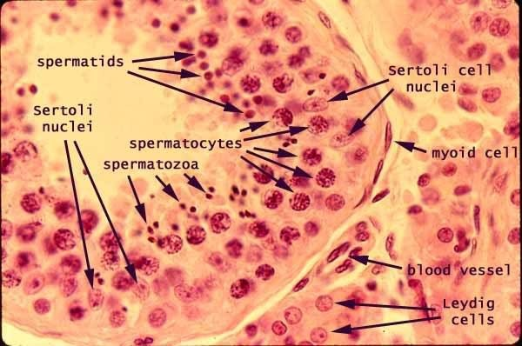
Lab Exercise # 7
Zoo- 145
The seminiferous tubule is highly convoluted tubule lined by the following cells:
1- Spermatogenic cells: The spermatogenic cells consist of five morphologically distinct classes of cells: Spermatogonia, Primary Spermatocytes, secondary spermatocytes, spermatids, and spermatozoa .
2- Sertoli cells: Sertoli cell is supporting cells, columnar cells with irregular nuclei. These cells are extend from basement membrane to the lumen of the seminiferous tubule.

Slide 6
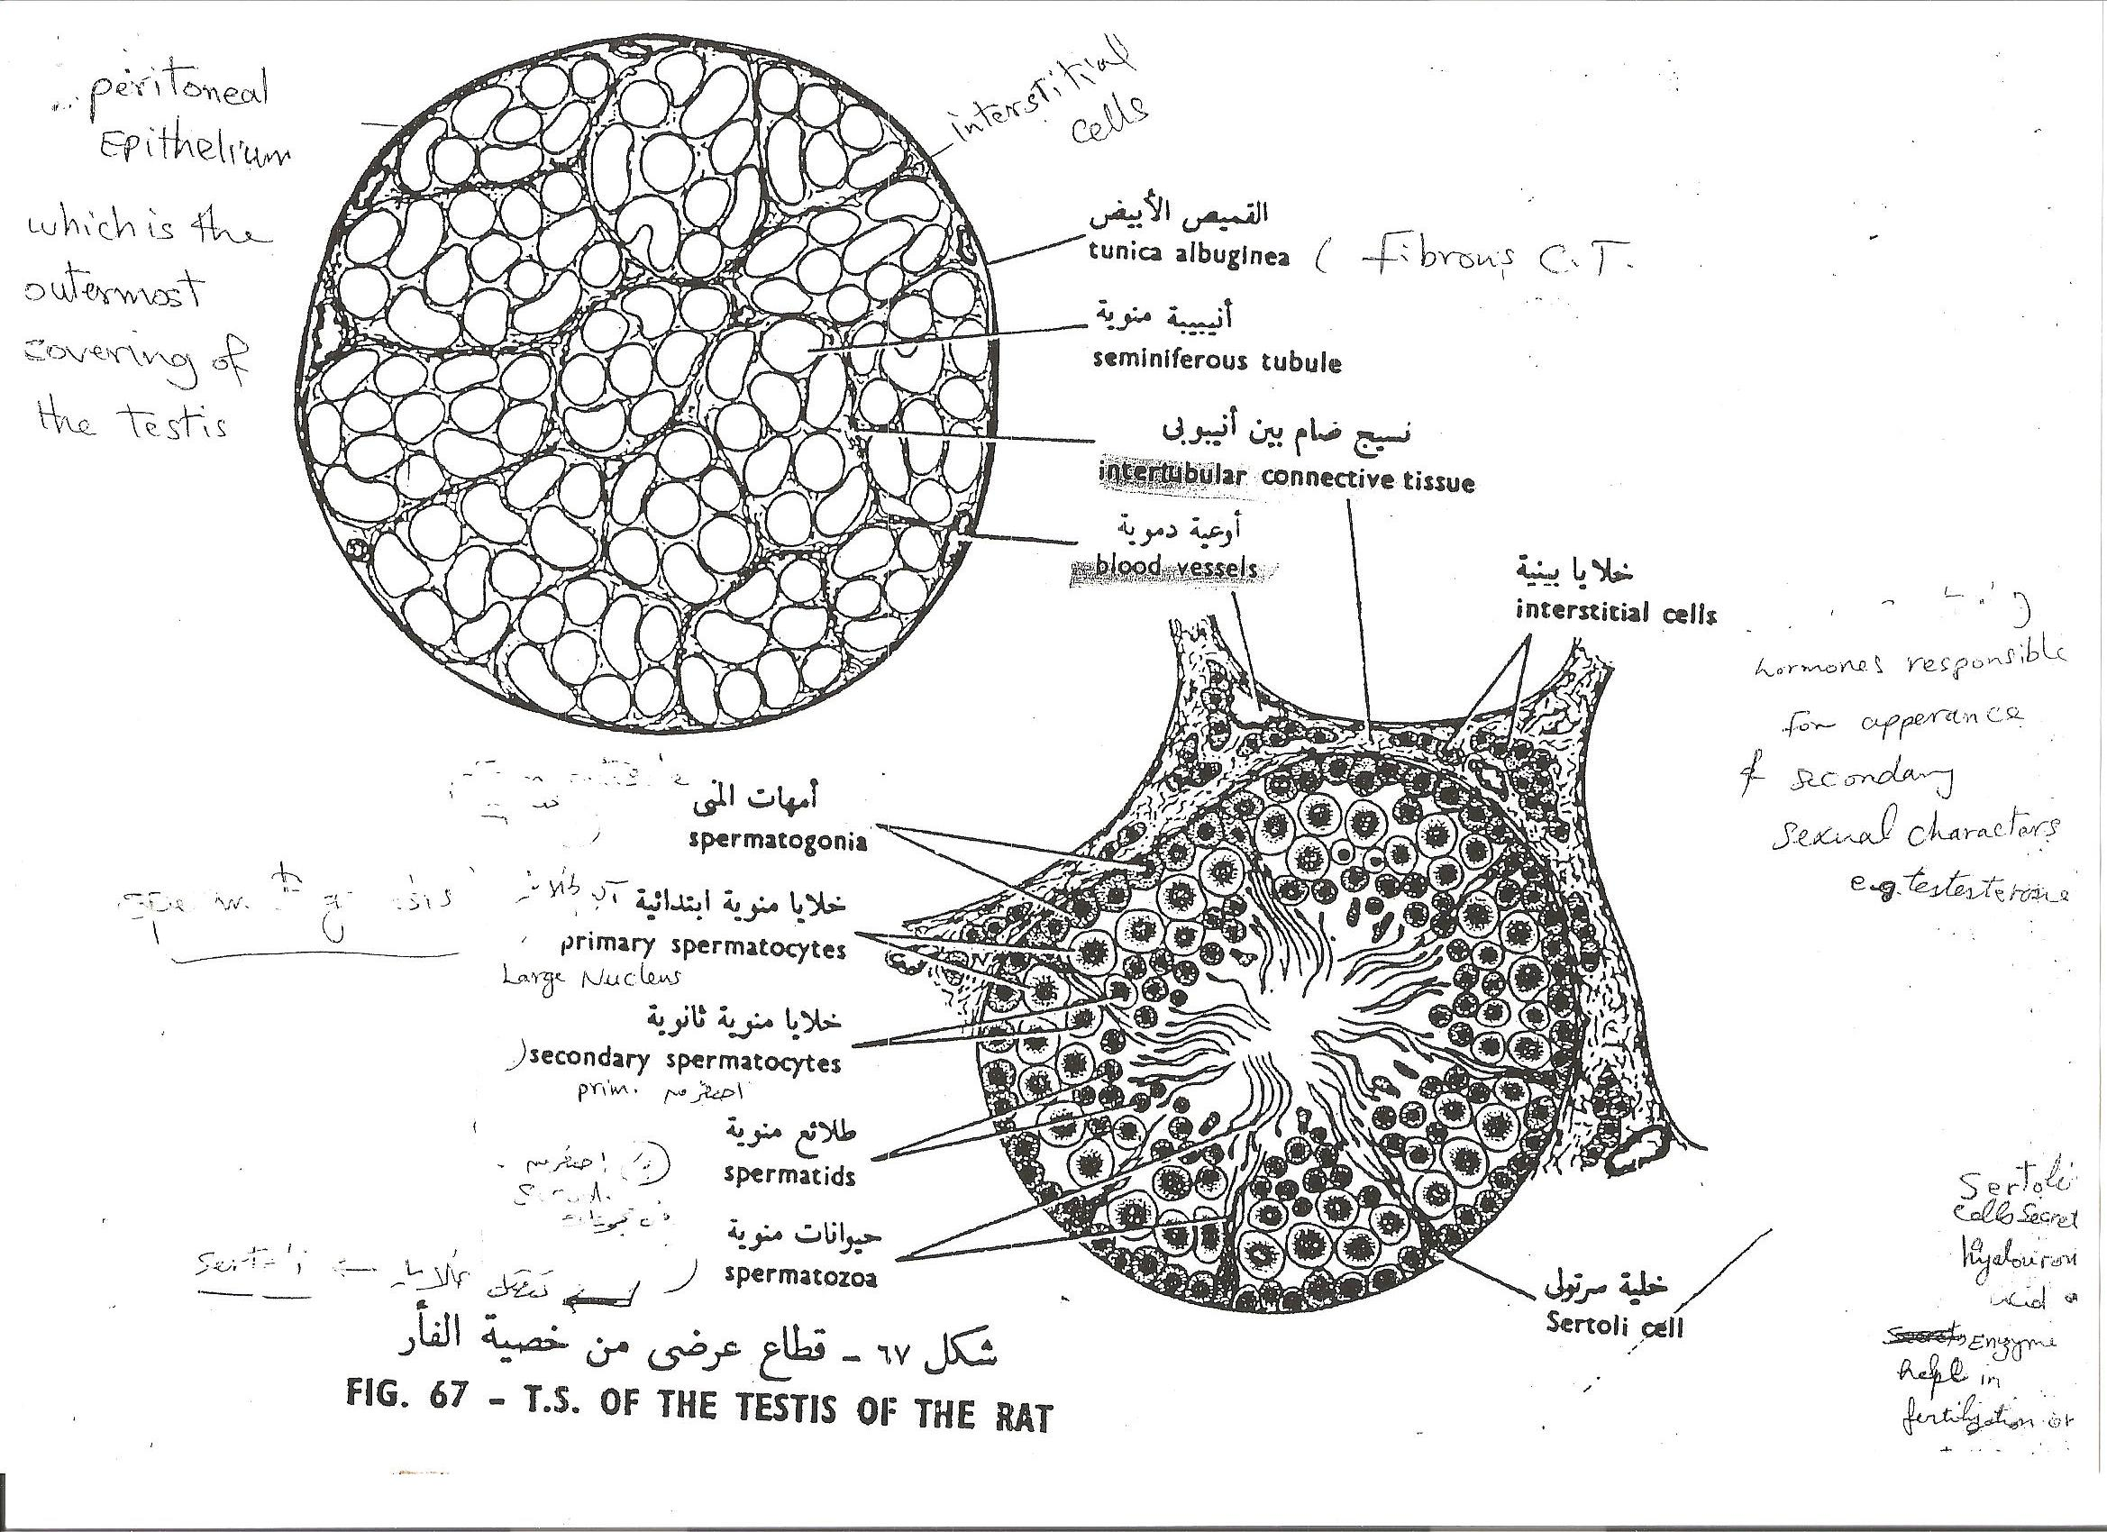
Lab Exercise # 7
Zoo- 145

Slide 7
Lab Exercise # 7
Zoo- 145
Female Reproductive System
Ovary
Oviduct
(Fallopian Tube)
Uterus
The Ovary is a large, almond-shaped structure covered by germinal epithelium
The ovary consist of :
1- Peripheral cortex
Primordial follicles.
Primary follicles.
Secondary follicles.
Growing follicles.
Mature Graaffian follicles.
Atretic follicles.
Corpus luteum
2- Central medulla
The medulla of ovary is small part compared to the cortex, its connective tissue contains many spiral arteries and convoluted veins.

Slide 8
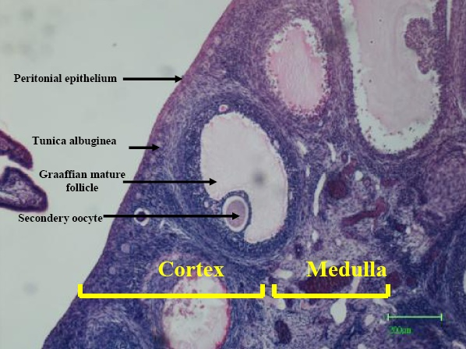
Lab Exercise # 7
Zoo- 145
The Ovary
Ovary is covered by a simple Cuboidal Epithelium known as the germinal epithelium (GE).
Beneath the Germinal Epithelium lies a tough connective tissue coat, the Tunica Albuginea (TA).
The tunical albuginea outlines the outer part of the Ovary, the cortex, in which the developing follicles lie.
The core of the Ovary, called the Medulla (M), is made up of connective tissue through which blood vessels (V) pass

Slide 9
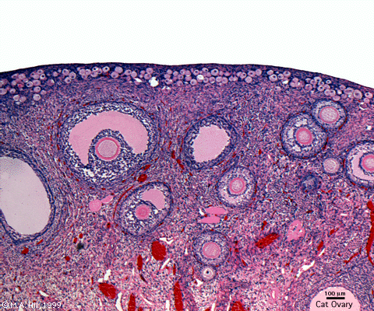
Lab Exercise # 7
Zoo- 145
Micro anatomically every ovary is composed of marginal layer of epithelium, peritoneal layer and then a germinal layer which are meitotically transformed into primary oocytes then secondary oocytes and graaffian follicles.
Finally graaffian follicles are grown into mature ova.
The space left by graaffian follicle is called corpus luteum which acts as an endocrine gland.
The tissue that binds the cells together in the ovary is called stroma and it is a combination of muscular tissue with connective tissue.

Slide 10
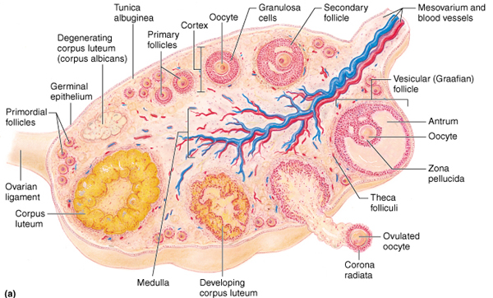
The ovary is a ductless reproductive gland in which the female reproductive cells are produced. Females have a pair of ovaries, held by a membrane beside the uterus on each side of the lower abdomen.
The ovary is needed in reproduction since it is responsible for producing the female reproductive cells, or ova.
During ovulation, a follicle (a small cavity in the ovary) expels an egg under the stimulation of gonadotropic hormones released by the pituitary gland, the luteinizing hormone and the follicle-stimulating hormone. The rest of the follicle, or the corpus luteum, secretes the sex hormones estrogen and progesterone,
An ovary is normally firm and smooth and is about the size of an almond.

Slide 11
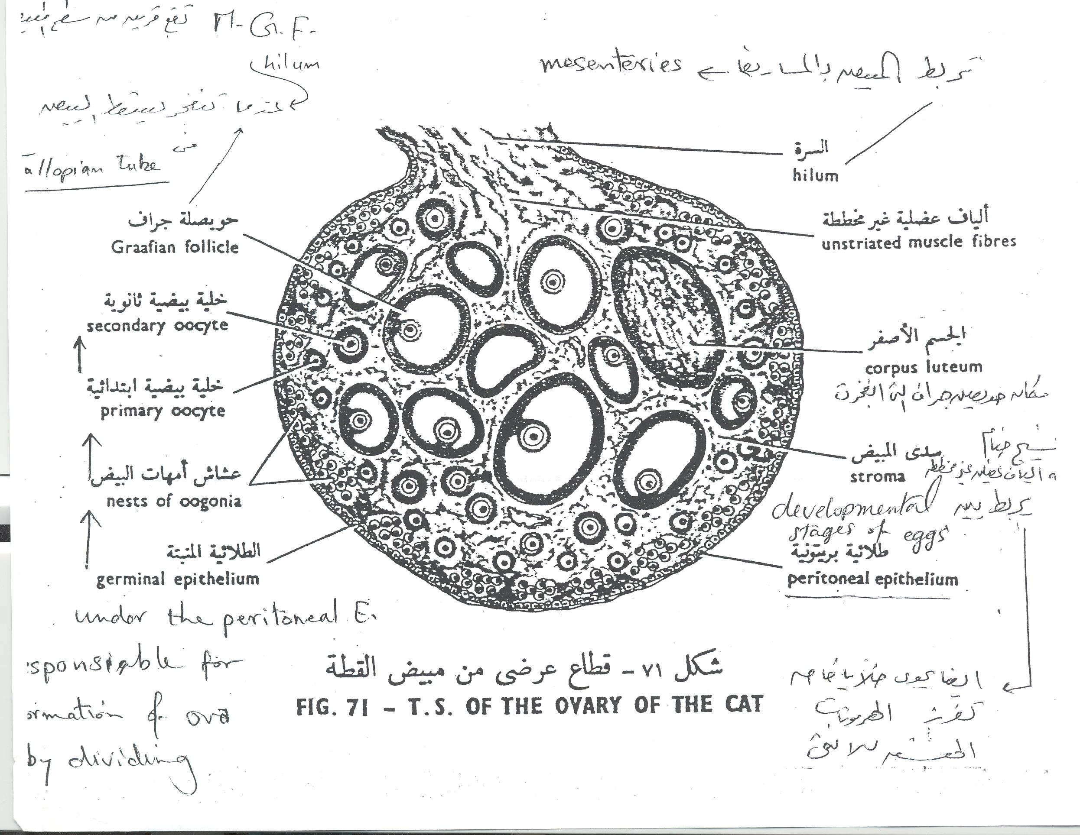

Slide 12
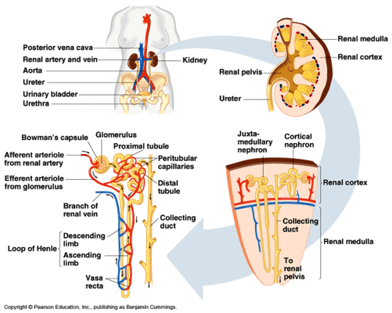
Lab Exercise # 6
Zoo- 145
Kidney
Micro anatomically every kidney is composed of units called nephrons. Each nephron has its early part, Glomerulous and Bowmens capsule ( malpighian tubule) in the cortex region . and proximal and distal tubules in the medulla region together with ascending limbs descending limbs of loop of Henle . Finally the filled fluid or urine is collected in the collecting tubule located at the periphery of the kidney.

Slide 13
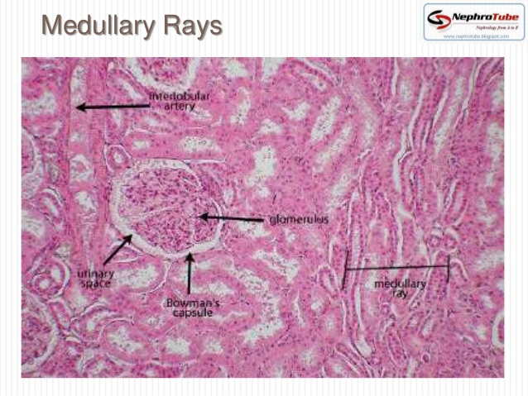
The Functional Unit of Kidney: Nephron
The nephron is the kidney's functional unit that removes waste from the body. Each kidney has more than a million nephrons in the renal cortex, which gives it a granular appearance on sagittal section.
There are 2 types of nephrons. The cortical nephrons, which make up about 85 percent, are found deep in the renal cortex, while the juxtamedullary nephrons, which make up about15 percent of total nephrons, lie close to the medulla.
The nephron consists of a renal corpuscle, a tubule, and a capillary network that originates from the small cortical arteries. Each renal corpuscle is composed of a glomerulus (a network of capillaries) and a Bowman's capsule(the cup-shaped chamber that surrounds it.
The glomerulus connects to a long, convoluted renal tubule which is divided into three functional parts. These consist of the loop of Henle (nephritic loop), the proximal convoluted tubule, and the distal convoluted tubule

Slide 14
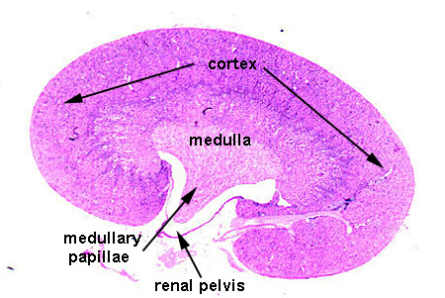
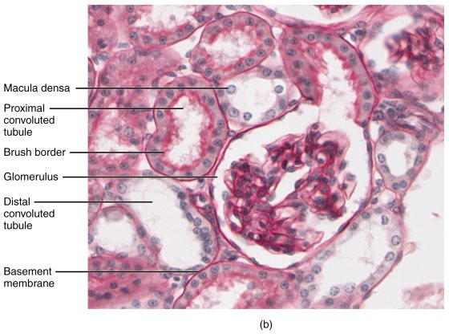

Slide 15
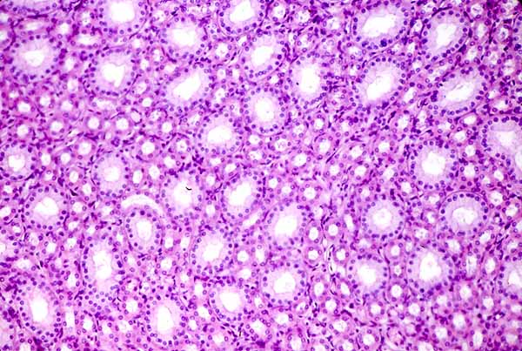
Kidney Function
Excretes waste: The kidneys get rid of toxins, urea, and excess salts. Urea is a nitrogen-based waste product of cell metabolism that is produced in the liver and transported by the blood to the kidneys.
Maintains water balance: The kidneys help maintain water and electrolyte balance in the body. They react to changes in the water level, which may increase or decrease throughout the day.
Regulates blood pressure: The kidneys help regulate blood pressure by producing angiotensin, a substance that constricts blood vessels and signals the body to retain water and sodium when blood pressure is low.
Regulates red blood cells: The kidneys produce erythropoietin, a hormone that stimulates your bone marrow to produce more red blood cells when the body does not get enough oxygen.
Regulates acid levels: Acids are products of metabolism. The kidneys help maintain proper acid-base balance to keep the body healthy.

Slide 16
Lab Exercise # 5
Zoo- 145
Thank you

