Slide 1

Microscopy
Lab Exercise # 1
Zoo- 145
OBJECTIVE: STRUCTURE, FUNCTION AND
OPERATION OF LIGHT MICROSCOPE

Slide 2
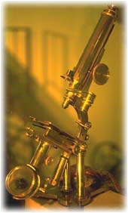
Lab Exercise # 1
Zoo- 145
INTRODUCTION
The Microscope (Micron = small, scope= application) is an instrument that is generally used to study the very small organisms or particles which are not visible by naked eyes.
In 1674, Anton Van Leeuwenhoeck made the microscope for the first time.
This microscope has practically been made with the combination of two lenses so it is also termed as Compound Microscope.
Notes:
A microscope is an optical instrument that uses a lens or a combination of lenses to magnify and resolve the fine details of an object.

Slide 3
Lab Exercise # 1
Zoo- 145
It has a provision of using the source of light thus sometimes it is also named as Light Microscope
The naked human eyes have an ability to see smallest object of 0.1 mm only, while the invention of microscope made it possible to see much smaller object i.e 0.2 µm or 200 nm.
This characteristic of seeing the minimum distance of 200 nm between the two particles is called as Resolution Power.
The microscope enlarges the view image of an object up to 1000 times of its original size and the times of enlargement is called as Magnification Power.

Slide 4
Types of Microscope
Lab Exercise # 1
Zoo- 145
Light Microscope
Electron Microscope
(Electron beam is used in place of lens to magnify the image)
Simple Microscope Compound Microscope
(single lens) (2 sets of lenses)
Monocular Binocular
(With one eye piece) (With two eye pieces)

Slide 5
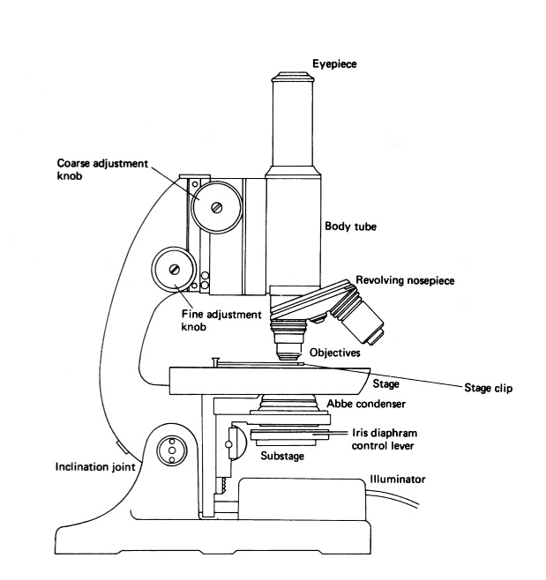
The Light Microscope
Lab Exercise # 1
Zoo- 145
In the basic light microscope, the object to be magnified is placed under the lower lens (objective lens) and the magnified image is viewed through the upper lens (eyepiece lens).
The microscope is composed of a mechanical system which supports the microscope, and an optical system which illuminates the object under investigation and passes light through a series of lens to form an image of the specimen.

Slide 6
The Light Microscope
Lab Exercise # 1
Zoo- 145
The Mechanical System
  Base: the support.
  Arm: the C-shaped upright structure.
  Stage: the plate on which the specimens are placed.
  Body Tube: the hollow tube on which the objectives and eyepiece lenses are mounted.
  Coarse Adjustment: the knob used to focus the microscope lenses by moving the body tube.
  Fine Adjustment: the knob also used to focus the lenses by moving the body tube, but by a much smaller magnitude.

Slide 7
The Light Microscope
Lab Exercise # 1
Zoo- 145
The Optical System
  Illuminator: artificial light, usually supplied by a light bulb, to illuminate the specimen.
  Condenser: lens system under the microscope stage that focuses light onto the specimen.
  Objective Lens: the lens closest to the specimen; usually several objectives are mounted on a revolving nosepiece.
  Eyepiece or Ocular Lens: the lens closest to the eye.
    Monocular: a microscope having only one eyepiece
    Binocular: a microscope having two eyepieces.

Slide 8
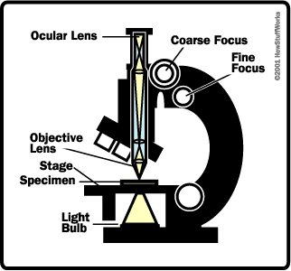
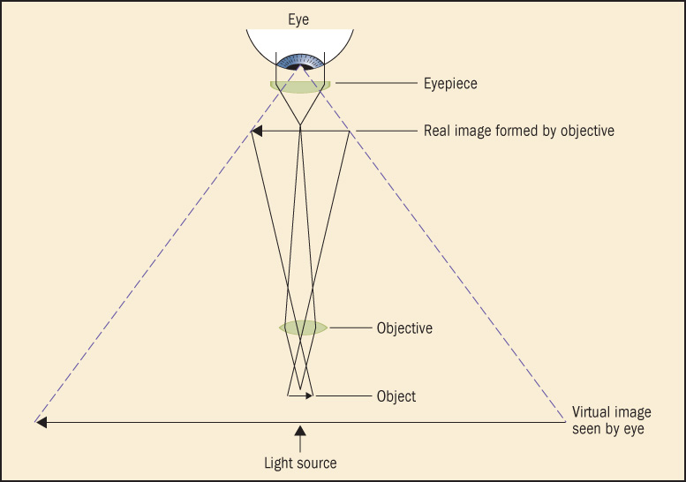
How Light Microscopes Work
Lab Exercise # 1
Zoo- 145
First, the objective lens gathers light from the specimen and magnifies the image
  Most microscopes have several objective lenses that can be rotated into position to provide different levels of magnification (4X, 10X, 40X, 60X and 100X)
The ocular lens in the eyepiece magnifies and transmits the image to your eye
  The magnification of the ocular lens is 10X
The passage of light through two lenses forms the virtual image of the object seen by the eye.

Slide 9
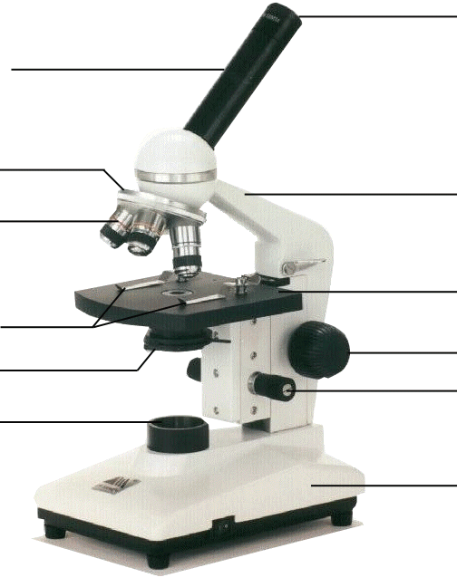
Lab Exercise # 1
Zoo- 145
The Parts of a Light Microscope
Eyepiece
Body Tube
Revolving Nosepiece
Arm
Objective Lens
Stage
Stage Clips
Coarse Focus
Diaphragm
Fine Focus
Light
Base
Notes:
This is the exact version of the microscope used in class. Students will be identifying the parts on the microscopes at their desks as we go along and what their functions are.

Slide 10
The Parts of a Light Microscope
Lab Exercise # 1
Zoo- 145
Light source: Could be a mirror, but most likely it is a bulb built into the base
Diaphragm: Adjusts the amount of light striking an object
Objective lens: Gathers light and magnifies image
Ocular lens (eyepiece): Magnifies objects and focuses light to your eye
Stage: Holds slide
  Can be moved using the coarse or fine adjustment knobs to bring the object into focus
Stage clips: Hold slide in place
Base and arm: Structural support for the microscope

Slide 11
Can you name the parts?
Lab Exercise # 1
Zoo- 145
Ocular lens (eyepiece)
Arm
Objective Lenses
Stage clip
Stage
Course adjustment
Diaphragm
Fine adjustment
Light Source
Base

Slide 12
Lab Exercise # 1
Zoo- 145
Magnification Power
Magnification of the Microscope is the product of the power of eye Pieces and the Power of objective
To find the total magnification of the microscope you are using, multiply the magnification of the objective lens by the magnification of the ocular lens.
Magnification = Power of the eye piece X Power of objective
  For example: 40X (objective lens) x 10X (ocular lens) = 400X magnification

Slide 13
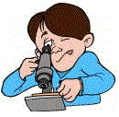
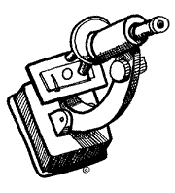
Lab Exercise # 1
Zoo- 145
Microscope Use and Care
Always carry with 2 hands
Only use lens paper for cleaning
Do not force knobs
Always Keep covered
Keep objects clear of desk and cords
Place the Slide on the Microscope
Use Stage Clips
Click Nosepiece to the lowest (shortest) setting
Look into the Eyepiece
Use the Coarse Focus
Follow steps to focus using low power
Then use the objective of higher magnification and use fine adjustment to focus it

Slide 14
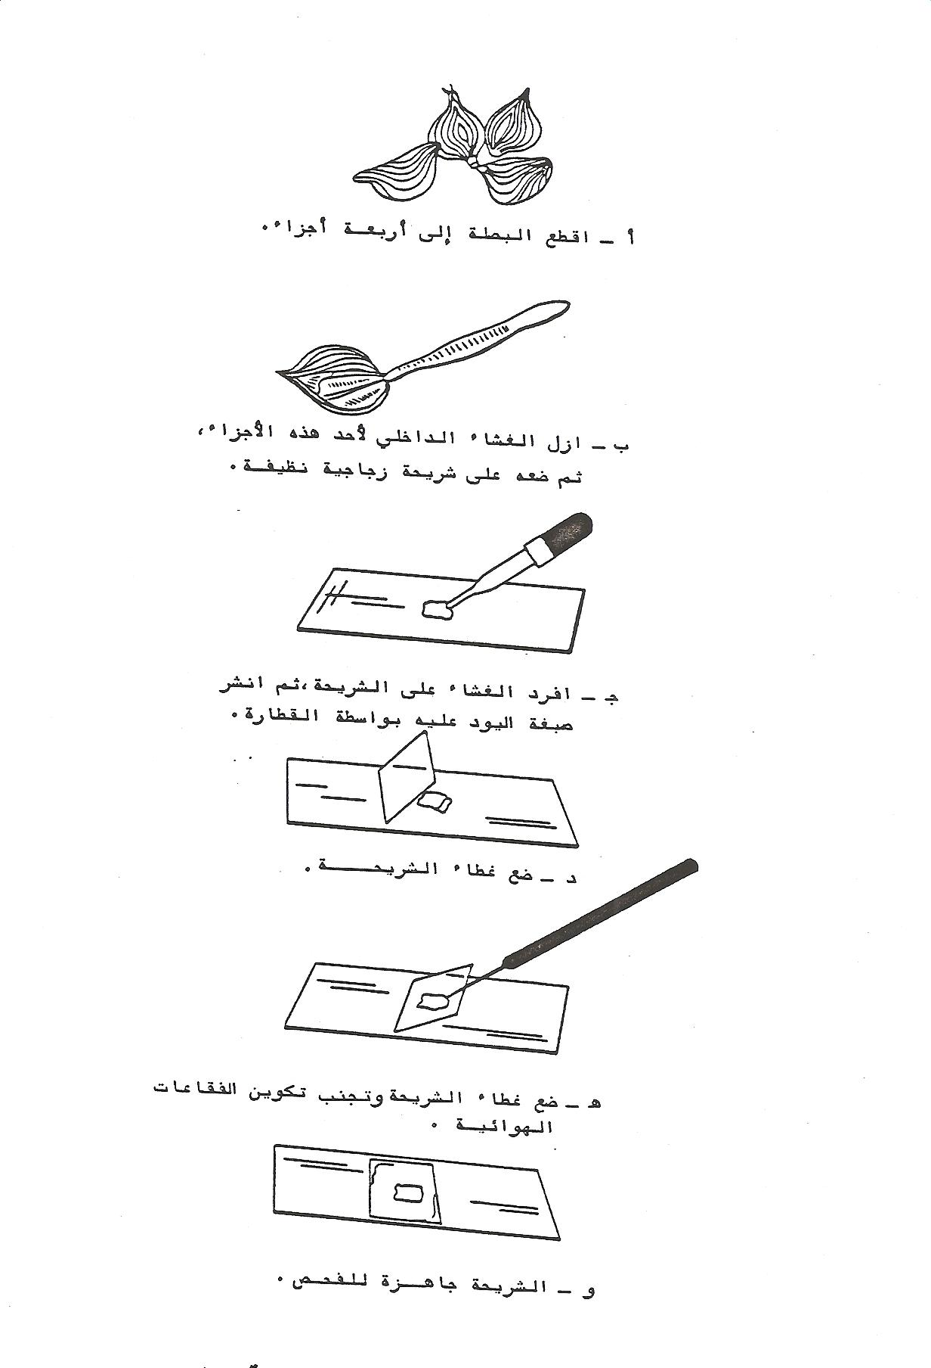
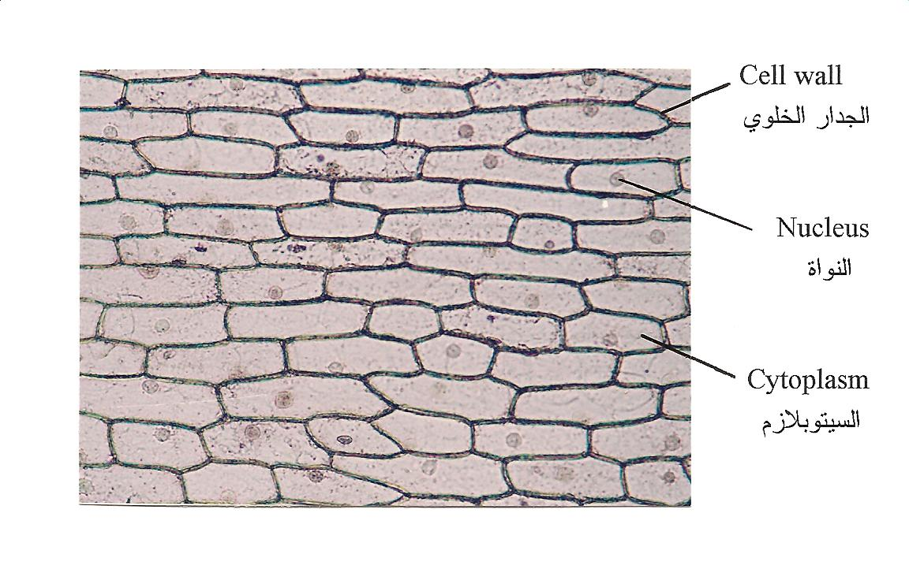
Lab Exercise # 1
Zoo- 145
For practice, Prepare a slide of epithelial cells of onion and stain it with Lugols iodine
Observe the cells under different magnification
Draw sketches and compare those with the figure shown below
Simple Columnar Epithelium
(Onion Cells)

Slide 15
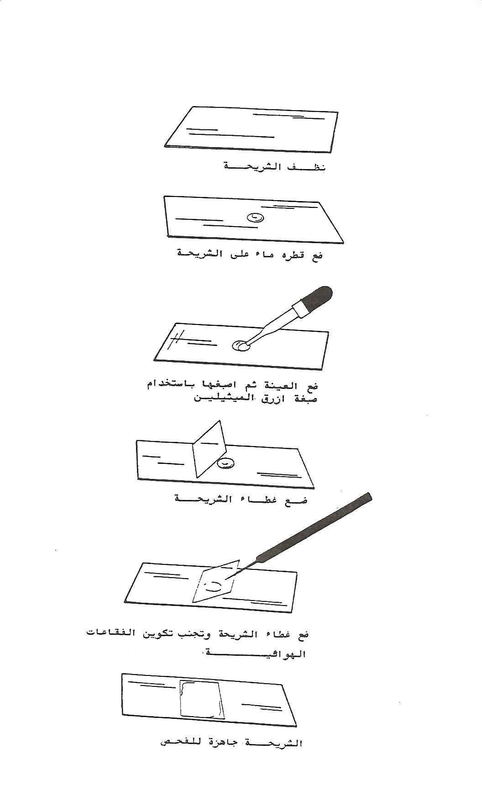
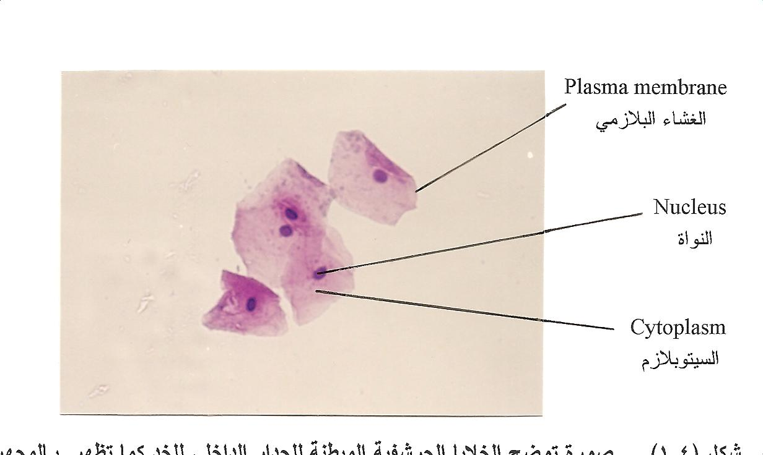
Lab Exercise # 1
Zoo- 145
For practice, Prepare a slide of Human Cheek cells and stain it with methylene blue
Observe the cells under different magnification
Draw sketches and compare those with the figure shown below
Simple Squamous Epithelium
(Human Cheek Cells)

Slide 16
Thank you

