Slide 1
Local Anesthetics
PHL. 322
Lab #6
Presented by
Mohammed Alyami
Teaching assistant
Department of pharmacology & Toxicology
College of pharmacy
KSU

Slide 2
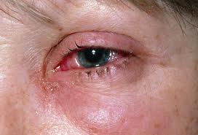
Local Anesthesia
Abolish sensation (including the feeling of pain)
A local area of the body
(not hole body)

Slide 3
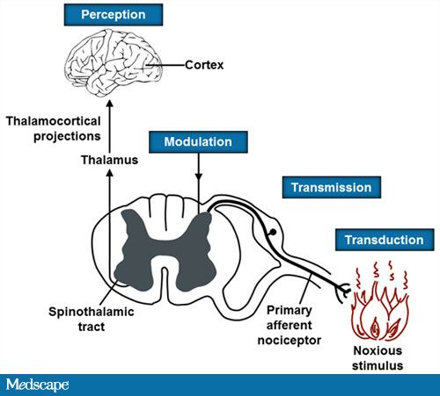
Is the condition that results when sensory transmission (action potential) from a local area of the body to the CNS is blockade
Local Anesthesia
Block nerve conduction of sensory impulse
Caused
Local Anesthetic
(LA)
Is a drug that causes reversible local anesthesia and a loss of nociception.

Slide 4
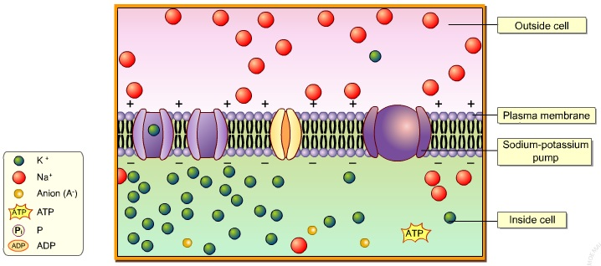
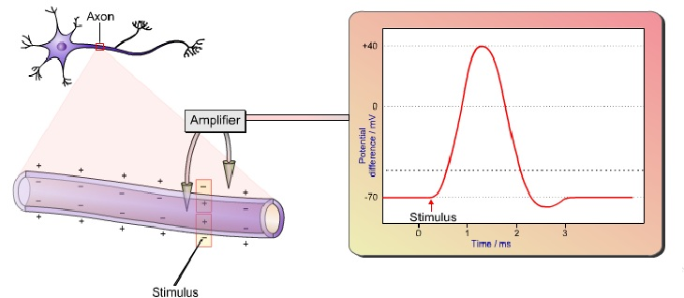
Action potential
Depolarization

Slide 5
MOA
LAs block voltage-dependent sodium channels (at axon) and reduce the influx of sodium ions, thereby preventing depolarization of the membrane and blocking conduction of the action potential.

Slide 6
Na+ channel
Drug
Outside
Membrane diffusion
Na+
Receptor
Membrane
Drug
Na+
Drug+
Inside
Drug+

Slide 7
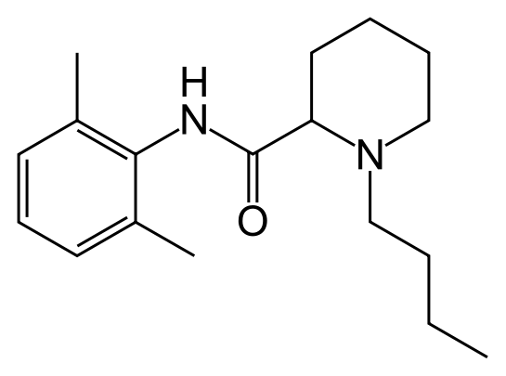
The commonly used LA are weak base with at least 1 ionizable amine function that can become charged through the gain of a proton.
+H⁺
Drug
Drug⁺
-H
Thus, both the nonionized and the ionized forms of the drug play important roles, the first in reaching the receptor site and the second in causing the effect.
Ionizable amine
+H⁺
-H
H⁺
the ionize (charged) form
The Nonionize ( uncharged) form
More lipid soluble
Once the drug has penetrated the lipid barrier and reach its site of action (receptor) it ionized and the ionized form is responsible for LA activity
It will facilitate its penetration through the cell membrane (bilayer phospholipid)

Slide 8
-H+
Na+ channel
Drug+
Drug
Outside
+H+
Membrane diffusion
Na+
Receptor
Membrane
Drug
Na+
Drug+
Inside
Drug
+H+
Drug+
-H+

Slide 9
PH
Uncharged forms
PH
Charged forms
Acidosis
Acidosis such as caused by inflammation at a wound partly reduces the action of LAs. This is partly because most of the anesthetic is ionized and therefore unable to cross the cell membrane.

Slide 10
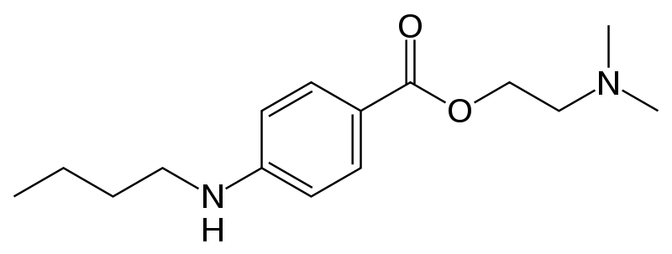
local anesthetics
Esters
long action (tetracaine)
short action (procaine)
Amides
long action (bupivacine, ropivacine)
medium action (lidocaine)
surface action (benzocaine, cocaine)

Slide 11
Pharmacologic effects
Nerve
Heart
Skeletal muscle
Local Anesthesia (including analgesia)
Antiarrthymia
(e.g. Lodicaine)
Paralysis
(no clinical application)
Clinical use

Slide 12
Method of administration
e.g. Clinical use | Definition | Method of adm.
Eye surgery Dentistry, Surgery of skin | application LA to the surface of the skin or mucosa | Surface anesthesia
minor surgical and dental procedures | injection of LA into the tissue | Infiltration anesthesia
surgical, dental, and diagnostic procedures and for pain management | Injected of LA in the vicinity of major nerve or major branch nerve | Nerve block
Labor pain Postoperative pain | injected of LA into the epidural space where it acts primarily on the spinal nerve roots | epidural anesthesia
operations below the umbilicus and Leg | injected LA into the cerebrospinal fluid, usually at the lower back, where it acts on spinal nerve roots and part of the spinal cord. | Spinal anesthesia
Block some kind of pain ( Cancer ) | injected LA around sympathetic nerves | Sympathetic block

Slide 13
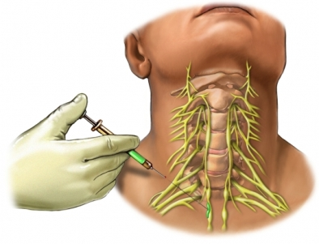
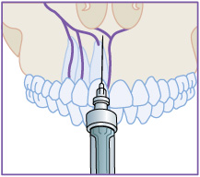
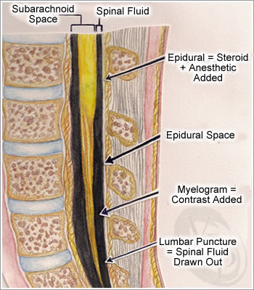
Infiltration anesthesia
Nerve block

Slide 14
Many shorter acting local anesthetics are readily absorbed into the blood from the injection site after administration.
Decrease of duration
Increase in systemic toxicity
Cocaine is an important exception because it has intrinsic sympathomimetic action (vasoconstrictor) due to its inhibition of norepinephrine reuptake into nerve terminals.
This can be accomplished by administration of a vasoconstrictor (usually an agonist sympathomimetic like epinephrine ) with the local anesthetic agent.
blood flow to the area is reduced
Epinephrine decrease of rate of absorption in blood that leads to minimize of systemic toxicity and increase duration .
Notes:
Definition
noun
The property of a drug that produces partial agonist effect at the receptor similar to the cholinergic stimulation of the sympathetic nervous system.
Supplement
Intrinsic sympathomimetic activity or ISA is often used to describe the property of certain beta-blockers.
Beta-blockers with ISA are beta-blockers that exert a partial agonism at the adrenergic receptor while simultaneously blocking the endogenous catecholamines from binding to the receptor. Hence, they are less potent than catecholamines and other beta-agonists.

Slide 15
Treatment of toxicity
Severe toxicity is treated symptomatically; there are no antidotes. e.g. Convulsions are usually managed with intravenous diazepam or a short-acting barbiturate such as thiopental.

Slide 16
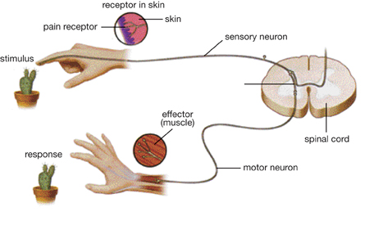
Withdrawal Reflex

Slide 17
Frog’s plexus method
“Foot withdrawal reflex of frog”
Principle:
The skin of the frog is very sensitive to diluted HCL and will reflex by withdrawing its leg when immersed in HCL

Slide 18
Procedure
1- Decapitaion the frog (avoid pithing the spinal cord)
2- Make a transverse incision in the abdominal wall just below the xiphoid cartilage and eviscerate the abdomen carefully to form abdominal sac and expose the lumbar plexus without damaging it
3- suspend the frog in a stand and test the withdrawal reflex with 0.1 N HCL by immersing one foot in HCL and avoid touching the bottom of the beaker.
4- remove the acid and wash immediately with tap water
N.B. the withdrawal reflex time should not exceed 10 seconds and the contact with HCL too.

Slide 19
LA | The time interval
 | 3
 | 6
 | 9
 | 12
 | 15
 | 18
 | 21
Still withdrawal Reflex
Still withdrawal Reflex
Absence of withdrawal Reflex
the drug has activity and blocks sodium channels

Slide 20
5- Administer 1 ml of LA solution in the abdominal sac of the frog and observe the zero time.
6- Test the withdrawal reflex at 3 minutes interval and wash with tap water after each exposure to the acid, observe the time at which the absence of withdrawal reflex occurs
Onset time: is the time from adding LA until the acid fails to provoke withdrawal of the foot
Recovery time: is the time in minutes from washing the LA till the appearance of the withdrawal reflex in response to HCL.
7- Tabulate your results and determine which of LA is more rapid in its action than the other.

Slide 21
Lignocaine | Procaine | The time interval
- | - | 3
+ | - | 6
 | - | 9
 | - | 12
 | - | 15
 | + | 18

Slide 22
Negative (-)= means the presence of the withdrawal reflex (the drug has no activity).
Positive (+)= means the absence of the withdrawal reflex (the drug has activity and blocks sodium channels)
Conclusion:
From the table we conclude that lignocaine is more rapid in inducing local anesthesia than procaine

