Slide 1

General Virology
250 MBIO
lab 5

Slide 2
Lab content
Laboratory methods in virology
  Different methods of cultivation and propagation .
  Types of cell cultures and their applications
  Different methods of viral isolation
  Purification of viruses
  Infectivity assays
  Titrations
  Multiplicity of Infection (MOI)

Slide 3
Isolation of viruses
Lytic viruses can be isolated and quantified by the plaque assay method, which involves infecting a monolayer of host cells fixed on a solid support, such as agarose, with suitable viral dilutions that result in localized cell lysis (plaque or discrete visible zones )
Each plaque represents the progeny of a single infectious viral particle; therefore, the virions within an individual plaque are genetically identical and form a viral clone. Upon isolation, such clones are termed isolates, and if it is distinct from all other isolates it can be referred to as a strain.
When a virus is ﬁrst isolated it may replicate poorly in cells in the laboratory , but after it has gone through a number of replication cycles it may replicate more efﬁciently. Repeated passaging of viral clones is performed to obtain purified viral populations via plaque purification and to eliminate mixed variants
After a number of passages the virus may be genetically different to the original wild strain, in which case it is now a laboratory strain.

Slide 4
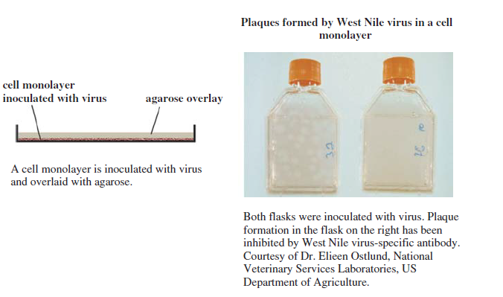
Isolation of viruses

Slide 5
purification of viruses
After a virus has been propagated it is usually necessary to remove host cell debris and other contaminants before the virus particles can be used .
Many virus puriﬁcation procedures involve centrifugation:
  partial puriﬁcation can be achieved by differential centrifugation
  higher degree of purity can be achieved by density gradient centrifugation.
  Ultracentrifugation uses extremely high centrifugal forces (>100,000 × g) to pellet viruses or separate them in gradients.
Virus centrifugation must be conducted at low temperatures to preserve viral integrity and infectivity.

Slide 6
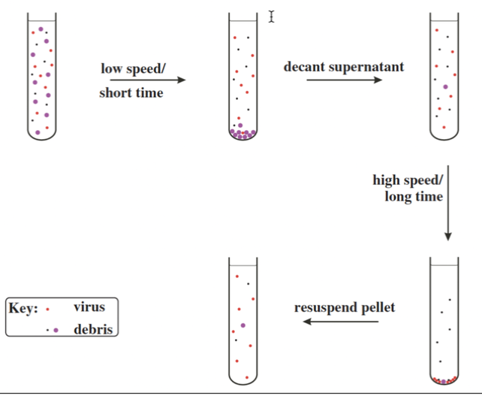
purification of viruses
Differential centrifugation
This method separates particles based on size and sedimentation rate using sequential centrifugation steps at increasing speeds.
Involves alternating cycles of low-speed centrifugation, after which most of the virus is still in the supernatant, and high-speed centrifugation, after which the virus is in the pellet.
Low-speed centrifugation removes cell debris and nuclei
Medium-speed centrifugation removes mitochondria and large organelles
High-speed centrifugation pellets viral particles

Slide 7
purification of viruses
Density gradient centrifugation
Viruses are separated based on buoyant density within a gradient medium.
Common Gradient Media:
  Sucrose (rate-zonal gradients)
  Cesium chloride (CsCl) (isopycnic gradients)
There are two major categories of density gradient centrifugation:
  Rate-Zonal Centrifugation:
Separation based on size and mass
Short centrifugation time
Homogeneous particles, such as identical virions, should move as a sharp band that can be harvested after the band has moved part way through the gradient.
  Isopycnic Centrifugation
Particles migrate until reaching their equilibrium density.
A particle/molecule suspended in the gradient moves to a point where the gradient density is the same as its own density. This technique enables the determination of the buoyant densities of nucleic acids and of virions.
High purity and reproducibility

Slide 8
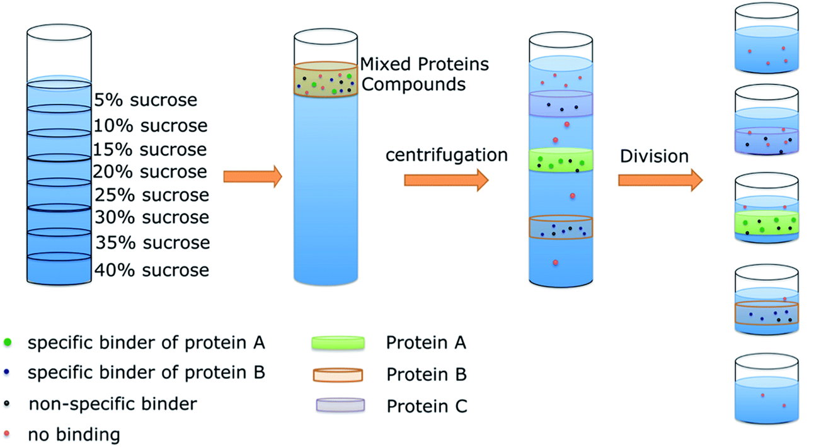
https://youtu.be/P8jkZAvM2AY?si=j9asy1q52B0aU9VV

Slide 9
Infectivity assays
An infectivity assay in virology is a laboratory test that measures the titre ) the concentration) of infective virus in a specimen or a preparation how much infectious (functional) virus is present in a sample—meaning virus particles that can enter susceptible cells and start an infection (often leading to replication and spread).
Suitable hosts might be animals, plants or cultures of bacterial, plant or animal cells.
Infectivity assays fall into two classes: quantitative and quantal.
    Quantitative: How many infectious units are there? (countable events)
    Quantal: At what dilution do half of the test units get infected? (probability)

Slide 10
Infectivity assays
Quantitative infectivity assays
  count discrete infection events (plaques or foci).
  count individual, localized infection units and directly calculate a titer.
  Readout: number of infectious units.
Main methods
Plaque assay → reports PFU/mL
  Count visible plaques formed on a cell monolayer under semi-solid overlay. Dishes are selected that have plaque numbers within a certain range, 30–300.
Focus-forming assay (FFA) / Immunofocus assay → reports FFU/mL
  Count infected foci detected by antibody staining .(immunostained clusters of infected cells =foci)
Pock assay (for some poxviruses on CAM-eggs) → counts sible lesions called pocks.
  CAM = the “living tissue sheet” inside the egg where the virus grows and makes spots (pocks)
.

Slide 11
Infectivity assays
Quantal infectivity assays
Each well/animal/egg is scored as infected or not infected (yes/no).
Readout: the dilution that infects a certain proportion of replicates.
Outcome is binary (infected/not infected), and the final result is based on probability across replicates.
Main methods
TCID50 assay (50% Tissue Culture Infectious Dose) → reports TCID50/mL
  Infect cells in multiple wells with serial dilutions.
  Score each well as CPE present/absent (or antigen positive/negative).
  Calculate the dilution infecting 50% of wells .
LD50 (50% Lethal Dose) → reports LD50
  In animal models: death vs. survival (used in pathogenesis/virulence work).
ID50 (50% Infectious Dose) → reports ID50
  Infection vs. no infection in animals or other systems.

Slide 12
Titrations
Titration means measuring the concentration (amount) of virus in a sample—most often reported as the virus titer.
General steps of titration :
Make serial dilutions of the virus sample (e.g., 10-fold dilutions).
Add each dilution to susceptible cells (or eggs/animals depending on the virus).
Measure infection using an assay such as: Plaque assay , TCID50 assay ,Focus-forming assay
Why titration is important
To standardize experiments (choose an MOI accurately)
To compare virus stocks between labs or experiments
To evaluate effects of antivirals, neutralizing antibodies, or disinfectants
To monitor viral growth and stability during storage

Slide 13
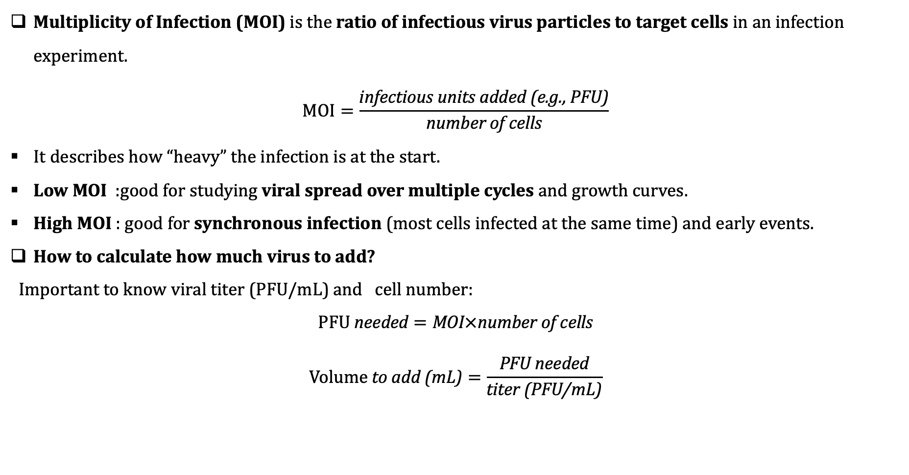
Multiplicity of Infection (MOI)
Multiplicity of Infection (MOI) is the ratio of infectious virus particles to target cells in an infection experiment.
$$\text{MOI}=\frac{\text{infectious} \text{units} \text{added}\text{ (}\text{e}\text{.}\text{g}\text{., }\text{PFU}\text{)}}{\text{number} \text{of} \text{cells}}$$
It describes how “heavy” the infection is at the start.
Low MOI :good for studying viral spread over multiple cycles and growth curves.
High MOI : good for synchronous infection (most cells infected at the same time) and early events.
How to calculate how much virus to add?
Important to know viral titer (PFU/mL) and cell number:
$$\text{PFU} \text{needed}=\text{MOI}×\text{number} \text{of} \text{cells}$$
$$\text{Volume} \text{to} \text{add}\text{ (}\text{mL}\text{)}=\frac{\text{PFU} \text{needed}}{\text{titer}\text{ (}\text{PFU}\text{/}\text{mL}\text{)}}$$

Slide 14
Viruses are amazing .

Slide 15
Questions ?

