Slide 1
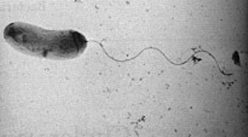
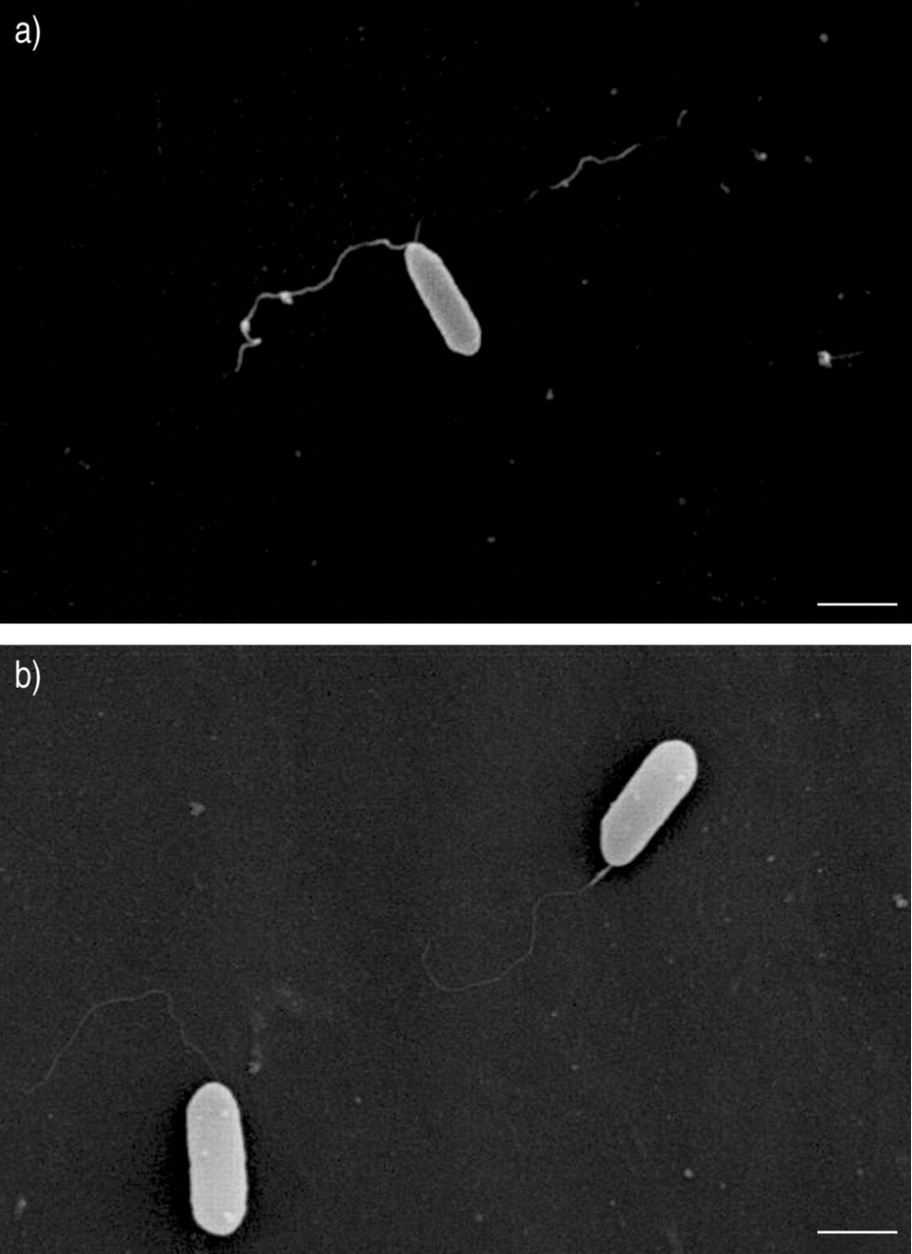
460 MBIO
Medical Bacteria
Lecture 9
Gram Negative Rods
Pseudomonadaceae )Pseudomonas(
Vibrionaceae ) Vibrio(

Slide 2
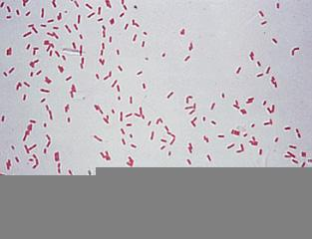
Pseudomonadaceae )Pseudomonas(
General Characteristics
Part of normal flora in human and animal intestine.
Found in water, soil, sewage, vegetable, moist environment in hospitals.
Medical importance species:
Pseudomonas aeruginosa
Morphology
  Gram negative bacilli (seen under microscope among pus cell)
  Medium size
  Straight bacilli no curve
  Singly arranged
  Non-sporulated
  Non –capsulated
  Highly motile

Slide 3
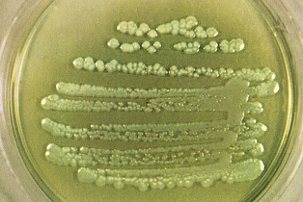
Culture character
  Strict aerobic
  Grow on simple media.
  Its optimum temperature for growth is 37 C, and it is able to grow at temperatures as high as 42C.
  Showing flat colony & exopigment (pyocyanin which is bluish green & fluorescein which is yellowish green but present of two together give green colors)
  Has characteristic odor (ripen grapes or apple)
  has the ability to grow with minimal nutrients, e.g. in water and in the presence of some disinfectants; these properties are the key to its role as a hospital pathogen.
Biochemical test
Oxidase positive
Catalase positive
Idol –ve
Gelatin liquefaction +ve
Serological test
Has O Ag & H Ag (motile)
Pseudomonas aeruginosa colonies on agar

Slide 4
P. aeruginosa Disease:
Nosocomial pathogen, Opportunistic pathogens.
Cause invasive and toxigenic infections in patients with abnormal host defenses.
Pyogenic wound infection, UTI, respiratory infection , otitis media,, eye infection,, endocarditis, septicemia , bacteremia, meningitis, brain abscesses.
Produce soluble fluorescent pyocyanin pigment, refers to "blue pus", which is a characteristic of suppurative infections caused by P. aeruginosa.
It is resistant to high concentrations of salts and dyes, weak antiseptics, and many antibiotics.
highly resistance to antibiotic.
Laboratory diagnosis:
Identification is based on:
colony morphology (Bluish-green pigmented large colonies with “fruity” odor on culture media)
oxidase-positive
growth at 42C
non-lactose fermenter

Slide 5
Virulence Factors
1- Pilli (Adhere to epithelial cells)
2- Exopolysaccharide capsule (protect from antibodies and phagocytosis)
3- Biofilm
4- Motility:spread through tissues
5- Fluorescent pigment pyocyanin (impairs normal function of human nasal cilia, disrupts respiratory epithelium).
6- Enzymes: Two extracellular proteases associated with invasive stage:
  Elastase) digests protein(
  Alkaline protease )lyses fibrin(.
7- Toxins:
• Haemolysins (beta haemolysis)
    • Phospholipase & lecithinase (destroy lipid and lecithin)
    • Exotoxin A (Cytotoxic by blocking protein synthesis- pore forming protein), same mechanism of action as the diphtheria toxin .
    • Exoenzyme S: interfere with membrane permeability
    • Lipd A (Endotoxin): tissue necrosis
    • Enterotoxins: food poising
8- Iron acquiring systems
9- Antibiotics resistance due to outer membrane changes.

Slide 6
Vibrionaceae
(Vibrio(
General Characteristics
Vibrios are one of the most common organisms in surface waters of the world.
Morphology
comma-shaped
Actively motile
Medical importance species:
V. cholerae and V. parahaemolyticus
Culture character
aerobic and facultatively anaerobic.
Optimum pH growth range 8.5- 9.5 (sensitive to acidic pH)
Biochemical test
ferment carbohydrates.
oxidase-positive.
Vibrios are distinguished from enterics by being oxidase-positive and motile by polar flagella.
Vibrios are distinguished from pseudomonads by being fermentative and oxidative in their metabolism.
Vibrio cholerae

Slide 7
Vibrio cholerae
• V. cholerae is noninvasive ( not reach the blood), only act locally, affecting the small intestine through secretion of an enterotoxin.
Found in fresh water, sea food. most often in communities with poor sewage and water treatment.
Causes Cholera (epidemic cholera) is a severe diarrheal disease
Transmission to humans is by contaminated water or food.
Large inoculum (10⁸ ) is required to cause disease because the
Virulence factor
Cholera toxin (heat-labile enterotoxin) is the most important virulence factor, action on the mucosal epithelium, it is responsible for the characteristic diarrhea of cholera disease.
Mode of action: Cholera toxin activates the adenylate cyclase enzyme in cells of the intestinal mucosa leading to increase the secretion of H₂O, Na⁺, K⁺, Cl⁻, and HCO₃⁻ into the lumen of the small intestine.

Slide 8
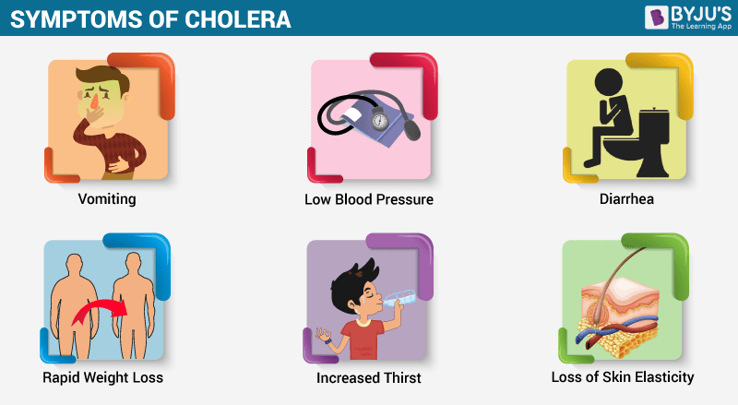
Cholera
Cholera is one of the most rapidly fatal illnesses .
Human may become hypotensive within an hour of the onset of symptoms and may die within 2-3h if no treatment.
Vomiting and abrupt watery diarrhea ( Rice– water stools is characteristic) contain enormous numbers of vibrios, mucosa, epithelial cells, result in severe fluids loss and dehydration.
Can lead to shock, coma and death.
The loss of potassium ions may result in cardiac complications and circulatory failure.
Untreated cholera results in high (50-60%) mortality.
Treatment:
  Give solution containing: (Glucose + Bicarbonate + Potassium) for fluids and electrolytes replacement
  Tetracycline shortens the duration of diarrhea and reduce fluid loss.

Slide 9


