Slide 1
^{460 MBIO}
^{Medical Bacteria}
^{Lecture 6}
^{Enterobacteriaceae}
^{(Escherichia coli)}

Slide 2
Enterobacteriaceae family
(The enteric bacteria)
General Characteristics
They found mainly in the intestinal tract of human or animal either :
    as normal flora non pathogenic as ( E.coli , Proteus spp. , Morganella)
    as pathogenic (Salmonella and Shigella)
Found in environmental sites (soil, water and plants).
Facultative anaerobic bacteria.
Ferment glucose with strong acid production and often gas.
Can diagnosis on selective and differential media
Release endotoxin from their cell wall, some release exotoxin.
Most important pathogen of Enterobacteriaceae:
Enterobacteriaceae includes many harmless symbionts and many pathogens, such as Escherichia coli, Salmonella, Klebsiella, Shigella, Enterobacter Citrobacter, Proteus and Serratia
Morphology:
Gram negative bacilli ) Short to medium size bacilli(
Arrangement is single or pairs.
Non-spore forming
some member of this family motile ( peritrichous flagella)
Some species are capsulated (developed capsule producing mucoid colony on sugar containing media)

Slide 3
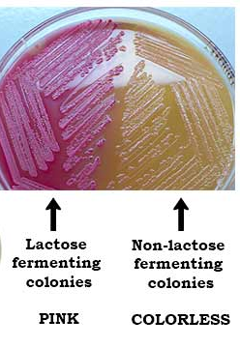
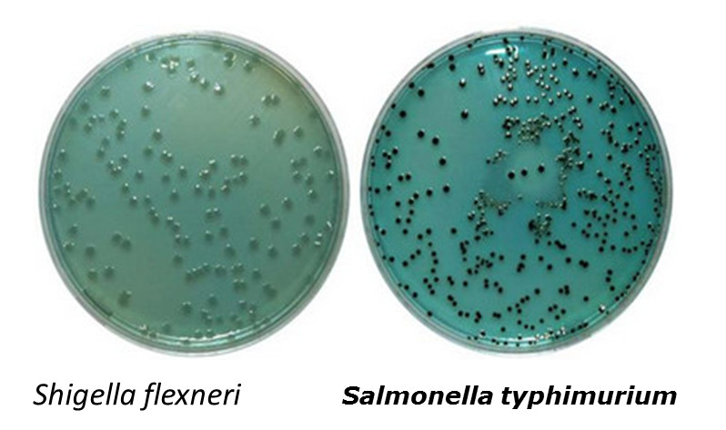
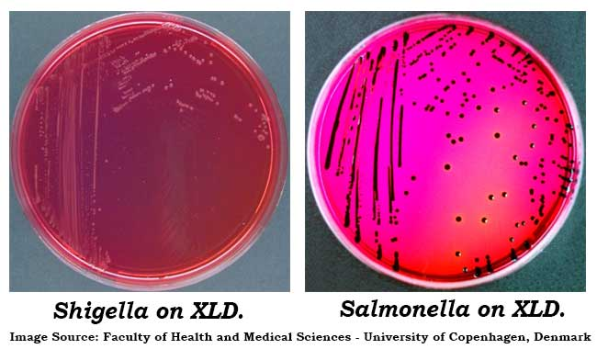
Culture character:
Facultative anaerobic on simple laboratory media ( ordinary nutrient media).
Grow at 37°C .
Media use for isolation of Enterobacteriaceae
Non-inhibitory & non-differential media as Nutrient agar.
Non-inhibitory but differential media such as bromothymol blue lactose agar media
Differential inhibitory selective media as :
  MacConkey agar media
    lactose fermenter genus: give pink color as in Escherichia coli , Klebsiella , Enterobacter (coliform bacteria).
    non lactose fermenter: give white color as in Salmonella, Shigella, Proteus.
    Coliform bacteria: member of Enterobacteraceae that ferment lactose.
  Hektoen enteric agar media
  Xylose lysine deoxycholate agar media (XLD media)
  MacConkey agar media
Hektoen enteric agar media

Slide 4
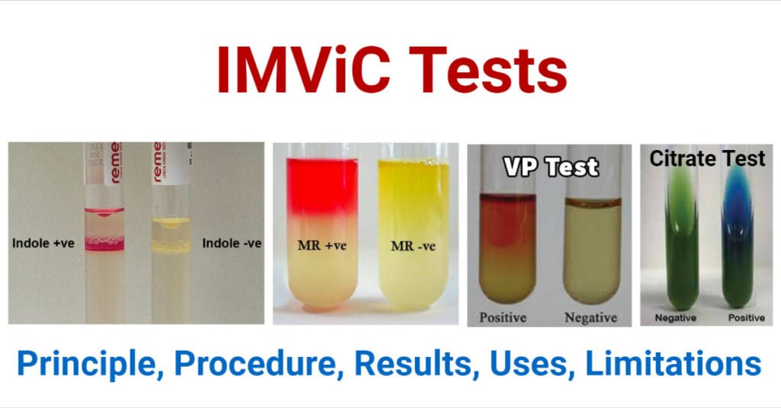
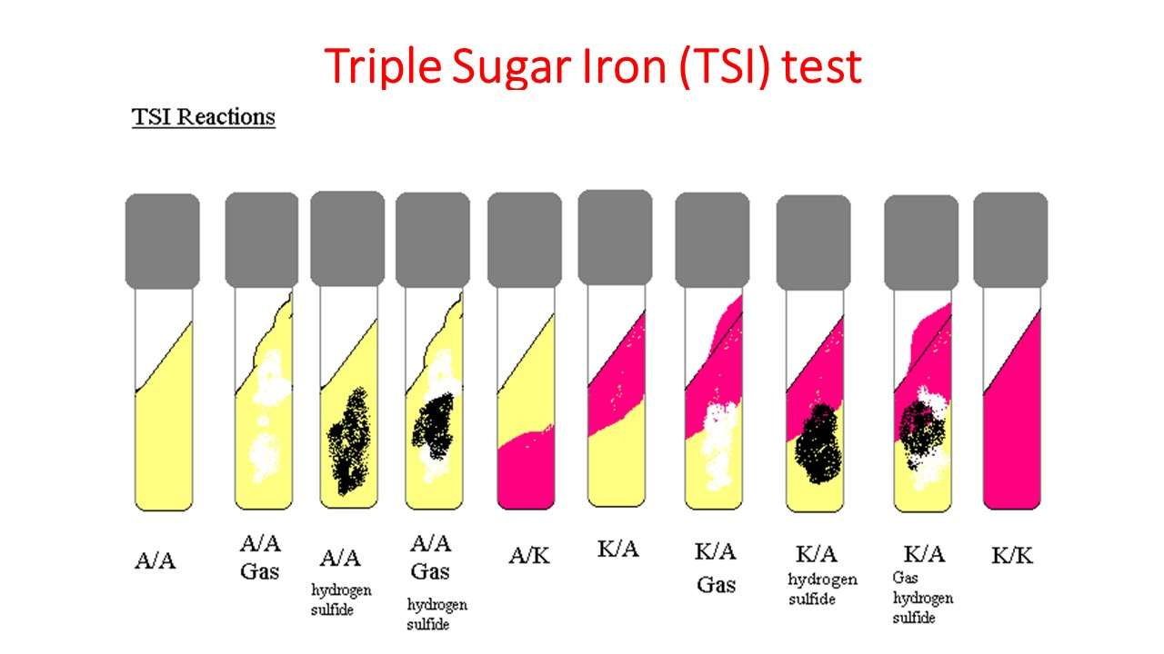
Biochemical test:
All of them ferment dextrose or glucose and give acid & gases after fermentation
Oxidase negative
Reduce nitrate to nitrite
A lot of genera within the family are differentiated by their biochemical character, Specially IMViC test (Indol , Methyl red , Vogus prauskeur , citrate utilization )
Triple Sugar Iron Agar (TSI) is used for the identification of Enterobacteriaceae based on the fermentation of glucose, lactose, sucrose and the production of gas and H₂S.
IMViC test
Triple Sugar Iron Agar

Slide 5
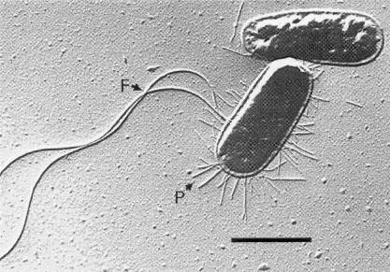
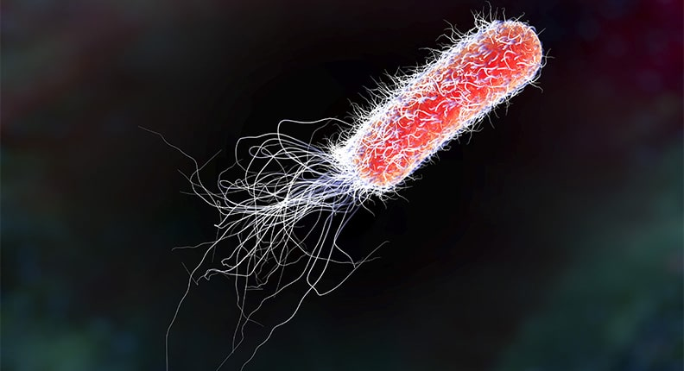
Escherichia coli
Theodor Escherich first described E. coli in 1885, as Bacterium coli commune, which he isolated from the feces of newborns.
The most common normal inhabitant of large intestine, Found in 100% of human colon (live in host intestinal tracts of healthy and diseased people)
Not all E. coli strains are pathogenic.
Over 700 antigenic types (serotypes) of E. coli are recognized based on O, H, and K antigens.
Scientific classification
Domain: | Bacteria
Phylum: | Pseudomonadota
Class: | Gammaproteobacteria
Order: | Enterobacterales
Family: | Enterobacteriaceae
Genus: | Escherichia
Species: | E. coli

Slide 6
Morphology:
Most of strain are motile by long peritrichous flagella
Some strain produce capsule (pathogenic strains )
Arranged in either singly or pairs.
Most of spp. formed Pilli or fimbriae
Culture character
Aerobic & facultative anaerobic grow at 14-44°C but optimum temp. is 37°C
Producing mucoid elastic colony on CHO containing media.
Grow on ordinary agar media
Grow on MacConkey media: Lactose-fermenting mucoid, rose pink or red colonies.
On blood agar media: some strains reduced ß- hemolysis
on Eosin methylene blue : metallic green sheen colonies.

Slide 7
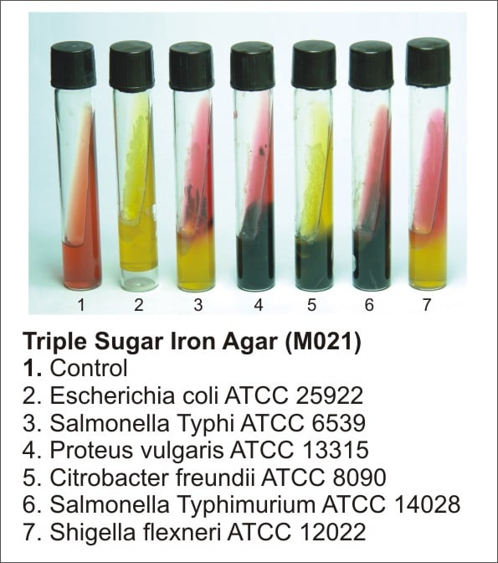
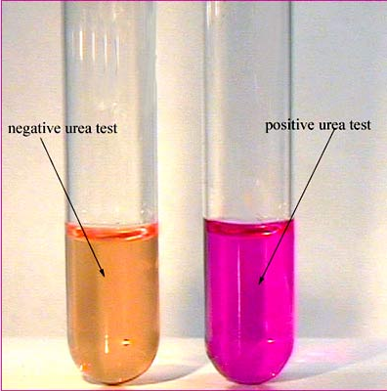
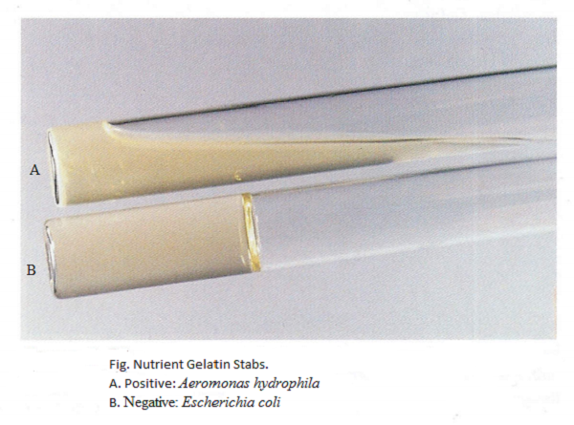
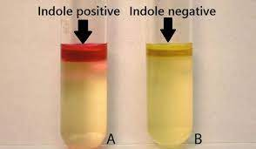
Biochemical reaction:
Indole test : produce indole
Ferment glucose, lactose and sucrose producing acid & gases
Gelatine Liquefaction Test: (-ve)
Urease test: (-ve)
IMViC is very important test (Indol +ve , Methyl red +ve, VP -ve, Citrate -ve) +/+/ - / -
On Triple sugar iron agar media (TSI) formation of
(yellow slant , yellow butt, gas positive, no H₂S produced) A/A/+/-
indole test
Urease Test
Gelatine Liquefaction Test

Slide 8
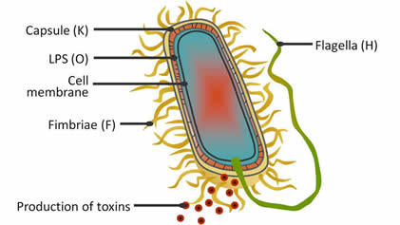
Antigenic structure
E. coli are classified into different serotypes:
1. somatic antigen ( O antigen): 171 serotype
It is the polysaccharide portion of the LPS in the outer membrane.
Heat stable, alcohol stable
O111 & O55 is highly pathogenic.
2. Capsular antigen (K antigen): 91 serotype
composed of polysaccharides
Most important K1
3. Flagellar antigen (H antigen): 56 serotype
protein, part of flagella
heat-labile and alcohol sensitive.
4. Fimbriae antigen (F antigen )
found in some species of E. coli especially F4, F5, F41.
is a highly pathogenic type causing adhesion of organisms in the intestinal mucosa.
Virulence factors
E. coli Toxins: E. coli produce two types of toxins
Hemolysisn
Eneterotoxins
    Heat labile (LT): resemble cholera toxin in structure & action
    Heat stable (ST)
    Verotoxin (Shiga-like toxin)

Slide 9
Pathogenesis:
The most common cause of non-nosocomial urinary tract infections, wound infections, Neonatal septicemia, and meningitis, dysentery, diarrhea of infants, diarrhea of travelers, pneumonia, endocarditis, , gastroenteritis, gynecological and endotoxic shock
E. coli strains causing Diarrhea:
Five classes (strains) of E. coli that cause diarrheal diseases:
1. Enteropathogenic E.coli (EPEC)
Do not produce enterotoxin, non- invasive.
2. Enteroinvasive E.coli (EIEC)
Non-motile, non-lactose fermenting.
resemble shigella, causes shigellosis-like dysentery in children in developing countries.
3. Enterotoxigenic E.coli (ETEC)
causes mild watery diarrhea to fatal disease indistinguishable from cholera.
4. Enterohemorrhagic E.coli ( EHEC)
Shiga toxin-producing E.coli (STEC)
Cytotoxic verotoxin producing E.coli serotype O157:H7
causes mild diarrhea to hemorrhagic colitis and cause a hemorrhagic uremic syndrome
5. Enteroaggressive E.coli ( EAEC)
Appear aggregated stacked brick formation.

Slide 10
Laboratory diagnosis:
Sample:
Urine or pus or stools
Isolation
on MacConkey agar media after colonies appear examines morphological and cultural character.
Biochemical reaction
Serological typing.
Toxin production by animal model or ELISA

Slide 11


