Slide 1
140MIC: Microbiology
Lecture-5
History of microbiology (Part-2)

Slide 2
140MIC: Microbiology
History of microbiology
Content
History of microbiology (part-1)
Microbiology in the Islamic era (Arabic content).
Pathways of discovery in microbiology
The historical roots of microbiology
Pasteur and the defeat of spontaneous generation
Koch, infectious disease, and pure culture microbiology.
History of microbiology (part-2)
The rise of microbial diversity
The modern era of microbiology

Slide 3
The rise of microbial diversity
Microbial Diversity
Field that focuses on nonmedical aspects of microbiology (soil , water)
Martinus Beijerinck (1851–1931)
Developed enrichment culture technique
Microbes isolated from natural samples in a highly selective techniques by adjusting nutrient and incubation conditions to favor a particular metabolic group of organisms.
Example: nitrogen-fixing bacteria, sulfate –reducing bacteria , sulfur- oxidizing bacteria, aerobic nitrogen –fixing bacteria.
Notes:
Beijerinck and Winogradsky studied bacteria in soil and water and developed the enrichment culture technique for the isolation of representatives of various physiological groups
Major new concepts in microbiology emerged during this period, including enrichment cultures, chemolithotrophy, chemoautotrophy, and nitrogen fixation.
Martinus Beijerinck, professor at the Delft Polytechnic School in Holland, trained as a botanist. Began career in microbiology studying plants.
Sergei Winogradsky, Russian microbiologist, contemporary of Beijerinick.

Slide 4
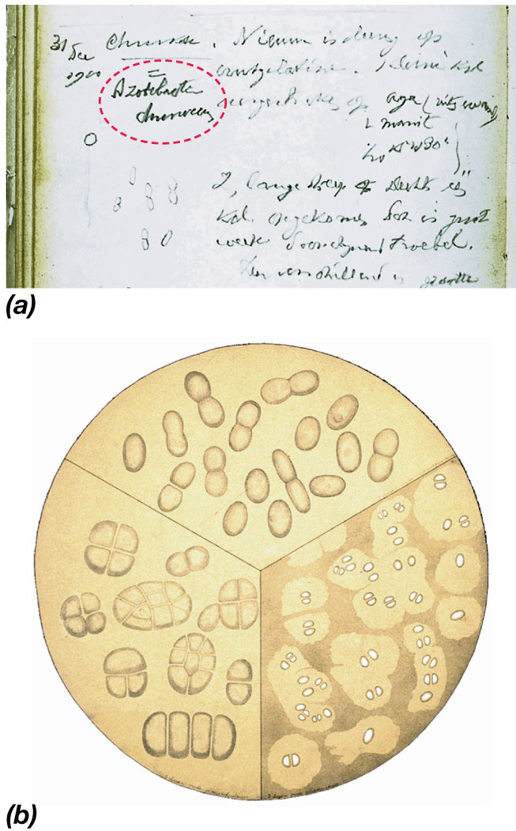
A page from the laboratory notebook of M.Beijerinck in 1900 describing the aerobic nitrogen-fixing bacterium Azotobacter chroococcum ( shown in red)
A painting by M.Beijerinck’s sister showing cells of the same bacteria .
© 2012 Pearson Education, Inc.
Notes:
4
Figure 1.21 Martinus Beijerinck and Azotobacter.

Slide 5
The rise of microbial diversity
Sergei Winogradsky (1856–1953)
The Concept of Chemolithotrophy
Demonstrated that specific bacteria are linked to specific biogeochemical transformations (e.g., S & N cycles)
Proposed concept of chemolithotrophy
Oxidation of inorganic compounds linked to energy conservation

Slide 6
Autotrophs
CO₂
Carbon source
Heterotrophs
Reduced organic molecule from other organisms
Phototrophs
Light
Energy source
Chemotrophs
Oxidation of organic and inorganic molecule
Lithotrophs
Reduce inorganic molecule
Electron source
Not required
Organotrophs
From organic molecule

Slide 7
The Modern Era of Microbiology
The major subdisciplines of microbiology
subdiscipline | Focus
1- Basic emphases
Microbial physiology | Study of the nutrients that microbes require for metabolism and growth and the products that they generate
Microbial genetics | Study of Genes , heredity and genetic variation
Microbial biochemistry | Study of microbial enzymes and chemical reactions
Microbial systematics | The science of grouping and classification and nomenclature
Molecular biology | Study Nucleic acids and protein
Microbial ecology | Study microbial diversity and activity in natural habitats
Virology | Study of viruses and subviral particles

Slide 8
The Modern Era of Microbiology
The major subdisciplines of microbiology
subdisciplines | Focus
2- Applied emphases
Medical Microbiology | Infectious disease
Immunology | Immune systems
Agricultural /soil microbiology | Microbial diversity and processes in soil
industrial microbiology | Large-scale production of antibiotics ,alcohol and other chemicals
Biotechnology ** | Production of human proteins by genetically engineered microorganisms
Aquatic Microbiology | Microbial processes in waters and wastewaters, drinking water safety.

Slide 9
The Modern Era of Microbiology
Molecular Microbiology
** Biotechnology
Manipulation of cellular genomes
DNA from one organism can be inserted into a bacterium and the proteins encoded by that DNA harvested
Genomics: study of all of the genetic material (DNA) in living cells
Transcriptomics: study of RNA patterns.
Proteomics: study of all the proteins produced by cells.
Metabolomics: study of metabolic expression in cells.

Slide 10

REMEMBER You can always ask questions through our discussion board on www.lms.ksu.edu.sa

