Slide 1
140MIC: Microbiology
Lecture-4
History of microbiology (Part-1)

Slide 2
140MIC: Microbiology
History of microbiology
Content
History of microbiology (part-1)
Microbiology in the Islamic era (Arabic content).
Pathways of discovery in microbiology
The historical roots of microbiology
Pasteur and the defeat of spontaneous generation
Koch, infectious disease, and pure culture microbiology.
History of microbiology (part-2)
The rise of microbial diversity
The modern era of microbiology

Slide 3
140MIC: Microbiology
History of microbiology
الأحياء الدقيقة في العصر الإسلامي
إلغاء فكرة المسبب العفوي:
قال صلى الله عليه وسلم عن الطاعون «إذا وقع بأرض فلا تدخلوها، وإذا كنتم بها فلا تفروا منه».
جاءت السنة المطهرة بالحث على النظافة في الأكل والشرب، والنظافة بعد الخارج من السبيلين والنهي عن الاكل في الآنية المشقوقة والتنفس في الطعام والشراب والحث على السواك والمضمضة وتغطية الطعام والتحذير من لعاب الكلب .. الخ
العلماء المسلمون والأمراض المعدية:
نصح المسلمون بالعديد من النصائح لتجنب الأمراض المعدية كالنظافة التامة وتخصيص أدوات للمريض، وعزل المريض المصاب بمرض معدي فكانوا أول من أسس نظام الحجر الصحي.

Slide 4
140MIC: Microbiology
History of microbiology
الأحياء الدقيقة في العصر الإسلامي
أبو بكر الرازي
فرق بين الحصبة والجدري- رغم التشابه الشديد بينهما.
ابن سينا
تناول السل وأنواعه وطرق انتقاله وكيفية الوقاية من عدواه
تناول الجمرة الخبيثة وسماه (النار الفارسية).
اقترح التطعيم
أول من اقترح وجود أجسام صغيرة مسببة للمرض. وسماها (السبب)
ابن رشد
قام بأول عملية تطعيم ضد الجدري.

Slide 5
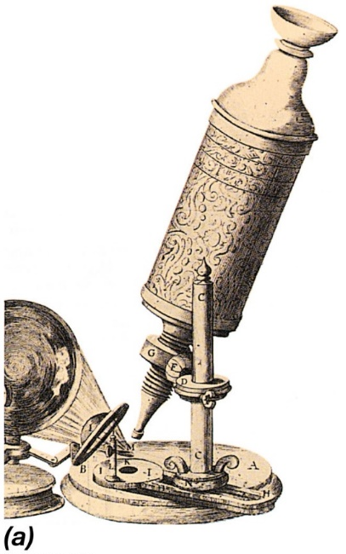
140MIC: Microbiology
The Historical Roots of Microbiology
Microbiology began with the microscope
Robert Hooke (1635–1703)
Antoni van Leeuwenhoek (1632–1723)
Ferdinand Cohn (1828–1898)
Louis Pasteur (1822–1895)
Robert Koch (1843–1910)
A drawing of the microscope used by Robert Hooke in 1664 .

Slide 6

140MIC: Microbiology
The Historical Roots of Microbiology
Microbiology began with the microscope
Robert Hooke (1635–1703):
The first description of microorganisms
Illustrated the fruiting structures of molds

Slide 7
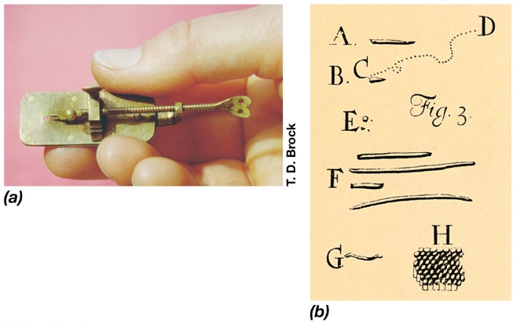
140MIC: Microbiology
The Historical Roots of Microbiology
Microbiology began with the microscope
Antoni van Leeuwenhoek (1632–1723)
The first to describe bacteria.
Further progress required development of more powerful microscopes

Slide 8
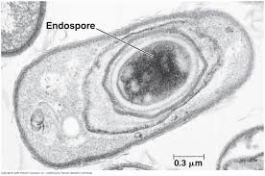
140MIC: Microbiology
The Historical Roots of Microbiology
Microbiology began with the microscope
Ferdinand Cohn (1828–1898):
Founded the field of bacterial classification and bacteriology .
Discovered bacterial endospores (heat resistance bacteria )

Slide 9
140MIC: Microbiology
Pasteur and the Defeat of Spontaneous Generation
Louis Pasteur (1822–1895).
Discovered that alcoholic fermentation was a biologically mediated process (originally thought to be purely chemical)
Disproved theory of spontaneous generation.
Led to the development of methods for controlling the growth of microorganisms (aseptic technique)or sterilization.
Developed vaccines for anthrax, fowl cholera, and rabies

Slide 10
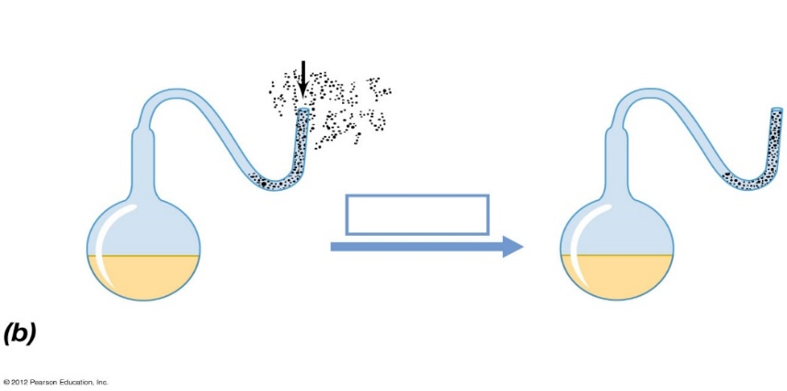
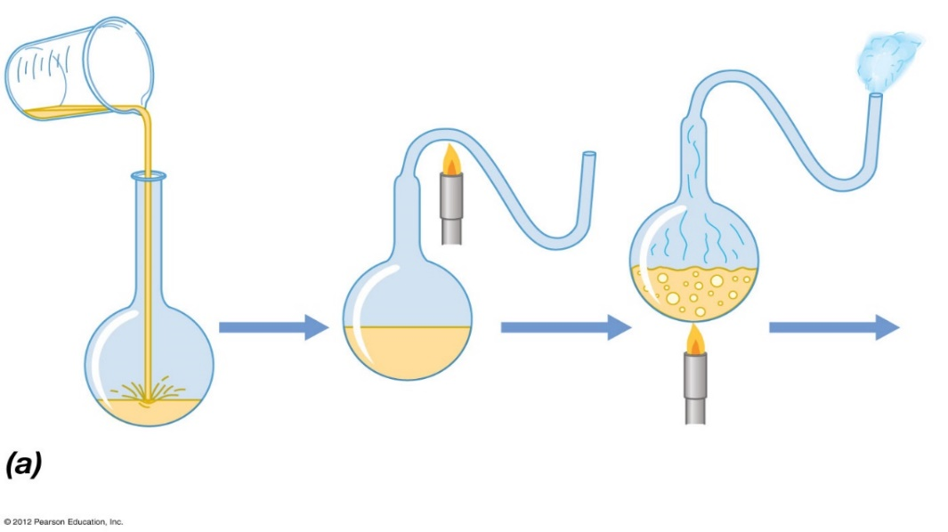
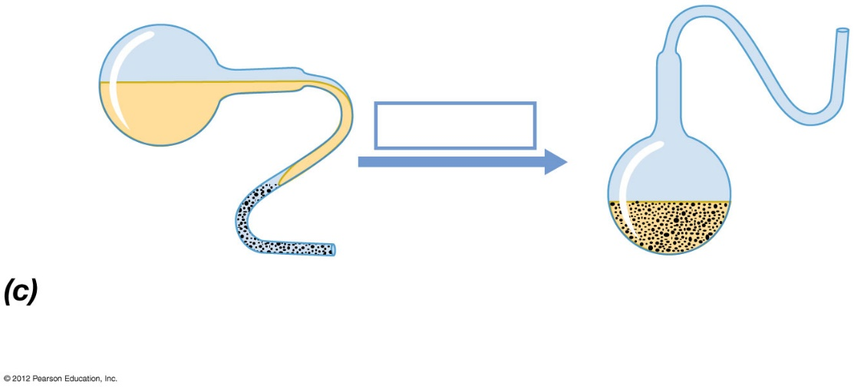
Pasteur's experiment that defeated the spontaneous generation theory
Dust and microorganisms trapped in bend
Open end
Steam, forced out open end
Long time
Liquid cooled slowly
Liquid remains sterile indefinitely
Short time
Nonsterile liquid poured into flask
Neck of flask drawn out in flame
Liquid sterilized by extensive heating
Flask tipped so microorganism-laden dust contacts sterile liquid
Liquid putrefies
© 2012 Pearson Education, Inc.
Notes:
10
Figure 1.16 The defeat of spontaneous generation: Pasteur’s swan-necked flask experiment.

Slide 11
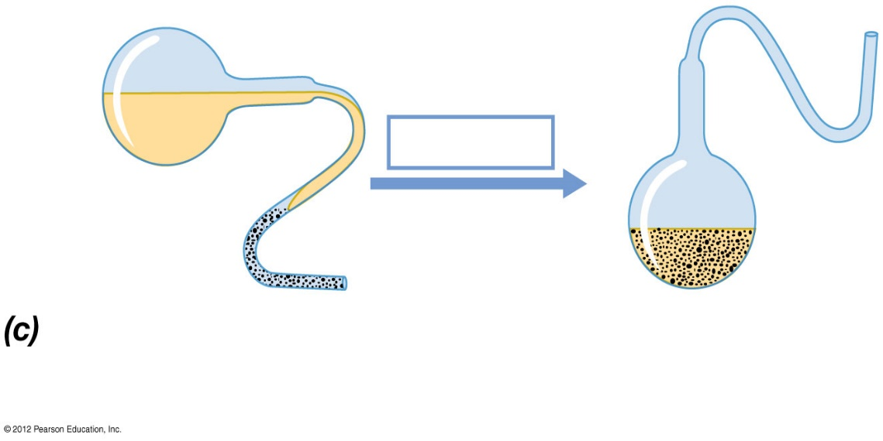
Figure 1.16c
Short time
Flask tipped so microorganism-laden dust contacts sterile liquid
Liquid putrefies
© 2012 Pearson Education, Inc.
Notes:
11
Figure 1.16 The defeat of spontaneous generation: Pasteur’s swan-necked flask experiment.

Slide 12
140MIC: Microbiology
Koch, Infectious Disease, and the Rise of Pure Cultures
Robert Koch (1843–1910)
Demonstrated the link between microbes and infectious diseases
Identified causative agents of anthrax and tuberculosis
Koch’s postulates
Developed techniques (solid media) for obtaining pure cultures of microbes, some still in existence today
Awarded Nobel Prize for Physiology and Medicine in 1905

Slide 13
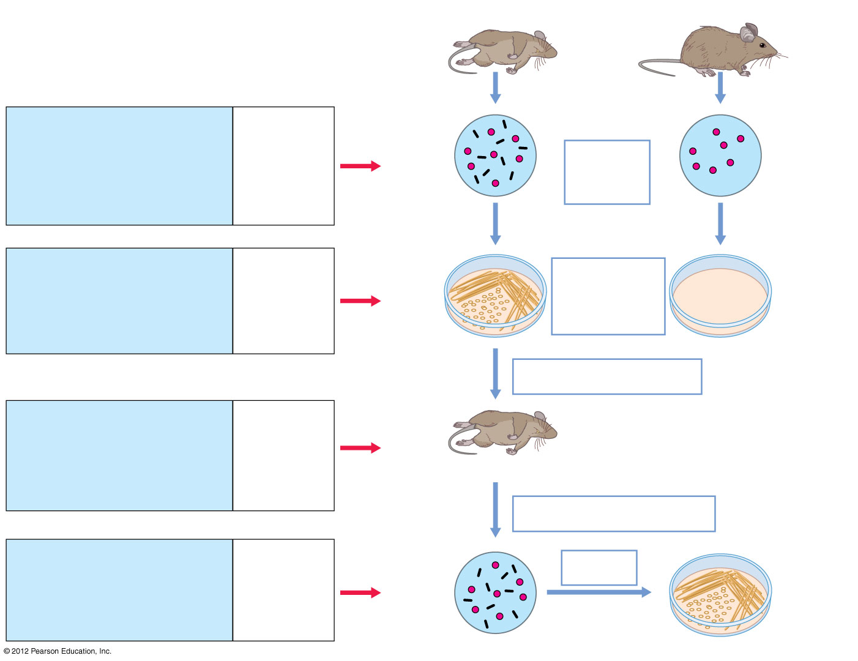
KOCH’S POSTULATES
Diseased animal
Healthy animal
The Postulates:
Tools:
1. The suspected pathogen must be present in all cases of the disease and absent from healthy animals.
Microscopy, staining
Red blood cell
Observe blood/tissue under the microscope
Red blood cell
Suspected pathogen
2. The suspected pathogen must be grown in pure culture.
Laboratory culture
Streak agar plate with sample from either diseased or healthy animal
No organisms present
Colonies of suspected pathogen
Inoculate healthy animal with cells of suspected pathogen
3. Cells from a pure culture of the suspected pathogen must cause disease in a healthy animal.
Experimental animals
Diseased animal
Remove blood or tissue sample and observe by microscopy
4. The suspected pathogen must be reisolated and shown to be the same as the original.
Laboratory reisolation and culture
Suspected pathogen
Laboratory culture
Pure culture (must be same organism as before)
© 2012 Pearson Education, Inc.
Notes:
13
Figure 1.19 Koch’s postulates for proving cause and effect in infectious diseases.

Slide 14
140MIC: Microbiology
Koch, Infectious Disease, and the Rise of Pure Cultures
Koch’s Postulates Today
Koch’s postulates apply for diseases that have an appropriate animal model
Remain “gold standard” in medical microbiology, but not always possible to satisfy all postulates for every infectious disease
Animal models not always available
For example, cholera, rickettsias, chlamydias
Koch and the Rise of Pure Cultures
Discovered that using solid media provided a simple way of obtaining pure cultures
Began with potato slices, but eventually devised uniform and reproducible nutrient solutions solidified with gelatin and agar

Slide 15

REMEMBER You can always ask questions through our discussion board on www.lms.ksu.edu.sa

